Slide 1

Field Manager Pro
User Guide & Role Responsibilities
fieldmanagerpro.app

Slide 2
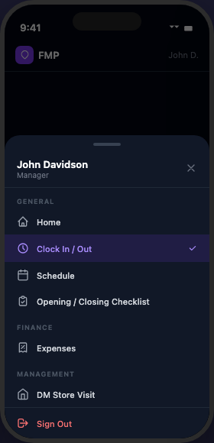
What is Field Manager Pro?
A mobile-first platform for managing field teams, schedules, tasks, and time tracking — all in one place.
Clock In/Out Tracking
Staff Scheduling
Task Management
Timecard Review
Flags & Alerts
Store Inspections
Expense Tracking
This guide is organized by role. Find your section and follow along.

Slide 3
Accessing the App
1. Open fieldmanagerpro.app on your phone or computer
2. Sign in with your username and password
3. Use the bottom navigation bar to switch between sections
Forgot your password? Tap 'Forgot your password?' on the login screen.

Slide 4
General Rules — All Users
⚠ TIME FRAUD POLICY
Any attempt to share login credentials or clock in another employee will result in immediate termination.
App Issues: If something isn't working, email your Owner with a description and screenshots of the error. Owner will escalate to the developer.
Never share your login credentials with anyone.

Slide 5
Employee
Your guide to using Field Manager Pro

Slide 6
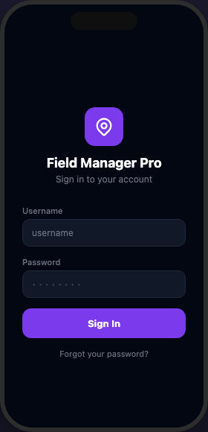
Getting Started
1. Go to fieldmanagerpro.app
2. Enter your username and password
3. Tap "Sign In"
4. Use the bottom nav to explore your sections
Your username and temporary password were sent to your email when your account was created.
Available on iOS & Android
🍎 App Store
▶ Google Play
Coming at launch — download for the best mobile experience

Slide 7
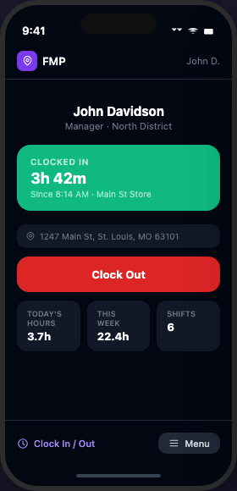
Clocking In & Out
Tap the Clock icon in the navigation bar
Tap Clock In when you arrive INSIDE the store
and are ready to work
Tap Clock Out BEFORE leaving the store
IMPORTANT
Clock in inside the store after you are ready to work. Clock out before leaving. GPS location is recorded at both events.

Slide 8
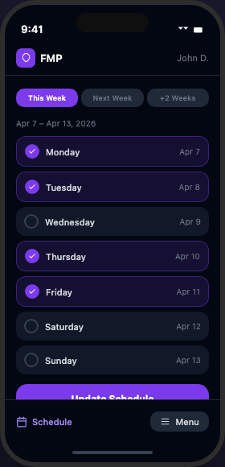
Your Schedule
Navigate to Schedule in the bottom navigation bar
to view your upcoming shifts.
Your DM posts the schedule. You will see your
assigned days and hours.
If you believe there's an error in your schedule,
contact your DM.

Slide 9
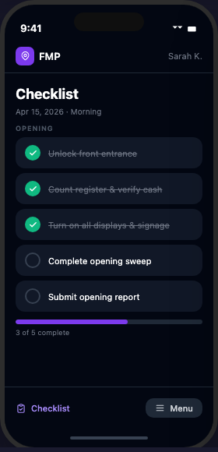
Daily Checklist
Navigate to Checklist to view and complete your daily assigned tasks.
Tap each item to mark it complete.
Complete all checklist items assigned to you each day.

Slide 10
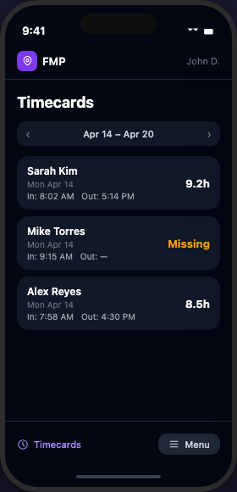
Time History
Navigate to Time History to review your past
clock-in and clock-out records.
If you notice a discrepancy, notify your DM immediately.
Your DM may make adjustments to your time entries
and will notify you when they do.

Slide 11
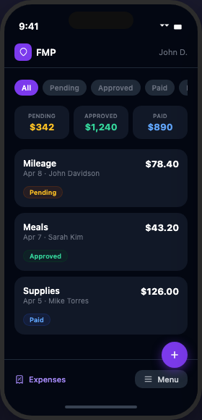
Submitting Expenses
Navigate to Expenses to submit a reimbursement request.
1. Tap + New Expense
2. Select Category
3. Enter Amount
4. Add description
5. Attach receipt photo
6. Submit — your DM will review

Slide 12
Support & App Issues
📸 Step 1: Take a screenshot of the error message or issue
✉ Step 2: Email your Owner with a description and the screenshot attached
📋 Step 3: Owner will forward to the developer for resolution
⚠ Never share your login credentials. Do not clock in for another employee. Time fraud = immediate termination.
fieldmanagerpro.app

Slide 13
DM
District Manager · Your guide to using Field Manager Pro

Slide 14
DM Responsibilities
Manage your assigned team of employees
Post the store schedule 2 WEEKS in advance at all times
YOUR personal schedule must be posted 1 WEEK in advance — failure will prevent clock-in
Review and validate timecards every Monday
Check the app for new tasks and flags DAILY
Clock in when you start your day; clock out only when your shift is fully complete
You are responsible for your team's performance and schedule compliance

Slide 15
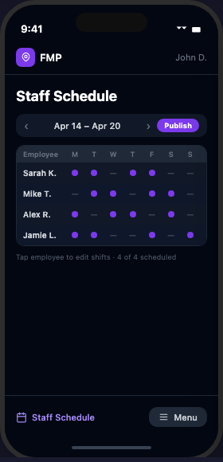
Creating the Staff Schedule
1. Navigate to Staff Schedule
2. Select the week using the arrows
3. Tap + Add Shift
4. Select employee, date, start time, end time
5. Tap Publish to make schedule visible to your team

Slide 16
Schedule Requirements
Employee schedules must be posted 2 WEEKS in advance.
Example: Today is Monday, April 14 → Schedule must be complete through Sunday, April 27
Your personal schedule must be posted 1 WEEK in advance.
Example: Today is Monday, April 14 → Your schedule must be set through Sunday, April 20
⚠ If your personal schedule is not loaded, you CANNOT clock in.

Slide 17
Timecard Review
Navigate to Timecards in the nav bar
REQUIRED: Complete timecard review every Monday
1. Review each employee's clock-in/out
2. If an entry looks incorrect, tap it
3. Edit the time
4. Add a note explaining the change
5. Save — employee is notified

Slide 18
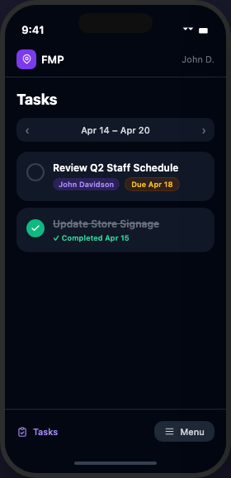
Managing Your Tasks
Navigate to Tasks to view tasks assigned to you.
Check for new tasks DAILY.
To complete a task:
Tap the circle → Add a note (optional)
→ Add a photo if required → Tap Mark Complete
Tasks show a due date — complete them on time.

Slide 19
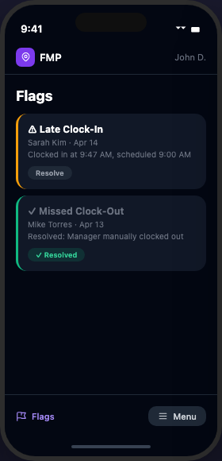
Reviewing Flags
Flags are automatically created when unusual time activity is detected.
Common flag types: Missed Clock-Out | Overtime Alert
| Late Clock-In | Missing Schedule
Check flags DAILY. Resolve each flag with a note explaining what happened.
1. Navigate to Flags
2. Tap a flag to view details
3. Enter resolution note
4. Tap Resolve

Slide 20
DM Clock In & Out
As a DM, clock in when you START your workday.
Clock out ONLY when your shift is completely finished for the day.
GPS is recorded — your location is logged at clock-in and clock-out.
Do not clock in for employees or allow others to clock in for you.

Slide 21
Support & App Issues
📸 Step 1: Take a screenshot of the error message or issue
✉ Step 2: Email your Owner with a description and the screenshot attached
📋 Step 3: Owner will forward to the developer for resolution
⚠ Never share your login credentials. Do not clock in for another employee. Time fraud = immediate termination.
fieldmanagerpro.app

Slide 22
Ops Manager
Your guide to using Field Manager Pro

Slide 23
Ops Manager Responsibilities
Tasks are assigned to you by the Owner
Your access level is determined by what the Owner delegates to you
Responsibilities vary — follow Owner's directives
May manage scheduling, timecards, flags, and tasks depending on your assignment
Apply DM-level standards to any area delegated to you
Report issues and updates directly to the Owner

Slide 24
Your App Access
Depending on Owner delegation, you may have access to:
✓
Staff Schedule (view + manage)
✓
Timecards (view + edit)
✓
Tasks (receive + complete)
✓
Flags (view + resolve)
✓
Team (view)

Slide 25
Support & App Issues
📸 Step 1: Take a screenshot of the error message or issue
✉ Step 2: Email your Owner with a description and the screenshot attached
📋 Step 3: Owner will forward to the developer for resolution
⚠ Never share your login credentials. Do not clock in for another employee. Time fraud = immediate termination.
fieldmanagerpro.app

Slide 26
Sales Director
Your guide to using Field Manager Pro

Slide 27
Sales Director Responsibilities
Assign and manage tasks for DMs
Monitor schedule compliance — employee schedules must be 2 weeks in advance
Review and validate timecards for your DMs
Use the app as your primary management and inspection tool
Ensure DMs are checking tasks and flags daily

Slide 28
Assigning Tasks to DMs
1. Navigate to Tasks
2. Tap "+ Assign Task"
3. Enter title and description
4. Select assignee (DM or Ops Manager)
5. Set a due date
6. Tap "Assign Task" — assignee receives email
Track completion: pending tasks show in the task list until marked complete.

Slide 29
Schedule & Timecard Oversight
Schedule
Navigate to Staff Schedule to view schedules across your stores. Verify DMs have schedules posted 2 weeks in advance.
Timecards
Navigate to Timecards to review DM time entries. Validate that hours are accurate and flag any discrepancies.

Slide 30
Support & App Issues
📸 Step 1: Take a screenshot of the error message or issue
✉ Step 2: Email your Owner with a description and the screenshot attached
📋 Step 3: Owner will forward to the developer for resolution
⚠ Never share your login credentials. Do not clock in for another employee. Time fraud = immediate termination.
fieldmanagerpro.app

Slide 31
Owner
Your guide to using Field Manager Pro

Slide 32
Owner Responsibilities
Primary operator of the organization in Field Manager Pro
Run company operations and inspections through the app
Assign tasks to Sales Director, Ops Manager, and DMs
Oversee scheduling compliance, timecard accuracy, and flag resolution
Manage your full team roster through the Team section
First point of contact for app issues — forward to developer with screenshots

Slide 33
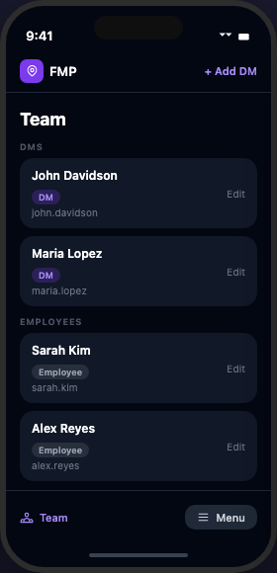
Managing Your Team
1. Navigate to Team
2. Tap "+ Add DM" or "+ Add Employee"
3. Fill in name, username, email, temporary password, and role
4. Tap Create — user receives welcome email with login credentials
Edit/deactivate: tap any user → Edit → adjust fields → Save Changes

Slide 34
Assigning Tasks
Navigate to Tasks → tap '+ Assign Task'
Assign to: Sales Director, Ops Manager, or DM
Set a due date for accountability — overdue tasks are highlighted in red
Track completion: tasks show as Pending or Completed

Slide 35
Store Inspections (DM Visit)
Navigate to DM Visit to log store inspection visits.
Record visit details, observations, and outcomes.
Use this to track compliance and document findings.

Slide 36
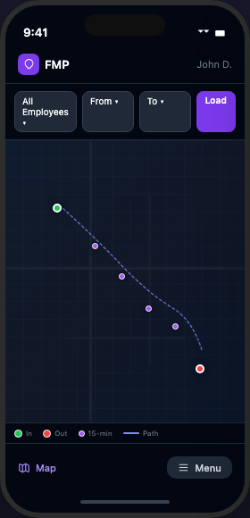
Map View
Navigate to Map to view store locations and GPS check-ins.
See where employees clocked in and out.
Use this to verify staff were on-site at time of clock-in.

Slide 37
Support & App Issues
📸 Step 1: Take a screenshot of the error message or issue
✉ Step 2: Email your Owner with a description and the screenshot attached
📋 Step 3: Owner will forward to the developer for resolution
⚠ Never share your login credentials. Do not clock in for another employee. Time fraud = immediate termination.
fieldmanagerpro.app

Slide 38
RDM
Regional Development Manager · Your guide to using Field Manager Pro

Slide 39
RDM Overview
The RDM role provides cross-organization visibility without administrative control.
No clock in/out requirement
View all staff schedules across all organizations
Assign tasks to DMs across all organizations
View-only access to schedules and task progress
Report findings and task updates directly to the developer/platform owner

Slide 40
Assigning Tasks to DMs
Navigate to Tasks → tap '+ Assign Task'
You can see DMs across all organizations in the assignee dropdown.
Fill in title, description, and due date.
The DM receives an email notification immediately.
Monitor completion status in the Tasks view.

Slide 41
Support & App Issues
📸 Step 1: Take a screenshot of the error message or issue
✉ Step 2: Email your Owner with a description and the screenshot attached
📋 Step 3: Owner will forward to the developer for resolution
⚠ Never share your login credentials. Do not clock in for another employee. Time fraud = immediate termination.
fieldmanagerpro.app

Slide 42
Support & App Issues
Step 1
Step 2
Step 3
Take a screenshot of the error message or issue
Email your Owner with a description and the screenshot attached
Owner will forward to the developer for resolution
Never share your login credentials. Do not attempt to clock in for another employee. Time fraud = immediate termination.
fieldmanagerpro.app

Slide 43
Welcome to Field Manager Pro
You now have everything you need to get started.
fieldmanagerpro.app

