Slide 1

Field Manager Pro
User Guide & Role Responsibilities
fieldmanagerpro.app

Slide 2
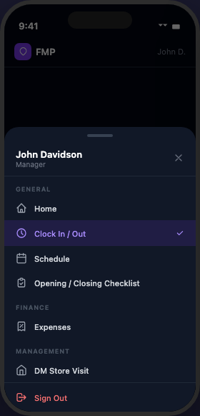
What is Field Manager Pro?
A mobile-first platform for managing field teams, schedules, tasks, and time tracking — all in one place.
Clock In/Out Tracking
Staff Scheduling
Task Management
Timecard Review
Flags & Alerts
Store Inspections
Expense Tracking
This guide is organized by role. Find your section and follow along.

Slide 3
Accessing the App
1. Download the app from the App Store or Google Play
2. Or open fieldmanagerpro.app in any browser
3. Sign in with your username and password
4. Use the navigation menu to switch between sections
Forgot your password? Tap ‘Forgot your password?’ on the login screen.
🍎 App Store
▶ Google Play
The app is also accessible from any browser at fieldmanagerpro.app

Slide 4
First-Time App Setup (iOS)
Complete these two steps the first time you open the app:
Step 1 — Allow Location Access
When the app asks about location, tap "Allow While Using App". Then go to: Settings → Field Manager Pro → Location → Select "Always" This allows GPS tracking to continue while you are clocked in.
Step 2 — Allow Push Notifications
When the app asks to send notifications, tap "Allow". You’ll receive alerts for new tasks, schedule updates, and more.
These steps only appear once. Both can be changed later in your phone’s Settings.

Slide 5
General Rules — All Users
⚠ TIME FRAUD POLICY
Any attempt to share login credentials or clock in another employee will result in immediate termination.
App Issues: If something isn't working, email your Owner with a description and screenshots of the error. Owner will escalate to the developer.
Never share your login credentials with anyone.

Slide 6
Employee
Your guide to using Field Manager Pro

Slide 7
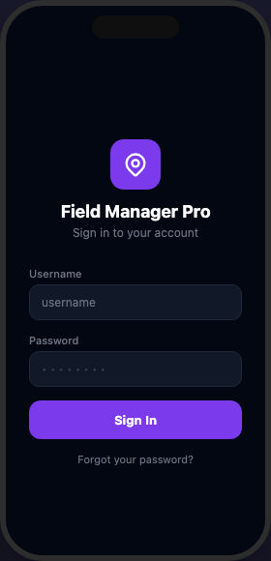
Getting Started
1. Go to fieldmanagerpro.app
2. Enter your username and password
3. Tap "Sign In"
4. Tap the menu icon (≡) in the top-left corner to explore your sections
Your username and temporary password were sent to your email when your account was created.
Available on iOS & Android
🍎 App Store
▶ Google Play
Coming at launch — download for the best mobile experience

Slide 8
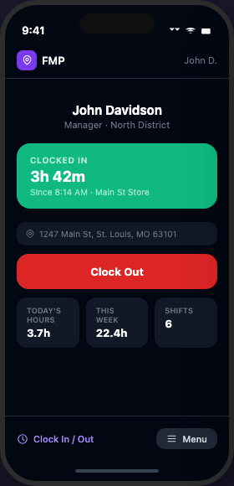
Clocking In & Out
Tap the menu icon (≡) → select Clock In/Out
Tap Clock In when you arrive INSIDE the store
and are ready to work
Tap Clock Out BEFORE leaving the store
IMPORTANT
Select your store, then clock in inside the store after you are ready to work. Clock out before leaving — a confirmation dialog will appear. GPS location is recorded at both events. You will receive a push notification 2 minutes before your shift starts and 5 minutes after your shift ends if you are still clocked in.

Slide 9
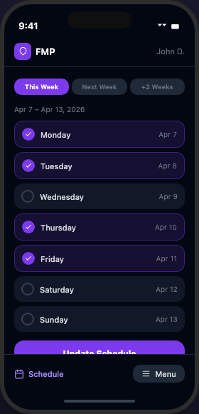
Your Schedule
Your schedule appears on the Home/Dashboard screen
when you open the app.
Your DM posts the schedule. You will see your
assigned days and hours.
If you believe there's an error in your schedule,
contact your DM.

Slide 10
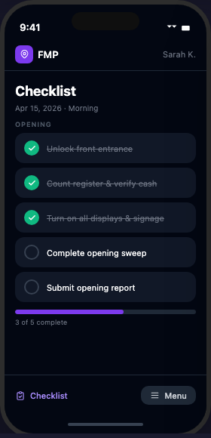
Opening & Closing Checklist
Complete a checklist at the start and end of every shift.
Opening Checklist
1. Navigate to Checklist → tap Opening 2. Select your store 3. Check off each item 4. Attach the inventory photo when prompted (item 2) 5. Tap Submit when all items are complete
Closing Checklist
1. Navigate to Checklist → tap Closing 2. Select your store 3. Check off each item → tap Submit
Your DM is notified automatically when you submit. Do not submit until all items are complete.

Slide 11
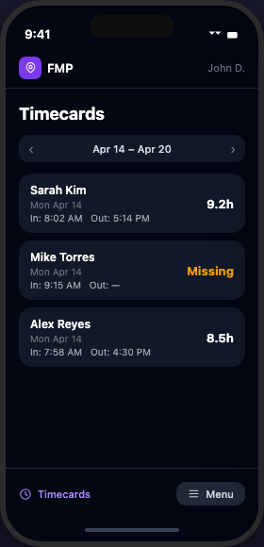
Time History
Navigate to Time History to review your past
clock-in and clock-out records.
If you notice a discrepancy, notify your DM immediately.
Your DM may make adjustments to your time entries
and will notify you when they do.

Slide 12
Your Timecards
Navigate to Timecards to view your logged hours
and pay period summaries.
Your timecard is updated each time you clock in or out.
If you notice a discrepancy, notify your DM
immediately so they can make a correction.
Your DM will notify you if they make any changes
to your time entries.

Slide 13
Support & App Issues
📸 Step 1: Take a screenshot of the error message or issue
✉ Step 2: Email your Owner with a description and the screenshot attached
📋 Step 3: Owner will forward to the developer for resolution
⚠ Never share your login credentials. Do not clock in for another employee. Time fraud = immediate termination.
fieldmanagerpro.app

Slide 14
DM
District Manager · Your guide to using Field Manager Pro

Slide 15
DM Responsibilities
Manage your assigned team of employees
Post the store schedule 2 WEEKS in advance at all times
Review and validate timecards every Monday
Check the app for new tasks and flags DAILY
Clock in when you start your day; clock out only when your shift is fully complete
You are responsible for your team's performance and schedule compliance

Slide 16
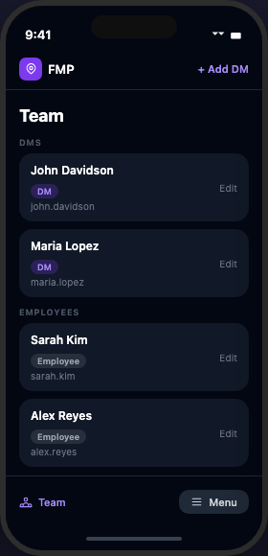
Adding a New Employee
When you hire a new team member, add them to the app the same day.
1. Navigate to Team
2. Tap "+ Add User"
3. Enter their full name
4. Create a username (e.g. first initial + last name: jsmith)
5. Set a temporary password they will use to first log in
6. Tap Create — account is submitted for approval
After creating the account
Do NOT share login credentials with the employee yet — their account is inactive until approved. Once an Owner, Sales Director, or Ops Manager approves the request, the employee will automatically receive a welcome email with their login details.

Slide 17
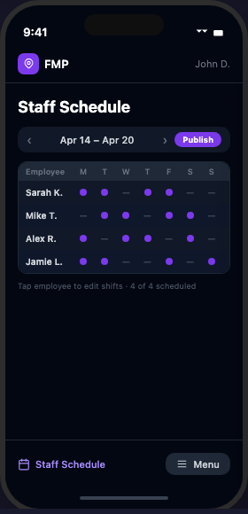
Creating the Staff Schedule
1. Navigate to Staff Schedule
2. Select the week using the arrows
3. Tap + Add Shift
4. Select employee, date, start time, end time
5. Tap Publish to make schedule visible to your team

Slide 18
Schedule Requirements
Employee schedules must be posted 2 WEEKS in advance.
Example: Today is Monday, April 14 → Schedule must be complete through Sunday, April 27
⚠ Schedules must be posted on time — late posting is a compliance violation.

Slide 19
Timecard Review
Navigate to Timecards in the nav bar
REQUIRED: Complete timecard review every Monday
1. Review each employee's clock-in/out
2. If an entry looks incorrect, tap it
3. Edit the time
4. Add a note explaining the change
5. Save — employee is notified

Slide 20
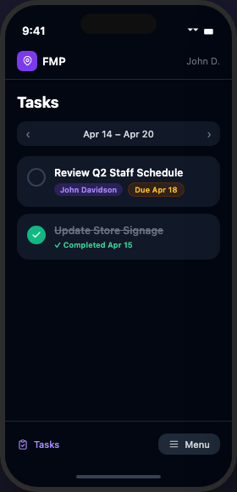
Managing Your Tasks
Navigate to Tasks to view tasks assigned to you.
Check for new tasks DAILY.
To complete a task:
Tap the circle → Add a note (optional)
→ Add a photo if required → Tap Mark Complete
Tasks show a due date — complete them on time.

Slide 21
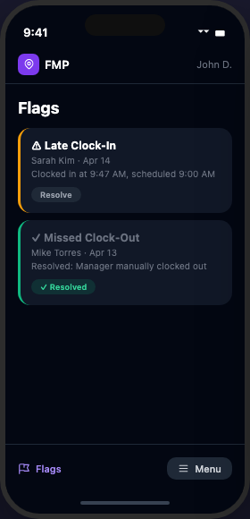
Reviewing Flags
Flags are automatically created when unusual time activity is detected.
Common flag types: Missed Clock-Out | Overtime Alert
| Late Clock-In | Missing Schedule
Check flags DAILY. Resolve each flag with a note explaining what happened.
1. Navigate to Flags
2. Tap a flag to view details
3. Enter resolution note
4. Tap Resolve

Slide 22
DM Clock In & Out
As a DM, clock in when you START your workday.
Clock out ONLY when your shift is completely finished for the day.
GPS is recorded — your location is logged at clock-in and clock-out. Unlike employees, DMs do not need to select a store location when clocking in. You will receive a push notification at 9:00 AM if you have not yet clocked in, and at 8:00 PM if you are still clocked in.
Do not clock in for employees or allow others to clock in for you.

Slide 23
Checklist Dashboard
Monitor opening and closing submissions across your stores in real time.
1. Navigate to Checklist → tap Dashboard
2. Use the date picker to select any day
3. Each store shows Opening and Closing status:
✅ Submitted
🔴 Not yet submitted
4. Tap any submission to view details,
completed items, and the inventory photo
You also receive a push notification each time
an employee submits a checklist.

Slide 24
Approving Payroll
Navigate to Payroll in the nav bar.
Review your team's hours for the pay period.
1. Verify each employee's total hours are accurate
2. Cross-reference with your timecard approvals
3. Tap Submit to send your team's hours to the Sales Director for final approval
After you submit, the Sales Director reviews and approves your team's payroll before running the ADP export.

Slide 25
Support & App Issues
📸 Step 1: Take a screenshot of the error message or issue
✉ Step 2: Email your Owner with a description and the screenshot attached
📋 Step 3: Owner will forward to the developer for resolution
⚠ Never share your login credentials. Do not clock in for another employee. Time fraud = immediate termination.
fieldmanagerpro.app

Slide 26
Ops Manager
Your guide to using Field Manager Pro

Slide 27
Ops Manager Responsibilities
Tasks are assigned to you by the Owner
Your access level is determined by what the Owner delegates to you
Responsibilities vary — follow Owner's directives
May manage scheduling, timecards, flags, and tasks depending on your assignment
Apply DM-level standards to any area delegated to you
Report issues and updates directly to the Owner

Slide 28
Your App Access
As an Ops Manager, you have access to:
✓
Staff Schedule (view + manage)
✓
Timecards (view + edit)
✓
Tasks (receive + complete)
✓
Flags (view + resolve)
✓
Team (view + manage — full create/edit/delete + approve new employees added by DMs)

Slide 29
Support & App Issues
📸 Step 1: Take a screenshot of the error message or issue
✉ Step 2: Email your Owner with a description and the screenshot attached
📋 Step 3: Owner will forward to the developer for resolution
⚠ Never share your login credentials. Do not clock in for another employee. Time fraud = immediate termination.
fieldmanagerpro.app

Slide 30
Sales Director
Your guide to using Field Manager Pro

Slide 31
Sales Director Responsibilities
Assign and manage tasks for DMs
Monitor schedule compliance — employee schedules must be 2 weeks in advance
Review and validate timecards for your DMs
Use the app as your primary management and inspection tool
Ensure DMs are checking tasks and flags daily Receive overstaffing alerts when a store is scheduled beyond target headcount Review and approve expense submissions from the field Use the Map view to monitor live GPS locations and DM route history Approve or reject new employees added by DMs before their accounts go live

Slide 32
Assigning Tasks to DMs
1. Navigate to Tasks
2. Tap "+ Assign Task"
3. Enter title and description
4. Select assignee (DM or Ops Manager)
5. Set a due date
6. Tap "Assign Task" — assignee receives email
Track completion: pending tasks show in the task list until marked complete.

Slide 33
Schedule & Timecard Oversight
Schedule
Navigate to Staff Schedule to view schedules across your stores. Verify DMs have schedules posted 2 weeks in advance.
Timecards
Navigate to Timecards to review DM time entries. Validate that hours are accurate and flag any discrepancies.

Slide 34
Payroll Review & ADP Export
Navigate to Payroll to review hours across your stores.
1. Review each DM's team hours for the pay period
2. Verify DM payroll approvals are complete
3. Use the Export to ADP button to download
the payroll file for ADP processing
Ensure all DMs have approved their team's payroll
before running the ADP export.

Slide 35
Support & App Issues
📸 Step 1: Take a screenshot of the error message or issue
✉ Step 2: Email your Owner with a description and the screenshot attached
📋 Step 3: Owner will forward to the developer for resolution
⚠ Never share your login credentials. Do not clock in for another employee. Time fraud = immediate termination.
fieldmanagerpro.app

Slide 36
Owner
Your guide to using Field Manager Pro

Slide 37
Owner Responsibilities
Primary operator of the organization in Field Manager Pro
Run company operations and inspections through the app
Assign tasks to Sales Director, Ops Manager, and DMs
Oversee scheduling compliance, timecard accuracy, and flag resolution
Manage your full team roster through the Team section
First point of contact for app issues — forward to developer with screenshots

Slide 38
Managing Your Team
1. Navigate to Team
2. Tap "+ Add User"
3. Fill in name, username, email, temporary password, and role
4. Tap Create — user receives welcome email with login credentials
Edit/deactivate: tap any user → Edit → adjust fields → Save Changes New views in Team: Role filter pills (quickly filter by role) | Org Chart (visual family-tree of your full team) | Bulk Import (add multiple employees at once) Employee Approval: When a DM adds a new employee, the account is held as Pending until you approve it. A push notification alerts you instantly. In the Team section, a Pending Approval panel appears at the top — tap Approve to activate the account and send the welcome email, or Reject to remove the request.

Slide 39
Assigning Tasks
Navigate to Tasks → tap '+ Assign Task'
Assign to: Sales Director, Ops Manager, or DM
Set a due date for accountability — overdue tasks are highlighted in red
Track completion: tasks show as Pending or Completed

Slide 40
Store Inspections (DM Visit)
Navigate to DM Visit to log store inspection visits.
Record visit details, observations, and outcomes.
Use this to track compliance and document findings.

Slide 41
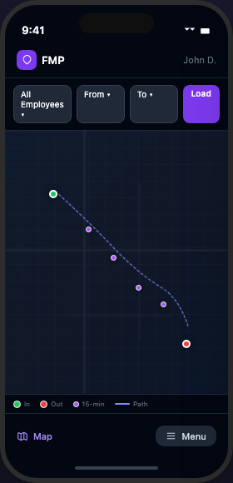
Map View
Navigate to Map to view real-time team locations and GPS history.
Live Mode (default): See active locations of anyone currently clocked in, updated in real time.
Historical Mode: Replay any DM's route for a past date — view the full GPS breadcrumb trail.
Use this to verify staff were on-site at clock-in and to review DM field activity.

Slide 42
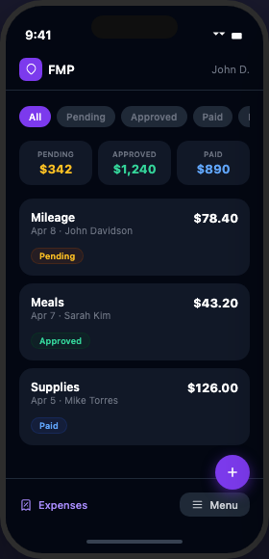
Approving Expenses
Navigate to Expenses to review submitted expense requests.
1. Tap a pending expense to view details
2. Review the amount, category, description,
and attached receipt
3. Tap Approve or Reject
4. Add a note if rejecting
Submitter is notified of your decision automatically.

Slide 43
Managing Payroll
Navigate to Payroll to oversee the full payroll cycle.
1. Confirm all DMs have approved their team's hours
2. Review total hours across all stores
3. Tap Export to ADP to generate the payroll file
4. Upload the file to ADP to process payroll
The ADP export includes all approved hours for
the current pay period.

Slide 44
Support & App Issues
📸 Step 1: Take a screenshot of the error message or issue
✉ Step 2: Email your Owner with a description and the screenshot attached
📋 Step 3: Owner will forward to the developer for resolution
⚠ Never share your login credentials. Do not clock in for another employee. Time fraud = immediate termination.
fieldmanagerpro.app

Slide 45
Welcome to Field Manager Pro
You now have everything you need to get started.
fieldmanagerpro.app

