Slide 1

Recommendation System REAL Estate - Berlin
Karina Condeixa
January, 2023

Slide 2
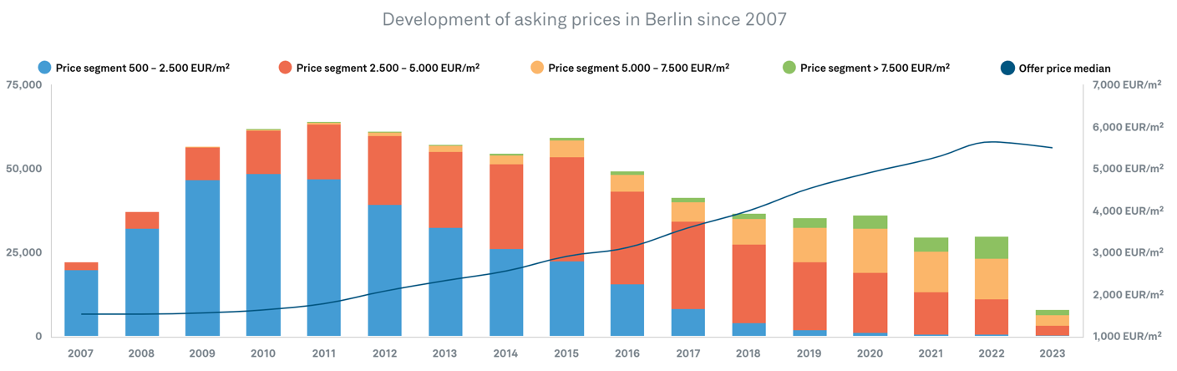
Problem / why is a real estate recommender system needed?
“Lockdowns, war and interest rate increases lead to visible amplitudes in asking prices. Especially in the last quarter of 2022. ” (Guthmann, 2023)
High rental prices
High demand and low offer for real estate in Berlin
Asking prices for properties have risen by 4.7% in the last 12 months.
Prices increased in value by around 148.3% in 10 years.
Berlin has been named as one of the most expensive cities for rental housing in Europe.
Prices in Berlin up by 40 percent in aftermath of the rent cap abortion (2021).

Slide 3

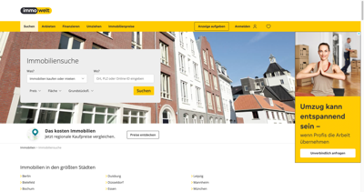

problem
Hiring for a brokerage service does not guarantee receiving the expected result and is expensive.
What is the demography in Berlin?
20% of the population is foreign (statista, 2021).
Immigrants need dwellings.
Immigrants don't have time to waste.
Many immigrants are highly qualified professionals sponsored by companies and receive high salaries.
Immigrants have no guidance on how to deal with the German bureaucracy when looking for property and rental.
The real estate websites are not foreign-friendly.
Does real estate deliver what these customers need?
There is no tool to gather information on offers from several real estate agencies.
Notes:
Help foreign customers to find a property/rental fast and make good business in Berlin. By providing a foreign-friendly and more efficient platform for real estate recommendation. / Many immigrants are highly qualified professionals sponsored by companies and receive high salaries. / Immigrants have no guidance on how to deal with the German bureaucracy when looking for property and rental. / The Real Estate services from today are not focused to help these customers./An RS that gathers information from different real estate companies, considers the personal needs of these customers can support more accurate choices and conduct more business, which is useful for foreign customers and for property owners.

Slide 4




Potential Solution
The MY NEW HOME recommendation system
Help foreign customers to find a property/rental and do good business.
Create a recommendation system (app) by providing personalized recommendations for rental and selling based on the profile of the user.
Based on the selected filters:
Setting some search criteria, such as : geographical location, price, pets, kids, number of bedrooms, balcony, lifestyle, services.
Interacting with some of the properties in the app by clicking on the property links, bookmarking, inquiring for more information, or requesting a visit or not.
MY NEW HOME
We have a flat that match you
Notes:
Create a recommendation system (app) by providing personalised recommendations for rental and selling based on the profile of the user (foreign). Including information to help the customer to making more assertive decisions, such as statistical data from neighbourhoods about crime, services, lifestyle, helping them to deal with the German bureaucracy (what is not usual for us: e.g. to expect to receive a detailed motivation letter with certificates and payslips before a first contact with the owner and visit the property). The RS should provide information in English, gather offers from different real estate companies and take accurate recommendations.

Slide 5





Constraints
Technical issues (technologies) API/databases, ML:
How to get the datasets? Which model to use? How to validate? How to deploy?
Depends on large amount of data
Time estimation and limitation
Cross-disciplinary communication

Slide 6

Success criteria
The MY NEW HOME recommendation system
Must have in a first launch:
Give good recommendations
Be foreign-friendly: Having at least an English version and translations from/into German
Notify fast
Must have in a future update:
Book visits
Facilitate a fast application
Offer models of motivation letter
Must not have:
Make contact with the owner
Do applications
Notes:
, which can help RS to better infer the user preferences and to provide more relevant recommendations

Slide 7
Project Workflow
Data Science
Data
Data collection: APIs, webscraping, statistics
Model
Feature engineering
Draw conclusion
Choose the best model
EDA
Training/test
Data documentation
Baseline Models/custom models
Build/ Integration/ test
Model evaluation (precision/recall)/model packaging
Data wrangling: error correction, feature engineering, encoding to data formats that machines can understand, and anomaly correction
Deployment
Prepare documentation
Clustering/classifying/labelling
Review
Prepare presentation
Prepare presentation
...
Prepare the app
Teams collaboration
Mid-Term presentation
Final presentation
Final delivery
Feb 7
Feb 17
Feb 28
Mar 7
Mar 22
Apr 4
Apr 9

Slide 8
References
Berlin among Europe's priciest cities for renting after rent cap abolished
Berlin Real Estate Report 2023, Guthmann 2023
Statista, 2021
Data science project proposals
Recommender Systems in the Real Estate Market—A Survey
Real Estate Recommender System
Is an e-commerce recommendation engine suitable for real estate, car & job portals?
Finding Your Dream Home: House Recommendations for REX Real Estate
Towards Real Estate Analytics using Map Personalisation
AnOverview of the End-to-End Machine Learning Workflow
How to Measure the Success of a Recommendation System?
Image mobile (modified)
Image Ampelmännchen
Notes:
https://www.mdpi.com/2076-3417/11/16/7502#:~:text=RSs%20serve%20a%20user%20of,price%2C%20and%20number%20of%20bedrooms.
https://github.com/arturlunardi/real-estate-recommender-system
https://co-libry.com/blogs/recommendation-engine-real-estate-job-car/
https://towardsdatascience.com/finding-your-dream-home-rex-house-recommendations-6f9a1384720
https://www.scitepress.org/Papers/2020/93683/93683.pdf
https://api.immobilienscout24.de/api-docs/authentication/introduction/
https://www.immobilien.de/
https://www.immowelt.de/suche/immobilien/mk?gclid=Cj0KCQiAiJSeBhCCARIsAHnAzT84dqGTli1mgNKFsutZB1J-COOnFpBRgatrSCGHqAt-xUsmieoFPusaAptPEALw_wcB&gclsrc=aw.ds

Slide 9
Thanks

Slide 10
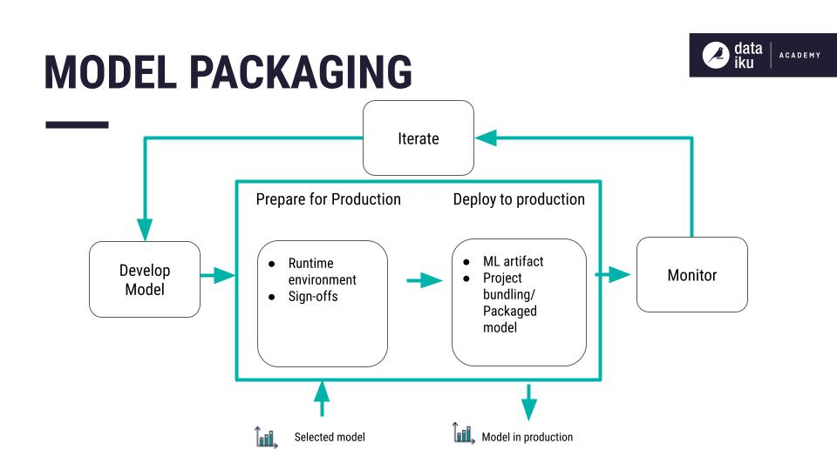
Model packaging
The model package includes the following components:
Documented code for implementing the model including its preprocessing.
Hyperparameters and their configuration.
Training and validation data.
Data for testing scenarios.

Slide 11
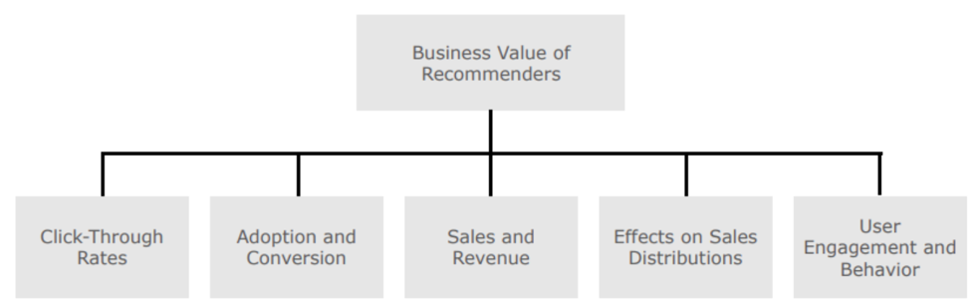
Metrics
Statistical metrics
Predictive accuracy metrics
Classification accuracy
Rank accuracy metrics (and mean average precision and recall)
ML metrics
Precision
Recall
F1-measure
False-positive rate
Mean average precision
Mean absolute error
The area under ROC curve (AUC)
Business specific measures
https://analyticsindiamag.com/how-to-measure-the-success-of-a-recommendation-system/

Slide 12
Statistical Metrics definitions
Predictive accuracy metrics
How near a recommender’s estimated ratings are to genuine user ratings.
Mean Absolute Error (MAE), Mean Squared Error (MSE), Root Mean Squared Error (RMSE), and Normalized Mean Absolute Error (NMAE).
Classification accuracy
If a recommendation algorithm’s successful decision-making capacity (SDMC).
Identifying good flats/houses to users by classificagying the number of right(relevant) and wrong(irrelevant) classifications generated by the system.
Rank accuracy metrics (and mean average precision and recall)
Assesses a recommender’s ability to estimate the correct order of items based on the user’s preferences.

Slide 13
Approaches
Approaches:
1-collaborative filtering (model-based, memory-based)
2-content-based
3- Knowledge-based
4- multi-criteria (multi-objective, multi-attribute)
5- Reinforcement learning
6-hybrid
7- Xgboost
8- Probabilistic relational model (PRM): extension of Bayesian networks for relational databases

Slide 14
Challenges
Cold-start problem;
Domain-specific item features
Complex buing behavior
Conflicting criteria
Data sparsity

Slide 15
Evaluation and benchmarking
Cold-start problem;
Domain-specific item features
Complex buing behavior
Conflicting criteria
Data sparsity

