Slide 1


Intro to Data Visualization Using Tableau Public
November 21, 2020
Vandana Srivastava
Founder & CEO ViSER LLC

Slide 2

About ViSER
Started in Jan 2019 :
to promote STEM and Finance learning among kids and adults; conducted bootcamps, after school classes, enrichment classes, online and in-person
In-person classes in USA and online sessions Worldwide
to provide AI backed, data-driven solutions to businesses; filed a patent in IoT chatbots
website: https://www.go-viser.com/
email: viserllc@gmail.com
Founder and CEO: Vandana Srivastava
About Vandana
MBA (Financial Management)
Pace University, NY, USA
MS (Computational Mathematics)
Arizona State University, AZ, USA
12+ years of experience as:
Vice President, Investor Relation (Tantiv4), Incentive Analyst (IBM)
Assistant Professor at different Engineering Colleges in India including IIT Delhi
https://bipvan.wixsite.com/vsrivastava
https://www.linkedin.com/in/vandana-srivastava/

Slide 3

Session Layout And Learning Objective
By the end of the session:
The participants are equipped with all the skills to Visualize a dataset using Tableau Public and create dashboards
About Tableau Software
Using Tableau
Upload data
Get Familiar with Interface
Create Vizualizations
Basic Viz (line chart, pie chart, bar chart, etc)
Complex viz (map etc)
Dashboard
Advanced Concepts
Filter, Set, Groupby, Calculation field, Parameter
Some Sample Dashboards

Slide 4
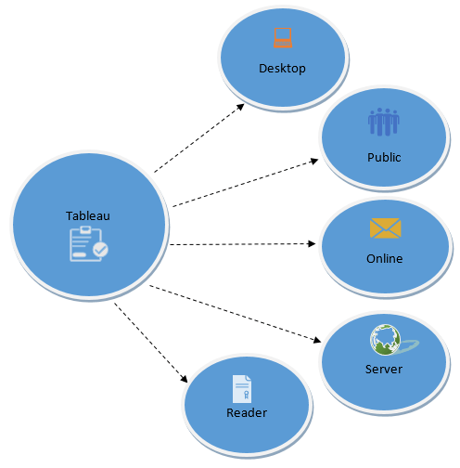
About Tableau Products
Prep
Tableau Public (freely available)
Support for data sets of up to 10 million rows so that anyone can analyze nearly all publicly available datasets for free (tableau.com, 2015)
An increased storage limit of 10 GB for everyone, so authors can create and store more information in Tableau is forward compatible not backward (tableau.com, 2015)
Consists of a free downloadable authoring tool to explore and visualize data,
A cloud platform to host, share and embed interactive visualizations
A learning program that provides support and training
Tableau Desktop (paid version)
Many more functionalities than Tableau public
Mostly used by companies
© ViSER LLC
Google Images

Slide 5
Tableau PUBLIC vs DESKTOP
Tableau Desktop can connect to data on-prem or in the cloud—
whether it’s big data,
a SQL database, a spreadsheet,
or cloud apps like Google Analytics and Salesforce.
Access and combine disparate data without writing code.
Power users can pivot, split, and manage metadata to optimize data sources.
Tableau Desktop Public Edition works with data
from Microsoft Excel,
multiple text file formats,
statistical files,
Google sheets,
web data connectors ( HTML file that includes JavaScript code)

Slide 6
Dataset – Sample “Superstore.xls”
Excel workbook
3 sheets
Order (Will work on this sheet)
Returns (returned, order_id)
People
https://data.world/mbark/sample-superstore

Slide 7
Step 0: Download Tableau Public
https://public.tableau.com/en-us/s/ (public.tableau.com)
Enter your email
DOWNLOAD
Follow instructions
Open “Tableau App”

Slide 8
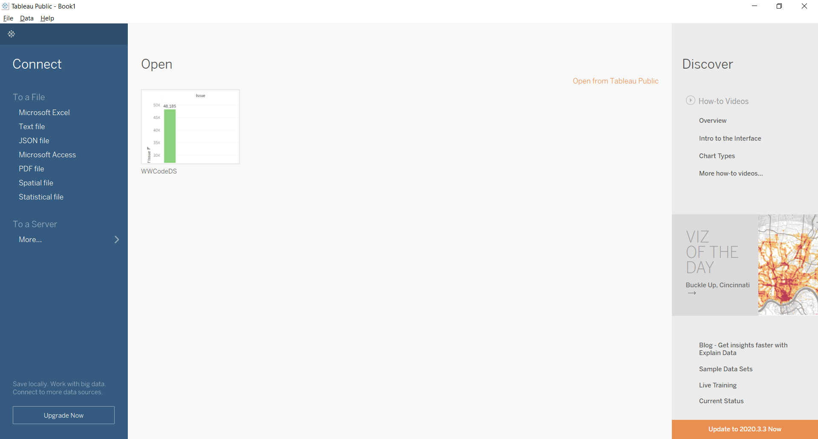
Step 1: Open Tableau Public App

Slide 9
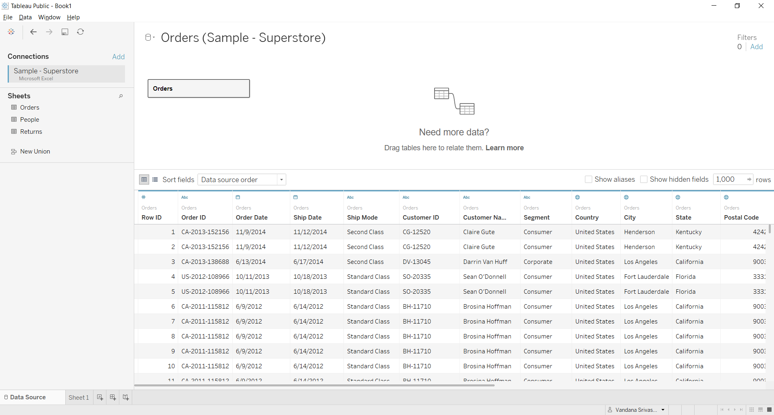
Step 2: Connect to Data Source
Columns in Sheet with datatype
Sheets in the file

Slide 10
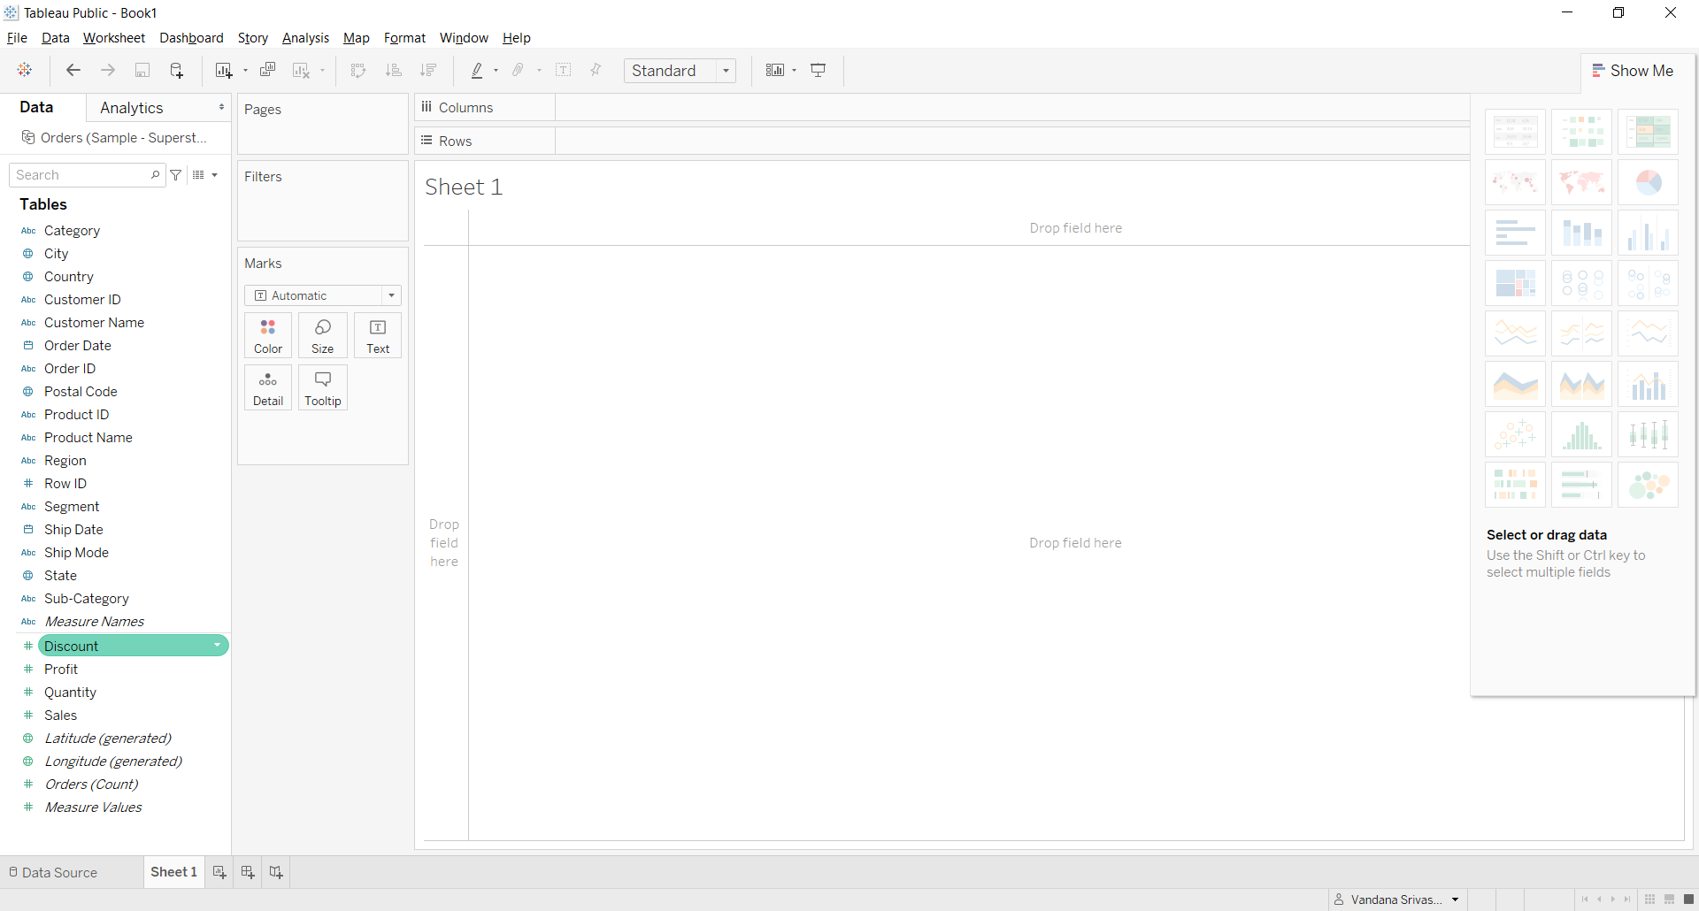


Work Area
Shelves
Data and Analytics
pane

Slide 11
Start Vizualization1
Which category has the highest amount of sales?
Draw bar chart and color it by sales (drag sales to ROWS and Category to COLUMNS)
Change colors (drag sales to COLOR on Marks card)
Show details (drag sales to LABEL on Marks card)
Rotate x-label(Click xlabel and choose rotate label option)
Sort the bars in ascending or descending order
Navigate other options for “Measure” values (like mx, min, avg, stdev etc)
Change “title” or sheet name

Slide 12
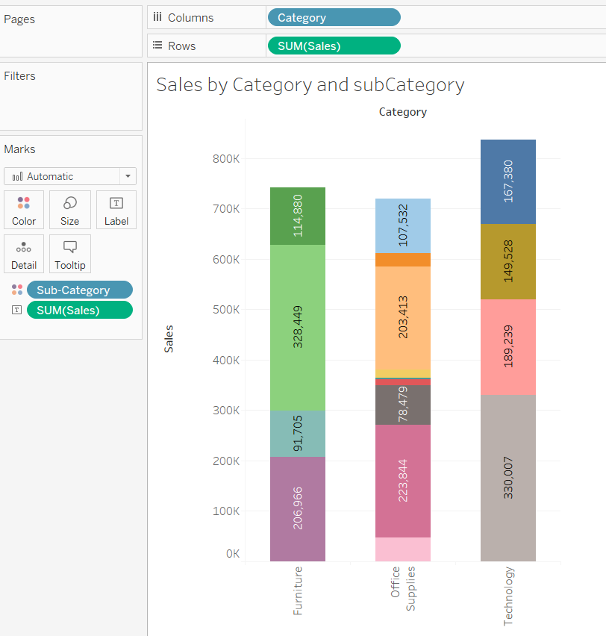
Start Vizualization – 2/3/4
Which subcategory has the highest amount of sales?
Draw bar chart and color it by sales (drag sales to ROWS and Category to COLUMNS)
Change colors (drag subcategory to COLOR on Marks card)
Bubble Chart for “Sales by Region”

Slide 13
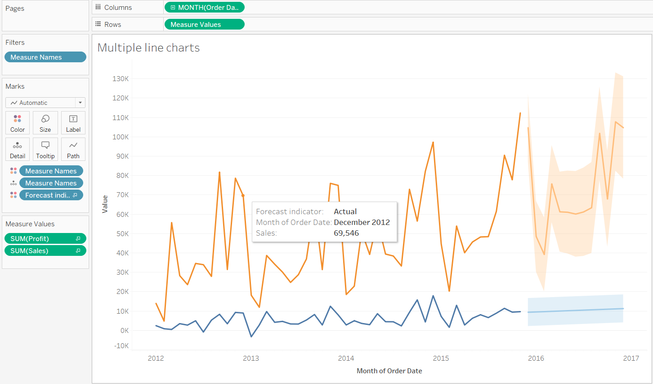
Start Vizualization – Multiple Line Charts for Comparison
Analyzing Profit and Sales over time
Rows: Measure Values
Columns: Order date (By Month/Year format)
Choose those values in Measure which we want to compare
Color: Measure Names
Filter: Measure Names
Analytics: Choose “Forecast” to add forecast

Slide 14
Pie Chart
TIP: To increase the size of the pie chart, press Ctrl+Shift+b
TRICK: To insert another sheet in “Tooltip”
Example: Find total SALES for each CATEGORY in each REGION

Slide 16
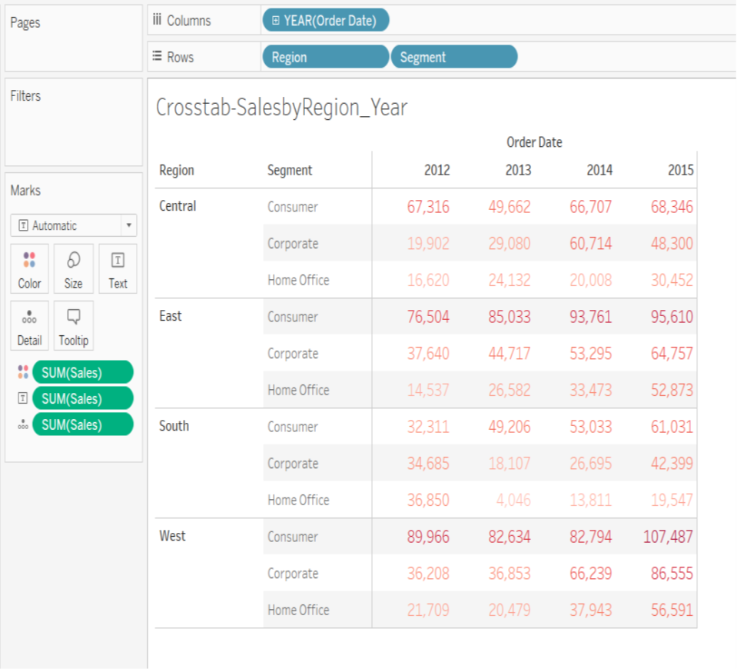
Start Vizualization – 5
Simple Crosstab
GOAL: to get the amount of sales for each segment for each year using the order dates available
Step 1 − Drag and drop the dimension order date to the columns shelf.
Step 2 − Drag and drop the dimensions region and segment to the rows shelf.
Step 3 − Pull the measure Sales to the labels Shelf under Marks.

Slide 17
Advanced Concepts – Calculated field
Right Click at data pane “dimension”
Create Calculated field
Name “Performance”
Enter formula:
IF SUM([Profit])> 0
THEN "Profitable"
ELSE "Loss"
END
Rows: Performance, Category, Sub-Category
Columns: Region
Color/Label: Sum(Profit)
Marks: Square

Slide 18
Advanced Concepts – Filter, Set, Group
Filter: A dimension or measure that narrows the data shown in a view to focus on relevant information
Group: Simplifies large numbers of dimension members by combining them into higher-level categories
Set: A subset of the data that meets certain conditions based on existing dimensions
filters only apply to the current worksheet
Sets can be used again and again throughout the workbook
Using sets maintains consistency and saves time
They can also be combined to create an even more specific subset of the data
Interworks.com

Slide 19
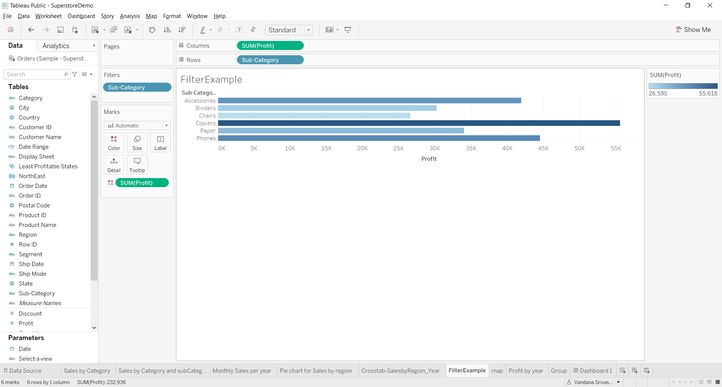
Filters
GOAL: showing profit for each sub-category of products(using dimension and measure filter)
Step 1− Drag the dimension field “Sub-Category” to the Rows shelf and the measure field “profit” to the Columns shelf.
Step 2− drag the Sub-Category dimension to the Filters shelf to open the Filter dialog box
Step 3 − Click the None button at the bottom of the list to deselect all segments
Step 4 - Select the Exclude option in the lower right corner of the dialog box
Step 5 - Select Labels and Storage and then click OK

Slide 20
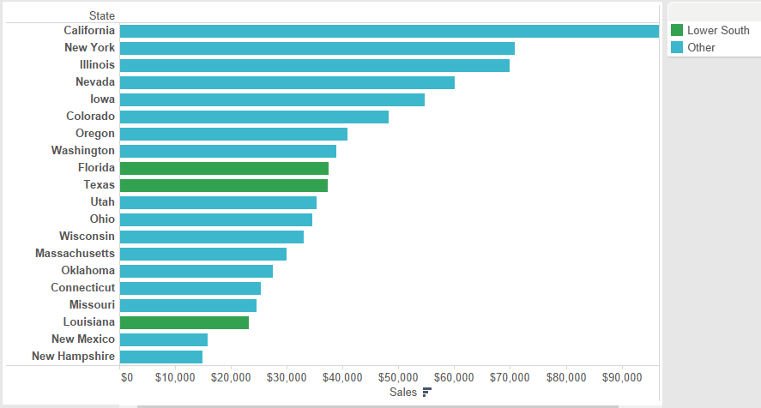
Groups
A regional manager and is only concerned with his territory’s states. He’d like to see how NorthEast compare to the rest of the country. In this situation, a visual group provides a better representation.

Slide 21
Add Drop Down Menu to Dashboard
Step 1
On an individual worksheet, right-click an empty area of the Data pane at left, and select Create Parameter.
Step 2
In the Create Parameter dialog box, do the following:
Enter a name that will appear above the menu, like Select a View.
For Data type, select String.
For Allowable values, select List.
Under List of values, type All for the first value, and then add values with the name of each view in the dashboard.
Click OK.
On any sheet, right-click an empty area of the Data pane at left, and select Create Calculated Field.
Give the calculation a descriptive name like Display sheet. In the formula text box, enter the name of the parameter you created above. Then click OK.
Open a sheet you plan to add to your dashboard, and drag the new calculation to the Filters shelf. Then do the following in the Filter dialog box:
Select Custom Value List.
Type All in the text box, and click the Add Item button.
Type the current view's name (like “Map”) in the text box, and click the Add Item button.
When you're done, click OK.
Repeat step 6 for every sheet you plan to add to your dashboard.
Select Dashboard > New Dashboard.
From the Objects section at lower left, drag a Vertical or Horizontal layout container to the dashboard.
Now drag each sheet to the layout container, identified by the dark blue outline.
To display the sheet selector, from the drop-down menu at the top of a view, choose Parameters > [new parameter name].
https://help.tableau.com/current/pro/desktop/en-us/dashboards_sheet_selector.htm

Slide 22
Dashboard Tips
Resize using “SIZE” option
Format
Title, font, background color
Use “Containers (Horizontal or Vertical) “ for displaying sheets
Add “Action” on Dashboard
Try to use similar colors on the dashboard views

Slide 23
Where to Save Tableau Public Viz?
Can not be saved locally, on your computer
Will be saved on public.tableau.com
Can be shared, downloaded
Embed on your website: Copy the Embed Code and paste it in your web page HTML
Send a link: Copy the Link and send to your colleagues
Send an email using your default email client
Share on Twitter or Facebook
Help Resources:
Tableau Community
Stack Overflow

Slide 24
Tableau Integration With Other Programming Languages
With PYTHON
Using TabPy
TabPy framework allows Tableau to remotely execute Python code
With R
Import R packages, libraries or any of your saved data models into Tableau
With MATLAB
Deploy MATLAB models in Tableau for predictive insights, or pre-process your data using MATLAB and persist into a Tableau data extract for further analysis
https://www.tableau.com/developer/data-science-integration

Slide 25
Some Sample Dashboards
https://www.tableau.com/covid-19-coronavirus-data-resources (Corona Virus related)
https://public.tableau.com/en-us/gallery/?tab=viz-of-the-day&type=viz-of-the-day
https://www.tableau.com/learn/articles/business-intelligence-dashboards-examples

Slide 26
Thank You!
Send email to: viserllc@gmail.com

