Slide 1
GEOFREE - DS
Proposals by Karina Condeixa
New feature: available/not available items from a ML model
Recommendation: ranked items using SQL

Slide 2
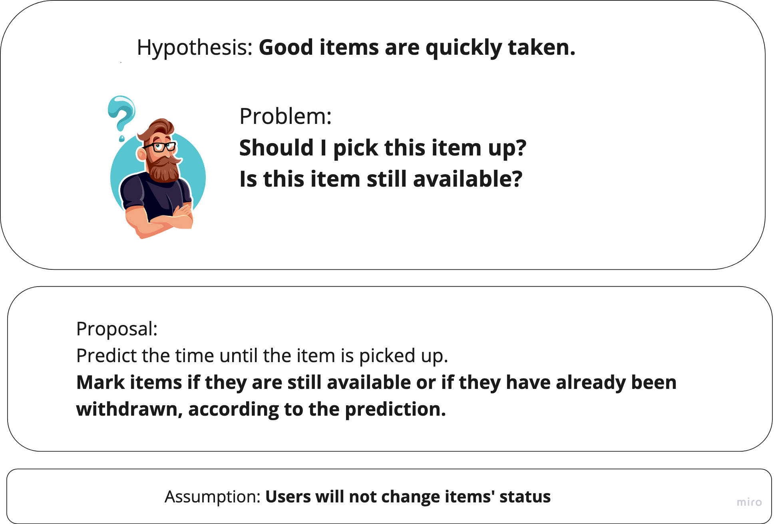
New feature

Slide 3
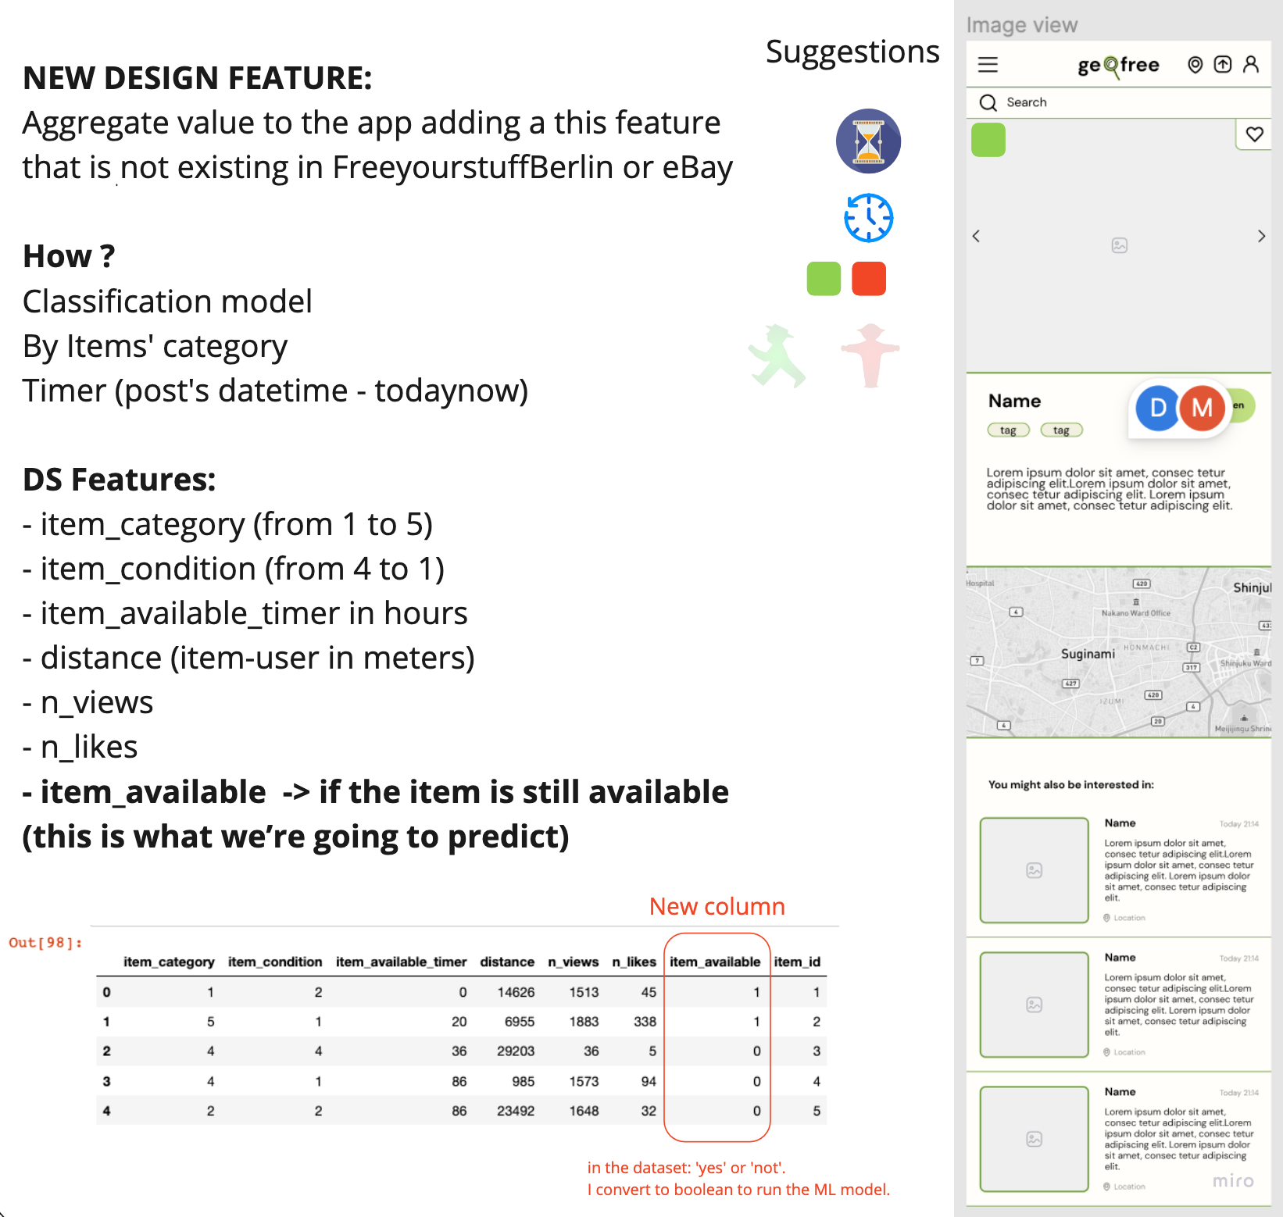
New feature

Slide 4
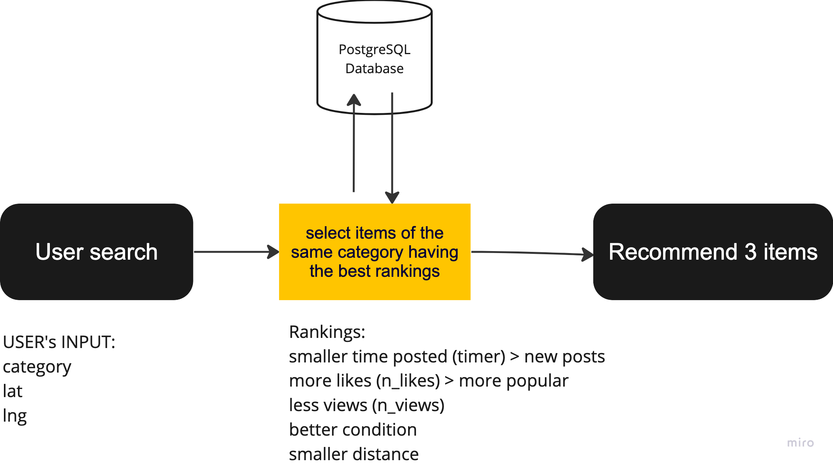
Recommendation

Slide 5
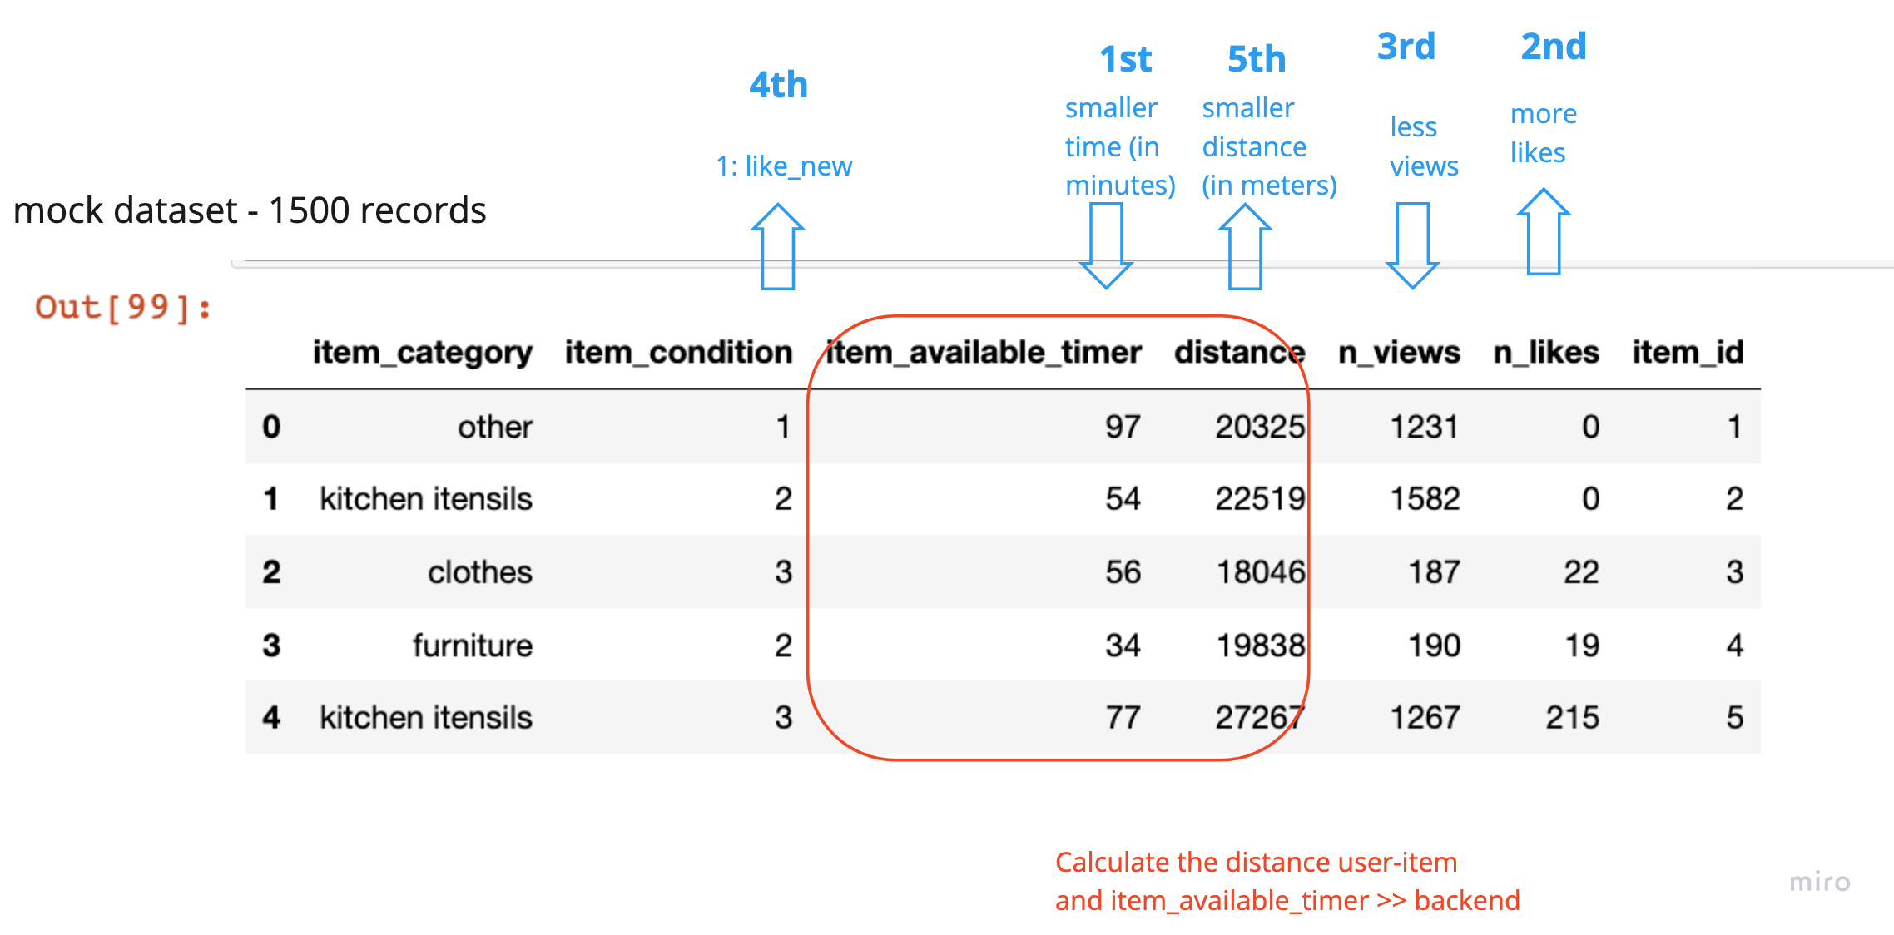
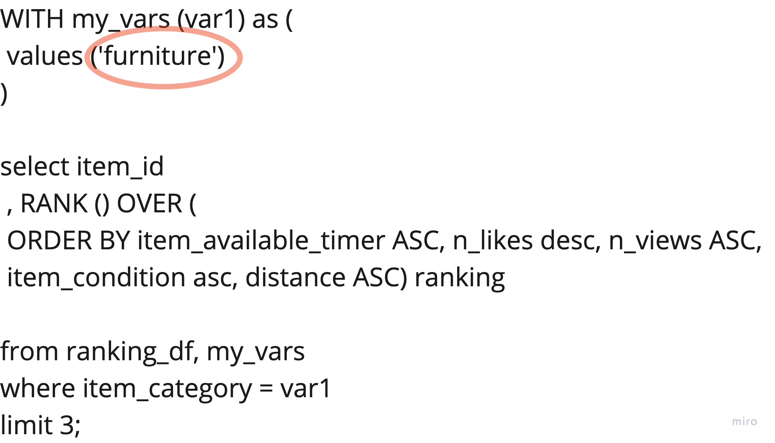
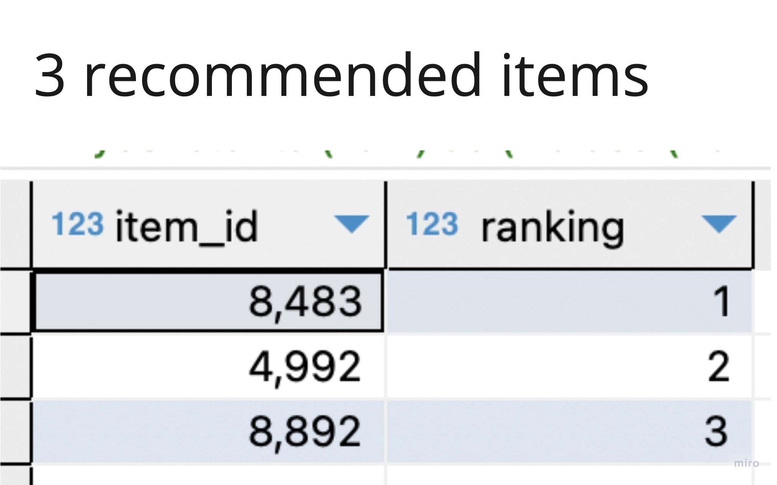
Recommendation

