Slide 1
INTRO TO QGIS
for Emergency Communications Mapping
Ham Radio EmComm · CERT · Situational Awareness
Rick Stoner - KC3DRU
Making simple, useful maps

Slide 2
What We'll Cover
01
Why maps matter in EmComm
Situational awareness, after-action, planning
02
Why QGIS (and when not)
Open-source power vs specialized radio tools
03
Core GIS concepts in 5 minutes
Layers, vectors, CRS, attributes
04
Hands-on workflow
Points, lines, labels, signal-strength styling
05
Data, offline use & next steps
Sources, printing, resources

Slide 3



Why Maps for EmComm?
Who can talk to whom
Where people & assets are
After-action & planning
Visualize net connectivity, simplex paths, and relay needs during an activation.
Stations, shelters, EOCs, repeaters, staging areas — all on one picture.
Document what worked, coverage gaps, and plan future exercises or deployments.

Slide 4
A Recent Real Example
Simple map features that answered a real question:
Points
Each station / operator location, labeled with callsign
Lines
Radio contacts between stations
Color
Line color = perceived signal strength (strong / fair / weak)
Result
Instant picture of net topology and where relays were needed

Slide 5
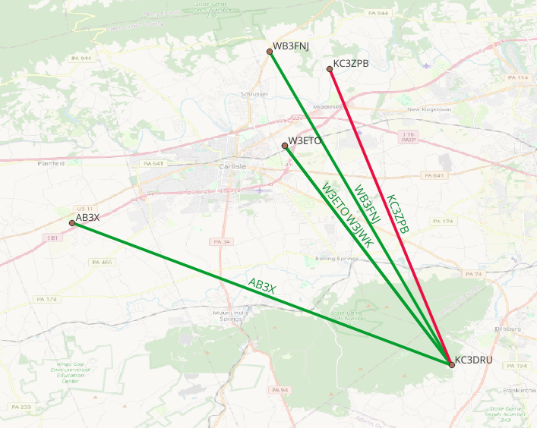
July 2026 Simplex Test
Operators that KC3DRU was able to hear over simplex
Map made with QGIS Software

Slide 6
What is QGIS?
Free and open-source Geographic Information System (GIS) desktop software
Cost
Completely free — no license fees
Platforms
Windows, macOS, Linux, even Raspberry Pi
Community
Huge user base + plugins for almost everything
Capability
From simple pins to advanced analysis & print layouts
Data
Reads shapefiles, GeoJSON, GPX, CSV, raster, WMS, etc.

Slide 7
Core Concepts (5-Minute GIS)
Layers
Symbology
Think of transparent sheets stacked. Basemap + stations + contacts + labels.
How features look: color, size, line style — driven by attribute values (e.g., signal strength).
Vector data
Labels
Points (stations), lines (paths/contacts), polygons (areas). Attributes live in a table.
Text pulled from attributes (callsign, name, grid square) placed on the map.
CRS / Projection
How the round Earth is flattened. Use a local projected CRS or Web Mercator for web maps.

Slide 8
Typical EmComm Map Workflow
1
Start a project
New project → set CRS (or let it be set by first layer)
2
Add basemap
XYZ tiles (OSM) or local offline tiles / county imagery
3
Create point layer
Stations with callsign, lat/lon, notes attributes
4
Create line layer
Contacts; attributes for signal strength, mode, notes
5
Style & label
Color lines by strength; label ends with callsigns
6
Print / export
Layout manager for PDF/print; or share the .qgz project

Slide 9
Why QGIS — and When Not
QGIS is excellent for…
Other, Specialized tools shine for…
▸ Custom situational maps (any layers you want)
▸ YAAC / Xastir / APRSISCE — live APRS tracking
▸ After-action reports & printed field maps
▸ Graywolf / similar — radio-specific mapping
▸ Combining radio data + public GIS + OSM
▸ SARTrack, Winlink map features, etc.
▸ Rich symbology, labeling, print layout
▸ When you need real-time position reports
▸ Multiple base maps to help orient viewer
▸ QGIS is complementary, not a replacement

Slide 10
QGIS → CalTopo for Live Field Sharing
Do the careful layer work in QGIS, then push the results to CalTopo so field teams can see (and update) them in real time.
1. Export from QGIS
2. Import into CalTopo
Reproject layer to WGS84 (EPSG:4326)
Open (or create) your map at caltopo.com
Have a “Name” field for labels (recommended)
Map Objects panel → Import
Right-click layer → Export → Save Features As…
Select the KML / GPX / GeoJSON file
Format: KML, GPX, or GeoJSON
Check the features you want, click Import
• GPX – best for routes / tracks / waypoints
Objects appear on the map & in the list
• KML – good all-around + attributes
Then share the map (link or QR code)
• GeoJSON – preserves more structure
Save the file
so field teams see live updates
Tip: Export windshield-survey routes as GPX tracks and resource locations as GPX waypoints or KML points for the cleanest results.

Slide 11
Hands-on Focus: Points + Lines
Point Layer — Stations
Line Layer — Contacts
• callsign (text)
• from_call / to_call
• name / tactical (text)
• signal (Strong / Fair / Weak)
• lat, lon (or just digitize)
• mode (FM, SSB, digital…)
• role (EOC, field, home…)
• time / net
• notes
• notes (relay needed?)

Slide 12
Styling by Signal Strength
In Layer Properties → Symbology → Categorized (or Rule-based)
Strong
Fair
Weak
Solid green — clear copy, reliable
Amber — usable with effort / QSB
Red — marginal, needs relay

Slide 13
Useful Data Sources
OpenStreetMap / XYZ tiles
County / State GIS portals
Free basemap; can cache for offline use
Parcels, roads, buildings, flood zones, EOCs
GPX from handhelds / APRS
CSV / spreadsheet
Import track logs or waypoint exports
Callsign + lat/lon list → Delimited Text layer
Repeater directories / FCC data
Your own digitizing
Public databases; convert to points
Click to add stations and draw contact lines

Slide 14
Practical Tips for EmComm Use
Offline readiness
Pre-download basemap tiles or use local GeoPackage / MBTiles so the map works without internet.
Print layouts
Use the Layout Manager to make clean 8.5×11 or 11×17 maps with legend, scale bar, and north arrow for the field.
Simple is better
One clear question per map. Too many layers = cluttered and hard to read under stress.
Share the project
A .qgz file + data folder can be handed to another operator who has QGIS.
Version & date
Always put date/time and “as of” on the map — situations change fast.
Practice now
Build a map of a recent net or exercise while the data is fresh.

Slide 15
Resources & Next Steps
qgis.org
https://qgis.org — Download + official docs
QGIS Training Manual
https://docs.qgis.org/latest/en/docs/training_manual/
OpenStreetMap (OSM)
https://www.openstreetmap.org — Free basemap data & tiles
PASDA (PA Spatial Data)
https://www.pasda.psu.edu — Free PA GIS data (counties, EOCs, flood…)
CalTopo
https://caltopo.com — Real-time collaborative maps for field teams
QuickMapServices plugin
Plugins → Manage and Install Plugins → “QuickMapServices”
Cumberland / York County GIS
https://www.cumberlandcountypa.gov/3517/Map-Services · https://york-county-pa-gis-portal-yorkcountypa.hub.arcgis.com/

Slide 16
Takeaways
QGIS lets you build custom EmComm maps that answer specific questions.
1
Points + lines + simple attributes (callsign, signal) already give huge value.
2
It complements (doesn’t replace) live APRS / radio-specific tools.
3
Offline capability and print layouts make it useful in the field and for reports.
4
Start small: one net, one map, one clear picture of connectivity.
5

Slide 17
Quick Glossary
OSM / OpenStreetMap
Free community-built world map; common source of basemap tiles. openstreetmap.org
lat / lon
Latitude / Longitude – geographic coordinates (degrees). Standard for GPS and web maps.
WGS84
World Geodetic System 1984 (EPSG:4326). The global lat/lon datum used by GPS. ESRI equivalent: GCS_WGS_1984.
UTM
Universal Transverse Mercator – projected coordinate system (meters) good for local distance/area work.
CRS / Projection
Coordinate Reference System – how the curved Earth is represented on a flat map.
LIDAR
Light Detection and Ranging – laser scanning that produces detailed elevation / 3-D surface data.
Vector
Points, lines, or polygons that carry attributes (e.g., a station with a callsign).

Slide 18
Quick Glossary
Raster
Grid-based data such as aerial photos, elevation models, or LIDAR-derived surfaces.
Basemap
Background reference map (often OSM or imagery) under your own layers.
Layer
One dataset (or styled view) stacked in the map — like transparent sheets.
Attribute
Information stored with a feature: callsign, signal strength, notes, etc.
GeoPackage / Shapefile
Common file formats for storing and sharing vector GIS data.
WMS / XYZ tiles
Web services that deliver basemap images. XYZ is typical for OSM-style tiles.
QGIS Project (.qgz)
Project file that saves layers, styles, and layouts for reuse or sharing.

Slide 19
Questions?
qgis.org · openstreetmap.org · pasda.psu.edu · Practice with a recent net map

