Slide 1





Traffic Sign Recognition
Batch 6
Under the guidance of
K N Sowjanya
By
Krishna Chaitanya 57
Amruth 46
Surya 52

Slide 2

Introduction
Traffic Sign detections and recognition have received an increasing interest in the last few years. This is due to the wide range of applications that a system with this capability provides, like driving Assistance System.
This is an attempt to make a self learning system that can understand and interpret the meaning of traffic signs.
Traffic signs appear in diverse background situations and, at times, may be partially obscured.
The software should be able to function in spite of these issues.

Slide 3
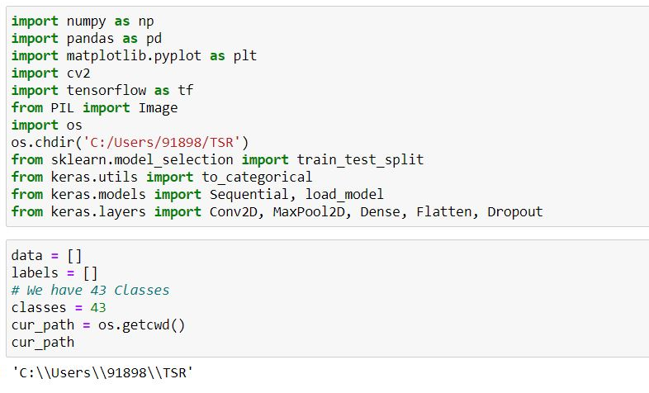
Importing modules and Initializing attributes

Slide 4
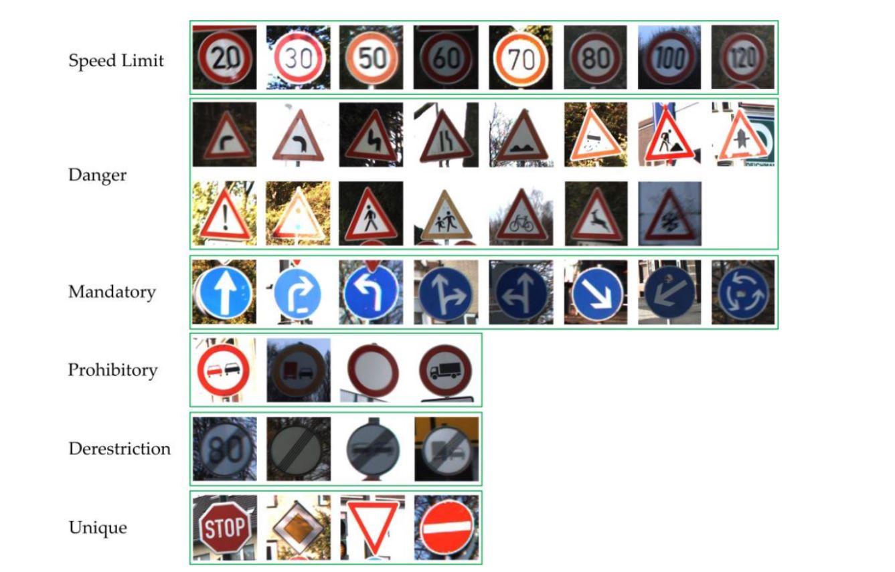
Categories and Signs

Slide 5
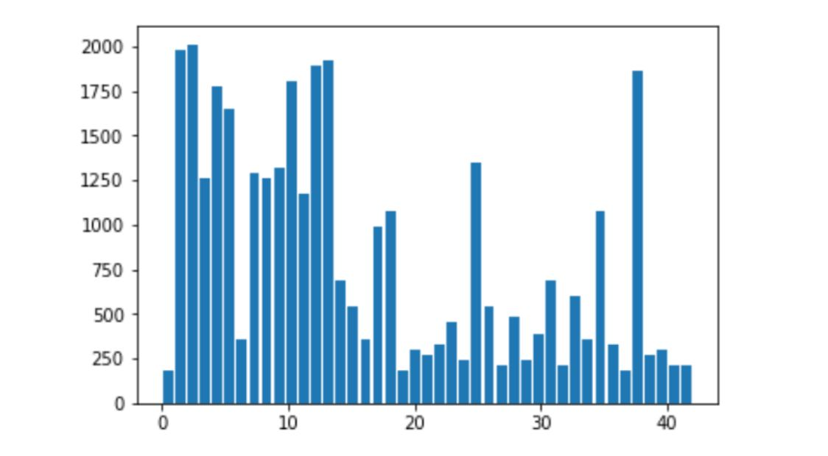
Data for each Class

Slide 6
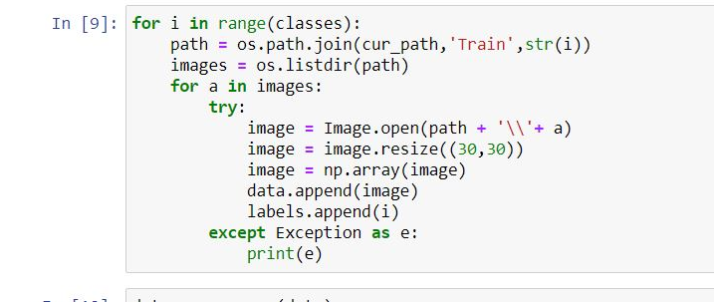
Importing Data

Slide 7
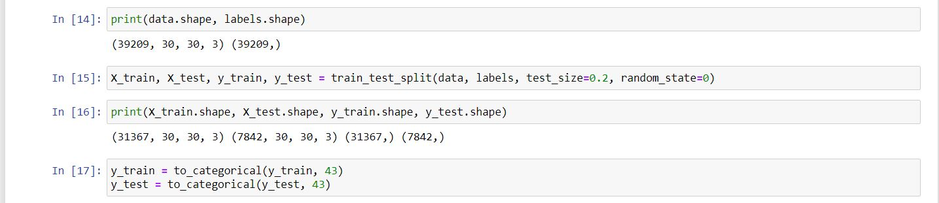
Training and Testing

Slide 8
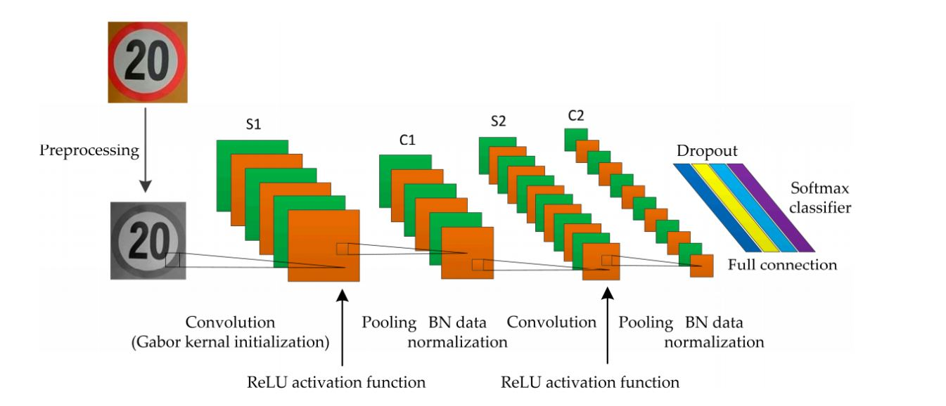
CNN Network

Slide 9
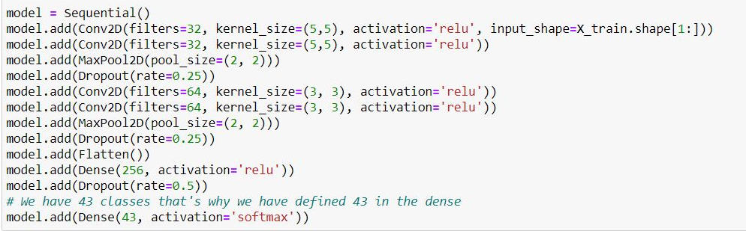
Building CNN Network

Slide 10
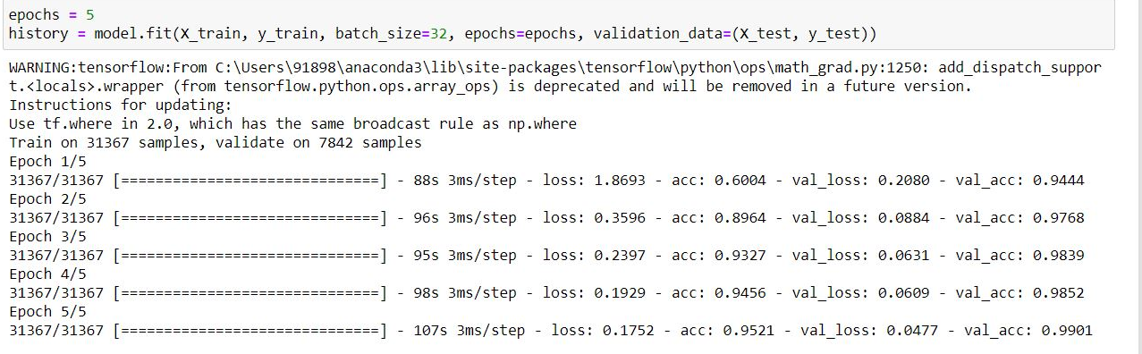
Model Building

Slide 11
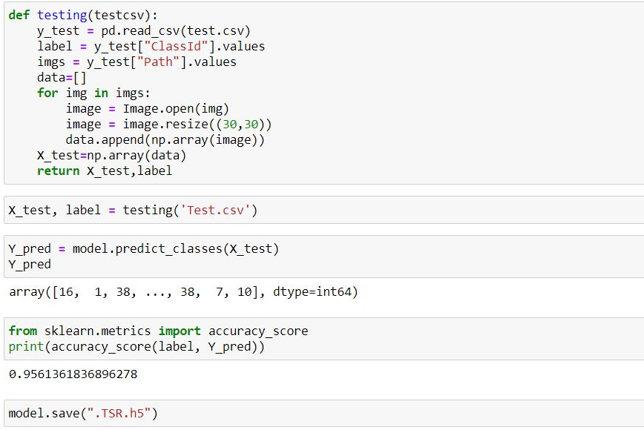
Testing and Accuracy

Slide 12
Advantages and Disadvantages
12

Slide 13









Conclusion

Slide 14

Thanks!

