Slide 1

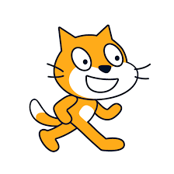

Programming with

Slide 2

What is Scratch?
Scratch is a programming language that helps to create:
Stories
Cartoons
Games
Music
Simulations
Etc.
In summary:
It is a program to make programs.

Slide 3
What is a program?
A program is a sequence of instructions, commands, and computer data that causes certain actions to be performed.
For that we have to "talk" to the computer in the same language

Slide 4
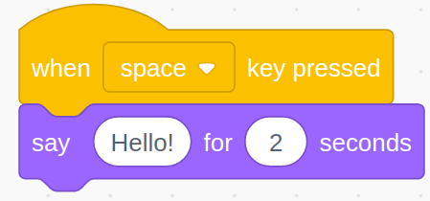
Summary
Human language
Scratch language
When I press the space bar, then the cat will say “Hello!” for two seconds

Slide 5
How are we doing this?
The screen and the sprites
Scratch is a visual programming language
That is, we use graphics (sprites) controlled and structured in a place called the screen

Slide 6
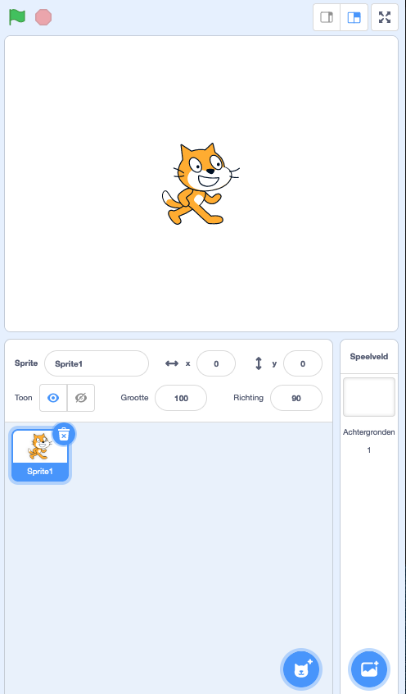
What does Scratch look like?
The layout:
Start & Stop: where you can control the action
The screen: where the story, the game and the program take place
The library: where all the sprites are
Sprite shop: where you can find new sprites to use

Slide 7
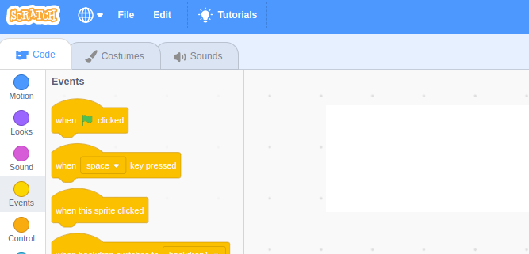
What does Scratch look like?
Always the first step:
On the left, choose Events

Slide 8
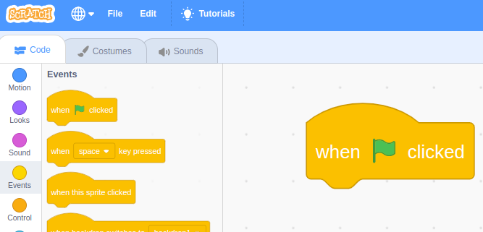
What does Scratch look like?
Always the first step:
On the left, choose Events
Drag the first option “when the flag clicked” to the workspace in the middle

Slide 9
What does Scratch look like?
Always the first step:
On the left, choose Events
Drag the first option “when the flag clicked” to the workspace in the middle
This event is the starting point for your Scratch program and are instructions with your sprites!

Slide 10
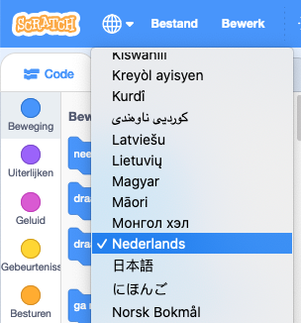
Let’s get started!
If you have questions or something is not working,
ask a volunteer for help
Steps to get going
Open a web browser
Go to https://scratch.mit.edu/
Click on ‘Create’
Click on the globe and choose your language
Follow the instructions from Scratch
Now you can start building! Remember: It is important to read the instructions carefully!

Slide 11
This is the end of the introduction.

