Slide 1
Eyeball Maze Android Game
BCPR282 Final Assignment

Slide 2
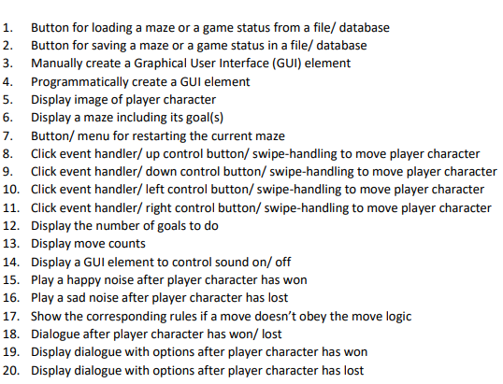
2o must have View Features

Slide 3
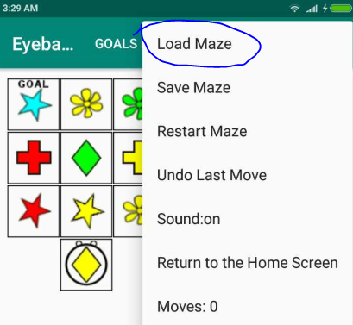
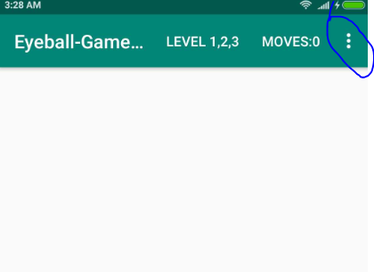
1. Button for loading a maze or a game status from a file/ database

Slide 4
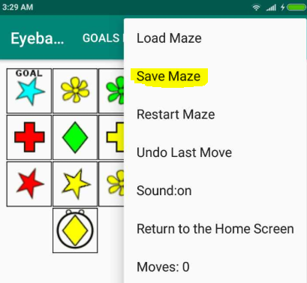
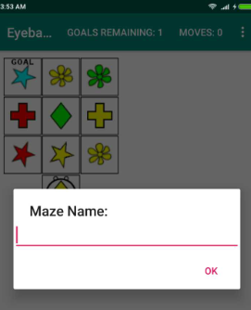
2. Button for saving a maze or a game status in a file/ database

Slide 5
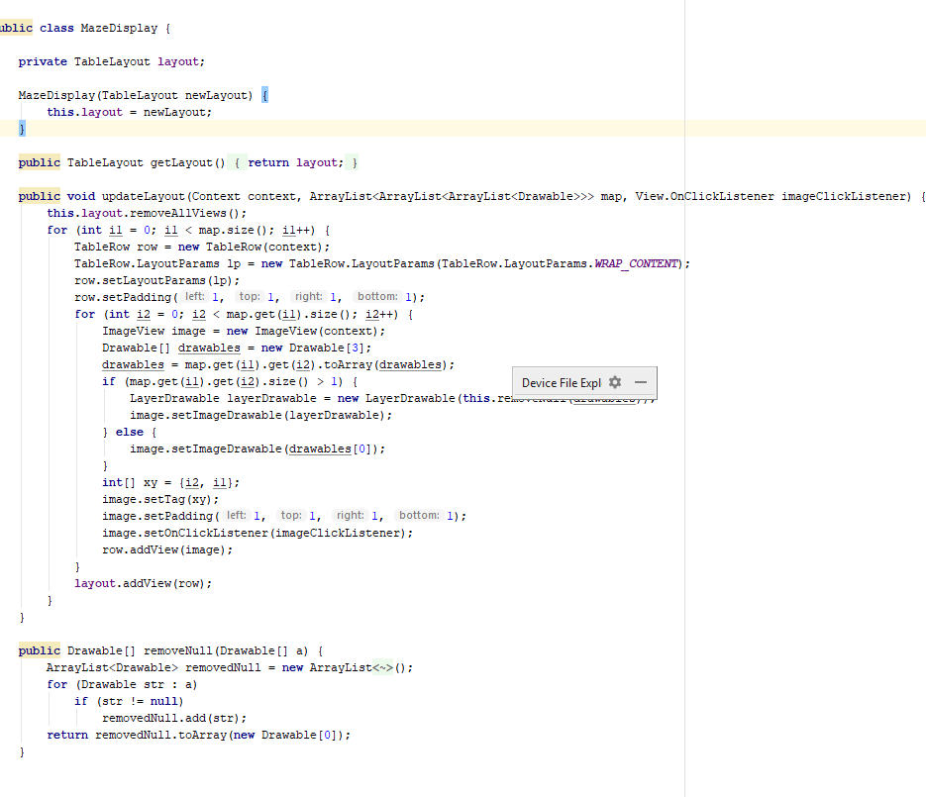
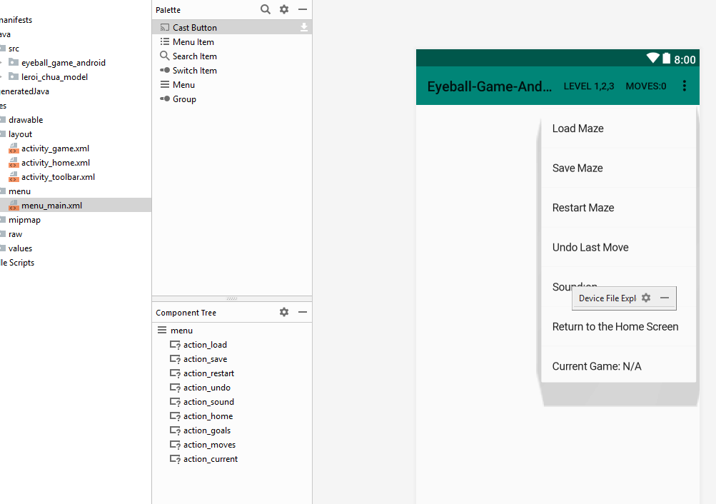
3. Manually create a Graphical User Interface (GUI) element 4. Programmatically create a GUI element

Slide 6
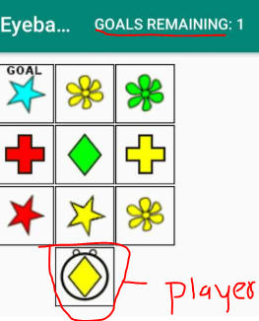
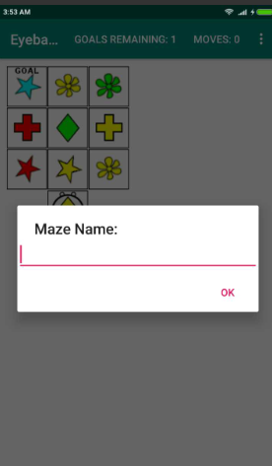
5. Display image of player character 6. Display a maze including its goal(s) 7. Button/ menu for restarting the current maze

Slide 7
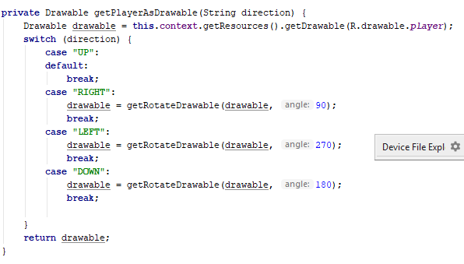
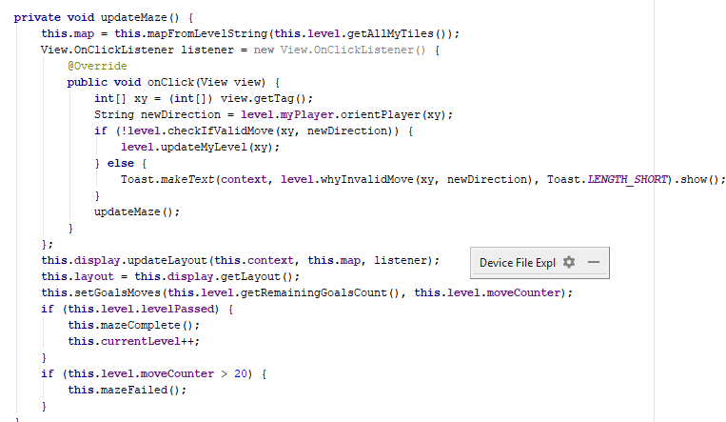
8. Click event handler/ up control button/ swipe-handling to move player character 9. Click event handler/ down control button/ swipe-handling to move player character 10. Click event handler/ left control button/ swipe-handling to move player character 11. Click event handler/ right control button/ swipe-handling to move player character

Slide 8
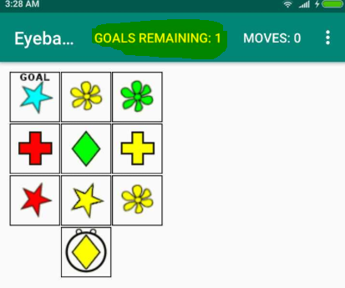
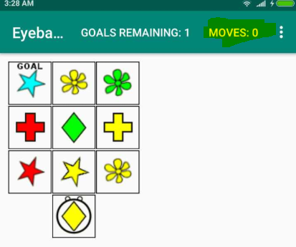
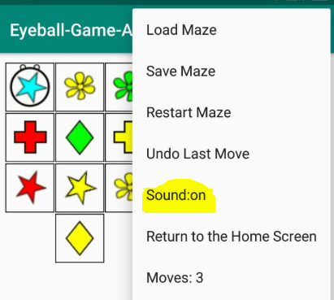
12. Display the number of goals to do 13. Display move counts 14. Display a GUI element to control sound on/ off

Slide 9
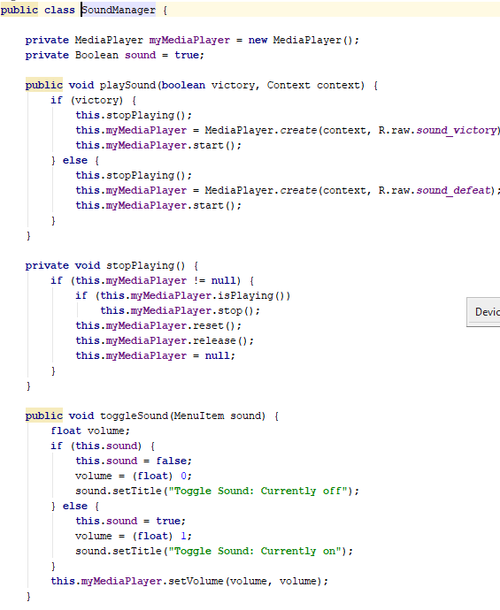
15. Play a happy noise after player character has won 16. Play a sad noise after player character has lost

Slide 10
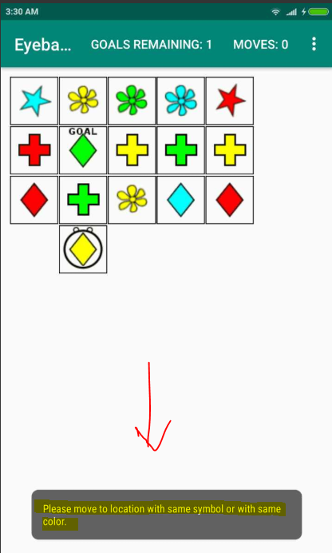
17. Show the corresponding rules if a move doesn’t obey the move logic

Slide 11
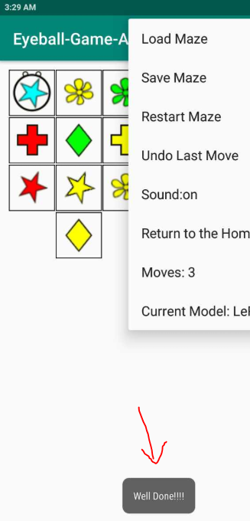
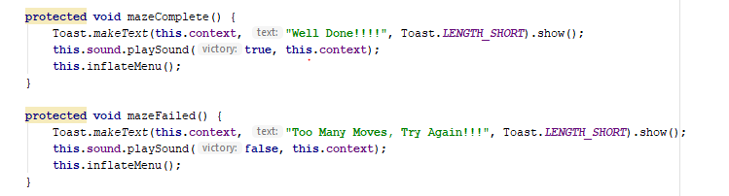
18. Dialogue after player character has won/ lost

Slide 12
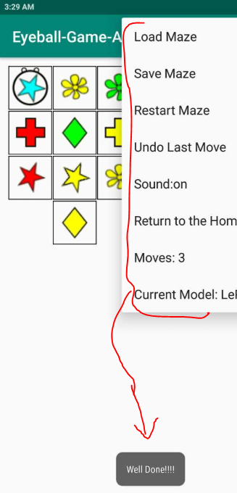
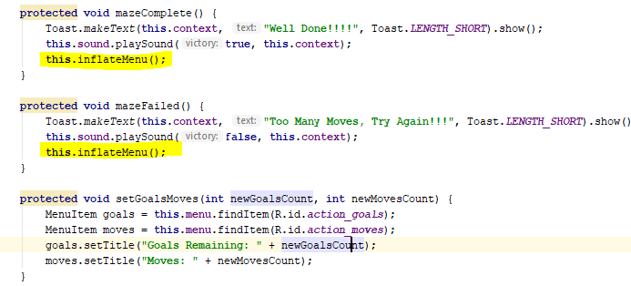
19. Display dialogue with options after player character has won 20. Display dialogue with options after player character has lost

Slide 13
Summary
I think I should get perfect mark for the MUST features of View.
I have used Someone else Model with My controller and View.
So, I’m expecting 5 marks for the Controller and 10 marks for the Implemented View.

