Slide 1
Cognitively Overloaded:
A Stylometric Perspective of Czech Anti-Establishment Media
Miroslav Kubát — Xinying Chen —
Michaela Nogolová — Michal Místecký
Department of Czech Language, Faculty of Arts, University of Ostrava

Slide 2

„Biography of Fake News with a Touch of AI: Dangerous Phenomenon through the Prism of Modern Human Sciences" project no.: CZ.02.01.01/00/23_025/0008724 via the Operational Programme Jan Ámos Komenský.

Slide 3
Quantitative Linguistics
intersubjectivity > reduction of bias
comparable results
universal methodologies
practical applications > software

Slide 4
Off-project Insights: Case Shifts of Toponyms
Eastern European states
  Ukraine.NOM
  Russia.ACC, Russia.DAT
  Belarus.ACC
Israel vs. Gaza
  Israel.NOM, Israel.DAT
  Gaza.NOM, Gaza.DAT, Gaza.ACC
> emotions, confrontational rhetoric

Slide 5
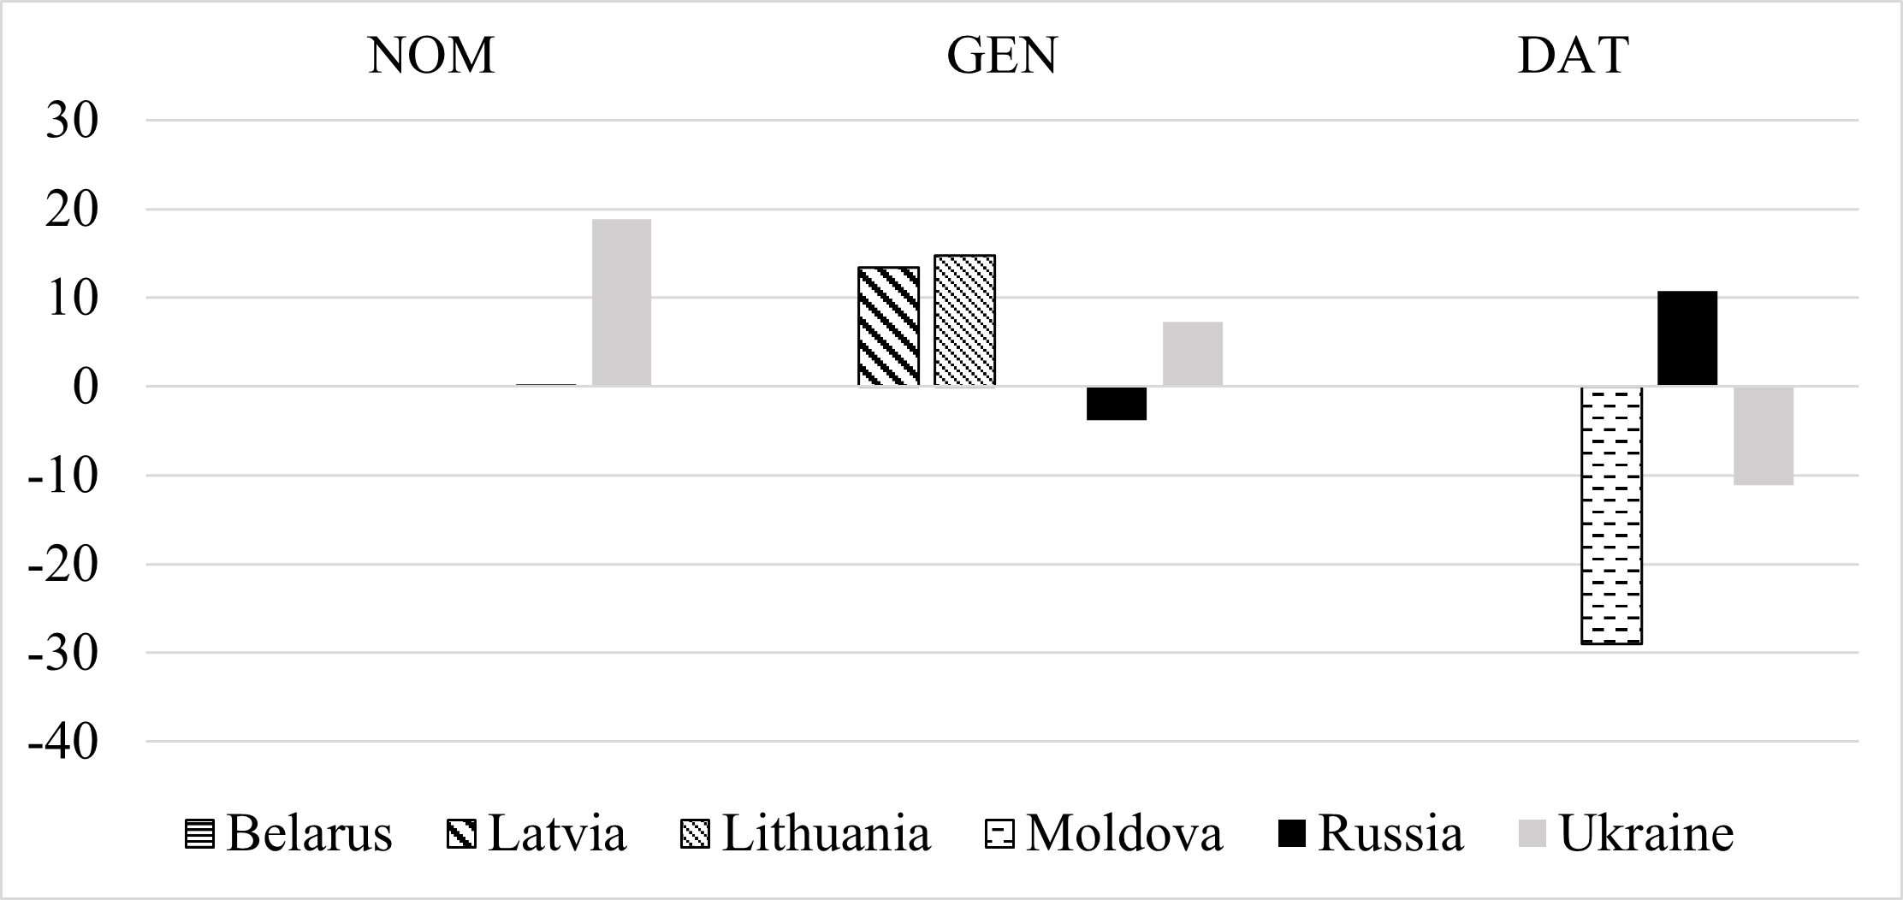

Slide 6
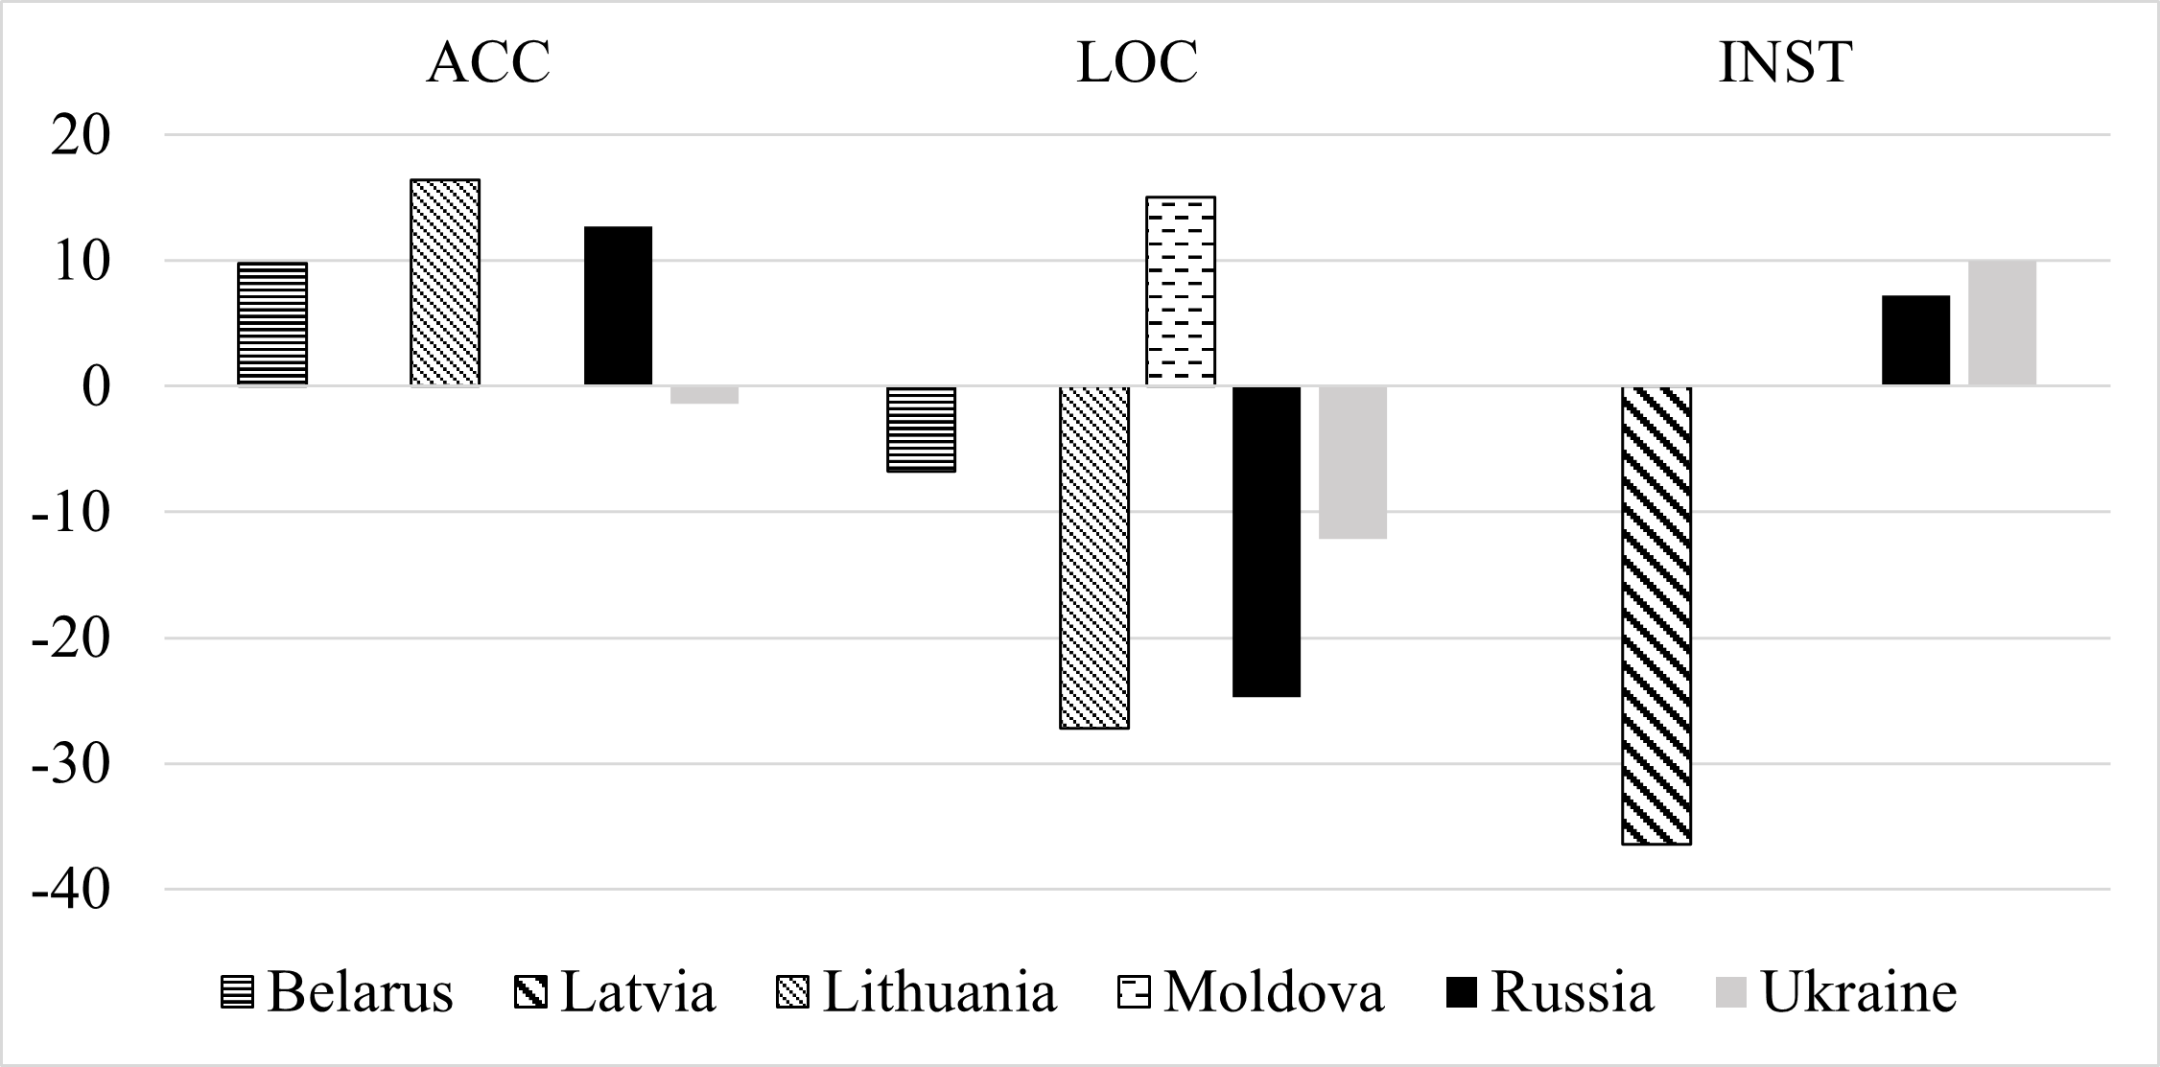

Slide 7
Project Corpus
https://verifee.ai/en.html
Category | Characteristics | Articles | %
cred | credible news | 3,506 | 34.6%
pacr | partially credible news | 2,564 | 25.3%
mis | misleading news | 1,511 | 14.9%
man | manipulative news | 1,840 | 18.2%
uncl | unclassifiable news | 695 | 6.9%
Total | — | 10,116 | 100%

Slide 8
Results
morphology
  more pronouns, conjunctions, punctuation, datives, vocatives
  fewer nouns, numerals, prepositions
  stylistic heterogenity
syntax
  higher mean dependency distance, mean hierarchical distance
  shorter clauses
  more diversified results
lexis
  more complex vocabulary
  fewer original lexical bigrams
> more complex on most levels, elaborated narratives

Slide 9
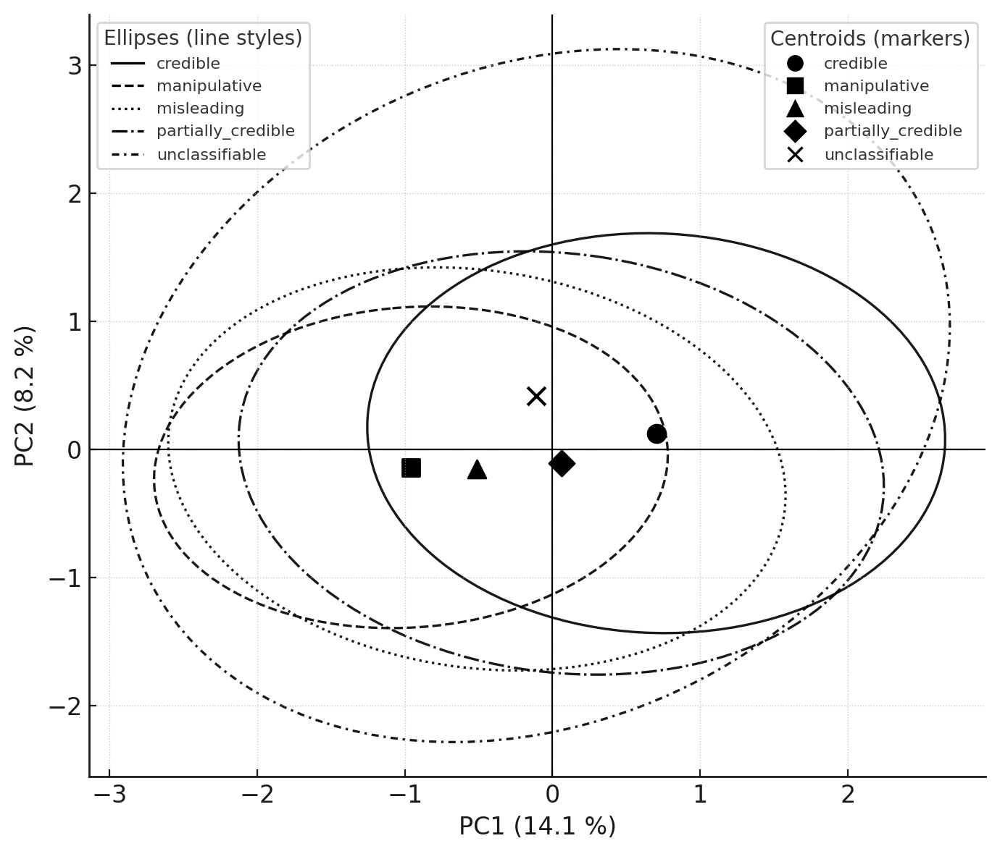

Slide 10
Papers
Fidler, M., & Cvrček, V. (2018). Going beyond “aboutness”: A quantitative analysis of Sputnik Czech Republic. In M. Fidler & V. Cvrček (Eds.), Taming the corpus: From inflection and lexis to interpretation (pp. 195–225). Springer.
Místecký, M. (2025). Rétorická konfliktnost: Antisystémová média v korpusu ONLINE1 z perspektivy slovních druhů [Rhetoric confliction. Anti-establishment media in the ONLINE1 corpus from the perspective of parts of speech]. In M. Škrabal, H. Skoumalová, & B. Štěpánová (Eds.), Festschrift k 30. výročí ČNK (pp. 24–37). Nakladatelství Lidové noviny [to be published].
Místecký, M., & David, J. (2025). Locatives lost: Case distributions of toponyms in anti-establishment media. Onoma, 60, 125–140 [to be published].
Maléř, M. & Místecký, M. Israel and Gaza in Mainstream and Anti-establishment Journalism: A Quantitative Linguistic Analysis of Selected Czech Media [to be submitted to Israel Studies].

Slide 11
Opening: Researching Absence
missing characteristics (nouns, numerals, prepositions, locatives)
anti-keywords
missing words from a particular group (e.g., academia)
missing collocates
  collocational stability
  rank stability

Slide 12
