Slide 1
Overcoming catastrophic forgetting in neural networks
Kirkpatrick et al.

Slide 2
Catastrophic forgetting
Neural networks are not able to learn in a sequential fashion
If a network is trained for task A, and afterwards on task B, the ‘knowledge’ pertaining to task A will be forgotten
This is what is commonly referred to as catastrophic forgetting
Common in transfer learning/domain adaptation tasks where the old task (A) remains important

Slide 3
Training from a probabilistic perspective
Slow down learning on certain weights based on how important they are to previously seen tasks
Training from a probabilistic perspective:
Given a dataset D and parameters (weight and biases) θ, optimising the parameters is trying to find p(θ|D)
Using Bayes: log p(θ|D) = log p(D|θ) + log p(θ) - log p(D)
Notes:
I’m

Slide 4
Training from a probabilistic perspective
Two tasks (A and B) with two independent datasets, D_{A} and D_{b}
log p(θ|D) = log p(D_{B}|θ) + log p(θ|D_{A}) - log p(D_{B})
The weights of task A are absorbed in the posterior distribution p(θ|D_{A})
They approximate this as a Gaussian distribution with mean given by θ*_{A} and a diagonal precision by the diagonal of the Fisher information matrix F.
Computed at every task switch

Slide 5
The Fisher information matrix
The Fisher information matrix has three properties
It is equivalent to the second derivate of the loss near a minimum
It can be computed from first derivates alone (and is thus easy to do)
It is guaranteed to be positive semi definite

Slide 6
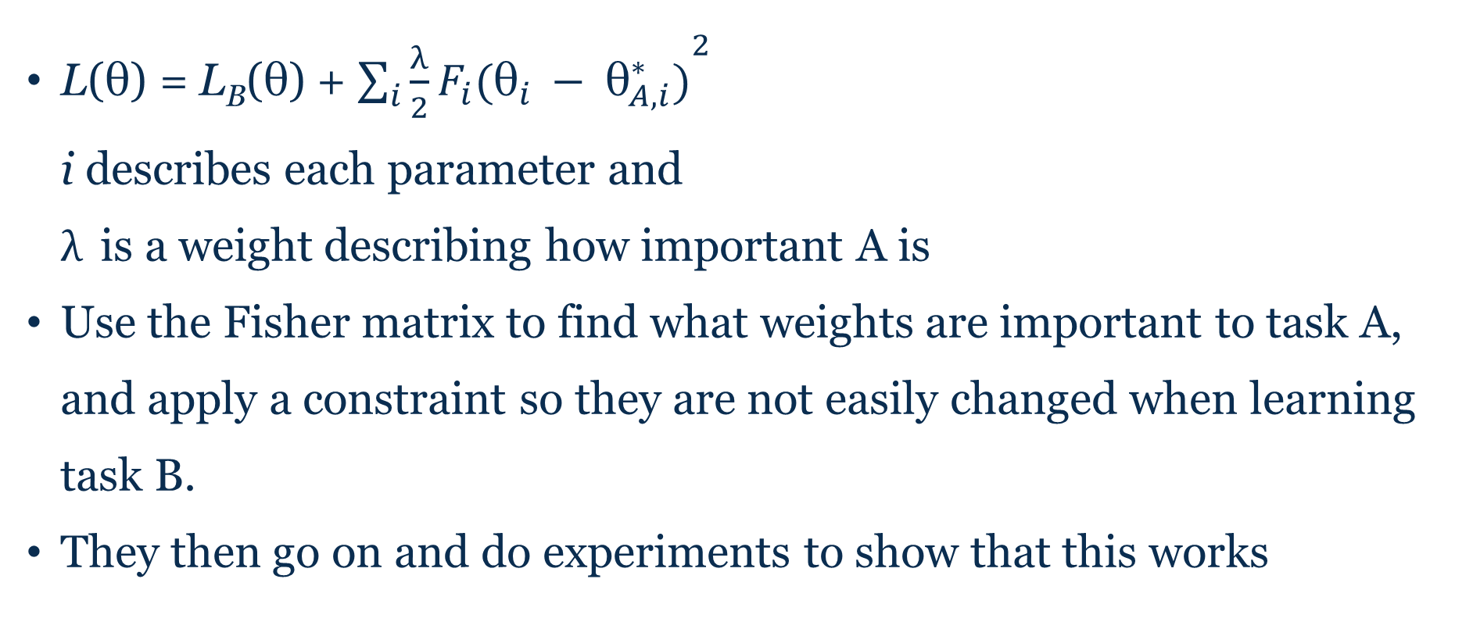
Elastic Weight Consolidation
L(θ) = L_{B}(θ) + ${\sum_{i}{{\frac{λ}{2}F}_{i}({\text{θ}}_{i }− {\text{θ}}_{A,i}^{∗})}}^{2}$ i describes each parameter and $λ$ is a weight describing how important A is
Use the Fisher matrix to find what weights are important to task A, and apply a constraint so they are not easily changed when learning task B.
They then go on and do experiments to show that this works
Notes:
Soft elastic constraint

Slide 7
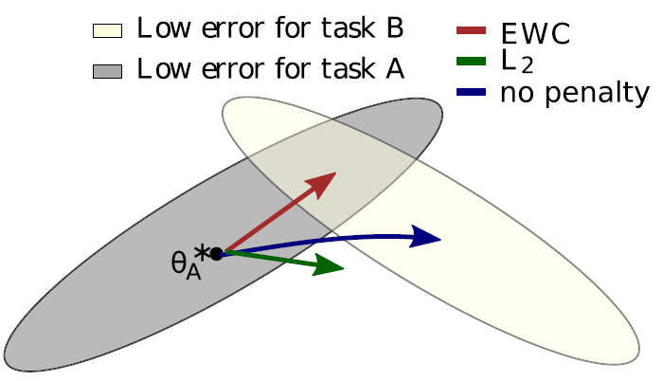
Finding optimal ${\text{θ}}_{B}^{∗}$

Slide 8
The Fisher information matrix
What is it?
How does it describe importance? (i.e. why this metric, what makes it so suitable to measure importance?)
How would you actually implement this?

Slide 9
What is the Fisher information matrix?
In mathematical statistics, the Fisher information (sometimes simply called information^{[1]}) is a way of measuring the amount of information that an observable random variable X carries about an unknown parameter θ of a distribution that models X. Formally, it is the variance of the score, or the expected value of the observed information
Which makes me think of (Shannon) entropy?

Slide 10
EWC vs. Distillation loss
Distillation loss (Hinton, 2015) can be used to address catastrophic forgetting
Activation of the last layer is compared between two networks (or the same, but different iterations) and the cross entropy is used as a loss function

Slide 11

EWC vs. Distillation loss
Hinton et al. argue that by playing around with the softmax temperature they can teach a network what makes a datapoint part of one class, and not another
MNIST: An ugly 2 might look like a 7, and thus the probability of 7 will be a bit higher, and this interesting information for a network
$q_{i}=\frac{e^{(z_{i}/T)}}{\sum_{j}{e^{(z_{j}/T)}}}$
Notes:
They don’t do experiments on mnist with the distillation loss paper, they just use it as an example

Slide 12
EWC vs. Distillation loss
Will the EWC also preserve this knowledge?
Which would be the preferable for preventing/lessening catastrophic forgetting?

