Slide 1
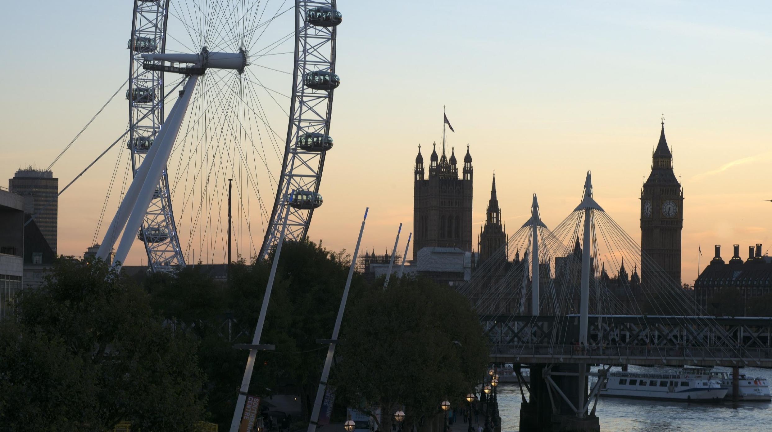

Method Journal Club round 2
Stochastic Deep Networks

Slide 2
Abstract
Machine learning is increasingly targeting areas where input data cannot be accurately described by a single vector, but can be modeled instead using the more flexible concept of random vectors, namely probability measures or more simply point clouds of varying cardinality. Using deep architectures on measures poses, however, many challenging issues. Indeed, deep architectures are originally designed to handle fixed length vectors, or, using recursive mechanisms, ordered sequences thereof. In sharp contrast, measures describe a varying number of weighted observations with no particular order. We propose in this work a deep framework designed to handle crucial aspects of measures, namely permutation invariances, variations in weights and cardinality. Architectures derived from this pipeline can (i) map measures to measures — using the concept of push-forward operators; (ii) bridge the gap between measures and Euclidean spaces — through integration steps. This allows to design discriminative networks (to classify or reduce the dimensionality of input measures), generative architectures (to synthesize measures) and recurrent pipelines (to predict measure dynamics). We provide a theoretical analysis of these building blocks, review our architectures’ approximation abilities and robustness w.r.t. perturbation, and try them on various discriminative and generative tasks.

Slide 3
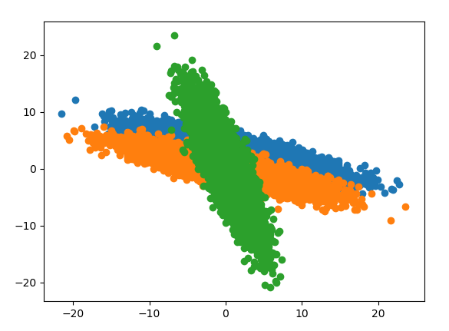
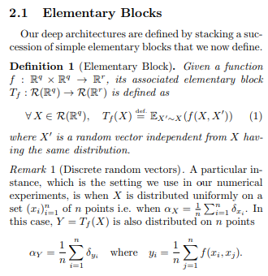
f_1(X, X’) = X - X’
f_2(X, X’) = [[0, 1], [1, 0]] * X

Slide 4
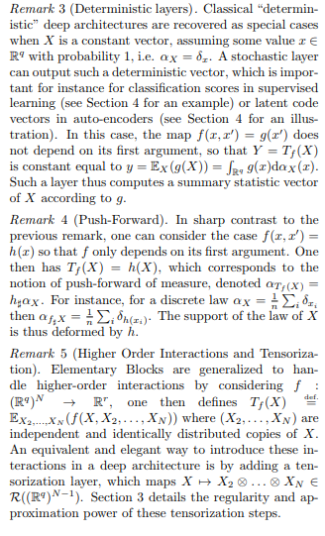
“Summarize” the distribution with a statistic and pursue processing at a global scale
“Deform”+”transport” the distribution
Introduce “higher order” interactions which means more than pairwise.

Slide 5
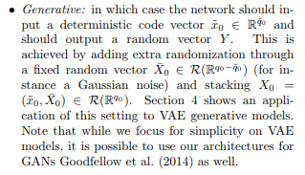
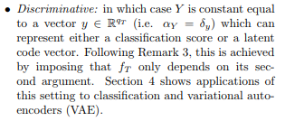

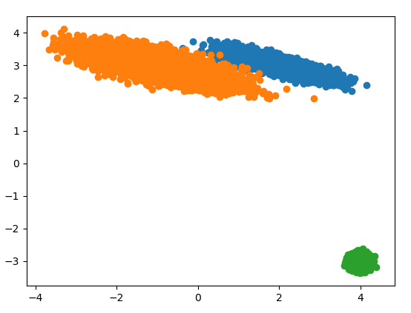
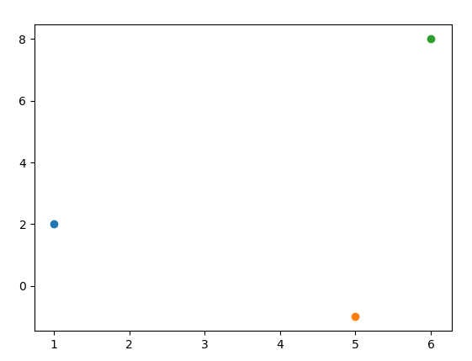
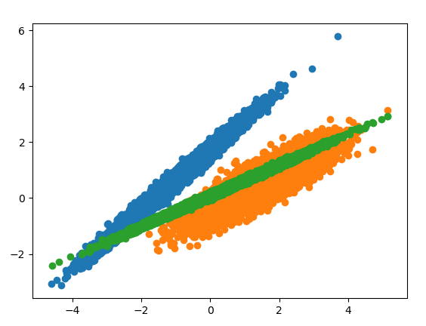

Slide 6
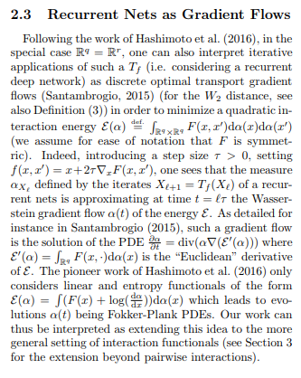
Obscure to me.
Unsupervised learning?

Slide 7
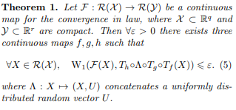
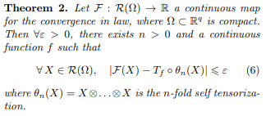
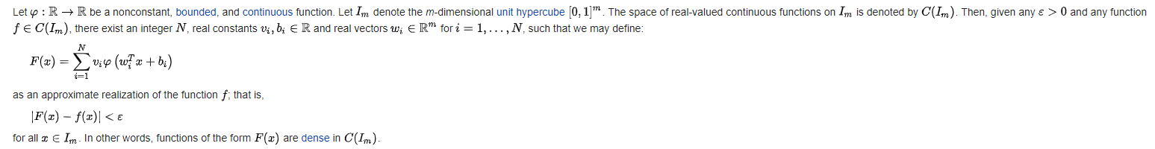
Theoretical Analysis
Universal approximation theorem

Slide 8

MNIST Dataset
We perform classification on the 2-D MNIST dataset of handwritten digits. To convert a MNIST image into a 2D point cloud, we threshold pixel values (threshold ρ = 0.5) and use as a support of the input empirical measure the n = 256 pixels of highest intensity, represented as points (xi) n i=1 ⊂ R 2 (if there are less than n = 256 pixels of intensity over ρ, we repeat input coordinates), which are remapped along each axis by mean and variance normalization. Each image is therefore turned into a sum of n = 256 Diracs 1 n P i δxi . Our stochastic network architecture is displayed on the top of Figure 1 and is composed of 5 elementary blocks (Tfk ) 5 k=1 with an interleaved selftensorisation layer X 7→ X ⊗ X. The first elementary block Tf1 maps measures to measures, the second one Tf2 maps a measure to a deterministic vector (i.e. does not depend on its first coordinate, see Remark 3), and the last layers are classical vectorial fully-connected ones. We use a ReLu non-linearity λ (see Remark 2). The weights are learnt with a weighted cross-entropy loss function over a training set of 55,000 examples and tested on a set of 10,000 examples. Initialization is performed through the Xavier method (Glorot and Bengio, 2010) and learning with the Adam optimizer (Kingma and Ba, 2014). Table 1 displays our results, compared with the PointNet Qi et al. (2016) baseline. We observe that maintaining stochasticity among several layers is beneficial (as opposed to replacing one Elementary Block with a fully connected layer allocating the same amount of memory).

Slide 9
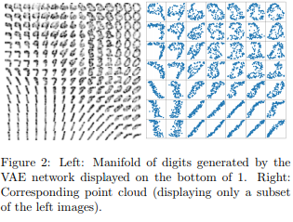
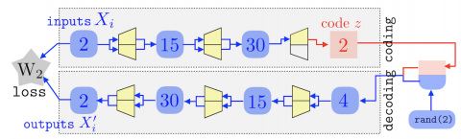
Generative networks
We further evaluate our framework for generative tasks, on a VAE-type model (Kingma and Welling, 2013) (note that it would be possible to use our architectures for GANs Goodfellow et al. (2014) as well). The task consists in generating outputs resembling the data distribution by decoding a random variable z sampled in a latent space Z. The model, an encoder-decoder architecture, is learnt by comparing input and output measures using the W2 Wasserstein distance loss, approximated using Sinkhorn’s algorithm (Cuturi, 2013; Genevay et al., 2018). Following (Kingma and Welling, 2013), a Gaussian prior is imposed on the latent variable z. The encoder and the decoder are two mirrored architectures composed of two elementary blocks and three fully-connected layers each. The corresponding stochastic network architecture is displayed on the bottom of 1. Figure 2 displays an application on the MNIST database where the latent variable z ∈ R 2 parameterizes a 2-D of manifold of generated digits. We use as input and output discrete probability measures of n = 100 Diracs, displayed as point clouds on the right of Figure 2.

Slide 10
Conclusion
In this paper, we have proposed a new formalism for stochastic deep architectures, which can cope in a seamless way with both probability distributions and deterministic feature vectors. The salient features of these architectures are their robustness and approximation power with respect to the convergence in law, which is crucial to tackle high dimensional classification, regression and generation problems over the space of probability distributions.

Slide 11
Thank you
© 2019 King’s College London. All rights reserved

Slide 12
Possible discussions
- The paper considers probability distributions as input and output, what are the benefits/drawbacks of this paradigm?
- This approach requires to change our view on the input. What are the pros and cons of this approach? In which situation is it more powerful than the standard approach? etc
- Do you think this approach is somehow related to some other methods you are more familiar with? (try to build bridges to understand better)
- What could be the possible applications in our domain?

