Slide 1


Method Journal Club
TopAwaRe: Topology-Aware Registration

Slide 2
Abstract
Deformable registration, or nonlinear alignment of images, is a fundamental preprocessing tool in medical imaging. State-of-the art algorithms restrict to diffeomorphisms to regularize an otherwise ill-posed problem. In particular, such models assume that a one-to-one matching exists between any pair of images. In a range of real-life-applications, however, one image may contain objects that another does not. In such cases, the one-to-one assumption is routinely accepted as unavoidable, leading to inaccurate preprocessing and, thus, inaccuracies in the subsequent analysis. We present a novel, piecewise-diffeomorphic deformation framework which models topological changes as explicitly encoded discontinuities in the deformation fields. We thus preserve the regularization properties of diffeomorphic models while locally avoiding their erroneous one-to-one assumption. The entire model is GPU-implemented, and validated on intersubject 3D registration of T1- weighted brain MRI. Qualitative and quantitative results show our ability to improve performance in pathological cases containing topological inconsistencies.

Slide 3
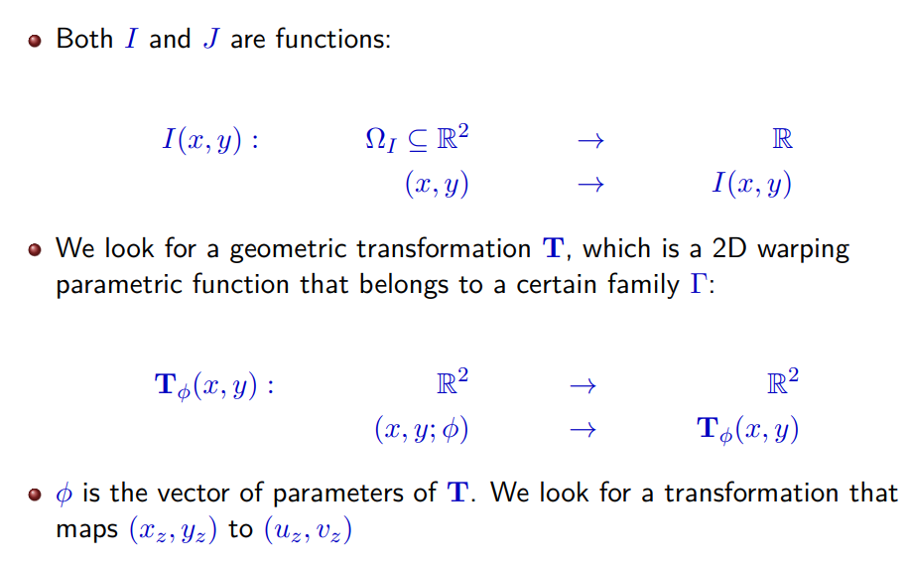
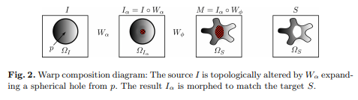
Model
Registration:
In the general framework, we use T to remap the coordinates of I to the ones of J.
Diffeomorphic registration impose T to be: smooth, invertible, smooth inverse.
In the following, they note W, T⁻¹ completed when the pre-image does not exist.
TopAwaRe:
First apply a non diffeomorphic mapping (templated), fill the missing values*, then apply a diffeomorphic transformation.
* Fill the hole with custom intensity.

Slide 4

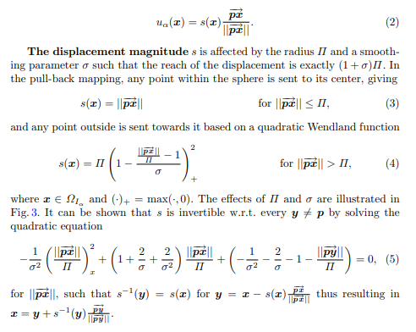

Expansions
Radial (hole)
Others:
Diffeomorphically transform into a convex structure, expand in the same way but p is the projection on x to the structure.

Slide 5
Experimental setting
Our model is implemented for GPU processing using C++ and CUDA. The diffeomorphic model (TopAwaRe_{D}) controlling Wφ is based on LDDMM [3] and optimizes the normalized cross-correlation (as in [1]) over a time-dependent velocity field. The whole warp is optimized in a multi-scale scheme.
We validate our models via intersubject registration of T1-weighted MRI 3D brain volumes from the MICCAI2012 [7] database, which contains 32 subjects with 139 expert-labeled anatomical regions. From these, we identify 6 subjects of interest (SOI) with particularly expanded ventricles in the back, which cannot be registered correctly to a normal subject using diffeomorphic registration, as global continuity leads to an incorrect stretching of subcortical regions in order to map a normal ventricle to an expanded one (see Figs. 5 and 7). The results are thus divided into pairwise registrations between all 32 subjects (N = 992) and normal subjects to SOI (N = 156). All subjects are affinely pre-registered to a common space of size 182 × 218 × 182 voxels. To facilitate TopAwaRe_{PD}, the two contracted ventricles of a single normal subject were manually delineated by 25 control points each. This subject was then registered to the rest and the control points coregistered accordingly to automatically obtain a discontinuity surface per source image (shown in Fig. 5). The background image β of Eq. (1) was set to a constant value of 0.2, corresponding roughly to the average intensity within the ventricles, such that points within the modeled holes are treated as ventricles when evaluating the results.
Validation OK!

Slide 6
Discussion and Conclusion
We have presented a novel framework for piecewise-diffeomorphic registration, preventing gross local misregistration caused by topological inconsistencies by applying knowledge of the underlying matter’s topology. The model has been applied to a diverse dataset, showing that the piecewise-diffeomorphism can be used to prevent incorrect registration at and nearby certain topological differences. In particular, we show improvement in the face of expanded ventricles; a known side-effect of pathological conditions such as Alzheimer’s disease. The standard global Dice overlap is well suited to show that our diffeomorphic base model TopAwaReD performs comparably to ANTs [1], but is less sensitive to improvements in the small subcortical regions shown in Fig. 5. Even the regionwise Dice overlap is insensitive to local changes if the majority of the region is not near the topological change. The improvements are, however, clear both from selected region-wise Dice coefficients and by visual inspection. Our model depends on predefined discontinuities. Allowing discontinuities to occur anywhere may result in implausible warping but manual interaction may be costly. In our experiments it sufficed to manually delineate the collapsed ventricles of a single subject and coregister them to other subjects. This indicates some robustness towards the exact location and curvature of the discontinuities. In its presented form, the framework is not symmetric. Specifically, the topology-altering model allows expansion from discontinuities in the source image but not vice-versa. This could be achieved by applying the model in both directions alongside a symmetric registration model [1]. One might expect the piecewise-diffeomorphic model to incur significant additional computational cost. However, as the size of an expansion is optimized by numerically estimating the gradient w.r.t. a single parameter, the increased cost is modest and the GPU implementation allows fast registration regardlessly. The current practice in image registration is to accept the incorrect diffeomorphic assumption as unavoidable. We believe that, through additional specialization our model may provide a practical foundation for further improving registration of pathological tissue. We thus hope this might spark interest in the community to move beyond diffeomorphic image registration.

