Slide 1
Unsupervised Data Imputation via Variational Inference of Deep Subspaces
Imputation Methods
Methods Discussion Group
Not a journal club! But kind of it is
Meeting 1

Slide 2
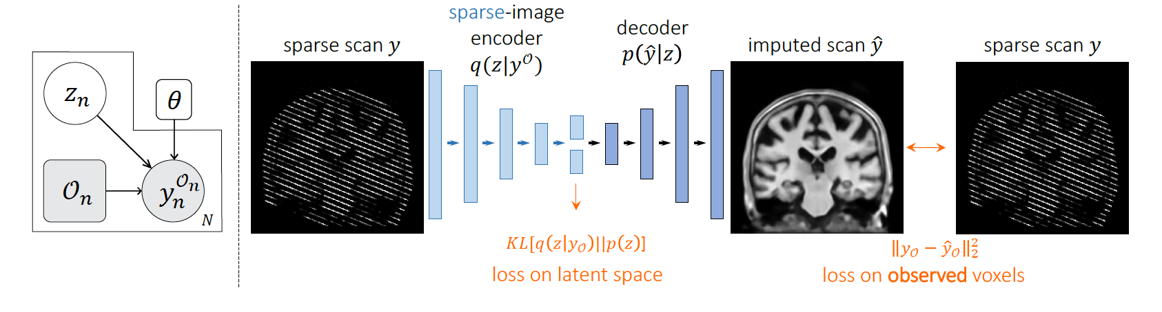
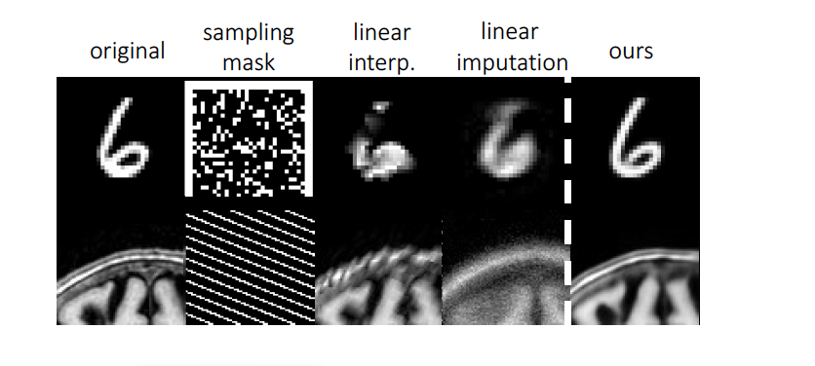
Context
Problem
Incomplete datasets, missing data.
Novelty
Unsupervised imputation of missing data using a general probabilistic model that describes sparse high dimensional imaging data.
Applications
Synthesis of missing modalities;
Imputation of missing values/voxels.
Particularly useful for small datasets.
Unsupervised Data Imputation via Variational Inference of Deep Subspaces
liane.dos_santos_canas@kcl.ac.uk
Notes:
Moreover, the lack of quantitative biomarkers, as well as the difficulty of identify the onset of the disease and the fast rate of progression of CJD, have limited the clinical understanding of the progression of CJD.
Rare, High heterogeneity, wide range of ages, lack of consistency

Slide 3
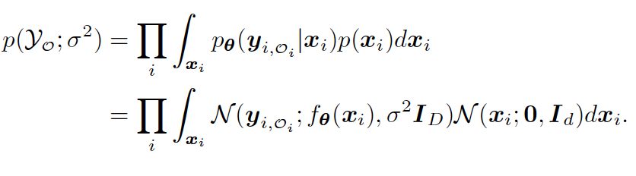
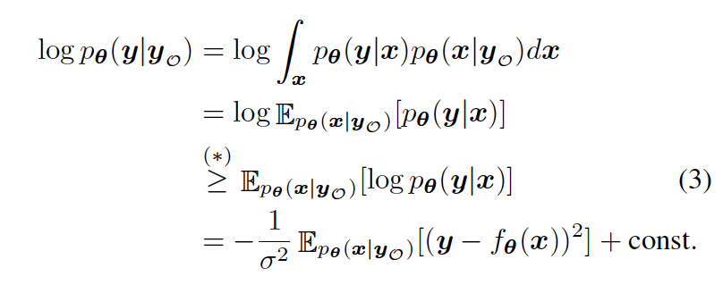


Model
Likelihood of the model
Aim: estimate the full data $y$ given a sparse observation $y_{O}$ using the posterior $p\left(y | y_{O}\right):$
Intractable
Unsupervised Data Imputation via Variational Inference of Deep Subspaces
liane.dos_santos_canas@kcl.ac.uk
Notes:
Moreover, the lack of quantitative biomarkers, as well as the difficulty of identify the onset of the disease and the fast rate of progression of CJD, have limited the clinical understanding of the progression of CJD.
Rare, High heterogeneity, wide range of ages, lack of consistency

Slide 4
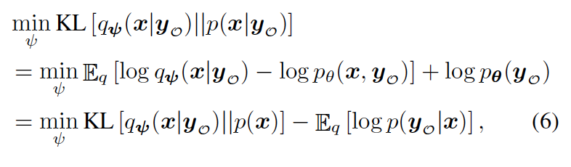
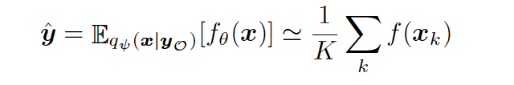

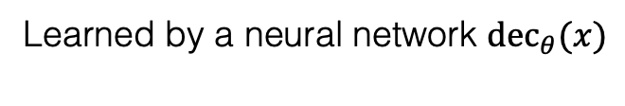
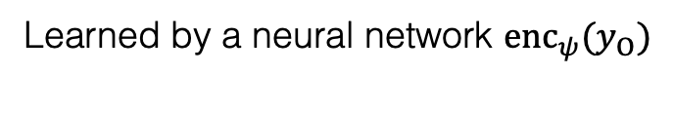
Model
Learning
Learned by a neural network $enc_{ψ}{(y}_{O})$
Sampling
Learned by a neural network ${dec}_{θ}(x)$
Unsupervised Data Imputation via Variational Inference of Deep Subspaces
liane.dos_santos_canas@kcl.ac.uk
Notes:
Moreover, the lack of quantitative biomarkers, as well as the difficulty of identify the onset of the disease and the fast rate of progression of CJD, have limited the clinical understanding of the progression of CJD.
Rare, High heterogeneity, wide range of ages, lack of consistency

Slide 5
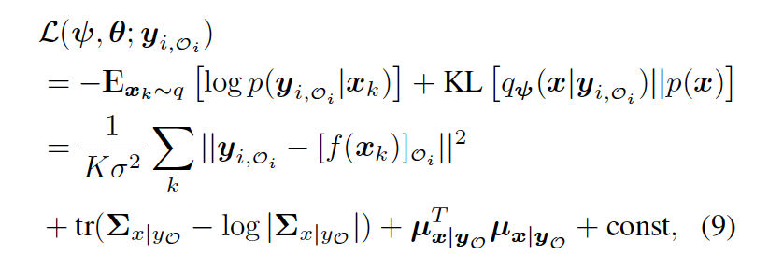
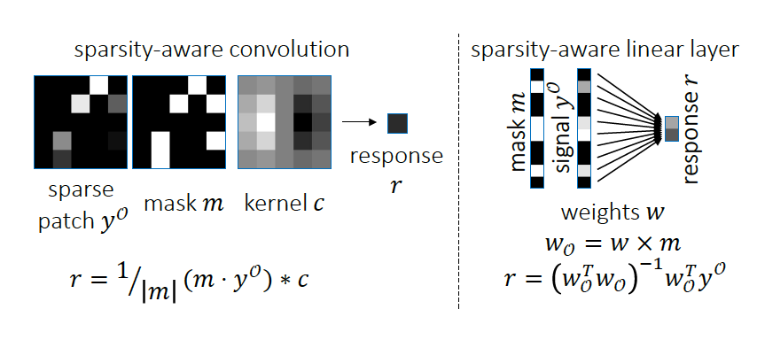
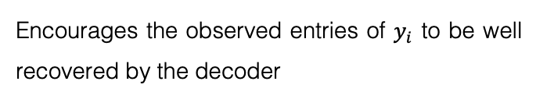
Model
Learning via sparsity aware neural networks
Encourages the observed entries of $y_{i}$ to be well recovered by the decoder
Encourages the subspace posterior to be close to the prior.
K is the number of samples draw for each input image
Unsupervised Data Imputation via Variational Inference of Deep Subspaces
liane.dos_santos_canas@kcl.ac.uk
Notes:
Moreover, the lack of quantitative biomarkers, as well as the difficulty of identify the onset of the disease and the fast rate of progression of CJD, have limited the clinical understanding of the progression of CJD.
Rare, High heterogeneity, wide range of ages, lack of consistency

Slide 6
Discussion
Is it possible to use this approach for estimation of biomarkers instead of images?
Yes. Still using deep learning?
Can the decoder and encoder be replaced by kernel functions?
Yes.
Can it be included in a classification task?
Yes.
How to do multiple imputation from different tasks? I.e., different sources of information being used to estimated the missing values.
Ideas?
How much impact has this for the images that should contain some intensity based features?
Ideas?
Is it possible to use a non-Gaussian posterior?
Hope so.
Can it be reformulated as a disease progression model?
Unsupervised Data Imputation via Variational Inference of Deep Subspaces
liane.dos_santos_canas@kcl.ac.uk
Notes:
Moreover, the lack of quantitative biomarkers, as well as the difficulty of identify the onset of the disease and the fast rate of progression of CJD, have limited the clinical understanding of the progression of CJD.
Rare, High heterogeneity, wide range of ages, lack of consistency

