Slide 1

Word embeddings

Slide 2
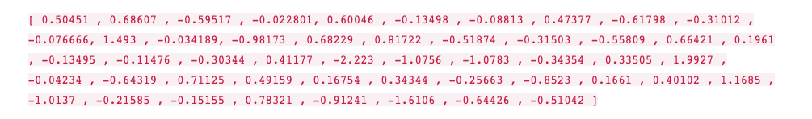
Representing a word as a vector of real numbers
Can we improve on our simple word vectors?
Can we use such a model to encode meaning?
Imagine this vector for the word “king”, (GloVe based vector, trained on Wikipedia):
Example from Jay Alammar, The illustrated Word2Vec:
https://jalammar.github.io/illustrated-word2vec/

Slide 3
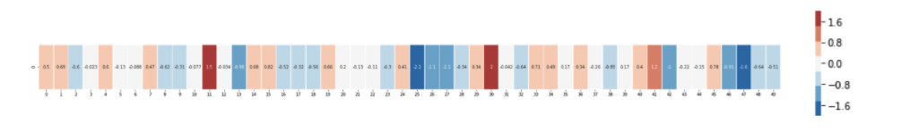
Visualising a vector
We can visualise this as bands of different colours and intensities:

Slide 4
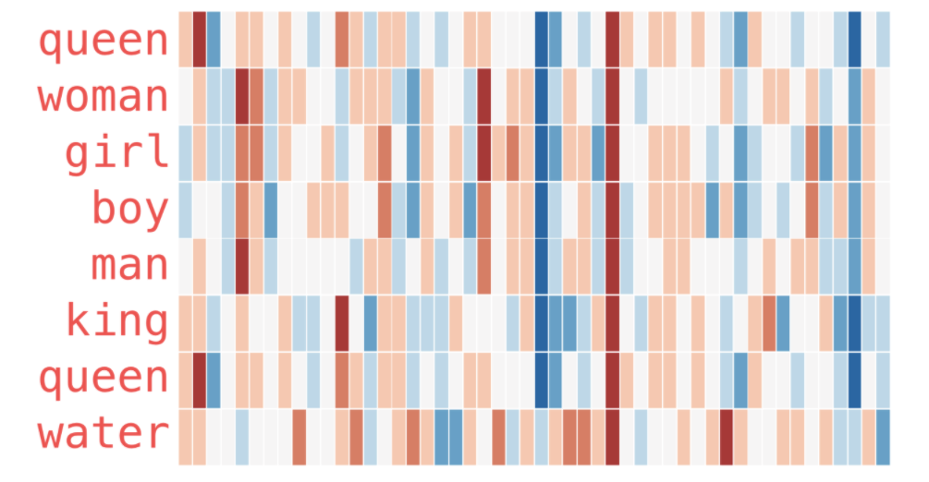
Comparing vectors
Compare this word vector to vectors for other words:

Slide 5
Learning the vectors
We start with a large corpus of language – a collection of texts
We initialise our model with a random vector of weights for each word in the corpus
We show lots of examples from the corpus of words surrounded by their context to the model
E.g. for “on” we might have this example and word vectors
      cat sat on the mat
      c1 c2 w c3 c4
      The model predicts the probability of seeing this example
      We compare this probability to what we really see in our corpus
      Adjust vector weights slightly to make the model prediction higher: maximise the probability of the example
We also present examples where our word has been replaced by a random word
E.g. we might replace “on” with “strawberry” (chosen at random)
      cat sat strawberry the mat
      c1 c2 w’ c3 c4
      Adjust vector weights to make this model prediction lower: minimise the probability of random replacements

Slide 6
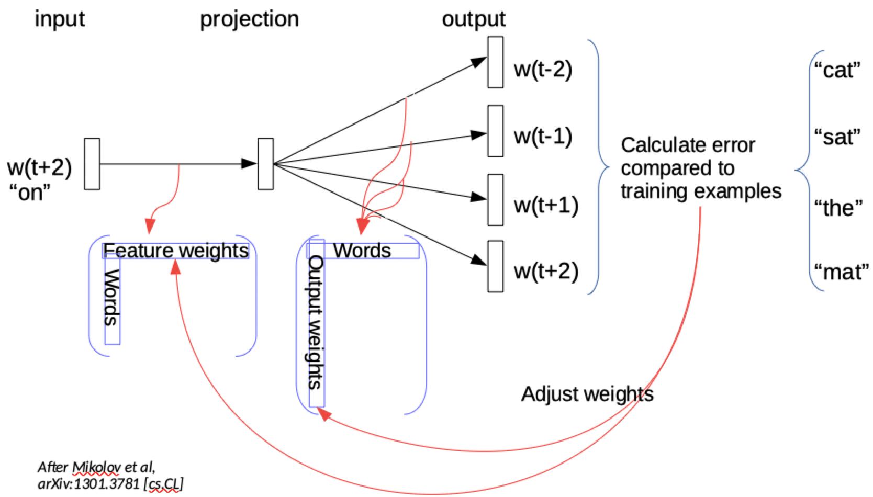
Learning the vectors

Slide 7
Intuition
Consider that “on” and “by” play similar roles in language:
      cat sat on the mat
      cat sat by the mat
We would expect “on” and “by” to have similar feature vectors
And for the other words, we can generalize further:
      dog sits on a rug
      dog lies under a rug
      …

Slide 8
Intuition
If two words have similar contexts, then their feature vectors will be similar
The final feature vector for a word gives a distributed representation of the word – word embeddings – a dimensionality reduction from our word space to real number vectors
We use these word embedding as features in place of our words in models

Slide 9
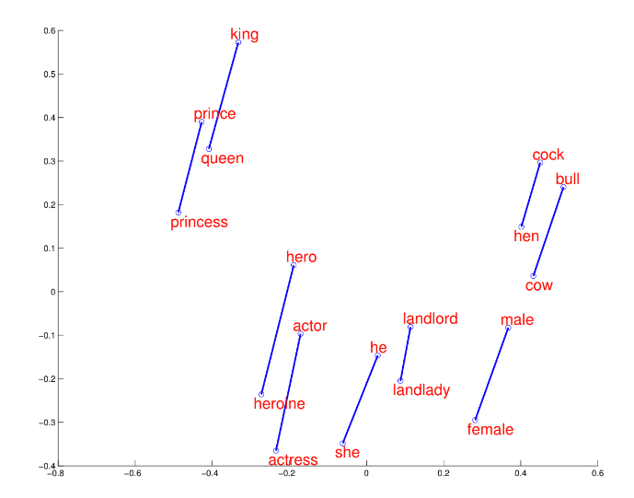
Visualisation
2D projection from Mikolov et al, Google Research, NIPS 2013

Slide 10
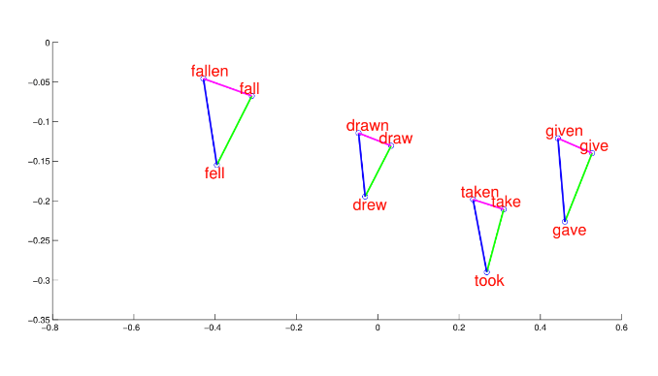
Visualisation
2D projection from Mikolov et al, Google Research, NIPS 2013

Slide 11
Thank you
angus.roberts@kcl.ac.uk
https://www.kcl.ac.uk/people/angus-roberts

