Slide 1

A simple document model:
Bag-of-Words

Slide 2
Rationalism: pattern matching
...amlodipine 5 m.g. once daily increased to 10MG …
Rationalist, armchair approach
Brittle
Not bad for simple regular patterns
Hard to scale
/[0-9]+ *[Mm].?[Gg].?/

Slide 3
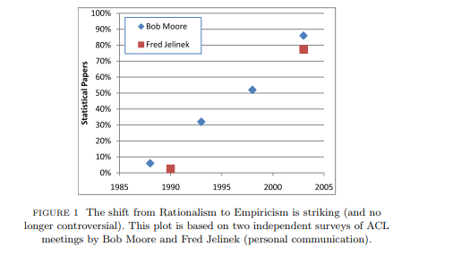
The rise of empiricism
Church K., LiLT Volume 2, Issue 4 May 2007

Slide 4
Representation documents: Bag of Words
(Credit: Jurafsky and Martin, draft 3rd edition
https://web.stanford.edu/~jurafsky/slp3/)

Slide 5
Bag of words as a vector space
loved
Here we have three dimensions in our model
Typically, we would have hundreds or thousands of dimensions
1
loved this amazing movie
loved it!
1
amazing
1
amazing how much I hated this
hated this movie
hated
hated the cast, hated the plot

Slide 6
Bag of words
loved
We can create a plane in the ”feature space” to separate out different classes of our examples
1
loved this amazing movie
loved it!
1
amazing
1
amazing how much I hated this
hated this movie
2
hated
hated the cast, hated the plot

Slide 7
Bag of words
loved
What about word order?
What about negation?
All words have the same influence, regardless of their salience
More sophisticated representations are available!
1
loved this amazing movie
loved it!
1
amazing
1
amazing how much I hated this
hated this movie
2
hated
hated the cast, hated the plot

Slide 8
Thank you
angus.roberts@kcl.ac.uk
https://www.kcl.ac.uk/people/angus-roberts

