Slide 1

Supervised machine learning for text classification

Slide 2
Rationalism: pattern matching
...amlodipine 5 m.g. once daily increased to 10MG …
Rationalist, armchair approach
Brittle
Not bad for simple regular patterns
Hard to scale
/[0-9]+ *[Mm].?[Gg].?/

Slide 3
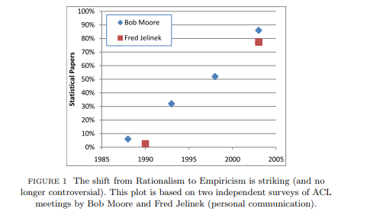
The rise of empiricism
Church K., LiLT Volume 2, Issue 4 May 2007

Slide 4
Learning from labelled examples
Example sentence | Label | Features
 |  | smok* | cig* | negation
He smokes | T | 1 | 0 | 0
Suffers from anhedonia | F | 0 | 0 | 0
She does not smoke | F | 1 | 0 | 1
20 cigarettes a day | T | 0 | 1 | 0
Blood pressure 70/120 | F | 0 | 0 | 0
cig*
smok*
negation
Compute some line or plane separating our positive and negative examples
Use this plane to determine the class (label) of previously unseen examples
This is supervised classification

Slide 5
Representation documents: Bag of Words
(Credit: Jurafsky and Martin, draft 3rd edition
https://web.stanford.edu/~jurafsky/slp3/)

Slide 6
Bag of words as a vector space
loved
Typically, hundreds or thousands of dimensions
1
loved this amazing movie
loved it!
1
amazing
1
amazing how much I hated this
hated this movie
hated
hated the cast, hated the plot

Slide 7
Bag of words
loved
What about word order?
What about negation etc.
All words have the same influence, regardless of their salience
More sophisticated representations are available!
1
loved this amazing movie
loved it!
1
amazing
1
amazing how much I hated this
hated this movie
hated
hated the cast, hated the plot

Slide 8
Supervised classification
Take a set of example texts.
They might be sentences, whole documents, single words, or some other portion of text.
This is our training corpus.

Slide 9
Supervised classification
Label each example, with the classes in our problem.
Labelling will often be done by human.
We might be lucky enough to have some existing labelled data, e.g. radiology reports with a code for tumour class attached..

Slide 10
Supervised classification
Select features to represent our texts.
These might be the presence of words, POS tags, distances between words, word sequences (ngrams), presence of word groups, sentence lengths, etc.
We may use numeric representations of words as features, computed in a separate step. In the state of the art, these are referred to as embeddings.

Slide 11
Supervised classification
Represent the texts in this feature space.

Slide 12
Supervised classification
Compute some separator between classes.
This will involve measures of distance between points.
It might also involve methods for projecting multiple dimensions into different spaces in which they are separable (kernels).

Slide 13
Supervised classification
Commonly used classification algorithms in NLP:
  SVM (very popular)
  CRF
  Naive Bayes
  KNN
  Random Forest
  State of the art: neural nets, e.g. CNNs, LSTMs

Slide 14
Supervised classification
?
Classify / label new, previously unseen examples by representing them in the same feature space.

Slide 15
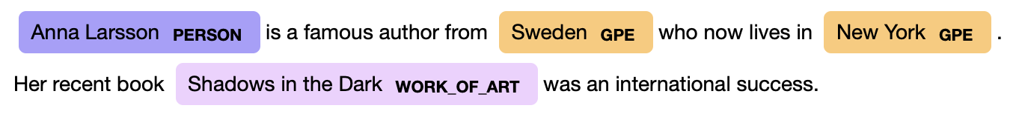
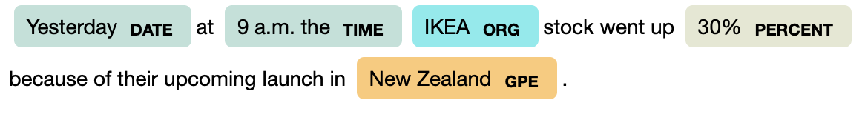
Sequence learning for NER

Slide 16
Sequence learning for NER
What are the instances?

Slide 17
Representation – BIO / IOB
TEXT | IOB | ENTITY TYPE | CLASS | DESCRIPTION
Anna | B | PERSON | PER_B | beginning of an entity
Larsson | I | PERSON | PER_I | inside an entity
is | O | "" | O | outside an entity
a | O | "" | O | outside an entity
famous | O | "" | O | outside an entity
author | O | "" | O | outside an entity
from | O | "" | O | outside an entity
Sweden | B | GPE | GPE_B | beginning of an entity

Slide 18
Representation - BILOU
TEXT | IOB | ENTITY TYPE | CLASS | DESCRIPTION
Anna | B | PERSON | PER_B | beginning of an entity
Larsson | L | PERSON | PER_L | last of an entity
is | O | "" | O | outside an entity
a | O | "" | O | outside an entity
famous | O | "" | O | outside an entity
author | O | "" | O | outside an entity
from | O | "" | O | outside an entity
Sweden | U | GPE | GPE_U | unit entity

Slide 19





How good is the model?
Training corpus
Split into training and tuning corpora
Test corpus
Train a model
Model
Apply the model on new unseen data
Algorithm,
Parameters,
…
Common measures:
Precision, P == positive predictive value
Recall, R == sensitivity
F1, the harmonic mean of P and R

Slide 20
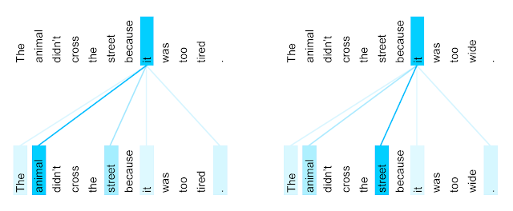
Self-attention – example distribution
The encoder self-attention distribution for the word “it” from the 5th to the 6th layer of a Transformer trained on English to French translation (one of eight attention heads).
Credit: https://research.google/blog/transformer-a-novel-neural-network-architecture-for-language-understanding/

Slide 21
Large Language Models
 | BERT | GPT | GPT2 | GPT3 | GPT4
Model layer | Encoder | Decoder | Decoder | Decoder | Decoder
Pre-training task | MLM, NSP | Text generation | + task conditioning | + in-context patterns
Training data | 3.3 billion words | 7000 books | 40 GB | 45 TB | 1 PB ?
Context window | 512 | 512 | 1024 | 2048 | 8000 – 32000 ?
Parameters | 110 M | 117 M | 1.5 B | 175 B | 1 T ?
Suitability | Sequence tasks | Generation | Generation | Generation, adaptable | Generation, adaptable
Availability | Open | Open | Open | Limited, API | Limited, API

Slide 22
Large Language Models
 | BERT | GPT | GPT2 | GPT3 | GPT4
Model layer | Encoder | Decoder | Decoder | Decoder | Decoder
Pre-training task | MLM, NSP | Text generation | + task conditioning | + in-context patterns
Training data | 3.3 billion words | 7000 books | 40 GB | 45 TB | 1 PB ?
Context window | 512 | 512 | 1024 | 2048 | 8000 – 32000 ?
Parameters | 110 M | 117 M | 1.5 B | 175 B | 1 T ?
Suitability | Sequence tasks | Generation | Generation | Generation, adaptable | Generation, adaptable
Availability | Open | Open | Open | Limited, API | Limited, API
Cost
Efficiency
Performance?

Slide 24
Thank you
angus.roberts@kcl.ac.uk
https://www.kcl.ac.uk/people/angus-roberts

