Slide 1

Distributional semantics NLP in one day

Slide 2
Representing language
How can we represent words numerically, so we can build computational models of language?
How can we account for:
Their similarities?
Their meaning, or semantics?
Distributional semantics and context as meaning
Vector based representations

Slide 3
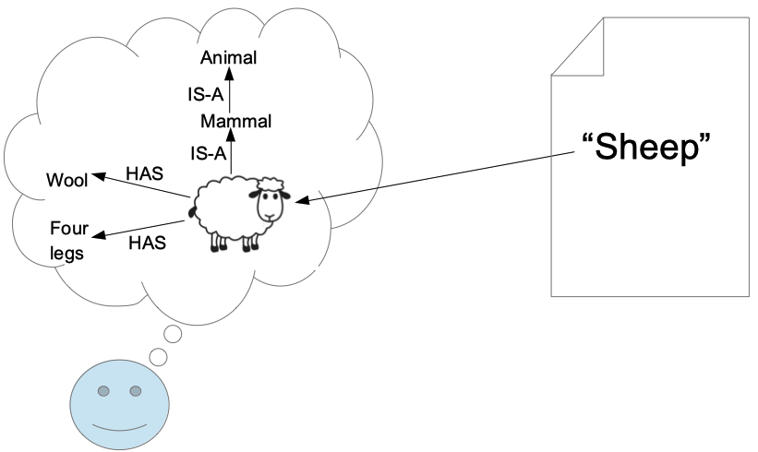
Lexical semantics

Slide 4
An experiment – wombling and snetches
The Captain's side raked first. Tom staked. The hired sportsmen played so hard that they wombled too fast, and were shaky with the rakes. Tom fooled around the way he always did, and all his stakes dropped true. When it was his turn to rake he did not let Captain Najork and the hired sportsmen score a single rung, and at the end of the snetch he won by six ladders.
From How Tom beat Captain Najork and his hired sportsmen
by Russell Hoban and Quentin Blake

Slide 5
Distributional semantics
“You shall know a word by the company it keeps” (JR Firth)
The contexts in which words appear correlate with their meaning
We understand a word by its distribution: the set of contexts in which it is found
“Don't think, but look!” (Wittgenstein) - i.e. the meaning of a word is the description of its use,

Slide 6
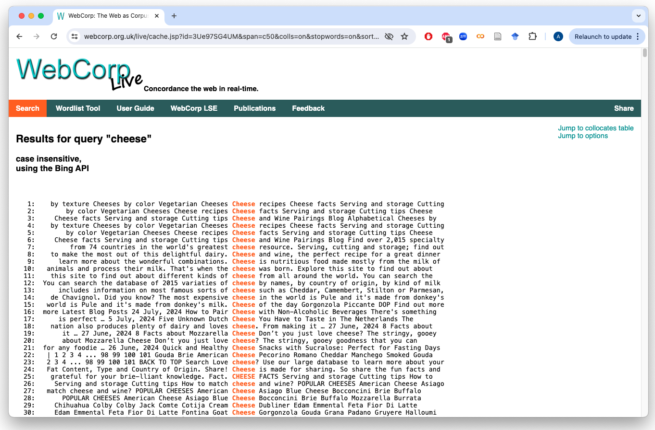
Words in context – concordances and collocations
https://www.webcorp.org.uk/

Slide 7
Thank you
angus.roberts@kcl.ac.uk https://www.kcl.ac.uk/people/angus-roberts

