Slide 1

Multi-Layer Neural Networks NLP in one day

Slide 2
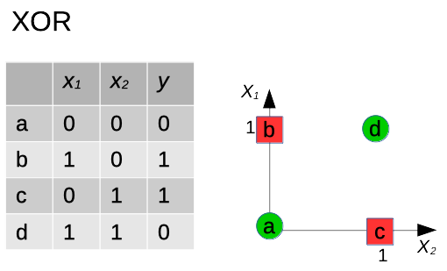
XOR is not linearly separable

Slide 3
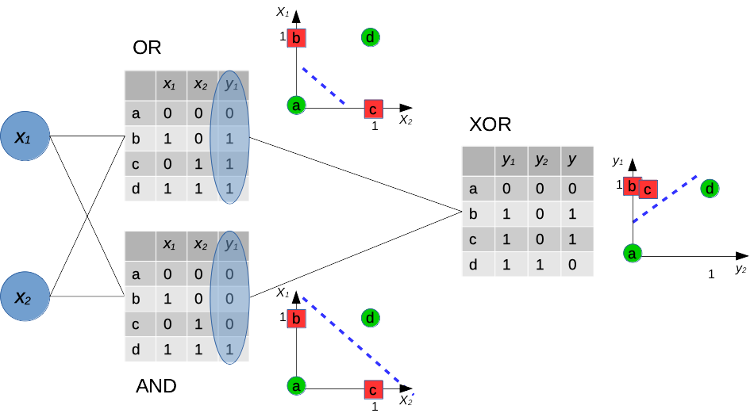
Solving a non-linear problem

Slide 4
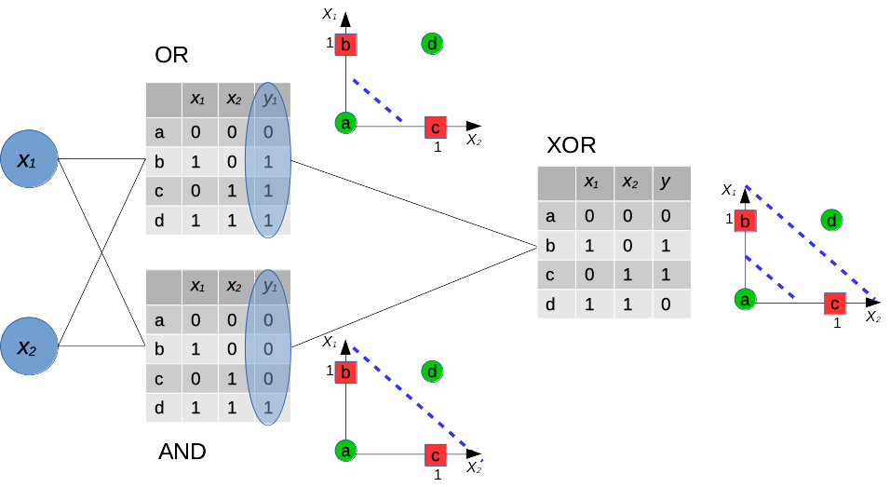
Solving a non-linear problem

Slide 5
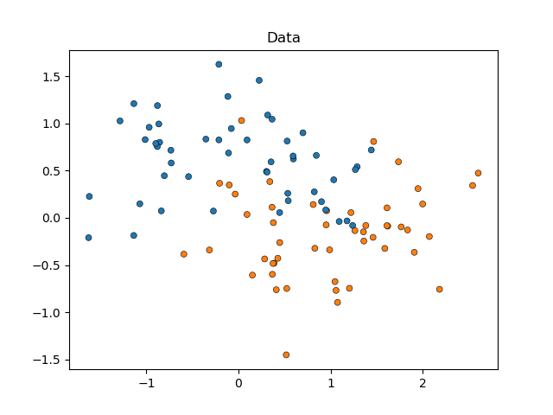
A single perceptron can only model linearly separable problems
Solvable with 12 parameters (weights)

Slide 6
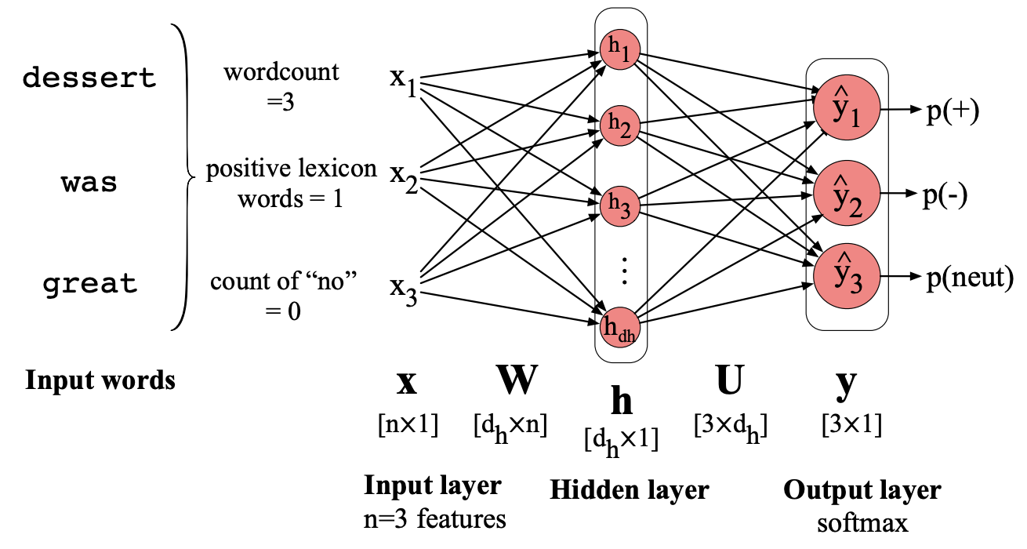
How do we model language in a neural network?
What other numeric representation could we use? What would its advantage be?
We learn the weights. These provide a representation that will map input to output.
(Jurafsky and Martin, Fig. 7.10)

Slide 7
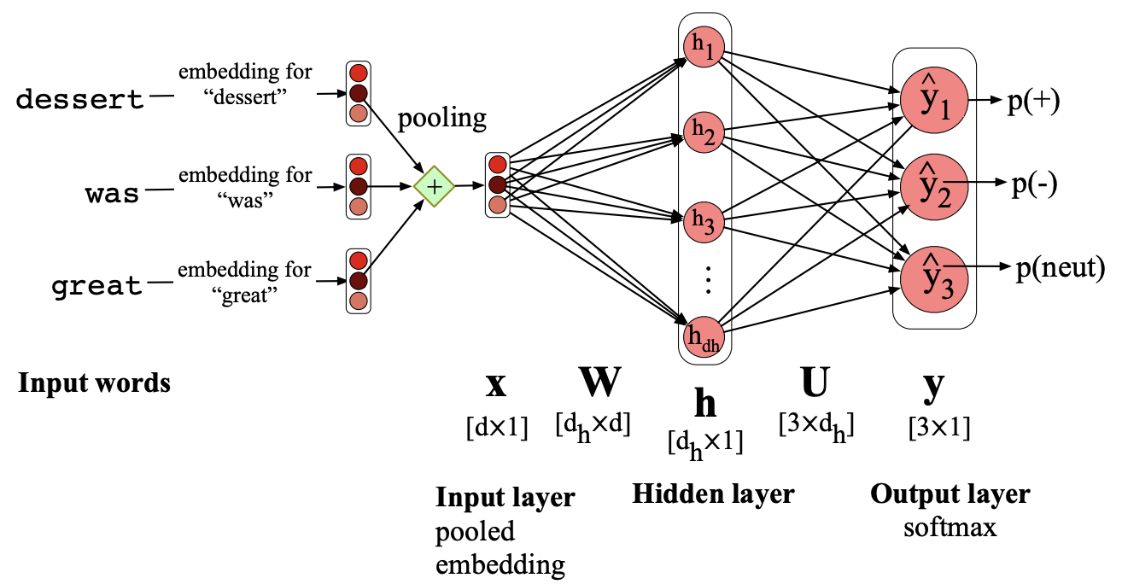
How do we model language in a neural network?
Replace the words with embeddings. The model will be more general, rather than focused on specific words from the training data.
Output is a probability distribution over all possible values
(Jurafsky and Martin, Fig. 7.11)

Slide 8
Thank you
angus.roberts@kcl.ac.uk https://www.kcl.ac.uk/people/angus-roberts

