Slide 1

Word embeddings NLP in one day

Slide 2
Representing words as vectors
We need to pass numbers to our NLP models
One-hot is a simple word-space vector representation. Words are represented by a vector encoding their position in an ordered vocabulary
aardvark [1, 0, 0, 0, 0, …, 0, 0]
abacus [0, 1, 0, 0, 0, …, 0, 0]
... [...]
zumba [0, 0, 0, 0, 0, …, 1, 0]
zygote [0, 0, 0, 0, 0, …, 0, 1]
As well as being necessary to represent our words numerically, it is also a step along the path of finding some abstraction of word meaning
Alternatively, we could encode as the integer position in the vocabulary
aardvark 0
abacus 1
... ...
zumba n-1
zygote n

Slide 3
Representing words as vectors
Such a vector representation does not really encode meaning
It is also high dimensional and sparse
Can we encode meaning such a vector representation?
Can we derive a low dimensional model of words?
What about the context vectors we have looked at? Would they be an improvement?

Slide 4
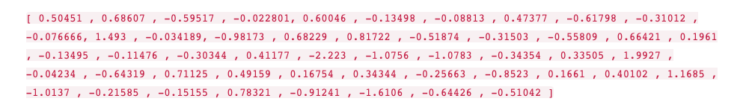
Intuition
Imagine a vector for the word “king”, (GloVe based vector, trained on Wikipedia):
Example from Jay Alammar, The illustrated Word2Vec:
https://jalammar.github.io/illustrated-word2vec/

Slide 5
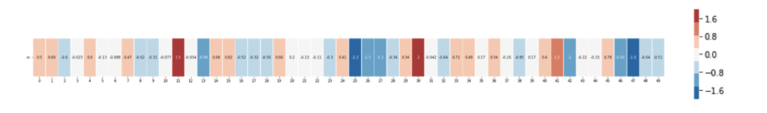
Intuition
We can visualise this as bands of different colours and intensities:

Slide 6
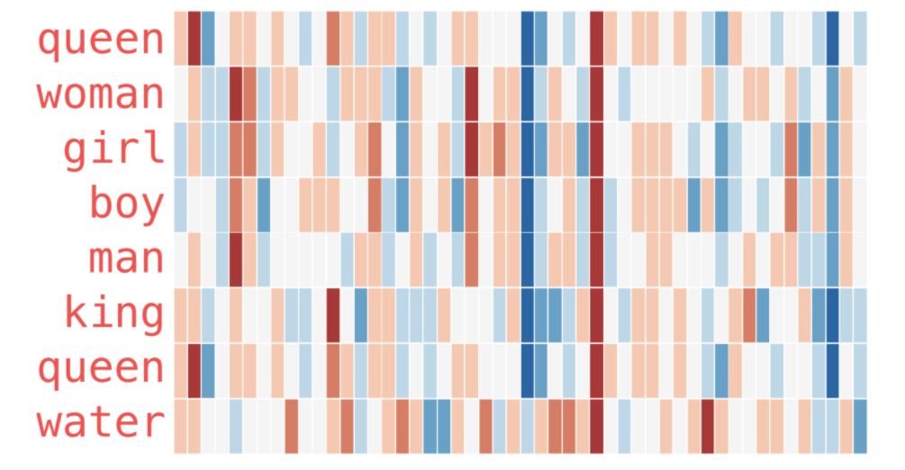
Intuition
Compare this word vector to vectors for other words:

Slide 7
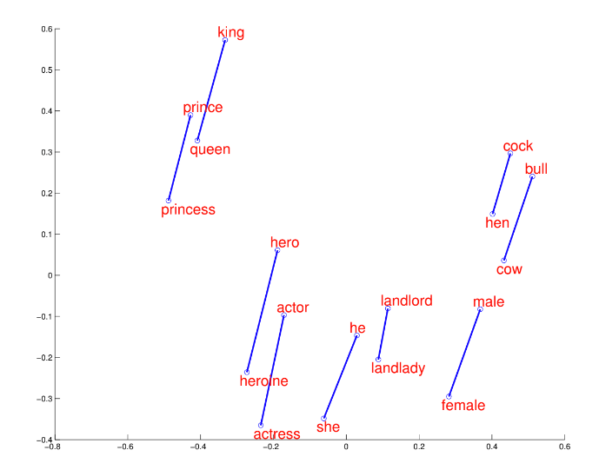
Visualisation
2D projection from Mikolov et al, Google Research, NIPS 2013

Slide 8
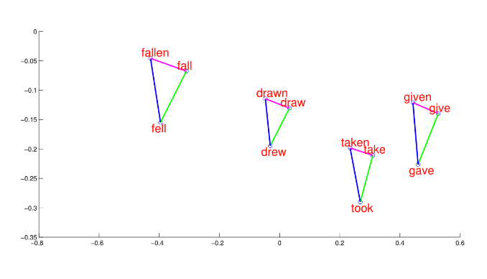
Visualisation
2D projection from Mikolov et al, Google Research, NIPS 2013

Slide 9
Thank you
angus.roberts@kcl.ac.uk https://www.kcl.ac.uk/people/angus-roberts

