Slide 1
Modelling language: distributed representations
Angus Roberts, Senior Lecturer in Health Informatics
Institute of Psychiatry, Psychology and Neuroscience
King’s College London

Slide 2
Representing language
Encoding meaning
Word embeddings
  an intuitive example
  outline of calculation
  visualising
Next steps: modelling language using artificial neural networks

Slide 3
Encoding meaning

Slide 4
One-hot encoding
One-hot is a simple word-space vector representation. Words are represented by a vector encoding their position in an ordered vocabulary
  aardvark [1, 0, 0, 0, 0, …, 0, 0]
  abacus [0, 1, 0, 0, 0, …, 0, 0]
  ...
  zumba [0, 0, 0, 0, 0, …, 1, 0]
  zygote [0, 0, 0, 0, 0, …, 0, 1]
As well as being necessary to represent our words numerically, it is also a step along the path of finding some abstraction of word meaning
Alternatively, we could encode as the integer position in the index
  aardvark 0
  abacus 1
  ...
  zumba n-1
  zygote n

Slide 5
Encoding meaning
Such a vector representation does not really encode meaning
It is also high dimensional and sparse
Can we encode meaning such a vector representation?
Can we derive a low dimensional model of words?

Slide 6
Relatedness
Semantic spaces
100
clozapine
olanzapine
75
antipsychotic
50
25
 | treatment | anti- psychotic
olanzapine | 110 | 76
clozapine | 70 | 78
vinegar | 15 | 0
0
vinegar
0
25
50
75
100
treatment

Slide 7
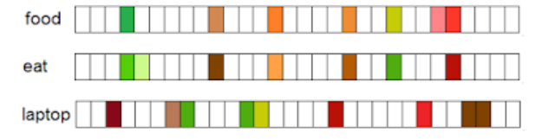
Encoding meaning
Can we define some space that is sufficient to encode the semantics of our language?
From http://veredshwartz.blogspot.co.uk

Slide 8
Word embeddings: intuition

Slide 9
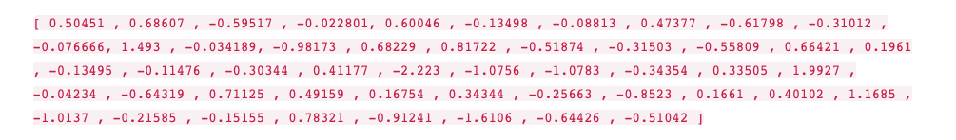
Intuition
Construct a vector for the word “king”, (GloVe based vector, trained on Wikipedia):
Example from Jay Alammar, The illustrated Word2Vec:
https://jalammar.github.io/illustrated-word2vec/

Slide 10
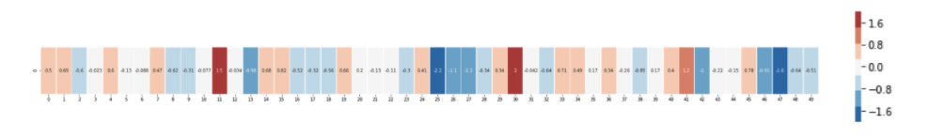
Intuition
Visualise as bands of different colours and intensities:

Slide 11
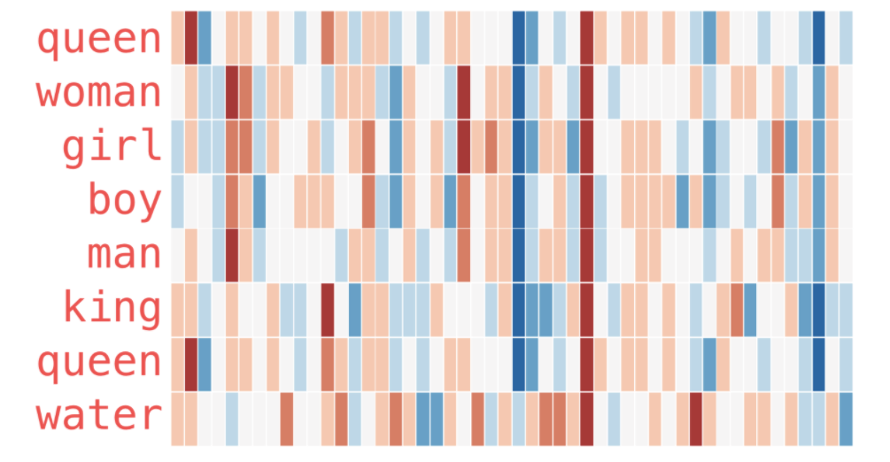
Intuition
Compare to vectors for other words:

Slide 12
Word embeddings: calculation

Slide 13
Distributed representations - Word2Vec
input
projection
output
w(t-2)
“cat”
w(t-1)
Calculate error
compared to
training examples
“sat”
w(t+2)
“on”
w(t+1)
“the”
Feature weights
Words
w(t+2)
“mat”
Words
Output weights
Adjust weights
After Mikolov et al, arXiv:1301.3781 [cs.CL]
Notes:
Given a word, can we calculate the probability of its context?
For each word in some context in our training data, e.g. “cat sat on the mat”
We have two functions:
One projects the word, on, to some set of features.
The other weights this feature vector for each possible context word in the vocabulary, giving the probability of seeing each word in the context of the input
So in our case “cat” is in the context, and weight vector will produce a high probability for “cat”

Slide 14
Training the vectors
w – real number feature vectors
c – real number output context vectors
cat sat on the mat
c1 c2 w c3 c4
calculate: w.c1 + w.c2 + w.c3 + w.c4
Adjust vector weights to make this high
– maximise the probability of an example
cat sat strawberry the mat
c1 c2 w’ c3 c4
calculate: w’.c1 + w’.c2 + w’.c3 + w’.c4
Adjust vector weights to make this low
– minimise the probability of random replacements

Slide 15
Intuition
Consider that “on” and “by” play similar roles in language:
  cat sat on the mat
  cat sat by the mat
We would expect “on” and “by” to have similar feature vectors
And for the other words, we can generalize further:
  dog sits on a rug
  dog lies under a rug
  …

Slide 16
Intuition
If two words have similar contexts, then their feature vectors will be similar
The final feature vector for a word gives a distributed representation of the word – word embeddings – a dimensionality reduction from our word space to real number vectors
(We throw away the output vectors – we don’t need those)
We use these word embedding as features in place of our words in models

Slide 17
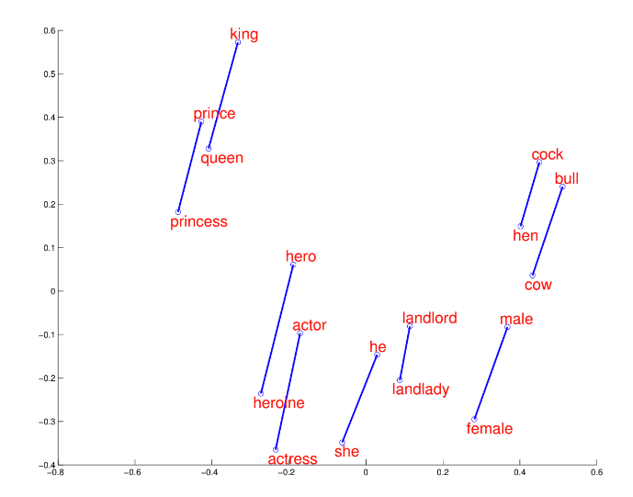
Visualisation
2D projection from Mikolov et al, Google Research, NIPS 2013

Slide 18
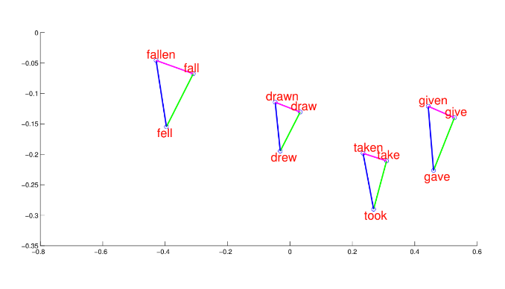
Visualisation
2D projection from Mikolov et al, Google Research, NIPS 2013

Slide 19
What about ambiguous words?
What about homonyms and polysemous words?
Word embeddings such as Word2Vec represent all senses of the word in a single vector
It is unable to represent them independently (though there are work arounds)
The key problem is again context
  Word embeddings model words based on their context
  But the final vector is applied independent of the context in which the word appears

Slide 20
Next steps: modelling language with artificial neural nets

Slide 21
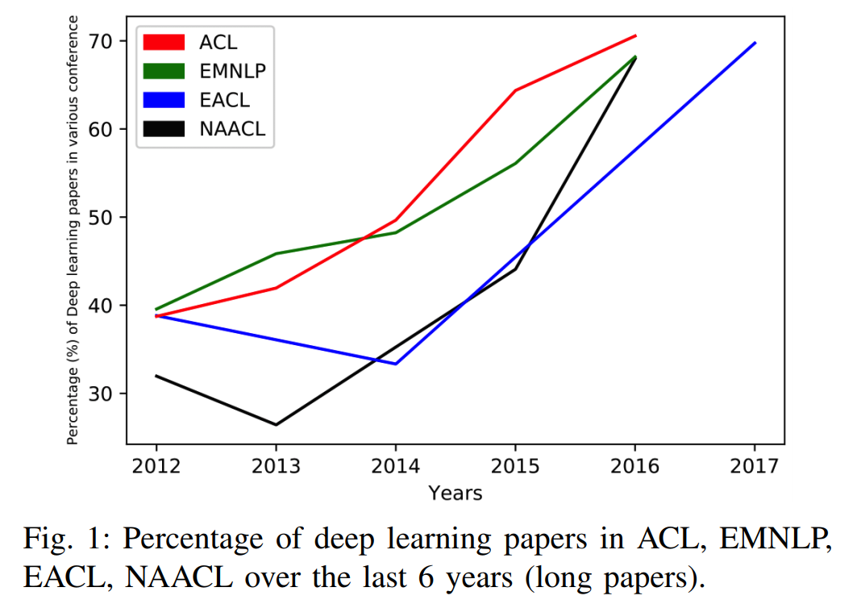
2010 onwards:
artificial neural networks
Young et al,
arXiv:1708.02709 [cs.CL]

Slide 22
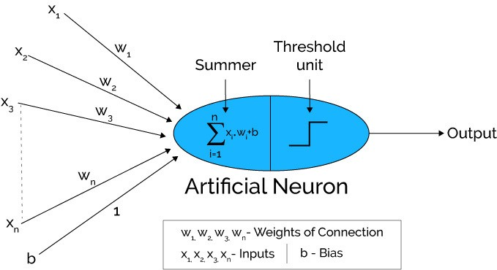
2010 onwards:
artificial neural networks for NLP
From https://medium.com/@xenonstack/overview-of-artificial-neural-networks-and-its-applications-2525c1addff7

Slide 23
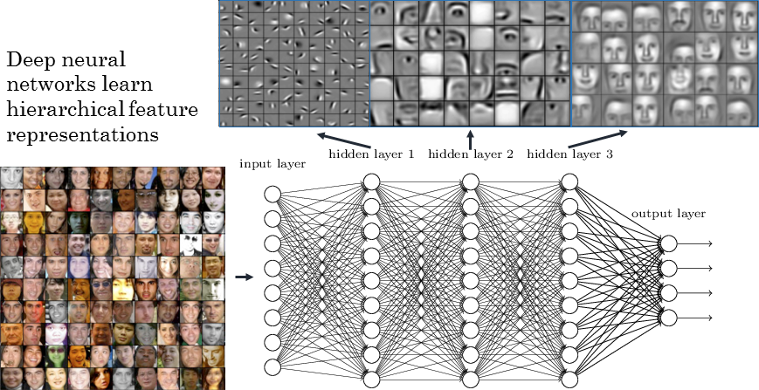
Learning hierarchical feature representations
From https://www.strong.io/blog/deep-neural-networks-go-to-the-movies

Slide 24
Thank you.
Any questions?
angus.roberts@kcl.ac.uk

