Slide 1
Modelling language: documents
Angus Roberts, Senior Lecturer in Health Informatics
Institute of Psychiatry, Psychology and Neuroscience
King’s College London

Slide 2
Representing language
How can we represent meaning in language?
Symbolic, rationalist approaches
Empirical approaches to representing documents
  Bag-of-words
  TF-IDF

Slide 3
Symbolic, rationalist approaches

Slide 4
Symbolic NLP
If we want to manipulate language computationally, we need to represent it in some way
In rule-based, symbolic NLP, we can consider language to be represented as strings of characters
  A string of characters has little inherent meaning
  We match these strings with expressions (rules, grammars) that define some pattern of characters
  These rules give meaning to our strings
  The approach can be extended to POS and other features
The thinking is that language can be reasoned about in some logical way, and that the structures of language could be can in to sets of rules
Prolog, a logic programming language, is a typical approach

Slide 5
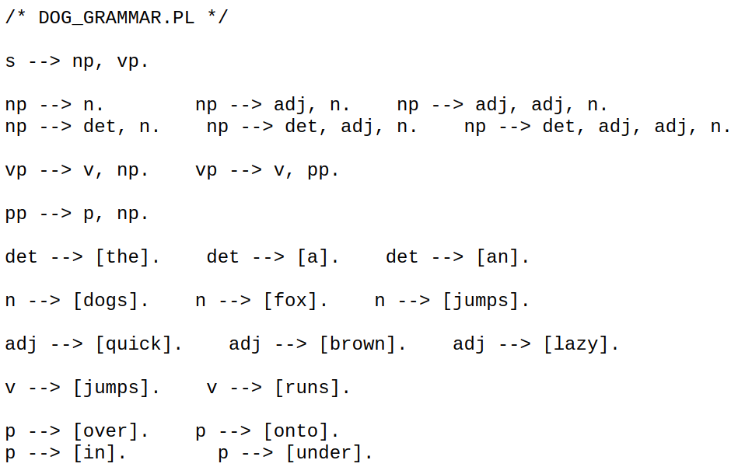
Prolog grammars
Credit: John Coleman, http://www.phon.ox.ac.uk/coleman

Slide 6
Grammars
How many rules does it take to represent “grammatical” English?
Do we have the same problem for all languages?
What about medical language?
Can we write grammars that capture not the syntax, but the semantics of language? i.e. the real-world categories that words relate to, and the relationships between them?
  e.g. diseases, medications, anatomy?

Slide 7
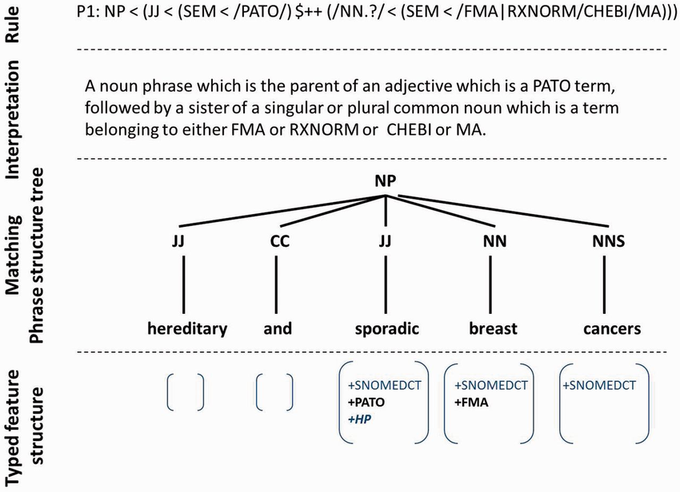
Semantic grammars
Collier et al (2015). PhenoMiner: From text to a database of phenotypes
associated with OMIM diseases. Database. 2015. bav104. 10.1093/database/bav104.

Slide 8
Empiricism
Empiricism is at the heart of current NLP
  Statistical models of language
  How often do words appear?
  In what context do they appear?
  How many of a particular word appear in a piece of text?
Is it disturbing that counting words in a document outperforms reasoning about the language?

Slide 9
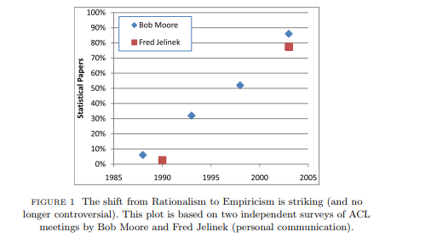
Rationalism vs Empiricism
Church, LiLT Volume 2, Issue 4 May 2007

Slide 10
Empirical representations: bag-of-words

Slide 11
Bag of words
Let’s consider four sentences:
  he is a smoker
  she is alcoholic
  he is anxious
  he is diabetic and diet controlled
We will plot these along 3 dimensions:
  smoker
  alcoholic
  is

Slide 12
Bag of words
smoker
alcoholic
is
(After: Feature Engineering for Machine Learning
by Amanda Casari, Alice Zheng. O’Reilley)

Slide 13
Bag of words
smoker
he is a smoker
1
he is a
smoker
alcoholic
1
is
(After: Feature Engineering for Machine Learning
by Amanda Casari, Alice Zheng. O’Reilley)

Slide 14
Bag of words
smoker
he is a smoker
she is alcoholic
1
he is a
smoker
1
alcoholic
1
she is
alcoholic
is
(After: Feature Engineering for Machine Learning
by Amanda Casari, Alice Zheng. O’Reilley)

Slide 15
Bag of words
smoker
he is a smoker
she is alcoholic
he is anxious
1
he is a
smoker
1
alcoholic
1
she is
alcoholic
he is
anxious
is
(After: Feature Engineering for Machine Learning
by Amanda Casari, Alice Zheng. O’Reilley)

Slide 16
Bag of words
smoker
he is a smoker
she is alcoholic
he is anxious
she is diabetic and is diet controlled
1
he is a
smoker
1
alcoholic
1
she is
alcoholic
he is
anxious
2
is
she is diabetic
and is diet
controlled
(After: Feature Engineering for Machine Learning
by Amanda Casari, Alice Zheng. O’Reilley)

Slide 17
Bag of words
Works surprisingly well on some problems
But…
  No word order: loss of context
    “is this cancer” vs “this is cancer”
  The Curse of Dimensionality: the power of our classifier reduces as the number of dimensions increases
  Over fitting: given a low number of training instances relative to number of features
  Important but less frequent words can have less of an influence than less important but more frequent words

Slide 18
Term frequency and inverse document frequency

Slide 19
Improving bag of words
smoker
The occurrence of a rare word like “smoker” or “alcoholic” has as much influence on the vector as the occurrence of a common word like “is”
Lots of occurrences of a common word (such as two mentions of “is” in one sentence) has a bigger effect than a more discriminating rare word.
Note that we are just using “is” as an example, Often, we would deal with such highly frequent, so-called stop words, by filtering them out. TFIDF is still relevant for other frequent words.
1
he is a
smoker
1
alcoholic
1
she is
alcoholic
he is
anxious
2
is
she is diabetic
and is diet
controlled

Slide 20

TFIDF
We can scale our BoW term frequencies, multiplying each by a factor that accounts for how rare the term is – an inverse document frequency (idf)
Usually this is scaled further by taking the log
The rarer a word, the higher idf
The more common a word, the lower idf
tf x idf scales the influence of each term accordingly

Slide 21
Improving bag of words
smoker
Document 1: tfidf(smoker) = 1 * ln(4/1) = 1.4
tfidf(is) = 1 * ln(4/4) = 0
1
he is a
smoker
1
alcoholic
1
2
is
is

Slide 22
Improving bag of words
smoker
Document 1: tfidf(smoker) = 1 * ln(4/1) = 1.4
tfidf(is) = 1 * ln(4/4) = 0
he is a
smoker
1
1
alcoholic
1
2
is
is

Slide 23
Improving bag of words
smoker
Document 1: tfidf(smoker) = 1 * ln(4/1) = 1.4
tfidf(is) = 1 * ln(4/4) = 0
Document 2: tfidf(alcoholic) = 1 * ln(4/1) = 1.4
tfidf(is) = 1 * ln(4/4) = 0
he is a
smoker
1
1
alcoholic
1
she is
alcoholic
2
is
is

Slide 24
Improving bag of words
smoker
Document 1: tfidf(smoker) = 1 * ln(4/1) = 1.4
tfidf(is) = 1 * ln(4/4) = 0
Document 2: tfidf(alcoholic) = 1 * ln(4/1) = 1.4
tfidf(is) = 1 * ln(4/4) = 0
he is a
smoker
1
she is
alcoholic
1
alcoholic
1
2
is
is

Slide 25
Improving bag of words
smoker
Document 1: tfidf(smoker) = 1 * ln(4/1) = 1.4
tfidf(is) = 1 * ln(4/4) = 0
Document 2: tfidf(alcoholic) = 1 * ln(4/1) = 1.4
tfidf(is) = 1 * ln(4/4) = 0
Document 3: tfidf(is) = 1 * ln(4/4) = 0
he is a
smoker
1
she is
alcoholic
1
alcoholic
1
he is
anxious
2
is
is

Slide 26
Improving bag of words
smoker
Document 1: tfidf(smoker) = 1 * ln(4/1) = 1.4
tfidf(is) = 1 * ln(4/4) = 0
Document 2: tfidf(alcoholic) = 1 * ln(4/1) = 1.4
tfidf(is) = 1 * ln(4/4) = 0
Document 3: tfidf(is) = 1 * ln(4/4) = 0
he is a
smoker
1
she is
alcoholic
he is
anxious
1
alcoholic
1
2
is
is

Slide 27
Improving bag of words
smoker
Document 1: tfidf(smoker) = 1 * ln(4/1) = 1.4
tfidf(is) = 1 * ln(4/4) = 0
Document 2: tfidf(alcoholic) = 1 * ln(4/1) = 1.4
tfidf(is) = 1 * ln(4/4) = 0
Document 3: tfidf(is) = 1 * ln(4/4) = 0
Document 4: tfidf(is) = 2 * ln(4/4) = 0
he is a
smoker
1
she is
alcoholic
he is
anxious
1
alcoholic
1
2
is
she is diabetic
and is diet
controlled
is

Slide 28
Improving bag of words
smoker
Document 1: tfidf(smoker) = 1 * ln(4/1) = 1.4
tfidf(is) = 1 * ln(4/4) = 0
Document 2: tfidf(alcoholic) = 1 * ln(4/1) = 1.4
tfidf(is) = 1 * ln(4/4) = 0
Document 3: tfidf(is) = 1 * ln(4/4) = 0
Document 4: tfidf(is) = 2 * ln(4/4) = 0
he is a
smoker
1
he is
anxious
she is
alcoholic
she is
diabetic and
is diet controlled
1
alcoholic
is

Slide 29
Improving bag of words
smoker
Document 1: tfidf(smoker) = 1 * ln(4/1) = 1.4
tfidf(is) = 1 * ln(4/4) = 0
Document 2: tfidf(alcoholic) = 1 * ln(4/1) = 1.4
tfidf(is) = 1 * ln(4/4) = 0
Document 3: tfidf(is) = 1 * ln(4/4) = 0
Document 4: tfidf(is) = 2 * ln(4/4) = 0
he is a
smoker
1
he is
anxious
she is
alcoholic
she is
diabetic and
is diet controlled
1
alcoholic
Influence of rare words increased
Influence of common words decreased
is

Slide 30
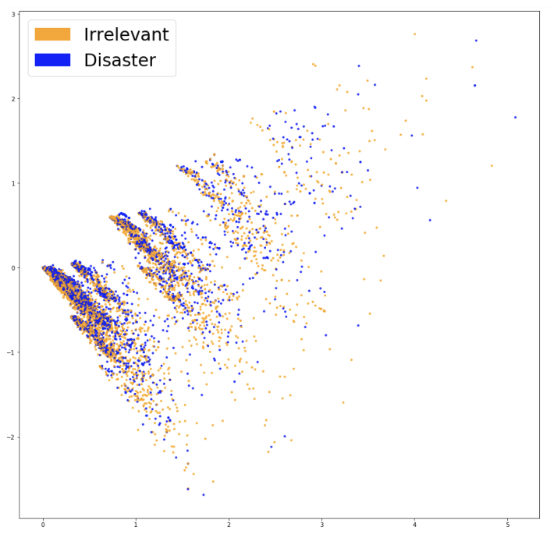
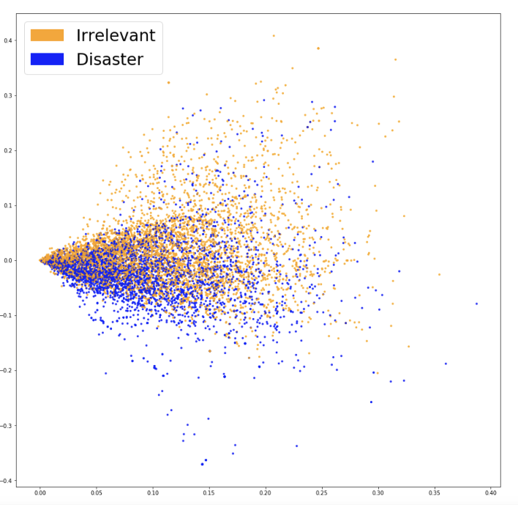
BoW vs TFIDF
Projections on to two dimensions of BoW (left) and TFIDF (right) vector spaces for
words in tweets about disasters, and tweets not about disasters
From:
https://blog.insightdatascience.com/how-to-solve-90-of-nlp-problems-a-step-by-step-guide-fda605278e4e

Slide 31
More complex features
Reduce dimensions and find the commonalities: increase ratio of instances to features
  Lemmas
  Parts of speech – he, she → pronouns
  Semantic classes – mother, father → parent
Introduce word order e.g by using n-grams
Introduce context
  dependencies between parts of the sentence – e.g. subject, verb and object
  contextual models: embeddings

Slide 32
Thank you.
Any questions?
angus.roberts@kcl.ac.uk

