Slide 1
Modelling language: words
Angus Roberts, Senior Lecturer in Health Informatics
Institute of Psychiatry, Psychology and Neuroscience
King’s College London

Slide 2
Representing words and context
BoW and TFIDF typically model a piece of text e.g. sentences or documents
But how can we model words numerically?
  Vector based representations
And how can we take in to account
  Their similarities
  Their meaning, or semantics
Distributional semantics and context as meaning
  Contrast with other approaches to semantics

Slide 3
Distributional semantics

Slide 4
Wombling and snetches
The Captain's side raked first. Tom staked. The hired sportsmen played so hard that they wombled too fast, and were shaky with the rakes. Tom fooled around the way he always did, and all his stakes dropped true. When it was his turn to rake he did not let Captain Najork and the hired sportsmen score a single rung, and at the end of the snetch he won by six ladders.
(How Tom beat Captain Najork and his hired sportsmen
Russell Hoban and Quentin Blake)

Slide 5
Distributional semantics
“You shall know a word by the company it keeps” (Firth)
The contexts in which words appear correlate with their meaning
We understand a word by its distribution: the set of contexts in which it is found
“Don't think, but look!” (Wittgenstein)
  i.e. the meaning of a word is the description of its use,

Slide 6
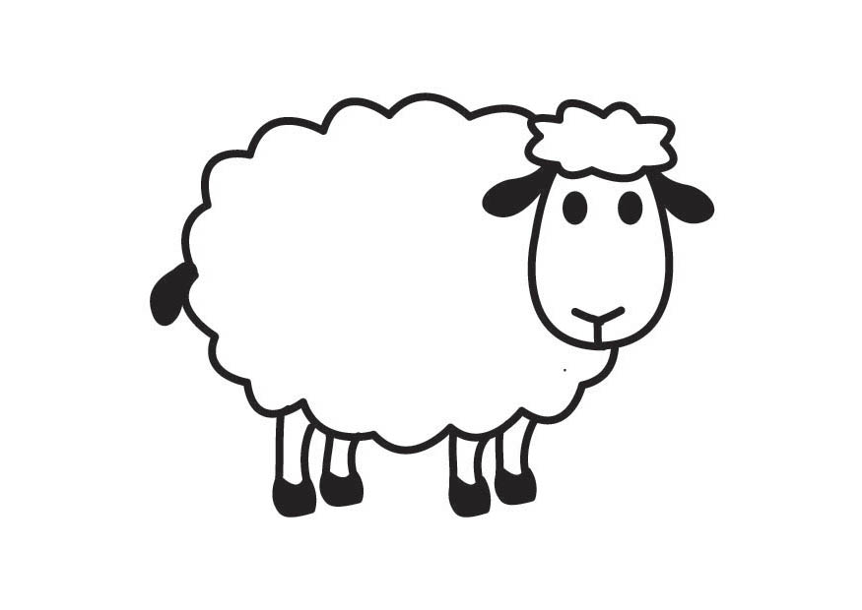
Lexical semantics
Animal
IS-A
Mammal
“Sheep”
IS-A
Wool
HAS
Four
legs
HAS

Slide 7
Formal semantics
A contrast to distributional semantics
Formal semantics
  models the relationship between language and the world in formal logical terms
  defines meaning in terms of this model
The lexicon is defined as mappings from words to structured, conceptual knowledge

Slide 8
Complementary
Distributional semantics is based on statistics, formal semantics on formal mathematics
Distributional semantics is differential, lexical semantics is referential
Distributional semantics is based on large corpora, lexical semantics (more often) on structured lexicons
Gathering a corpus is easier than building a lexicon and grammar

Slide 9
Lack of grounding
One criticism of distributional approaches is that they lack grounding in real world knowledge
Consider the task of finding semantic features for sheep – which of these approaches are grounded?
  Generated by psychology students (McRae, 2005):
    have four legs, say “Baah”, have wool
  Generated from texts using a rule based approach (Barbu, 2009):
    live on farms, graze, get scrapie
  Words found close to “sheep” in Bing, via WebCorp (collocates):
    society, wool, association, breed… … electric
References:
McCrae et al 2005, Semantic feature production norms for a large set of living and nonliving things, https://doi.org/10.3758/bf03192726
Barbu, 2010, Extracting conceptual structures from multiple sources, PhD thesis, University of Trento
http://www.webcorp.org.uk/live/

Slide 10
Representing context

Slide 11
Collocations
VE: The authors compared the efficacy of olanzapine and lithium in the prevention of mood
nd received open-label co-treatment with olanzapine and lithium for 6-12 weeks. Those meet
in Pharmacokinet. 1999 Sep;37(3):177-93. Olanzapine. Pharmacokinetic and pharmacodynamic p
patients with schizophrenia confirm that olanzapine is a novel antipsychotic agent with br
d with traditional antipsychotic agents, olanzapine causes a lower incidence of extrapyram
urbation of prolactin levels. Generally, olanzapine is well tolerated. The pharmacokinetic
okers and men have a higher clearance of olanzapine than women and nonsmokers. After admin
rred between olanzapine and alcohol, and olanzapine and imipramine, implying that patients
:485-92. doi: 10.1192/bjp.bp.107.037903. Olanzapine for the treatment of borderline person
o evaluate treatment with variably dosed olanzapine in individuals with borderline persona
double-blind trial, individuals received olanzapine (2.5-20 mg/day; n=155) or placebo (n=1
rried-forward methodology. RESULTS: Both olanzapine and placebo groups showed significant
p. CONCLUSIONS: Individuals treated with olanzapine and placebo showed significant but not
he types of adverse events observed with olanzapine treatment appeared similar to those ob
is study compared three dosage ranges of olanzapine (5 +/- 2.5 mg/day [Olz-L], 10 +/- 2.5
Collocates from www.webcorp.org.uk
Restricted to *.ncbi.nlm.nih.gov (i.e. mostly PubMed abstracts)

Slide 12
Contexts as matrices
Build matrices of event frequencies, where events are words in documents
  Row: words (or terms)
  Column: colocated words (or documents or sentences, or....)
This is very similar to bag of words, with the bag represented as a row (vector)
The row gives a “signature” of the word / term
Sequential information is lost (at least in the simplest models)
The matrix will be sparse

Slide 13
Word-Word matrices
 | treatment | mg | anti- psychotic | placebo | patients
olanzapine | 110 | 86 | 76 | 75 | 73
Top 5 collocates for olanzapine
Collocates four to the left and right, from www.webcorp.org.uk
Restricted to *.ncbi.nlm.nih.gov (i.e. mostly PubMed abstracts)
Normalised to collocates per 1000 hits

Slide 14
Word-Word matrices
 | treatment | mg | anti- psychotic | placebo | patients
olanzapine | 110 | 86 | 76 | 75 | 73
clozapine | 70 | 30 | 78 | 0 | 89

Slide 15
Word-Word matrices
 | treatment | mg | anti- psychotic | placebo | patients
olanzapine | 110 | 86 | 76 | 75 | 73
clozapine | 70 | 30 | 78 | 0 | 89
vinegar | 15 | 0 | 0 | 0 | 0

Slide 16
Word-Word matrices
 | treatment | mg | anti- psychotic | placebo | patients | balsamic
olanzapine | 110 | 86 | 76 | 75 | 73 | 0
clozapine | 70 | 30 | 78 | 0 | 89 | 0
vinegar | 15 | 0 | 0 | 0 | 0 | 109

Slide 17
Relatedness
Semantic spaces
100
75
antipsychotic
50
25
 | treatment | anti- psychotic
olanzapine | 110 | 76
clozapine | 70 | 78
vinegar | 15 | 0
0
0
25
50
75
100
treatment

Slide 18
Relatedness
Semantic spaces
100
olanzapine
75
antipsychotic
50
25
 | treatment | anti- psychotic
olanzapine | 110 | 76
clozapine | 70 | 78
vinegar | 15 | 0
0
0
25
50
75
100
treatment

Slide 19
Relatedness
Semantic spaces
100
clozapine
olanzapine
75
antipsychotic
50
25
 | treatment | anti- psychotic
olanzapine | 110 | 76
clozapine | 70 | 78
vinegar | 15 | 0
0
0
25
50
75
100
treatment

Slide 20
Relatedness
Semantic spaces
100
clozapine
olanzapine
75
antipsychotic
50
25
 | treatment | anti- psychotic
olanzapine | 110 | 76
clozapine | 70 | 78
vinegar | 15 | 0
0
vinegar
0
25
50
75
100
treatment

Slide 21
Relatedness
Semantic spaces
100
clozapine
olanzapine
75
antipsychotic
50
25
 | treatment | anti- psychotic
olanzapine | 110 | 76
clozapine | 70 | 78
vinegar | 15 | 0
0
vinegar
0
25
50
75
100
treatment

Slide 22
Relatedness
Semantic spaces
100
clozapine
olanzapine
75
antipsychotic
50
25
 | treatment | anti- psychotic
olanzapine | 110 | 76
clozapine | 70 | 78
vinegar | 15 | 0
0
vinegar
0
25
50
75
100
treatment

Slide 23
Semantic vectors
Our vectors capture something about the context, and therefore the meaning, of words
They could potentially be used to replace words in any NLP, so that instead of the word, we would manipulate or classify the vector representation of the word
The simple result we have shown would create very sparse, crude vectors
In reality, we use more sophisticated techniques

Slide 24
Tools for the job
Rationalist NLP – facetiously referred to as armchair linguistics
  Needs an armchair, within which to dream up examples and rules that match those examples
Empirical NLP
  Needs a pile of documents (corpus)
  And a representation
What about the algorithm to classify our words in representation space? Are they important?

Slide 25
Thank you.
Any questions?
angus.roberts@kcl.ac.uk

