Slide 1

Multi-Layer Neural Networks BHI Youth Awards

Slide 2
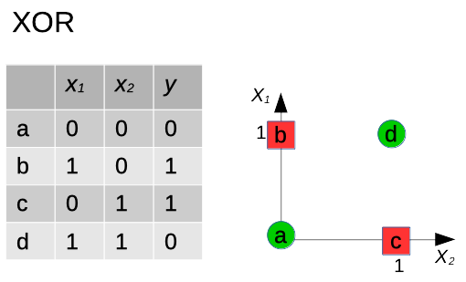
XOR is not linearly separable

Slide 3
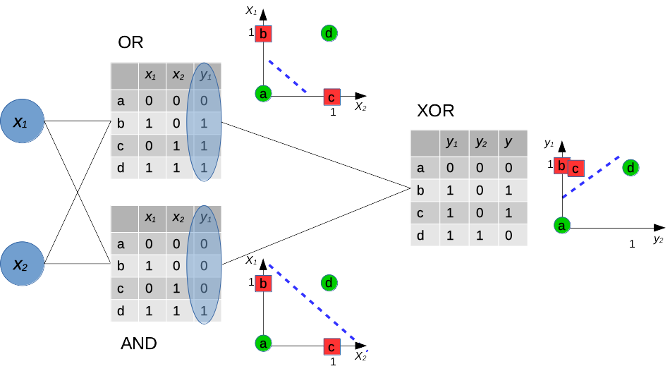
Solving a non-linear problem

Slide 4
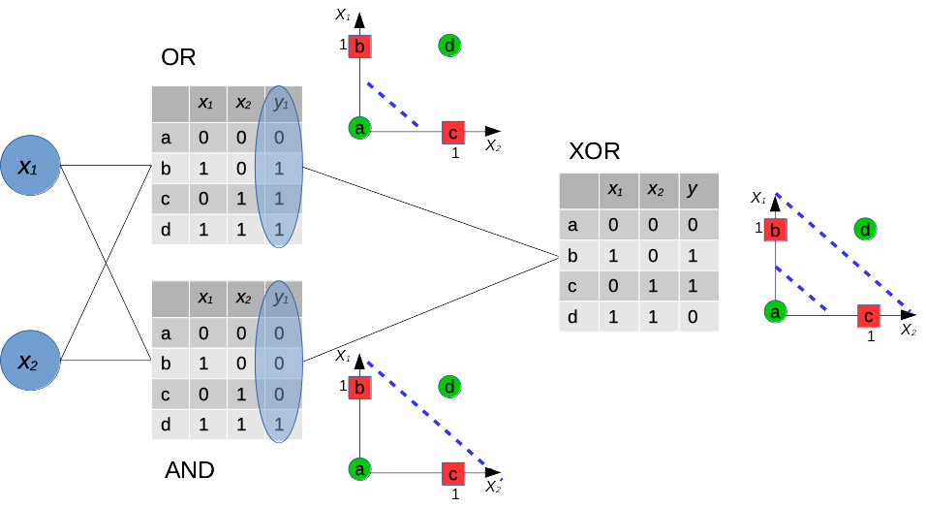
Solving a non-linear problem

Slide 5
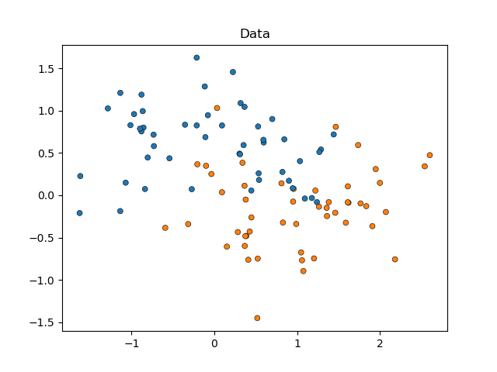
A single perceptron can only model linearly separable problems
1
Dog
Bull shark
Cat
Placental
Pigeon
Lizard
0
Lactates
1
Solvable with 12 parameters (weights)

Slide 6
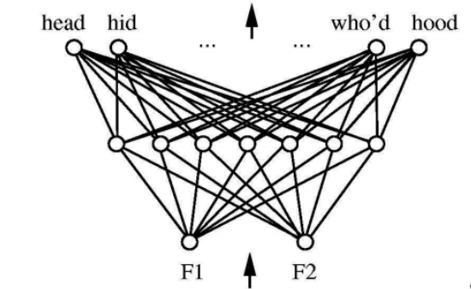
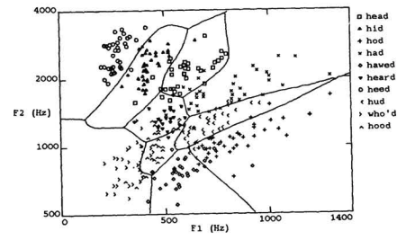
More complex problems: hidden layers
Two layers
100 nodes
1200 parameters (estimate)
Credit: Huang & Lippmann, NIPS 1988

Slide 7
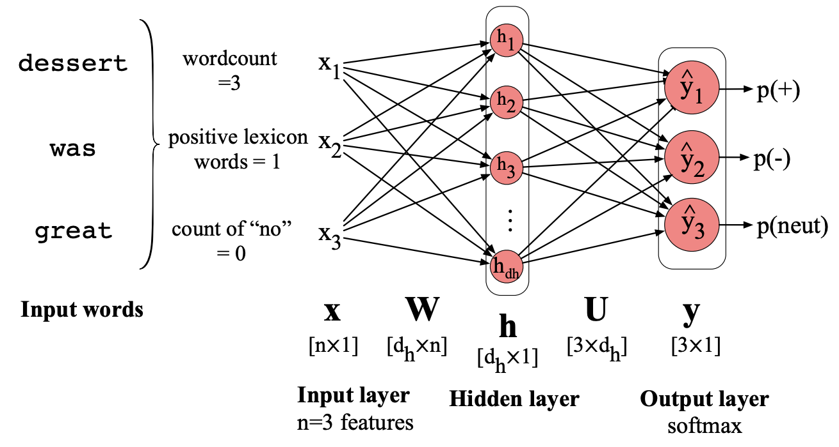
How do we model language in a neural network?
What other numeric representation could we use? What would its advantage be?
We learn the weights. These provide a representation that will map input to output.
(Jurafsky and Martin, Fig. 7.10)

Slide 8
Thank you
angus.roberts@kcl.ac.uk https://www.kcl.ac.uk/people/angus-roberts

