Slide 1

Neural Networks BHI Youth Awards

Slide 2
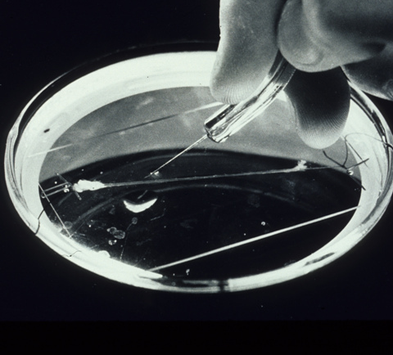
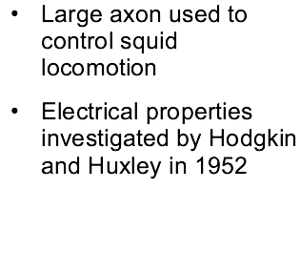
Giant squid axon

Slide 3
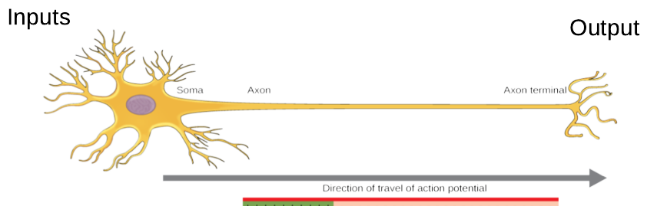
Input and output

Slide 4
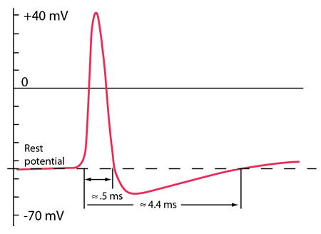
Action potential

Slide 5




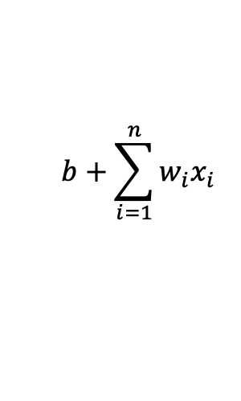




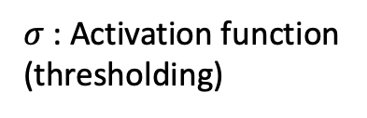
A single perceptron (artificial neuron)
$$x_{2}$$
$$x_{1}$$
$$w_{1}$$
$$w_{2}$$
Other features
(dimensions)
. . . . . .
$$x_{n}$$
$$w_{n}$$
$$b+\sum_{i=1}^{n}{w_{i}x_{i}}$$
$$o$$
$$σ$$
1
$σ$: Activation function
(thresholding)
bias

Slide 6
A single perceptron (artificial neuron)
 | x₁ Placental | x₂ Lactates | y (output) Mammal
Dog | 1 | 1 | 1
Cat | 1 | 1 | 1
Bull shark | 1 | 0 | 0
Pigeon | 0 | 1 | 0
Lizard | 0 | 0 | 0
$$w_{1}$$
$$w_{2}$$
Other features
(dimensions)
. . . . . .
$$x_{n}$$
$$w_{n}$$
$$b+\sum_{i=1}^{n}{w_{i}x_{i}}$$
$$o$$
$$σ$$
1
$σ$: Activation function
(thresholding)
bias

Slide 7

A single perceptron (artificial neuron)
 | x₁ Placental | x₂ Lactates | y (output) Mammal
Dog | 1 | 1 | 1
Cat | 1 | 1 | 1
Bull shark | 1 | 0 | 0
Pigeon | 0 | 1 | 0
Lizard | 0 | 0 | 0
$${Δw}_{i}=η(y−o)x_{i}$$
$$w_{1}$$
$$w_{2}$$
Other features
(dimensions)
. . . . . .
$$x_{n}$$
$$w_{n}$$
$$b+\sum_{i=1}^{n}{w_{i}x_{i}}$$
$$o$$
$$σ$$
1
$σ$: Activation function
(thresholding)
bias

Slide 8

A single perceptron (artificial neuron)
 | x₁ Placental | x₂ Lactates | y (output) Mammal
Dog | 1 | 1 | 1
Cat | 1 | 1 | 1
Bull shark | 1 | 0 | 0
Pigeon | 0 | 1 | 0
Lizard | 0 | 0 | 0
$${Δw}_{i}=η(y−o)x_{i}$$
$$w_{1}$$
$$w_{2}$$
$${w_{i}{←w}_{i}+Δw}_{i}$$
Other features
(dimensions)
. . . . . .
$$x_{n}$$
$$w_{n}$$
$$b+\sum_{i=1}^{n}{w_{i}x_{i}}$$
$$o$$
$$σ$$
1
$σ$: Activation function
(thresholding)
bias

Slide 9

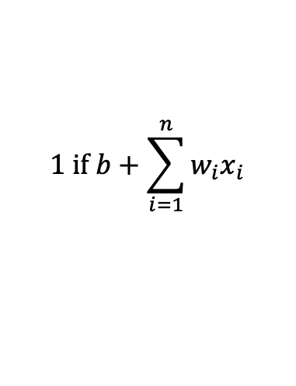


Representational power of a perceptron
$$1 if b+\sum_{i=1}^{n}{w_{i}x_{i}}$$
1
Dog
O =
Bull shark
Cat
0 otherwise
Placental
For a two parameter problem, the decision boundary is given by:
Pigeon
Lizard
0
Lactates
1
$$1 if b+w_{1}x_{1}+w_{2}x_{2}>0$$
$$w_{1}x_{1}+w_{2}x_{2}=−b$$
$$x_{2}=−\frac{w_{1}}{w_{2}}x_{1}−\frac{b}{w_{2}}$$
i.e. a perceptron can only represent linearly separable problems.

Slide 10
Some linearly separable problems
AND
1
b
d
 | x₁ | x₂ | o
a | 0 | 0 | 0
b | 0 | 1 | 0
c | 1 | 0 | 0
d | 1 | 1 | 1
x₁
a
c
0
x₂
1
OR
1
b
d
 | x₁ | x₂ | o
a | 0 | 0 | 0
b | 0 | 1 | 1
c | 1 | 0 | 1
d | 1 | 1 | 1
x₁
a
c
0
x₂
1

Slide 11
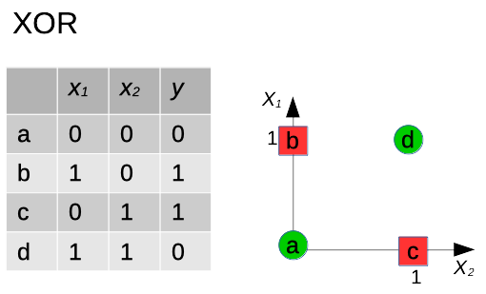
XOR is not linearly separable

Slide 12
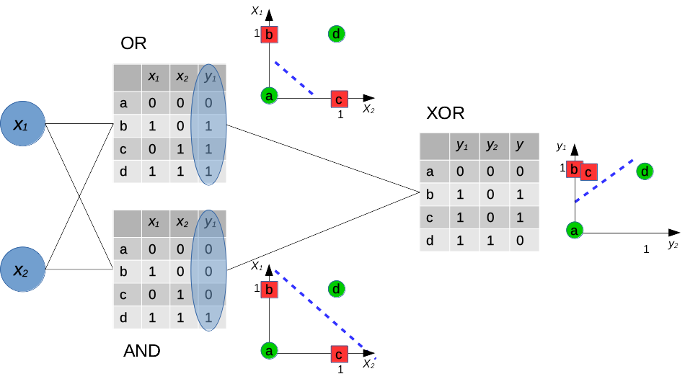
Solving a non-linear problem

Slide 13
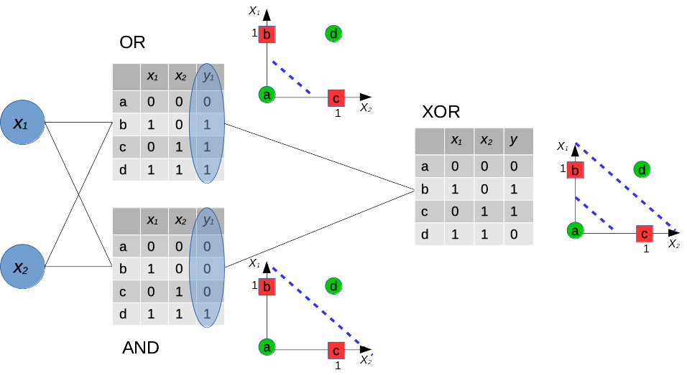
Solving a non-linear problem

Slide 14
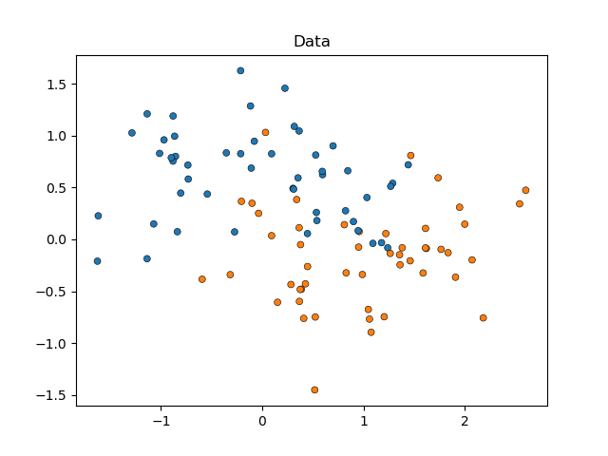
A single perceptron can only model linearly separable problems
1
Dog
Bull shark
Cat
Placental
Pigeon
Lizard
0
Lactates
1
Solvable with 12 parameters (weights)

Slide 15
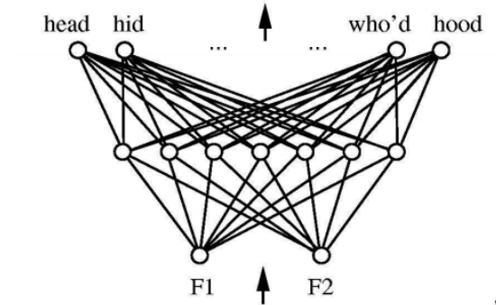
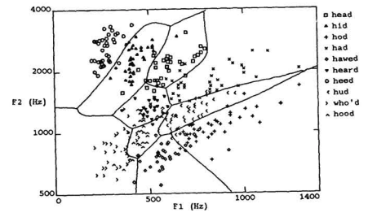
More complex problems: hidden layers
Two layers
100 nodes
1200 parameters (estimate)
Credit: Huang & Lippmann, NIPS 1988

Slide 16
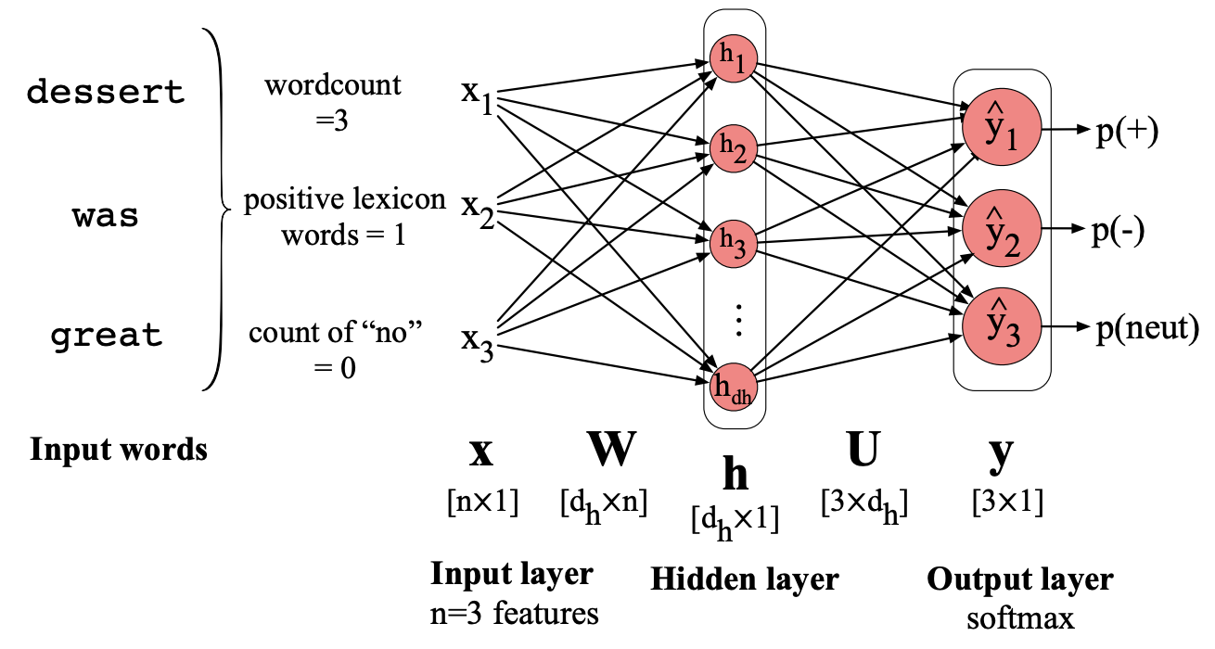
How do we model language in a neural network?
What other numeric representation could we use? What would its advantage be?
We learn the weights. These provide a representation that will map input to output.
(Jurafsky and Martin, Fig. 7.10)

Slide 17
Thank you
angus.roberts@kcl.ac.uk https://www.kcl.ac.uk/people/angus-roberts

