Slide 1

Generative models BHI Youth Awards

Slide 2
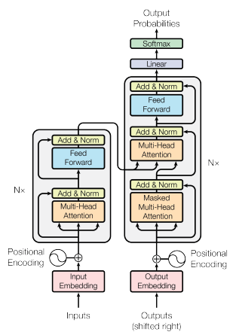
A more complex architecture - the Transformer
See “Attention Is All You Need”, Vaswani et al, NIPS 2017 (127000 citations)
Produces probability distributions across the entire vocabulary
Has proved to be flexible and scalable
Power comes from number of parameters and size of training corpus
The encoder and decoder weights are models of language
Can be reused in other tasks
………..
Output at each step is a probability distribution over our entire vocabulary

Slide 3
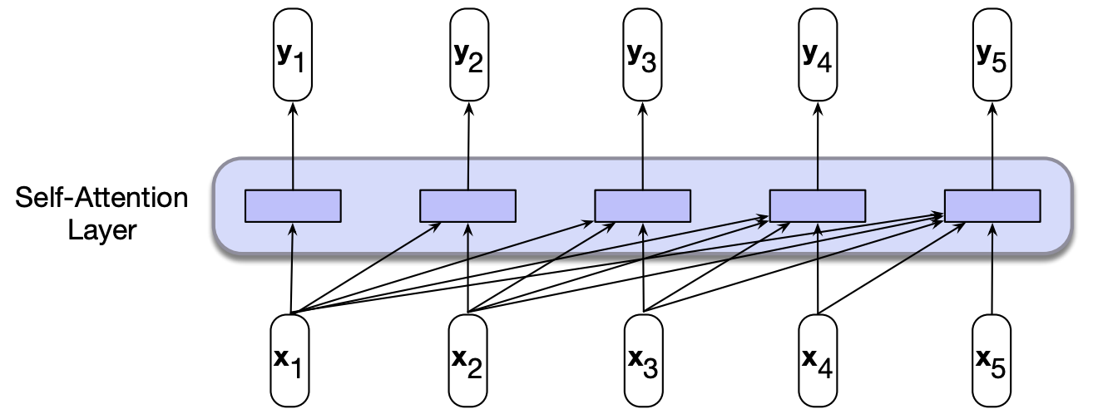
Self-attention – encoding word context and word order
Self-attention allows a network to extract information from arbitrary context lengths
Attention compares (scores) each input to the preceding ones, to reveal their relevance
Scores are softmaxed and used to weight inputs to predict y
The model learns how to weight different parts of the context
At each input, model has access to all inputs prior to this one.
Many models are bi-directional, so access all inputs after this one too
Each input computation is independent of others, so can be parallelized
(Jurafsky and Martin, Fig. 9.15)

Slide 4
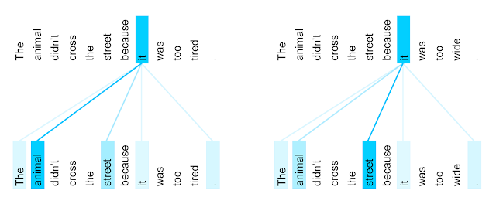
Self-attention – example distribution
The encoder self-attention distribution for the word “it” from the 5th to the 6th layer of a Transformer trained on English to French translation (one of eight attention heads).
Credit: https://research.google/blog/transformer-a-novel-neural-network-architecture-for-language-understanding/

Slide 5
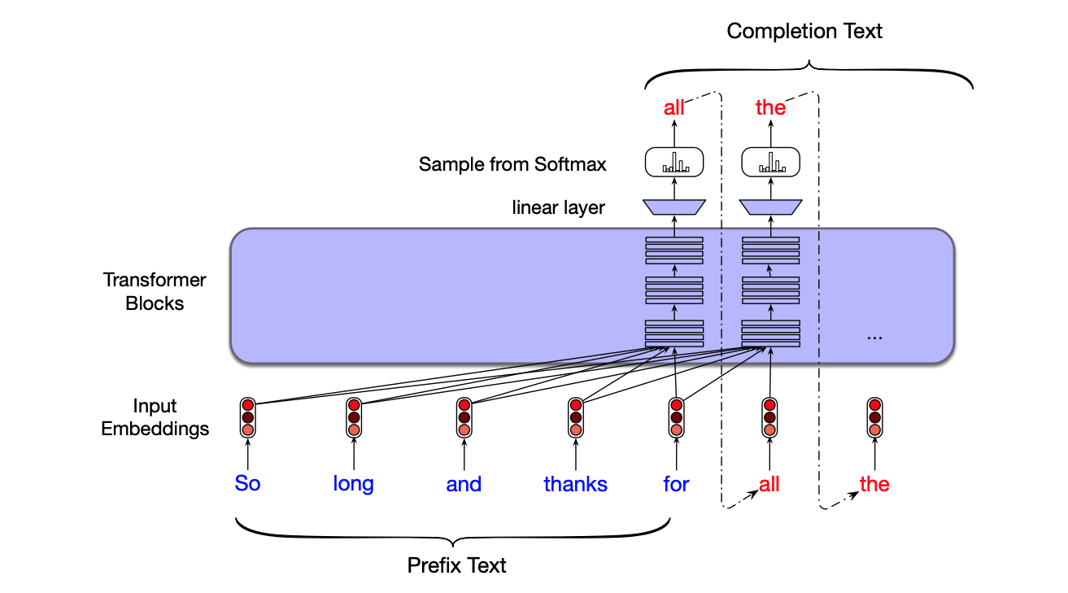

Completing text
Task: predict the next word
Output at each step is a probability distribution over our entire vocabulary. We could choose the word with the greatest probability:
More sophisticated sampling strategies are possible
$W_{t}={argmax}_{W}(P\left(W \right| W_{1:t−1}$))

Slide 6
Using text completion for practical NLP tasks
Sentence classification:
select the classification with the highest probability:
P(positive|The sentiment of the sentence “Such a good movie!” is:)
P(negative|The sentiment of the sentence “Such a good movie!” is:)
Question answering:
P(w|Q: Who wrote the book “The Origin of Species”? A:)
Choose the next most probable word and ask:
P(w|Q: Who wrote the book “The Origin of Species”? A: Charles)

Slide 7
Large Language Models
 | BERT | GPT | GPT2 | GPT3 | GPT4
Model layer | Encoder | Decoder | Decoder | Decoder | Decoder
Pre-training task | MLM, NSP | Text generation | + task conditioning | + in-context patterns
Training data | 3.3 billion words | 7000 books | 40 GB | 45 TB | 1 PB ?
Context window | 512 | 512 | 1024 | 2048 | 8000 – 32000 ?
Parameters | 110 M | 117 M | 1.5 B | 175 B | 1 T ?
Suitability | Sequence tasks | Generation | Generation | Generation, adaptable | Generation, adaptable
Availability | Open | Open | Open | Limited, API | Limited, API
Cost
Efficiency
Performance? Biases?

Slide 8
Thank you
angus.roberts@kcl.ac.uk https://www.kcl.ac.uk/people/angus-roberts

