Slide 1

ROS Basics
ROS offers a message passing interface that provides inter-process communication.
A ROS system is composed of nodes, which pass messages, usually in two forms:
1. ROS messages are published on topics and are many-to-many.
2. ROS services are used for synchronous request/response.

Slide 2
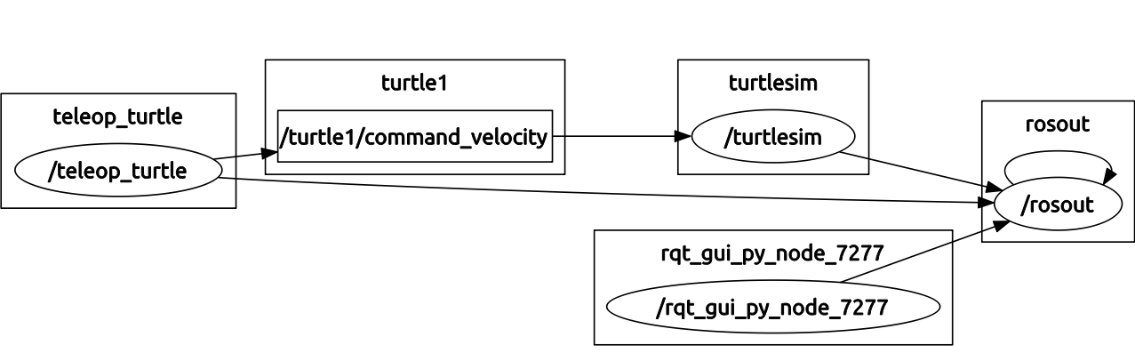
ROS Basics
ROS offers a message passing interface that provides inter-process communication.
A ROS system is composed of nodes, which pass messages, usually in two forms:
1. ROS messages are published on topics and are many-to-many.
2. ROS services are used for synchronous request/response.

Slide 3
ROS Basics
ROS offers a message passing interface that provides inter-process communication.
A ROS system is composed of nodes, which pass messages, usually in two forms:
1. ROS messages are published on topics and are many-to-many.
2. ROS services are used for synchronous request/response.
<launch>
<include file="$(find turtlebot_navigation)/launch/includes/velocity_smoother.launch.xml"/>
<include file="$(find turtlebot_navigation)/launch/includes/safety_controller.launch.xml"/>
<arg name="global_frame_id" default="map"/>
<arg name="odom_topic" default="odom" />
<arg name="laser_topic" default="scan" />
<node pkg="move_base" type="move_base" respawn="false" name="move_base" output="screen">
<rosparam file="$(find turtlebot_navigation)/param/costmap_common_params.yaml" command="load" ns="global_costmap" />
<rosparam file="$(find turtlebot_navigation)/param/costmap_common_params.yaml" command="load" ns="local_costmap" />
<rosparam file="$(find turtlebot_navigation)/param/local_costmap_params.yaml" command="load" />
<remap from="cmd_vel" to="navigation_velocity_smoother/raw_cmd_vel"/>
<remap from="odom" to="$(arg odom_topic)"/>
<remap from="scan" to="$(arg laser_topic)"/>
</node>
</launch>

Slide 4
ROS Basics
ROS offers a message passing interface that provides inter-process communication.
A ROS system is composed of nodes, which pass messages, usually in two forms:
1. ROS messages are published on topics and are many-to-many.
2. ROS services are used for synchronous request/response.
The actionlib package standardizes the interface for pre-emptable tasks.
For example:
- navigation,
- performing a laser scan
- detecting the handle of a door...
Aside from numerous tools, Actionlib provides standard messages for sending task:
- goals
- feedback
- result

Slide 5
ROS Basics
Aside from numerous tools, Actionlib provides standard messages for sending task:
- goals
- feedback
- result
move_base/MoveBaseGoal
geometry_msgs/PoseStamped target_pose
std_msgs/Header header
uint32 seq
time stamp
string frame_id
geometry_msgs/Pose pose
geometry_msgs/Point position
float64 x
float64 y
float64 z
geometry_msgs/Quaternion orientation
float64 x
float64 y
float64 z
float64 w

Slide 6
ROSPlan Basics
The ROSPlan package provides a standard interface for PDDL planners in ROS.
The purpose of the ROSPlan package is to integrate planners within a ROS system without having to write an architecture from scratch.
knowledge_base
planner
problem_generation
plan_parser
plan_dispatcher

Slide 7
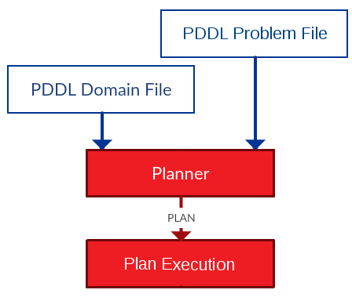
Plan Execution 1: Very simple Dispatch
The most basic structure.
- The plan is generated.
- The plan is executed.

Slide 8
Plan Execution 1: Very simple Dispatch
The most basic structure.
- The plan is generated.
- The plan is executed.
The red boxes are included in ROSPlan. They correspond to ROS nodes.
The domain and problem file can be supplied
- in launch parameters
- as ROS service parameters

Slide 9
Plan Execution 1: Very simple Dispatch
rosplan_dispatch_msgs/CompletePlan
ActionDispatch[] plan
int32 action_id
string name
diagnostic_msgs/KeyValue[] parameters
string key
string value
float32 duration
float32 dispatch_time

Slide 10
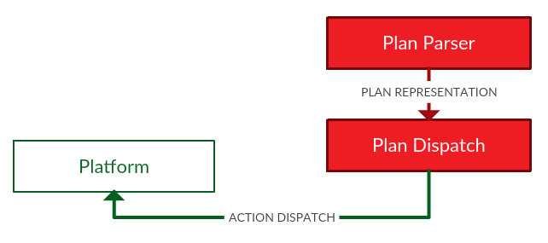
Dispatch Loop without feedback
How does the “Plan Execution” ROS node work? There are multiple variants:
- simple sequential execution
- timed execution
- Petri-Net plans
- Conditional Contingent Temporal Constraint Network.
- etc.

Slide 11
Dispatch Loop without feedback
How does the “Plan Execution” ROS node work? There are multiple variants:
- simple sequential execution
1. Take the next action from the plan.
2. Send the action to control.
3. Wait for the action to complete.
4. GOTO 1.

Slide 12
Dispatch Loop without feedback
How does the “Plan Execution” ROS node work? There are multiple variants:
- simple sequential execution
1. Take the next action from the plan.
2. Send the action to control.
3. Wait for the action to complete.
4. GOTO 1.
An action in the plan is stored as a ROS message ActionDispatch, which corresponds to a PDDL action.

Slide 13
Dispatch Loop without feedback
How does the “Plan Execution” ROS node work? There are multiple variants:
- simple sequential execution
1. Take the next action from the plan.
2. Send the action to control.
3. Wait for the action to complete.
4. GOTO 1.
The ActionDispatch message is received by a listening interface node, and becomes a goal for control.

Slide 14
Dispatch Loop without feedback
How does the “Plan Execution” ROS node work? There are multiple variants:
- simple sequential execution
1. Take the next action from the plan.
2. Send the action to control.
3. Wait for the action to complete.
4. GOTO 1.
0.000: (goto_waypoint wp0) [10.000]
10.01: (observe ip3) [5.000]
15.02: (grasp_object box4) [60.000]
move_base/MoveBaseGoal
geometry_msgs/PoseStamped target_pose
std_msgs/Header header
...
geometry_msgs/Pose pose
geometry_msgs/Point position
float64 x
float64 y
float64 z
geometry_msgs/Quaternion orientation
...
ActionDispatch
action_id = 0
name = goto_waypoint
diagnostic_msgs/KeyValue[] parameters
key = “wp”
value = “wp0”
duration = 10.000
dispatch_time = 0.000

Slide 15
Dispatch Loop without feedback
How does the “Plan Execution” ROS node work? There are multiple variants:
- simple sequential execution
1. Take the next action from the plan.
2. Send the action to control.
3. Wait for the action to complete.
4. GOTO 1.
Feedback is returned to the simple dispatcher (action success or failure) through a ROS message ActionFeedback.

Slide 16

Plan Execution Failure
This form of simple dispatch has some problems. The robot often exhibits zombie-like behaviour in one of two ways:
1. An action fails, and the recovery is handled by control.
2. The plan fails, but the robot doesn't notice.

Slide 17
Bad behaviour 1: Action Failure
An action might never terminate. For example:
- a navigation action that cannot find a path to its goal.
- a grasp action that allows retries.
At some point the robot must give up.

Slide 18
Bad behaviour 1: Action Failure
An action might never terminate. For example:
- a navigation action that cannot find a path to its goal.
- a grasp action that allows retries.
At some point the robot must give up.
If we desire persistent autonomy, then the robot must be able to plan again, from the new current state, without human intervention.
The problem file must be regenerated.

Slide 19
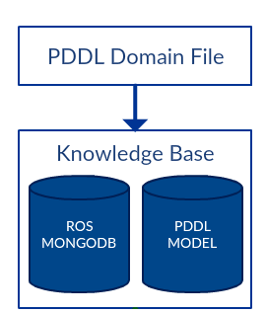
PDDL Model
To generate the problem file automatically, the agent must store a model of the world.
In ROSPlan, a PDDL model is stored in a ROS node called the Knowledge Base.

Slide 20
PDDL Model
To generate the problem file automatically, the agent must store a model of the world.
In ROSPlan, a PDDL model is stored in a ROS node called the Knowledge Base.
rosplan_knowledge_msgs/KnowledgeItem
uint8 INSTANCE=0
uint8 FACT=1
uint8 FUNCTION=2
uint8 knowledge_type
string instance_type
string instance_name
string attribute_name
diagnostic_msgs/KeyValue[] values
string key
string value
float64 function_value
bool is_negative

Slide 21
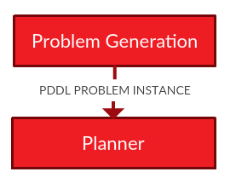
PDDL Model
To generate the problem file automatically, the agent must store a model of the world.
In ROSPlan, a PDDL model is stored in a ROS node called the Knowledge Base.
From this the initial state of a new planning problem can be created.
ROSPlan contains a node which will generate a problem file for the ROSPlan planning node.

Slide 22
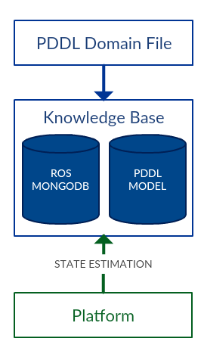
PDDL Model
The model must be continuously updated from sensor data.
For example a new ROS node:
1. subscribes to odometry data.
2. compares odometry to waypoints from the PDDL model.
3. adjusts the predicate (robot_at ?r ?wp) in the Knowledge Base.

Slide 23
PDDL Model
The model must be continuously updated from sensor data.
For example a new ROS node:
1. subscribes to odometry data.
2. compares odometry to waypoints from the PDDL model.
3. adjusts the predicate (robot_at ?r ?wp) in the Knowledge Base.
nav_msgs/Odometry
std_msgs/Header header
string child_frame_id
geometry_msgs/PoseWithCovariance pose
geometry_msgs/Pose pose
geometry_msgs/Point position
geometry_msgs/Quaternion orientation
float64[36] covariance
geometry_msgs/TwistWithCovariance twist
geometry_msgs/Twist twist
geometry_msgs/Vector3 linear
geometry_msgs/Vector3 angular
float64[36] covariance
rosplan_knowledge_msgs/KnowledgeItem
uint8 INSTANCE=0
uint8 FACT=1
uint8 FUNCTION=2
uint8 knowledge_type
string instance_type
string instance_name
string attribute_name
diagnostic_msgs/KeyValue[] values
string key
string value
float64 function_value
bool is_negative

Slide 24
Bad Behaviour 2: Plan Failure
What happens when the actions succeed, but the plan fails?
This can't always be detected by lower level control.

Slide 25
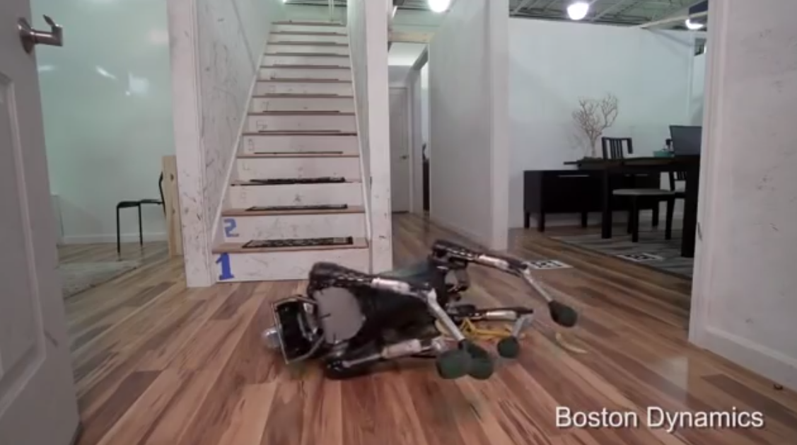
Bad Behaviour 2: Plan Failure
What happens when the actions succeed, but the plan fails?
This can't always be detected by lower level control.
PLAN COMPLETE

Slide 26
Bad Behaviour 2: Plan Failure
There should be diagnosis at the level of the plan.
If the plan will fail in the future, the robot should not continue to execute the plan for a long time without purpose.

Slide 27
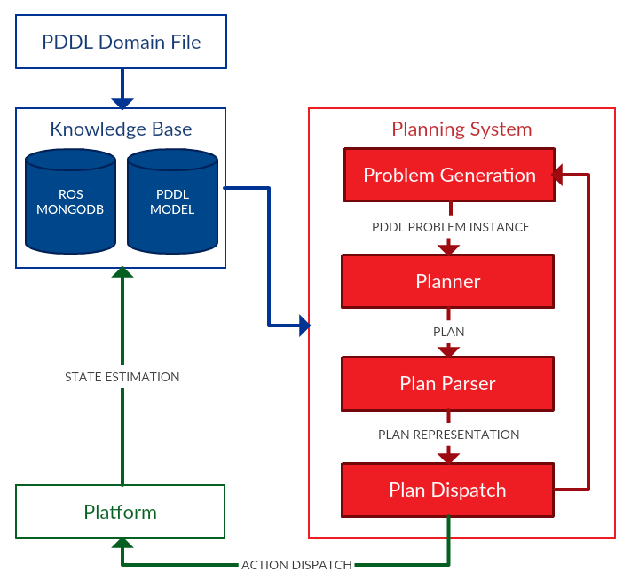
Bad Behaviour 2: Plan Failure
There should be diagnosis at the level of the plan.
If the plan will fail in the future, the robot should not continue to execute the plan for a long time without purpose.

Slide 28
Bad Behaviour 2: Plan Failure
The AUV plans for inspection missions, recording images of pipes and welds.
It navigates through a probabilistic roadmap. The environment is uncertain, and the roadmap might not be correct.

Slide 29
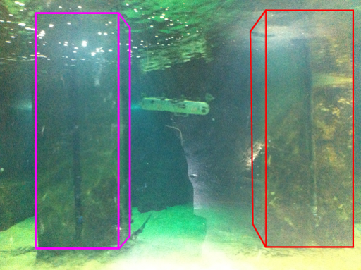
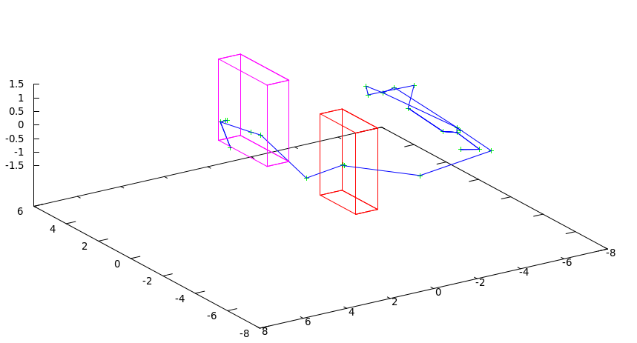
Bad Behaviour 2: Plan Failure
The plan is continuously validated against the model.
The planned inspection path is shown on the right. The AUV will move around to the other side of the pillars before inspecting the pipes on their facing sides.
After spotting an obstruction between the pillars, the AUV should re-plan early.

Slide 30
Bad Behaviour 2: Plan Failure
The plan is continuously validated against the model.
A_{E}
A_{S}
INV
P_{E}
P_{S}
(
)
E_{S}
E_{E}
B_{S}
B_{E}
C_{S}
C_{E}
PDDL MODEL

Slide 31
Bad Behaviour 2: Plan Failure
The plan is continuously validated against the model.
A_{E}
A_{S}
INV
P_{E}
P_{S}
(
)
E_{S}
E_{E}
B_{S}
B_{E}
C_{S}
C_{E}
PDDL MODEL

Slide 32
Bad Behaviour 2: Plan Failure
The plan is continuously validated against the model.
A_{E}
A_{S}
INV
P_{E}
P_{S}
(
)
E_{S}
E_{E}
B_{S}
B_{E}
C_{S}
C_{E}
PDDL MODEL

Slide 33

Bad Behaviour 2: Plan Failure
ROSPlan validates using VAL. [Fox et al. 2005]

Slide 34
ROSPlan: Default Configuration
Now the system is more complex:
- PDDL model is continuously updated from sensor data.
- problem file is automatically generated.

Slide 35
ROSPlan: Default Configuration
Now the system is more complex:
- PDDL model is continuously updated from sensor data.
- problem file is automatically generated.
- the planner generates a plan.
- the plan is dispatched action-by-action.

Slide 36
ROSPlan: Default Configuration
Now the system is more complex:
- PDDL model is continuously updated from sensor data.
- problem file is automatically generated.
- the planner generates a plan.
- the plan is dispatched action-by-action.
- feedback on action success and failure.
- the plan is validated against the current model.

Slide 37
Plan Execution 2: Very Simple Temporal Dispatch
The real world requires a temporal and numeric model:
- time and deadlines,
- battery power and consumption,
- direction of sea current, or traffic flow.
What happens when we add temporal constraints, and try to dispatch the plan as a sequence of actions?

Slide 38
Plan Execution 2: Very Simple Temporal Dispatch
The real world requires a temporal and numeric model:
- time and deadlines,
- battery power and consumption,
- direction of sea current, or traffic flow.
What happens when we add temporal constraints, and try to dispatch the plan as a sequence of actions?

Slide 39
Plan Execution 2: Very Simple Temporal Dispatch
The real world requires a temporal and numeric model:
- time and deadlines,
- battery power and consumption,
- direction of sea current, or traffic flow.
What happens when we add temporal constraints, and try to dispatch the plan as a sequence of actions?

Slide 40
Plan Execution 2: Very Simple Temporal Dispatch
The real world requires a temporal and numeric model:
- time and deadlines,
- battery power and consumption,
- direction of sea current, or traffic flow.
What happens when we add temporal constraints, and try to dispatch the plan as a sequence of actions?

Slide 41

Plan Execution 2: Very Simple Temporal Dispatch
The real world requires a temporal and numeric model:
- time and deadlines,
- battery power and consumption,
- direction of sea current, or traffic flow.
What happens when we add temporal constraints, and try to dispatch the plan as a sequence of actions?
The plan is not only less efficient, but it may become incorrect and unsafe!

Slide 42
Plan Execution 2: Very Simple Temporal Dispatch
The real world requires a temporal and numeric model:
- time and deadlines,
- battery power and consumption,
- direction of sea current, or traffic flow.
What happens when we add temporal constraints, and try to dispatch the plan as a sequence of actions?
The plan is not only less efficient, but it may become incorrect and unsafe!
The plan execution loop could instead dispatch actions at their estimated timestamps.

Slide 43
Temporal Constraints
The plan execution loop could instead dispatch actions at their estimated timestamps.
However, in the real world there are many uncontrollable durations and events. The estimated duration of actions is rarely accurate.
0.000: (goto_waypoint wp1) [10.0]
10.01: (goto_waypoint wp2) [14.3]
24.32: clean_chain wp2) [60.0]

Slide 44
Temporal Constraints
The plan execution loop could instead dispatch actions at their estimated timestamps.
However, in the real world there are many uncontrollable durations and events. The estimated duration of actions is rarely accurate.
0.000: (goto_waypoint wp1) [10.0]
10.01: (goto_waypoint wp2) [14.3]
24.32: clean_chain wp2) [60.0]

Slide 45
Temporal Constraints
The plan execution loop could instead dispatch actions at their estimated timestamps.
However, in the real world there are many uncontrollable durations and events. The estimated duration of actions is rarely accurate.
0.000: (goto_waypoint wp1) [10.0]
10.01: (goto_waypoint wp2) [14.3]
24.32: clean_chain wp2) [60.0]

Slide 46
Temporal Constraints
The plan execution loop could instead dispatch actions at their estimated timestamps.
However, in the real world there are many uncontrollable durations and events. The estimated duration of actions is rarely accurate.
0.000: (goto_waypoint wp1) [10.0]
10.01: (goto_waypoint wp2) [14.3]
24.32: clean_chain wp2) [60.0]

Slide 47
Temporal Constraints
The plan execution loop could instead dispatch actions at their estimated timestamps.
However, in the real world there are many uncontrollable durations and events. The estimated duration of actions is rarely accurate.
The plan execution loop could dispatch actions, while respecting the causal ordering between actions.
0.000: (goto_waypoint wp1) [10.0]
10.01: (goto_waypoint wp2) [14.3]
24.32: clean_chain wp2) [60.0]

Slide 48
Temporal Constraints
The plan execution loop could instead dispatch actions at their estimated timestamps.
However, in the real world there are many uncontrollable durations and events. The estimated duration of actions is rarely accurate.
The plan execution loop could dispatch actions, while respecting the causal ordering between actions.
However, some plans require temporal coordination between actions, and the controllable durations might be very far apart.

Slide 49
Temporal Constraints
The plan execution loop could instead dispatch actions at their estimated timestamps.
However, in the real world there are many uncontrollable durations and events. The estimated duration of actions is rarely accurate.
The plan execution loop could dispatch actions, while respecting the causal ordering between actions.
However, some plans require temporal coordination between actions, and the controllable durations might be very far apart.

Slide 50
Temporal Constraints
The plan execution loop could instead dispatch actions at their estimated timestamps.
However, in the real world there are many uncontrollable durations and events. The estimated duration of actions is rarely accurate.
The plan execution loop could dispatch actions, while respecting the causal ordering between actions.
However, some plans require temporal coordination between actions, and the controllable durations might be very far apart.

Slide 51
Temporal Constraints
The plan execution loop could instead dispatch actions at their estimated timestamps.
However, in the real world there are many uncontrollable durations and events. The estimated duration of actions is rarely accurate.
The plan execution loop could dispatch actions, while respecting the causal ordering between actions.
However, some plans require temporal coordination between actions, and the controllable durations might be very far apart.

Slide 52
Temporal Constraints
observe_{s}
observe_{e}
goto_waypoint_{e}
goto_waypoint_{e}
illuminate_{s}
illuminate_{s}
goto_waypoint_{s}
The temporal plan in which every action and duration can be controlled could be represented as a Simple Temporal Network.
The real upper and lower bounds, and ordering constraints on actions can be represented explicitly.
With this representation, the system is able to dispatch actions at times to maintain the consistency of the STN.

Slide 53
Temporal Constraints
[0,-]
observe_{s}
observe_{e}
goto_waypoint_{e}
[5,-]
[2,-]
[0,-]
illuminate_{s}
[0,30]
illuminate_{s}
[0,-]
goto_waypoint_{e}
goto_waypoint_{s}
The temporal plan in which every action and duration can be controlled could be represented as a Simple Temporal Network.
The real upper and lower bounds, and ordering constraints on actions can be represented explicitly.
With this representation, the system is able to dispatch actions at times to maintain the consistency of the STN.

Slide 54
Temporal Constraints
[0,-]
observe_{s}
observe_{e}
goto_waypoint_{e}
[5,-]
[2,-]
[0,-]
illuminate_{s}
[0,30]
illuminate_{s}
[0,-]
goto_waypoint_{e}
goto_waypoint_{s}
The temporal plan with uncontrollable durations can also be represented as a Temporal Plan Network (TPN). [Vidal & Fargier 1999]

Slide 55
Temporal Constraints
[0,-]
observe_{s}
observe_{e}
goto_waypoint_{e}
[5,-]
[2,-]
[0,-]
illuminate_{s}
[0,30]
illuminate_{s}
[0,-]
goto_waypoint_{e}
goto_waypoint_{s}
The temporal plan with uncontrollable durations can also be represented as a Temporal Plan Network (TPN). [Vidal & Fargier 1999]
The time-points of a TPN are divided into activated time-points whose dispatch time can be chosen by the agent, and received time-points whose time is unpredictable.

Slide 56
Temporal Constraints
[0,-]
observe_{s}
observe_{e}
goto_waypoint_{e}
[5,-]
[2,-]
[0,-]
illuminate_{s}
[0,30]
illuminate_{s}
[0,-]
goto_waypoint_{e}
goto_waypoint_{s}
The temporal plan with uncontrollable durations can also be represented as a Temporal Plan Network (TPN). [Vidal & Fargier 1999]
The time-points of a TPN are divided into activated time-points whose dispatch time can be chosen by the agent, and received time-points whose time is unpredictable.
The Simple Temporal Problem under Uncertainty (STPU) described by a TPN might be strongly, weakly, or dynamically controllable. [Ciamatti, Micheli et al. 2016]

Slide 57
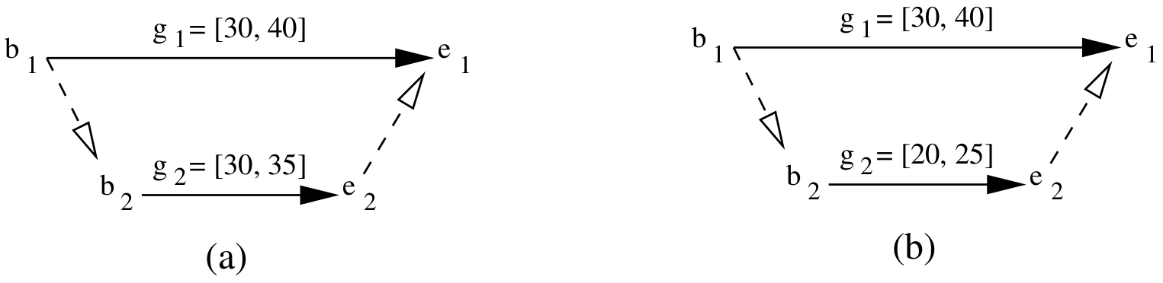
STPUs: Strong controllability
An STPU is strongly controllable iff:
- the agent can commit to a time for all activated time-points,
- such that for any possible time for received time points,
- the temporal constraints are not violated.

Slide 58


STPUs: Strong controllability
An STPU is strongly controllable iff:
- the agent can commit to a time for all activated time-points,
- such that for any possible time for received time points,
- the temporal constraints are not violated.
Setting t(b1) == t(b2) will always obey the temporal constraints.

Slide 59
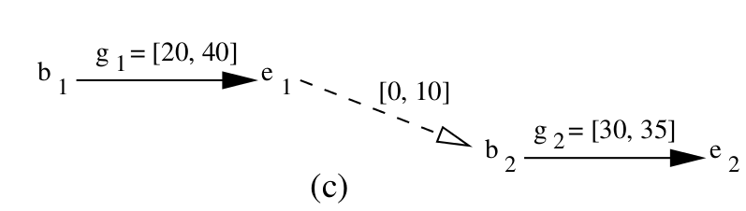
STPUs: Strong controllability
An STPU is strongly controllable iff:
- the agent can commit to a time for all activated time-points,
- such that for any possible time for received time points,
- the temporal constraints are not violated.
The STPU is not strongly controllable, but it is obviously executable.
We need dynamic controllability.

Slide 60
STPUs: Dynamic controllability
An STPU is dynamically controllable iff:
- at any point in time, the execution so far is ensured to extend to a complete solution such that the temporal constraints are not violated.
In this case, the agent does not have to commit to a time for any activated time points in advance.

Slide 61
STPUs: Dynamic controllability
An STPU is dynamically controllable iff:
- at any point in time, the execution so far is ensured to extend to a complete solution such that the temporal constraints are not violated.
In this case, the agent does not have to commit to a time for any activated time points in advance.

Slide 62
STPUs: Dynamic controllability
Not all problems will have solutions which have any kind of controllability. This does not mean they are impossible.
To reason about these kinds of issues we need to use a plan representation sufficient to capture the controllable and uncontrollable durations, causal orderings, and temporal constraints.

Slide 63
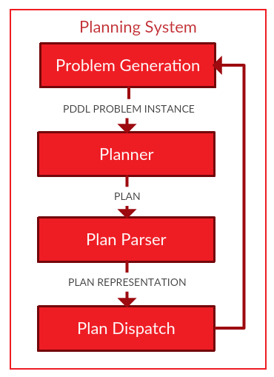
Plan dispatch in ROSPlan
To reason about these kinds of issues we need to use a plan representation sufficient to capture the controllable and uncontrollable durations, causal orderings, and temporal constraints.
The representation of a plan is coupled with the
choice of dispatcher.
The problem generation and planner are not
necessarily bound by the choice of
representation.

Slide 64
Plan Execution 3: Conditional Dispatch
Uncertainty and lack of knowledge is a huge part of AI Planning for Robotics.
- Actions might fail or succeed.
- The effects of an action can be non-deterministic.
- The environment is dynamic and changing.
- The environment is often initially full of unknowns.
The domain model is always incomplete as well as inaccurate.

Slide 65
Uncertainty in AI Planning
- The environment is dynamic and changing.
- The environment is often initially full of unknowns.

Slide 66
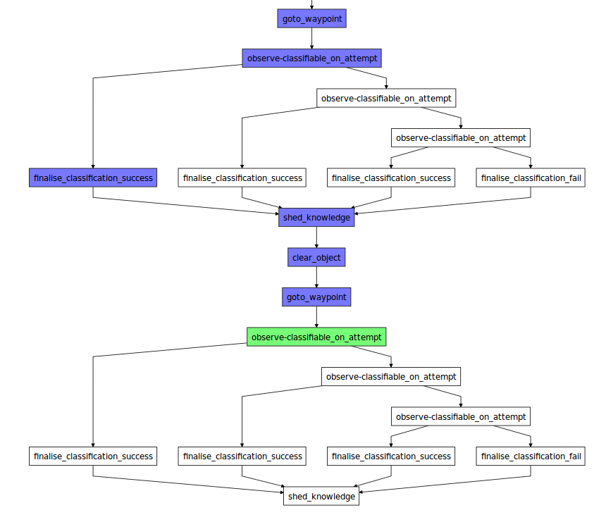
Uncertainty in AI Planning
Some uncertainty can be handled at planning time:
- Fully-Observable Non-deterministic planning.
- Partially-observable Markov decision Process.
- Conditional Planning with Contingent Planners. (e.g. ROSPlan with Contingent-FF)

Slide 67
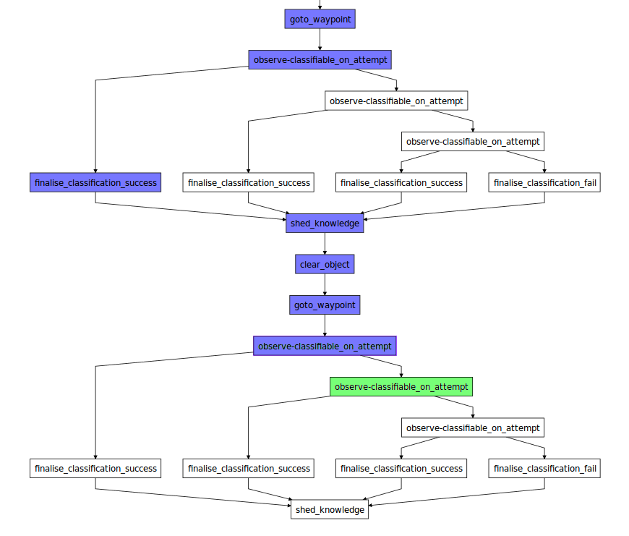
Uncertainty in AI Planning
Some uncertainty can be handled at planning time:
- Fully-Observable Non-deterministic planning.
- Partially-observable Markov decision Process.
- Conditional Planning with Contingent Planners. (e.g. ROSPlan with Contingent-FF)

Slide 68
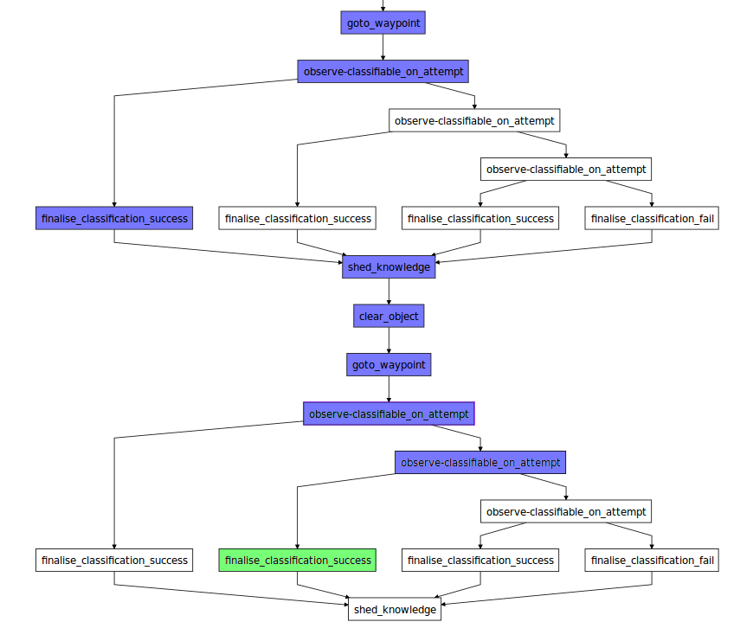
Uncertainty in AI Planning
Some uncertainty can be handled at planning time:
- Fully-Observable Non-deterministic planning.
- Partially-observable Markov decision Process.
- Conditional Planning with Contingent Planners. (e.g. ROSPlan with Contingent-FF)

Slide 69
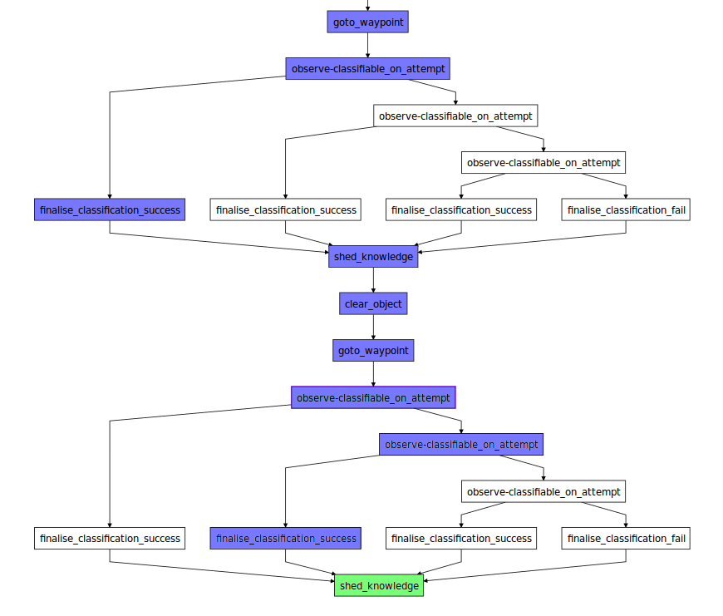
Uncertainty in AI Planning
Some uncertainty can be handled at planning time:
- Fully-Observable Non-deterministic planning.
- Partially-observable Markov decision Process.
- Conditional Planning with Contingent Planners. (e.g. ROSPlan with Contingent-FF)

Slide 70
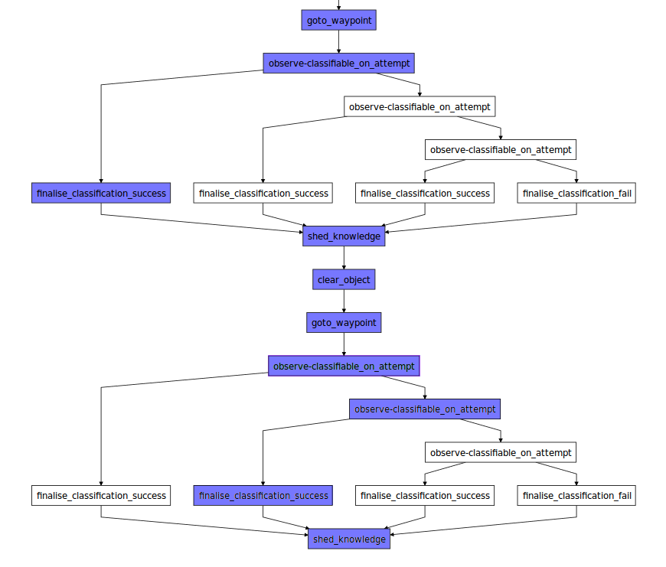
Uncertainty in AI Planning
Some uncertainty can be handled at planning time:
- Fully-Observable Non-deterministic planning.
- Partially-observable Markov decision Process.
- Conditional Planning with Contingent Planners. (e.g. ROSPlan with Contingent-FF)

Slide 71
Uncertainty in AI Planning
Human Robot Interaction is filled with uncertainties.

Slide 72
Plan Execution 4: Temporal and Conditional Dispatch together
Robotics domains require a combination of temporal and conditional reasoning. Combining these two kinds of uncertainty can result in very complex structures.
There are plan formalisms designed to describe these, e.g.:
- GOLOG plans. [Claßen et al., 2012]
- Petri-Net Plans. [Ziparo et al. 2011]

Slide 73
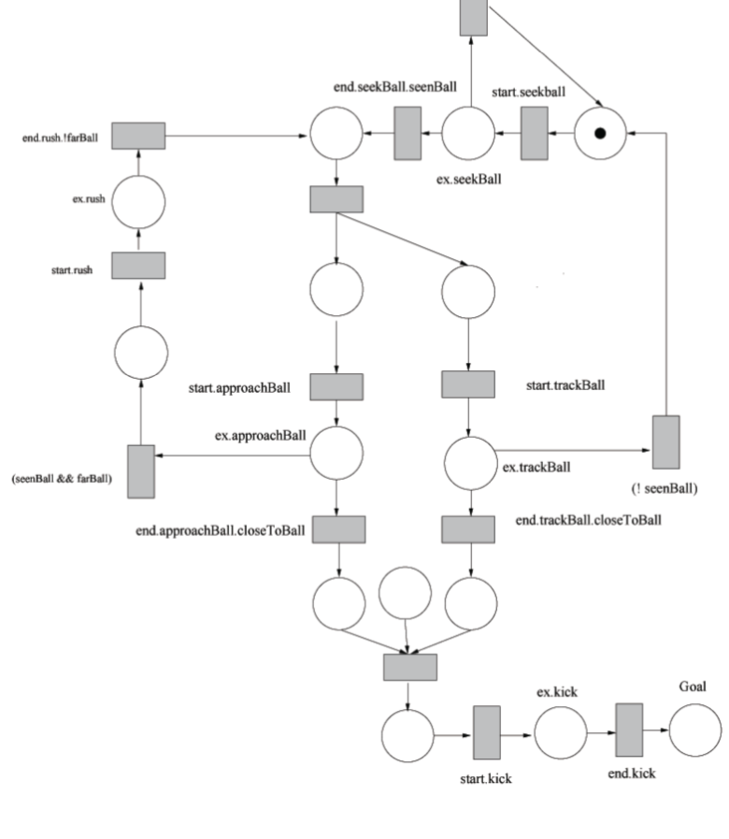
Plan Execution 4: Temporal and Conditional Dispatch together
Robotics domains require a combination of temporal and conditional reasoning. Combining these two kinds of uncertainty can result in very complex structures.
There are plan formalisms designed to describe these, e.g.:
- GOLOG plans. [Claßen et al., 2012]
- Petri-Net Plans. [Ziparo et al. 2011]

Slide 74
Plan Execution 4: Temporal and Conditional Dispatch together
Robotics domains require a combination of temporal and conditional reasoning. Combining these two kinds of uncertainty can result in very complex structures.
There are plan formalisms designed to describe these, e.g.:
- GOLOG plans. [Claßen et al., 2012]
- Petri-Net Plans. [Ziparo et al. 2011]
ROSPlan is integrated with the PNPRos library for the representation and execution of Petri-Net plans. [Sanelli et al. 2017]

Slide 75
Summary of Very Simple Plan Execution
Plan Execution depends upon many components in the system. Changing any one of which will change the robot behaviour, and change the criteria under which the plan will succeed or fail.

Slide 76
Summary of Very Simple Plan Execution
Plan Execution depends upon many components in the system. Changing any one of which will change the robot behaviour, and change the criteria under which the plan will succeed or fail.

Slide 77
Summary of Very Simple Plan Execution
Plan Execution depends upon many components in the system. Changing any one of which will change the robot behaviour, and change the criteria under which the plan will succeed or fail.

Slide 78
Summary of Very Simple Plan Execution
Plan Execution depends upon many components in the system. Changing any one of which will change the robot behaviour, and change the criteria under which the plan will succeed or fail.

Slide 79
Summary of Very Simple Plan Execution
Plan Execution depends upon many components in the system. Changing any one of which will change the robot behaviour, and change the criteria under which the plan will succeed or fail.
The execution of a plan is an emergent behaviour of the whole system.

Slide 80

Summary of Very Simple Plan Execution
Plan Execution depends upon many components in the system. Changing any one of which will change the robot behaviour, and change the criteria under which the plan will succeed or fail.
The execution of a plan is an emergent behaviour of the whole system.

Slide 81
Dispatching more than a Single Plan
The robot can have many different and interfering goals. A robot's behaviour might move toward achievement of multiple goals together.

Slide 82
Dispatching more than a Single Plan
The robot can have many different and interfering goals. A robot's behaviour might move toward achievement of multiple goals together.
The robot can also have:
- long-term goals (plans are abstract, with horizons of weeks)
- but also short-term goals (plans are detailed, with horizons of minutes)

Slide 83
Dispatching more than a Single Plan
The robot can have many different and interfering goals. A robot's behaviour might move toward achievement of multiple goals together.
The robot can also have:
- long-term goals (plans are abstract, with horizons of weeks)
- but also short-term goals (plans are detailed, with horizons of minutes)
The behaviour of a robot should not be restricted to only one plan.
In a persistently autonomous system, the domain model, the planning process, and the plan are frequently revisited.
There is no “waterfall” sequence of boxes.

Slide 84
Dispatching more than a Single Plan
Example of multiple plans: What about unknowns in the environment?
One very common and simple scenario with robots is planning a search scenario. For tracking targets, tidying household objects, or interacting with people.
How do you plan from future situations that you can't predict?

Slide 85
Dispatching more than a Single Plan

Slide 86
Dispatching more than a Single Plan

Slide 87
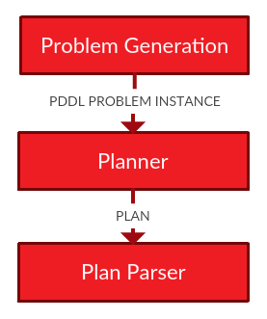
Hierarchical and Recursive Planning
For each task we generate a tactical plan.

Slide 88
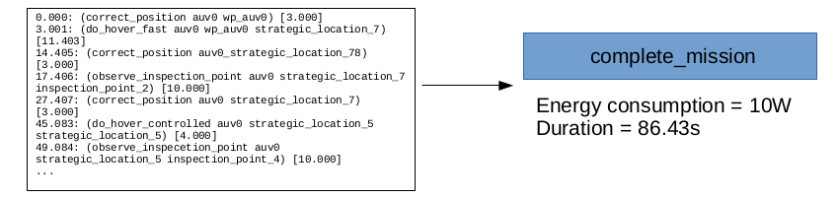
Hierarchical and Recursive Planning
For each task we generate a tactical plan. The time and resource constraints are used in the generation of the strategic problem.

Slide 89
Hierarchical and Recursive Planning
For each task we generate a tactical plan. The time and resource constraints are used in the generation of the strategic problem.

Slide 90
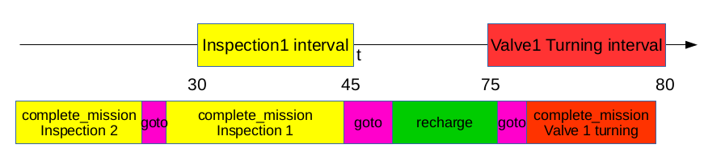
Hierarchical and Recursive Planning
For each task we generate a tactical plan. The time and resource constraints are used in the generation of the strategic problem.
A strategic plan is generated that does not violate the time and resource constraints of the whole mission.

Slide 91
Hierarchical and Recursive Planning
When an abstract “complete_mission” action is dispatched, the tactical problem is regenerated, replanned, and executed.

Slide 92
Hierarchical and Recursive Planning
When an abstract “complete_mission” action is dispatched, the tactical problem is regenerated, replanned, and executed.
The tactical mission is executed by a complete planning system.
[Cashmore et al. 2015]

Slide 93
Dispatching more Plans: Opportunistic Planning
There might also be unknowns that we don't expect to discover.
For example, new opportunities are found during execution, and the robot should exploit them.

Slide 94
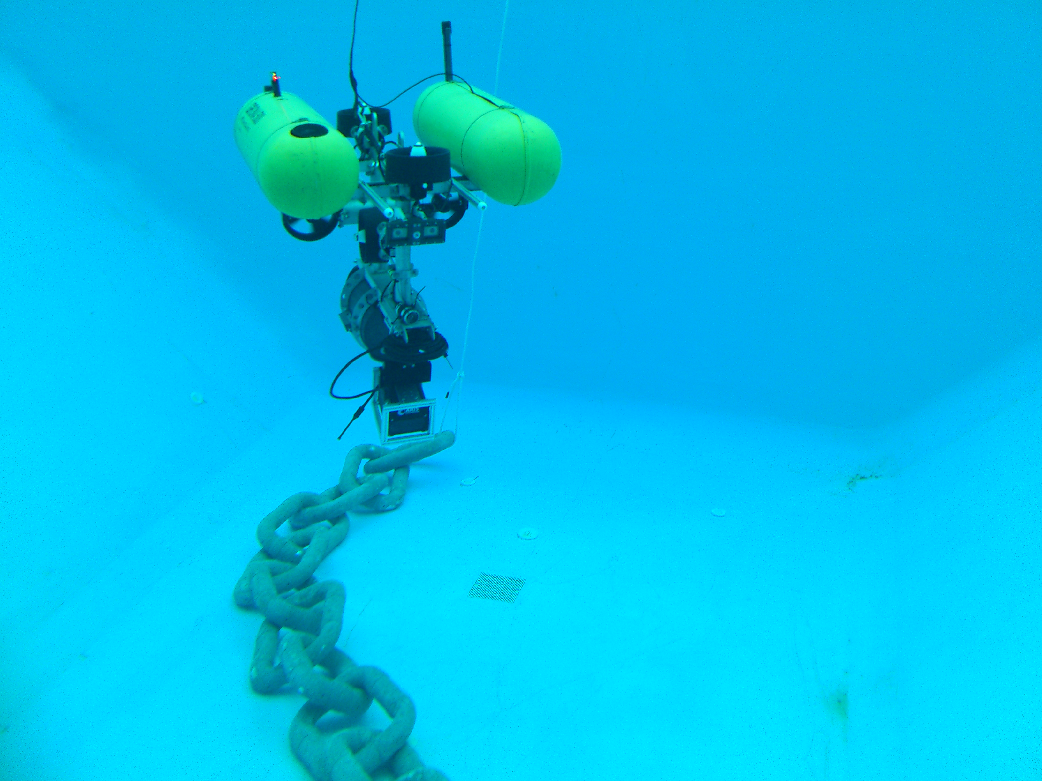
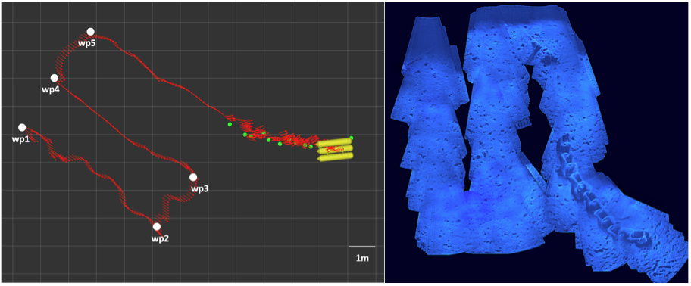
Dispatching more Plans: Opportunistic Planning
v
High Impact Low-Probability Events (HILPs)
- the probability distribution is unknown
- cannot be anticipated
- our example is chain following
If you see an unexpected chain, it's a good idea to investigate...
2011 Banff 5 of 10 lines parted.
2011 Volve 2 of 9 lines parted
2011 Gryphon Alpha 4 of 10 lines parted, vessel drifted a distance, riser broken
2010 Jubarte 3 lines parted between 2008 and 2010.
2009 Nan Hai Fa Xian 4 of 8 lines parted; vessel drifted a distance, riser broken
2009 Hai Yang Shi You Entire yoke mooring column collapsed; vessel adrift, riser broken.
2006 Liuhua (N.H.S.L.) 7 of 10 lines parted; vessel drifted a distance, riser broken.
2002 Girassol buoy 3 (+2) of 9 lines parted, no damage to offloading lines (2 later)

Slide 95
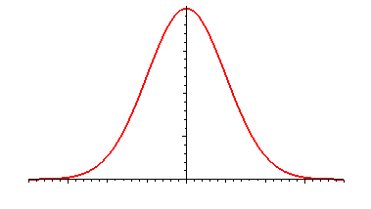
Dispatching more Plans: Opportunistic Planning
In PANDORA we planned and executed missions over long-term horizons (days or weeks)
Our planning strategy was based on the assumption that actions have durations normally distributed around the mean.
To build a robust plan we therefore used estimated durations for the actions that were 95th percentile of the normal distribution.
The resulting overestimation of actions builds a free time window

Slide 96
Dispatching more Plans: Opportunistic Planning
In PANDORA we planned and executed missions over long-term horizons (days or weeks)
Our planning strategy was based on the assumption that actions have durations normally distributed around the mean.
To build a robust plan we therefore used estimated durations for the actions that were 95th percentile of the normal distribution.
The resulting overestimation of actions builds a free time window

Slide 97
Dispatching more Plans: Opportunistic Planning
In PANDORA we planned and executed missions over long-term horizons (days or weeks)
Our planning strategy was based on the assumption that actions have durations normally distributed around the mean.
To build a robust plan we therefore used estimated durations for the actions that were 95th percentile of the normal distribution.
The resulting overestimation of actions builds a free time window

Slide 98
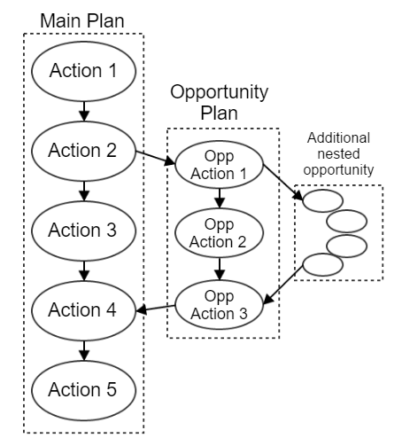
Dispatching more Plans: Opportunistic Planning
New plans are generated for the opportunistic goals and the goal of returning to the tail of the current plan.
If the new plan fits inside the free time window, then it is immediately executed.

Slide 99
Dispatching more Plans: Opportunistic Planning
New plans are generated for the opportunistic goals and the goal of returning to the tail of the current plan.
If the new plan fits inside the free time window, then it is immediately executed.
The approach is recursive
If an opportunity is spotted during the execution of a plan fragment, then the currently executing plan can be pushed onto the stack and a new plan can be executed.
[Cashmore et al. 2015]

Slide 100
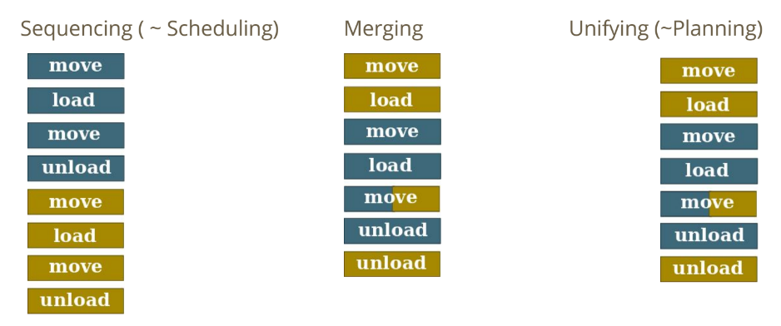
Dispatching Plans at the same time
Separating tasks and scheduling is not as efficient.
Planning for everything together is not always practical.

Slide 101
Dispatching Plans at the same time
Separating tasks and scheduling is not as efficient.
Planning for everything together is not always practical.
Plans can be merged in a more intelligent way. A single action can support the advancement towards multiple goals. [Mudrova et al. 2016]

Slide 102
Questions?
What is the glue in a Plan Execution framework that is always required?
How do we modify a domain model during execution?
Which parts of a domain model are transferable to other tasks?
Which parts of a domain model can be generated automatically
From a description of the robot?
From a source ontology?
How can we get rid of the planning expert?
Can a description of a task be written by a non-expert, and a generic domain extended?

