Slide 1
Simple Neural Networks in CUDA
Kyle Salitrik

Slide 2
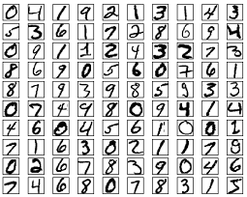
Purpose of Neural Networks
Facial recognition
Image identification
Estimating stock projections
Determining validity of emails
Etc…
Our implementation focused on identifying hand-written digits from the MNIST dataset.

Slide 3
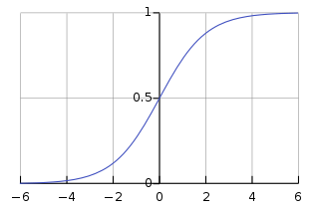

Logistic Regression
Sigmoid Function:
$σ\left(z\right)=\frac{1}{1−e^{z}}$
Roughly estimates the way that the human neuron behaves
Output is bound between 0 and 1
Important in order for keeping values from becoming extreme
Many other functions that can be used as a logistic function exist:
tanh
logit = $\log\left(\frac{p}{1−p}\right)$ from statistical regression

Slide 4
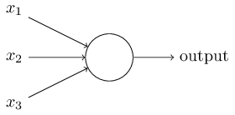
Neurons
Neurons in a network are assigned a specific behavior like the Sigmoid function, called their activation function
Each neuron may have one or more inputs
The inputs and outputs of a neuron should be within the bounds of their activation function.
Neurons may be modeled with a bias term, adding a small offset to whatever the result is, but must then be hardly bound at 1 and 0.

Slide 5

Functions Implemented
Vector & Matrix Addition
Vector & Matrix Hadamard Products
$\left[\begin{matrix}a_{1,1} & ⋯ & a_{1,n} \\ ⋮ & ⋱ & ⋮ \\ a_{m,1} & ⋯ & a_{m,n}\end{matrix}\right]$ $⨀$ $\left[\begin{matrix}b_{1,1} & ⋯ & b_{1,n} \\ ⋮ & ⋱ & ⋮ \\ b_{m,1} & ⋯ & b_{m,n}\end{matrix}\right]$ = $\left[\begin{matrix}a_{1,1}×b_{1,1} & ⋯ & a_{1,n}×b_{1,n} \\ ⋮ & ⋱ & ⋮ \\ a_{m,1}×b_{m,1} & ⋯ & a_{m,n}×b_{m,n}\end{matrix}\right]$
Sigmoid Function for Matrices and Vectors
Sigmoid Derivative for Matrices
Vector Dot Product
Matrix multiplication used was from the CUBLAS library

Slide 6
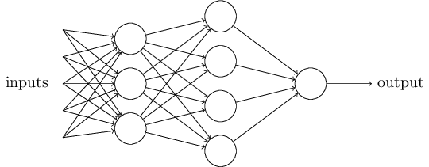

Network Structure
We used a Densely connected network, meaning each neuron in one layer is connected to each neuron in the next.
These connections are represented by a weight matrix where element $W_{m,n}$ represents the connection from neuron $m$ in the previous layer to neuron $n$ in the next.
Other structures exist:
Sparsely Connected
Dropout
Every iteration a certain percentage of neuron connections are ‘dropped out’ by randomly choosing their weights to be 0 temporarily.
A shallow network consists of 3 layers: input, hidden, output. A deep neural network is one with at least 2 hidden layers.

Slide 7

Forward Propagation
Forward propagation is the process of feeding your input through the network and returning a result.
In general, the one must compute the following equations for each layer past the input:
$z^{(l)}=a^{\left(l−1\right)}∗{\left[W^{\left(l\right)}\right]}^{T}$
$a^{\left(l\right)}=σ\left\{z^{\left(l\right)}\right\}$
The output of the network is usually formatted as a “one-hot” array.
The 1H array is formatted where the index that contains a 1 corresponds to a guess for that state.
[ 0 0 0 1 0 ] = 4

Slide 8

Backward Propagation
During backward propagation, the goal is to determine where errors were contributed to your model.
For the last layer, the error is:
$δ^{\left(L\right)}=a^{\left(L\right)}−y$
For all previous layers:
$δ^{\left(l\right)}=δ^{\left(l+1\right)}W^{\left(l\right)}⨀σ^{′}\left\{z^{\left(l\right)}\right\}$

Slide 9

Gradient Descent
Finally, gradient descent is the process used to train the weights.
For each weight matrix, the gradient is computed:
$∇^{l}=\frac{1}{m}{\left[δ^{\left(l+1\right)}\right]}^{T}∗a^{\left(l\right)}$
The gradient is adjusted by 1/m, where m is the number of samples, in order to help prevent the weights from diverging.
The weight matrices are then updated by a simple subtraction:
$W^{\left(l\right)}$ := $W^{\left(l\right)}− ∇^{\left(l\right)}$

Slide 10
Training & Other methods
Typically a neural network is trained over multiple iterations over all of the training data, called an epoch.
After each epoch the data is shuffled before reiterating through all of it.
One alternative method to our approach is to use a portion of all training examples at once (ie 5000 x 784 matrix vs 1 x 784 vector)
Another method that is commonly employed is using a regularization term. The regularization term is a simple method to prevent the gradients from reaching stagnation.
To include regularization a small value is added to each element of the gradient.

Slide 11
Runtimes
For our implementation, there was actually a detriment to the runtime vs a serial implementation because of the small amount of data needed for our computations.
The majority of the CUDA runtime was copying memory on and off of the device.

