Slide 1
Kavomat

Slide 2
Ideja projekta

Slide 3
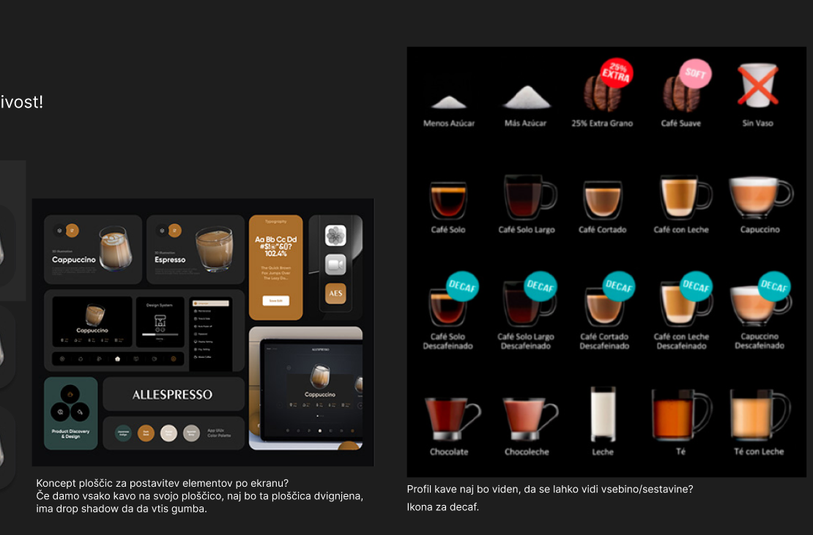
Design thinking

Slide 4
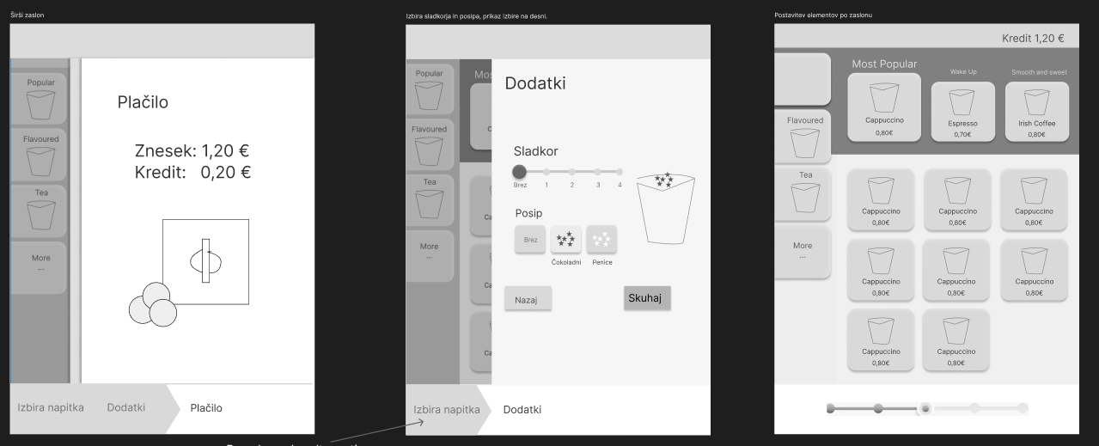
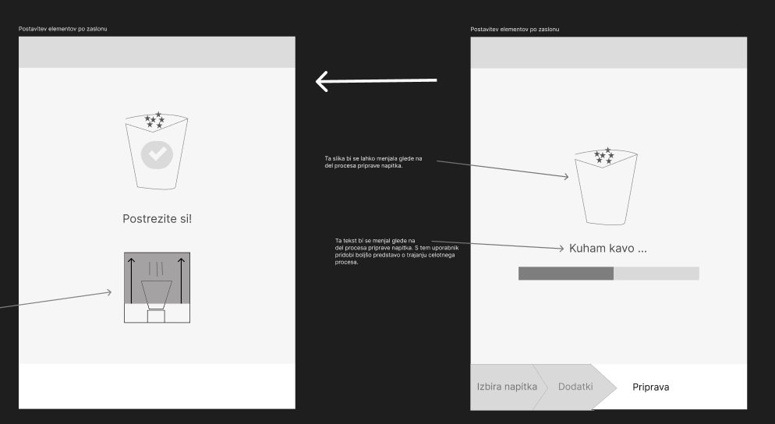
Low/Mid fidelity

Slide 5
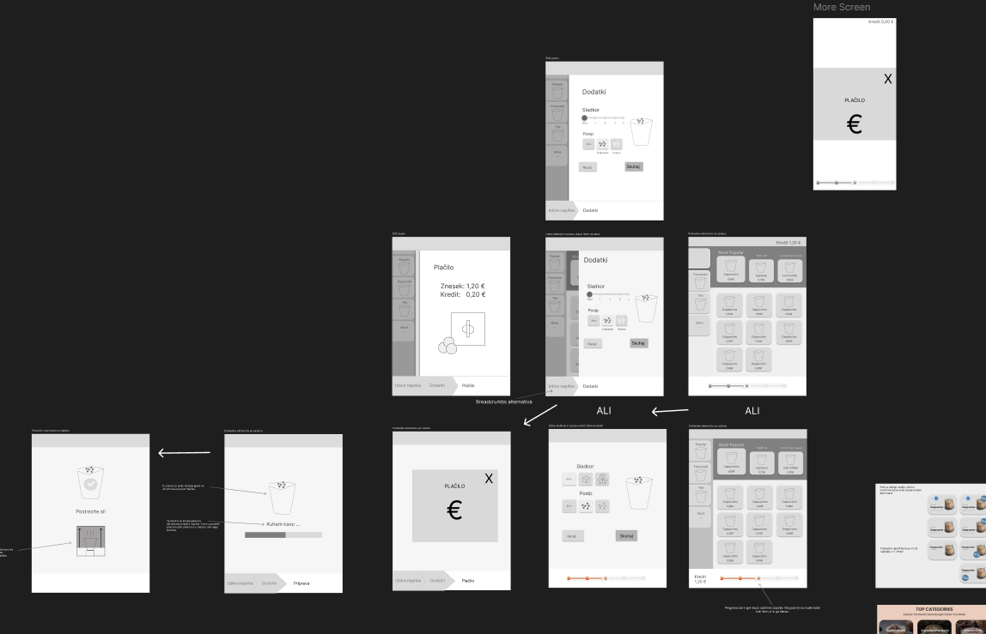

Slide 6
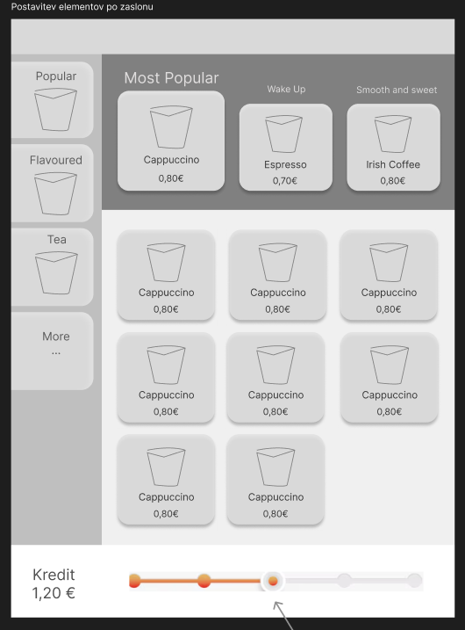





Feedback
Strnjenih 5 točk feedbacka

Slide 7
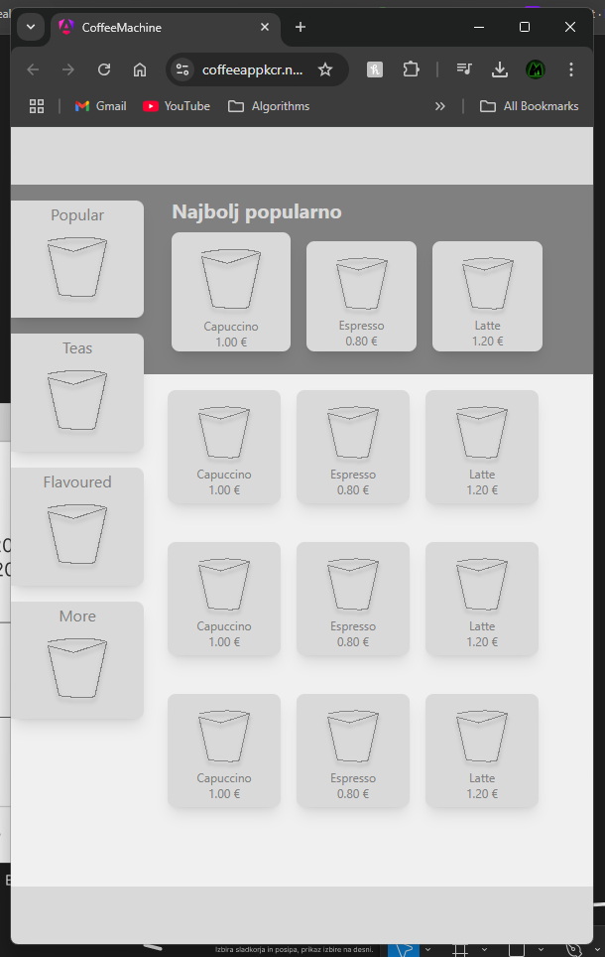
High fidelity prototip
https://coffeeappkcr.netlify.app/

