Slide 1
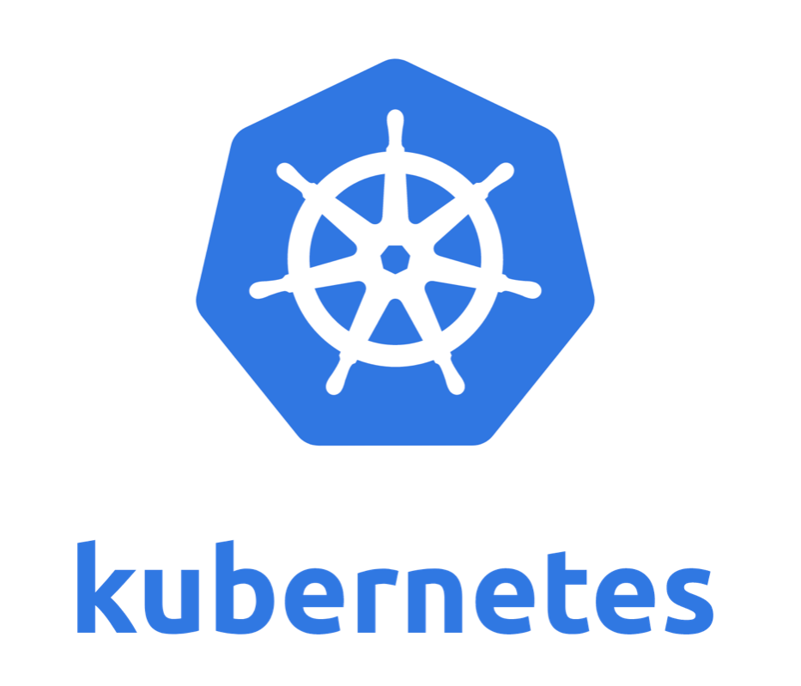
Lectured by: POENG Kokthay
Prepared by: Team 2

Slide 2
Team Members
KONG CHANROTANAK
KHOEUNG SOKHAI
KHUT SOCHEATA
KITH SOMNEAR
KOENG GANA

Slide 3
Contents
01
02
03
04
05
What is Kubernetes?
Kubernetes Components
What Kubernetes can do?
Kubernetes Objects and Workloads
Benefits of Kubernetes

Slide 4
01
What is Kubernetes?

Slide 5
What is Kubernetes?
Definition
Developed by
Problem Solve
Setup a K8s cluster

Slide 6
What is Kubernetes?
Definition
Kubernetes is an open-source system for automating deployment, scaling, and management of containerized applications or container orchestration tool, they are also known as K8s.

Slide 7
What is Kubernetes?
Developed by
Kubernetes was originally developed and designed by engineers at Google. Google was one of the early contributors to Linux container technology.
Developer: Google, Rancher Labs, Cloud Native Computing Foundation
Release date: September 9 2014 (over 15 year)
Program language: GO
Latest version: 1.26.0

Slide 8
What is Kubernetes?
Problem Solve
Automatic Deployment
Distribution of the load
Auto-scaling
Monitoring and healthcheck
Replacement

Slide 9
What is Kubernetes?
Setup a K8s cluster
Installing Kubeadm
Requirement
Checking
Installing kubeadm, kubelet and kubectl
Learning environment
Install tool(kubectl, minikube, kubeadm)
Production cluster setup
Control plan
Worker nodes

Slide 10
02
Kubernetes Components

Slide 11
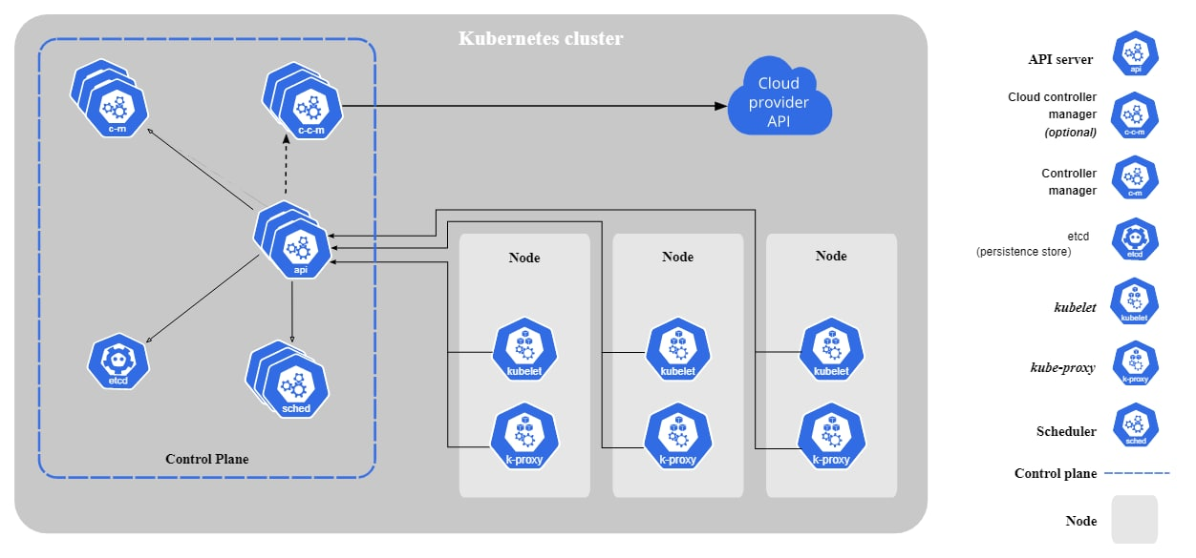
Kubernetes Components

Slide 12
03
What Kubernetes can do?

Slide 13
What Kubernetes can do?
Kubernetes provides you with a framework to run distributed systems resiliently. It takes care of scaling and failover for your application, provides deployment patterns, and more.
Service discovery and load balancing: expose a container using the DNS name or using their own IP address.
Storage orchestration: automatically mount a storage system of your choice, such as local storages, public cloud providers, and more.
Automated rollouts and rollbacks: automate Kubernetes to create new containers for your deployment, remove existing containers and adopt all their resources to the new container.
Automatic bin packing: provide Kubernetes with a cluster of nodes that it can use to run containerized tasks.
Self-healing: restarts fail, replaces, kills that don't respond until they are ready to serve.
Secret and configuration management: store and manage sensitive information.

Slide 14
04
Kubernetes objects and workloads

Slide 15
Kubernetes Objects
Kubernetes objects are persistent entities in the Kubernetes system. Kubernetes uses these entities to represent the state of your cluster. Specifically, they can describe:
What containerized applications are running (and on which nodes)
The resources available to those applications
The policies around how those applications behave, such as restart policies, upgrades, and fault-tolerance

Slide 16
Kubernetes Objects
A Kubernetes object is a "record of intent", once you create the object, the Kubernetes system will constantly work to ensure that object exists. By creating an object, you're effectively telling the Kubernetes system what you want your cluster's workload to look like.

Slide 17
Kubernetes Workloads
A workload is an application running on Kubernetes. Whether your workload is a single component or several that work together, on Kubernetes you run it inside a set of pods. In Kubernetes, a Pod represents a set of running containers on your cluster.

Slide 18
Kubernetes Workloads
Kubernetes pods have a defined lifecycle. For example, once a pod is running in your cluster then a critical fault on the node where that pod is running means that all the pods on that node fail. Kubernetes treats that level of failure as final: you would need to create a new Pod to recover, even if the node later becomes healthy.

Slide 19
05
Benefits of Kubernetes

Slide 20
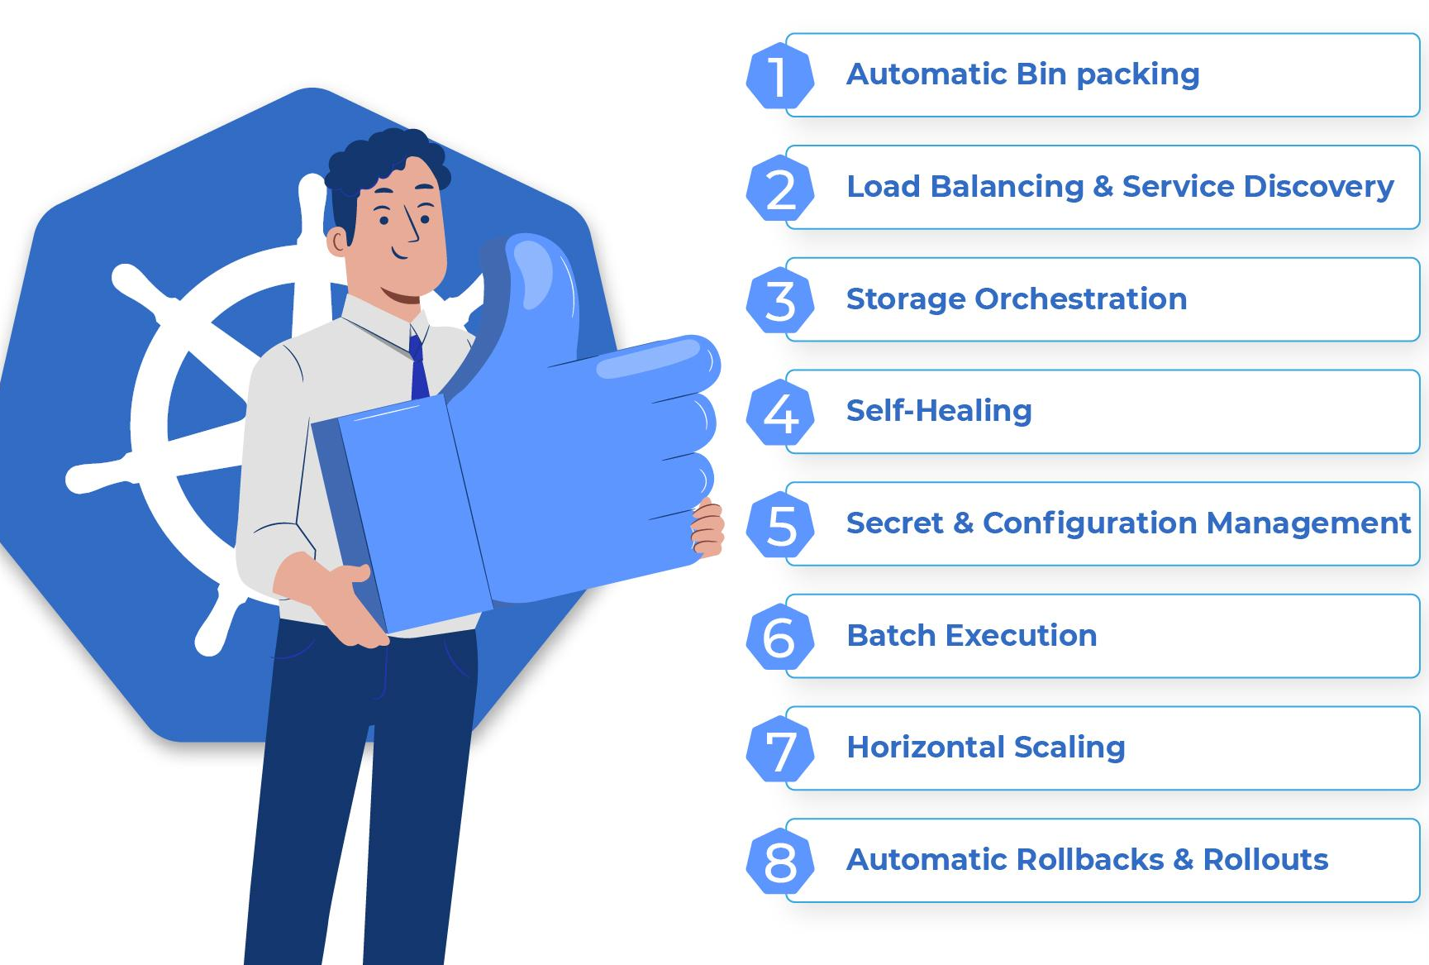
Benefits of Kubernetes

Slide 21
References
https://kubernetes.io/
https://www.clickittech.com/devops/kubernetes-architecture-diagram/
https://spot.io/resources/kubernetes-architecture/11-core-components-explained/
https://www.aquasec.com/cloud-native-academy/kubernetes-101/kubernetes-nodes/

Slide 22
Thanks for your attention

