Slide 1

EN1070 Electronic Product Design and Manufacture
Safety Switch for Iron
TEAM RSDC

Slide 2
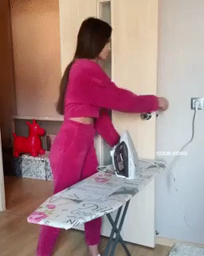
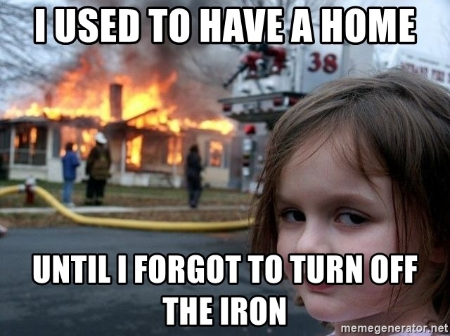
Problem Description
Busy Lifestyle
Forgetting to turn of the iron frequently

Slide 3
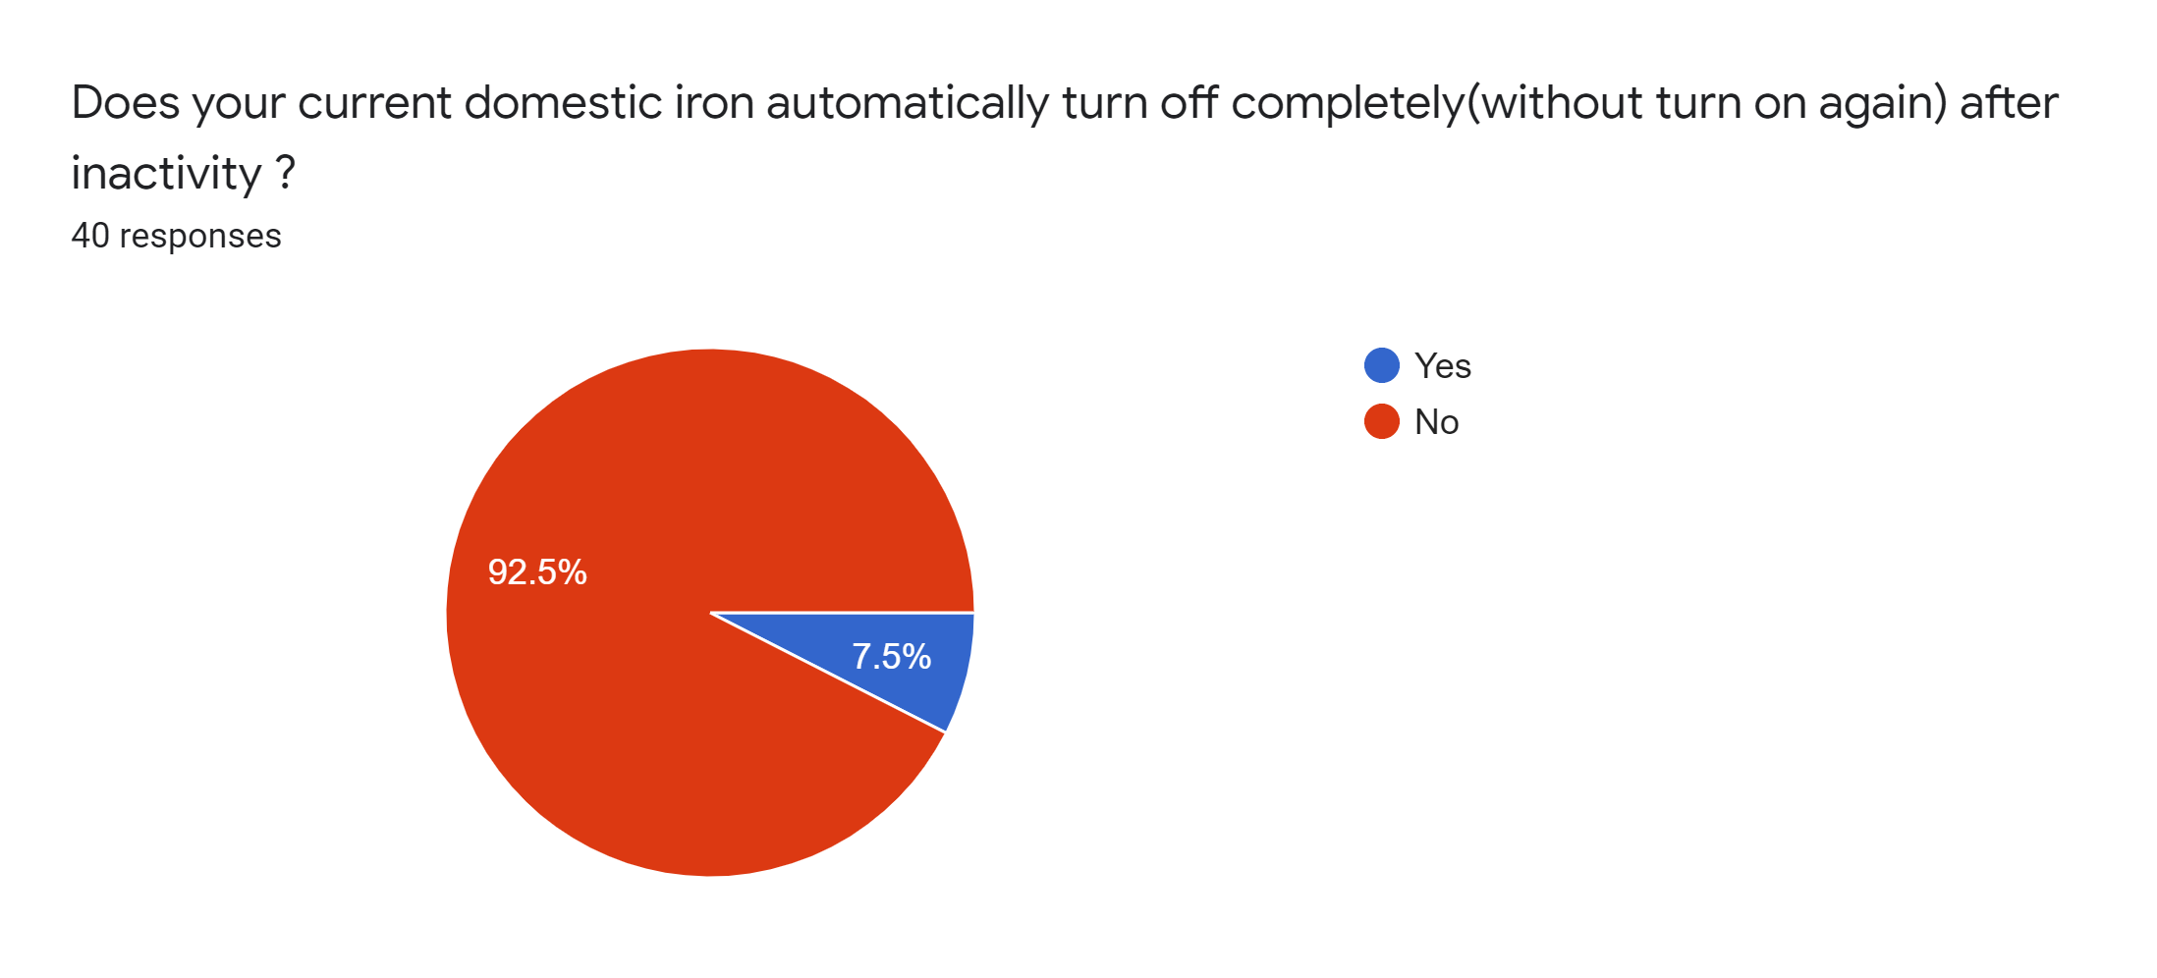
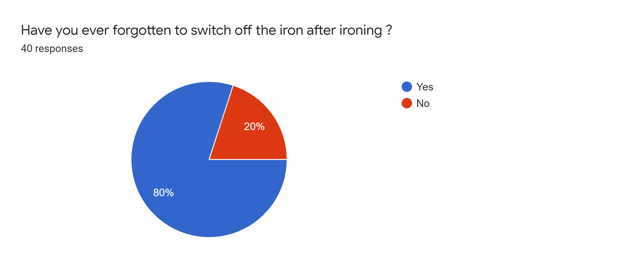
Product Idea Validation
With a survey we were able to verify that our product is a need.
Survey results

Slide 4
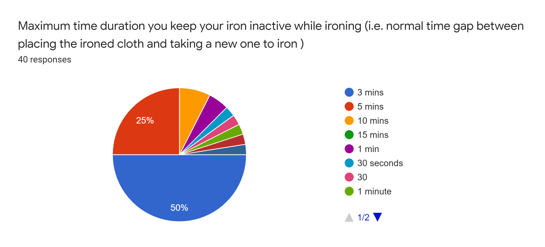
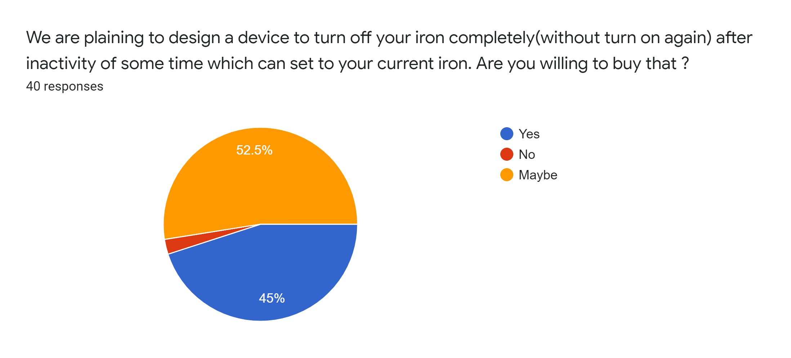

Slide 5
Technical Specifications
Operating Voltage 230V- 240V
Warranty time period is 1 year

Slide 6
Product Architecture

Slide 7
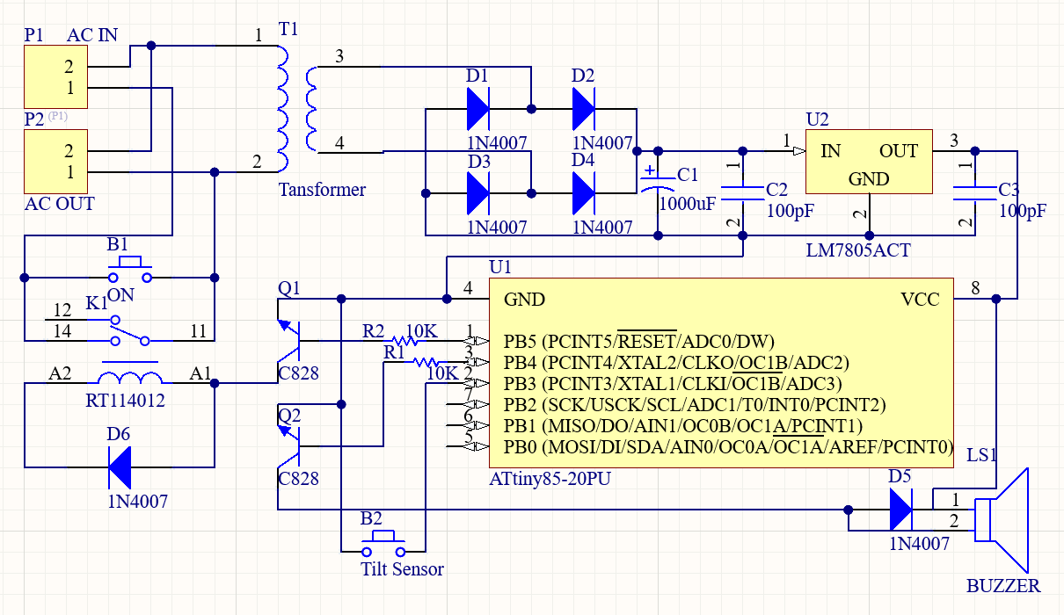
Schematic Diagram

Slide 8
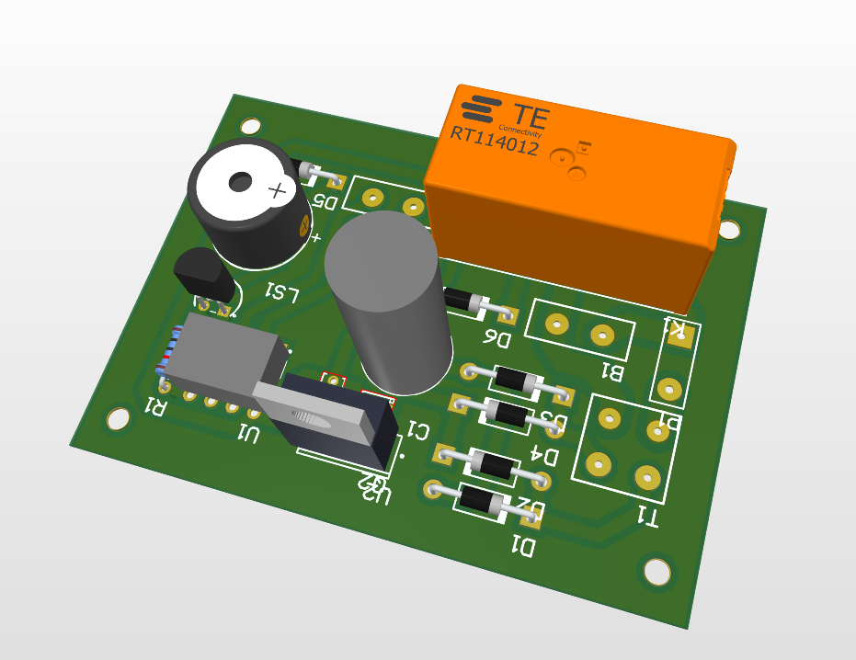
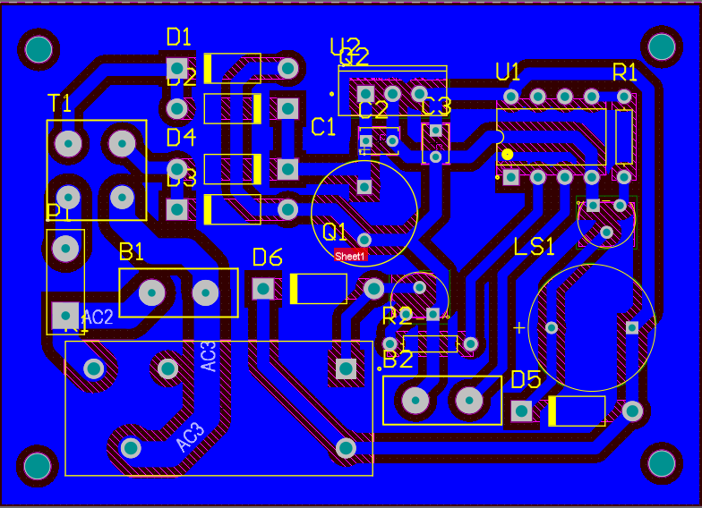
PCB design

Slide 9
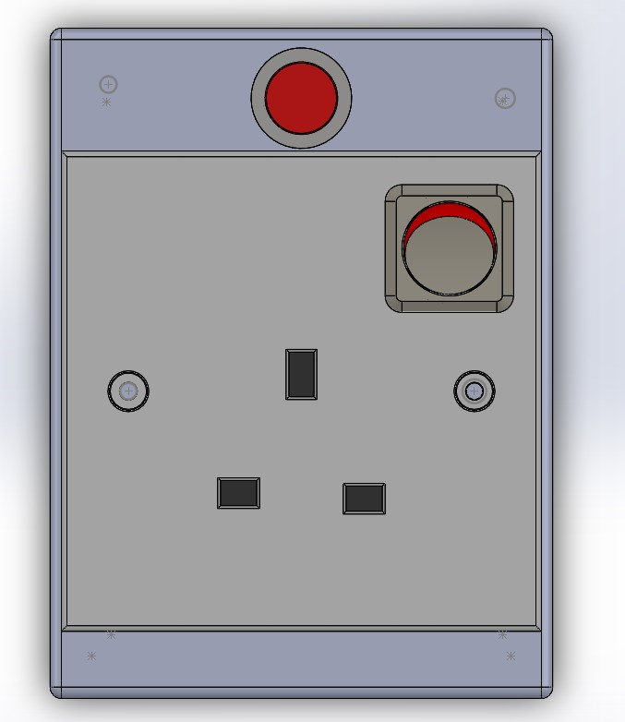
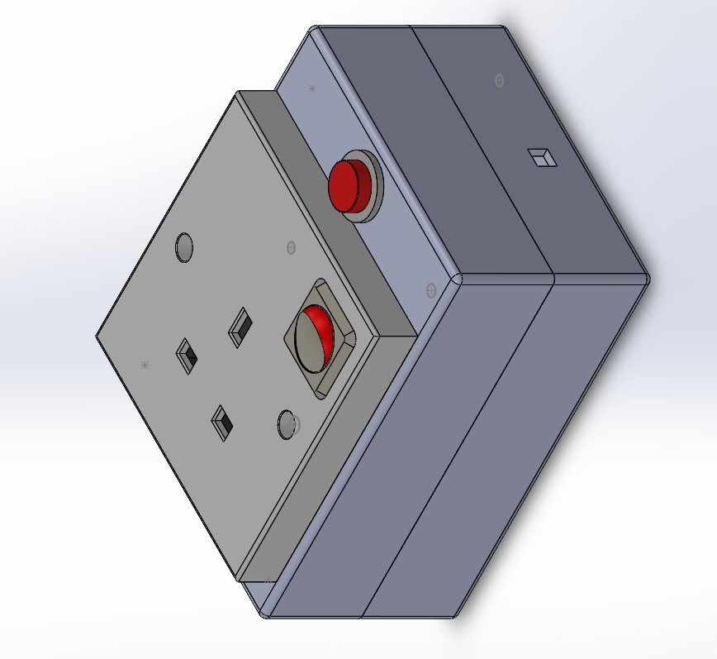
Enclosure Design

Slide 10
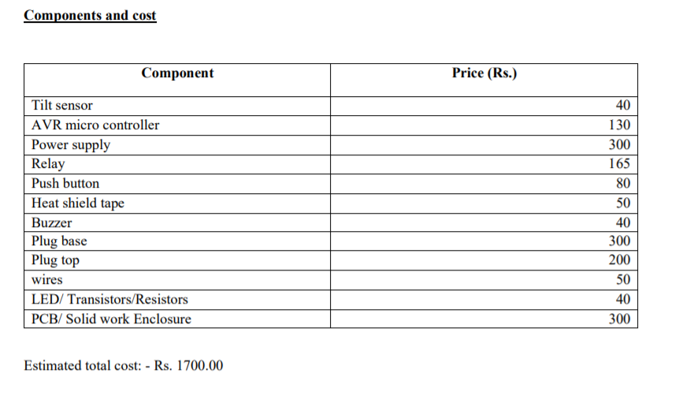
Project Budget

Slide 11
Thank You !

