Slide 1

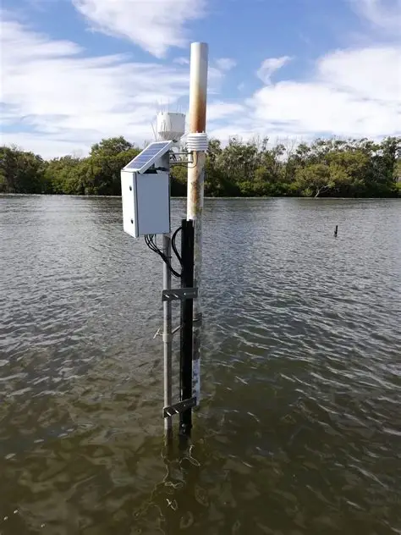
Design and Performance Analysis
of a Telemetry-Based Smart
Water Quality Monitoring System
Remote Control and Telemetry
GROUP 5 MEMBERS
Kobamelo Caiphus · 21001023 · System Architect
Karabo Matenge · 14000561 · Integration & Testing Lead
Seetsele Peo Kgakole · 21000287 · Modulation Lead
Wadza Seitibatso · 22001188 · Digital Telemetry Lead
Kamogelo Karen Ngwako · 21000284 · Monitoring Lead
Gorata Mandedu · 14000331 · Signal Processing Lead
BIUST · Faculty of Engineering and Technology · TELE 523
Supervisors: Prof. Abid Yahya · Mr Robin Tau
Notes:
Welcome the audience. Introduce the group and supervisors. This project was completed for TELE 523 — Remote Control and Telemetry at BIUST. The system designs and evaluates a complete end-to-end telemetry pipeline for smart water quality monitoring.

Slide 2
01
Introduction & Problem Statement
02
Literature Review & Research Gap
02
System Architecture
03
Signal Processing & Telemetry Design
Presentation Overview
04
Communication Channel Analysis
05
Signal Recovery
06
Monitoring & Alert System
07
System Demonstration
08
Results, Analysis & Discussion
1
Notes:
Briefly walk through the 7 sections. Mention that the presentation follows the pipeline sequentially — from why we built the system through to final results. Estimated time: 20–25 minutes.

Slide 3
Introduction — Why Water Quality Matters
2B
People drinking
contaminated water
WHO, 2023
Problem
Existing monitoring relies on manual sampling slow, costly and unable to detect rapid contamination events under realistic channel conditions.
1.4M
Preventable child deaths annually
low-income countries
Project Aim
Design and evaluate a complete end-to-end telemetry-based system for smart water quality monitoring that would be tested under realistic AWGN channel conditions with real sensor data.
98K+
Infected in the
2008 Zimbabwe outbreak
cholera
2
Notes:
Emphasise the scale of the problem — 2 billion people, 1.4 million deaths. Draw attention to the Zimbabwe cholera example. Explain that Sub-Saharan Africa, including Botswana, still faces these challenges. The core problem: current systems don't rigorously evaluate the communication layer. Our project fills that gap.

Slide 4
Literature Review & Research Gap
Water Quality Monitoring
Telemetry & Communications
Pasika & Gandla (2020)
Bharati et al. (2020)
Low-cost IoT with wireless transmission & SMS alerts
BPSK achieves lowest BER under AWGN vs ASK/FSK — synthetic signals only
Jan et al. (2021)
Mahamud et al. (2021)
IoT architectures: sensors, comms, analytics — but no channel evaluation
PCM validated for real-time IMU data — not applied to environment
Bhardwaj & Cenkeramaddi (2025)
Li & Xu (2023)
ML-based anomaly detection — limited telemetry integration
Comms in telemetry under harsh conditions — not water-specific
Essamlali et al. (2024)
Majadibodu (2021)
IoT + ML review; end-to-end transmission reliability unexplored
Empirical evaluation in water treatment — component-level focus only
Research Gap: Neither area fully examines a complete integrated end-to-end telemetry system operating on real environmental data under realistic noisy channel conditions.
3

Slide 5
System Architecture — 8-Stage Pipeline
1
2
3
4
Data
Acquisition
Signal
Processing
Quantisation
& PCM
BPSK
Modulation
5
6
7
8
AWGN
Channel
Demodulation
& Decode
Feature
Extraction
Monitoring
Output
Python · NumPy · SciPy · Pandas · Matplotlib | Real data: Darling–Baaka River Smart Buoy Network
4
Notes:
Walk through each stage sequentially. Each stage is owned by a named group member and implemented as a modular Python function. The output of each stage is the verified input to the next — ensuring pipeline integrity. Stage 8 (Monitoring Output, in mint) is the final deliverable seen by operators.

Slide 6
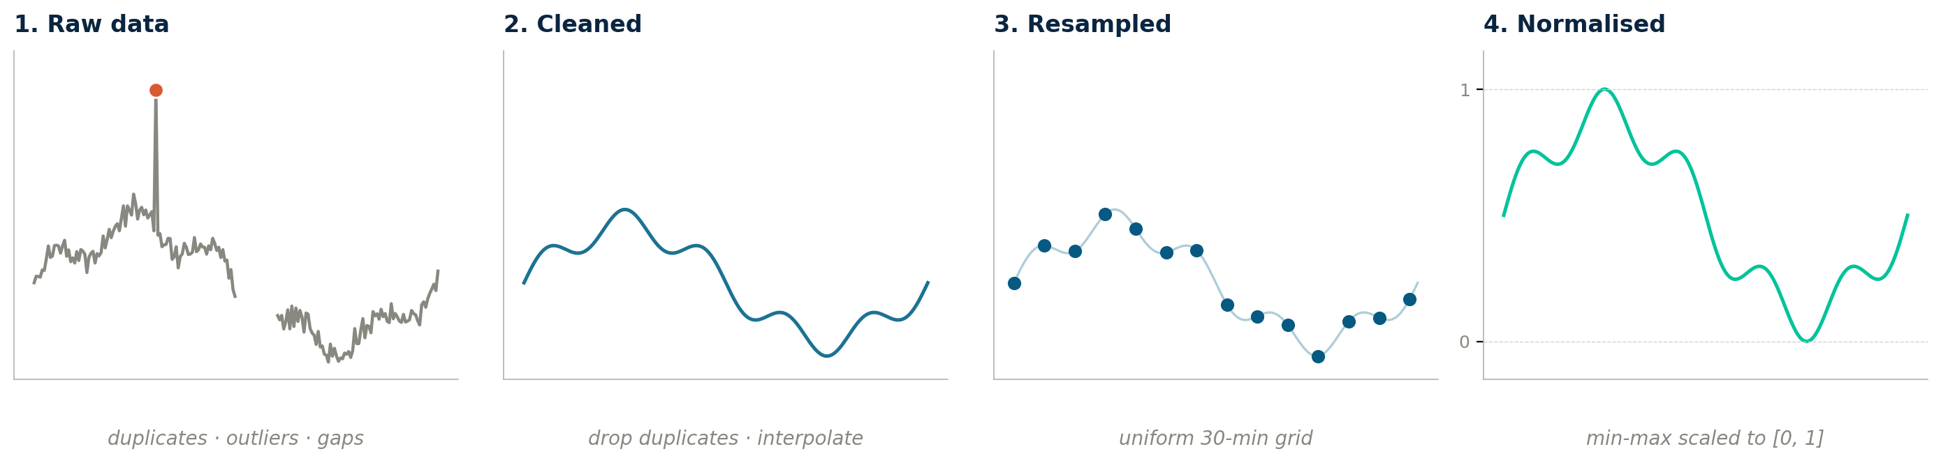
Signal Processing — Dataset & Preprocessing
Dataset: Darling–Baaka River Smart Buoy Network · NSW DCCEEW
Parameters: Temperature (°C), pH, Dissolved Oxygen (mg/L) · Sampling interval: 30 minutes · Period: Jan–Mar 2024
Implemented in Python as clean_data() → resample_uniform() → normalize_columns()
Duplicates removed
Time-based interpolation
Min-max to [0, 1]
out-of-range flagged
fills gaps smoothly
ready for PCM encoder
5

Slide 7
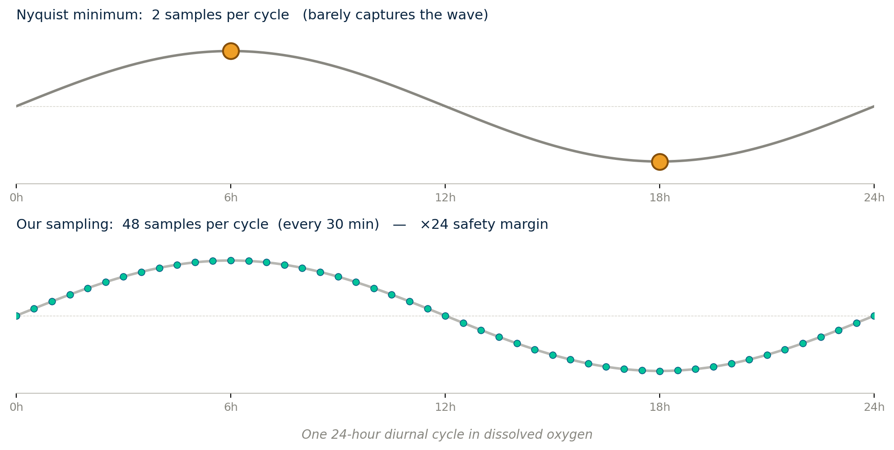
Signal Processing — Nyquist Verification & PSD
Sampling frequency
fs = 5.56 × 10⁻⁴ Hz
one sample every 30 min
Dominant signal frequency
f_m = 1.16 × 10⁻⁵ Hz
24-hour diurnal cycle
Nyquist margin
×24 over 2·f_m
no aliasing, no filter needed
PSD Analysis — Welch's method (scipy.signal.welch)
Signal energy is concentrated at very low frequencies only (DC + diurnal peak) — confirms empirically that aliasing is not a concern.
6

Slide 8
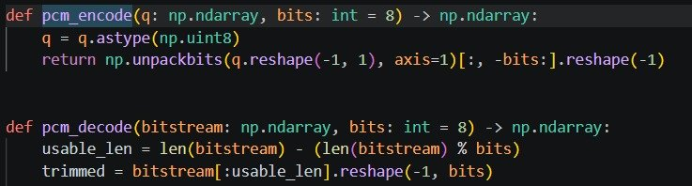
PCM Encoding & BPSK Modulation
Stage 3 — PCM Encoding
Stage 4 — BPSK Modulation
8-bit quantisation
Symbol mapping
L = 2⁸ = 256 levels
bit 1 → +1 (0° phase)
Step size
Symbol mapping
Δ = (x_max − x_min) / 255
bit 0 → −1 (180° phase)
SQNR
Why BPSK?
6.02 × 8 + 1.76 = 49.9 dB
Lowest BER among binary schemes
NRZ line coding
Noise resilience
bit 1 → +1, bit 0 → −1
Phase-encoded: robust vs ASK
BER_BPSK = Q( √(2 · SNR_linear) )
+1 (bit 1)
−1 (bit 0)
decision boundary
BPSK constellation
7
Notes:
Explain PCM: the continuous normalised DO signal is mapped to 256 discrete levels. Each sample becomes an 8-bit binary codeword. The SQNR of 49.9 dB means quantisation error is negligible relative to channel noise. BPSK is chosen because it gives the lowest BER among binary schemes — encoding information in phase makes it inherently immune to amplitude noise unlike ASK.

Slide 9
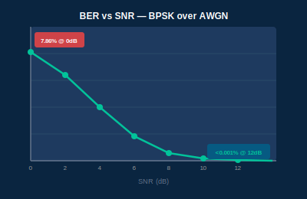
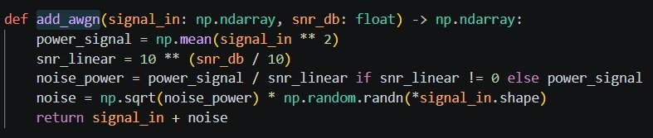
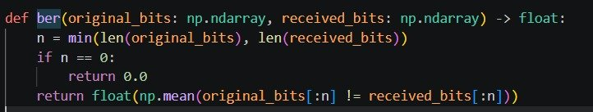
AWGN Channel Model & BER Analysis
Stage 5 — AWGN Channel
BER Performance
Received signal
rᵢ = sᵢ + nᵢ
Noise model
nᵢ ~ N(0, σ²)
Noise variance
σ² = Pₛ / SNR_linear
SNR sweep
0, 2, 4, 6, 8, 10, 12 dB
BER = Q( √(2 · SNR_linear) )
8
Notes:
The AWGN model adds zero-mean Gaussian noise scaled to the specified SNR level. We evaluate 7 SNR points from 0 dB (very noisy) to 12 dB (near ideal). The ber() function compares transmitted vs received bits element-wise. BER drops steeply from 7.86% at 0 dB to under 0.001% at 12 dB — matching theoretical Q-function predictions exactly.

Slide 10
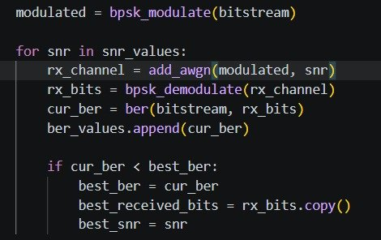
Signal Recovery — Demodulation & Reconstruction
1
2
3
4
Demodulate
PCM Decode
Reconstruct
RMSE Fidelity
Hard threshold: r≥0 → bit 1
r<0 → bit 0
Trim bitstream to 8-bit multiple
Repack bits → quant. index q̂
x̂ = x_min + q̂ · Δ
Inverse of Stage 3
Recovers physical values
RMSE = √(Σ(x−x̂)²/N)
Evaluated at SNR* (min BER)
Quant + channel error combined
Code Implementation:
9
Notes:
Signal recovery reverses everything done in stages 3–5. The hard-decision detector is optimal under AWGN — placing the decision boundary at zero. PCM decoding groups 8 bits back into quantisation indices. Any bit error causes the recovered index to be wrong, adding reconstruction error on top of baseline quantisation error. RMSE at SNR* (12 dB) is dominated by quantisation noise alone.

Slide 11
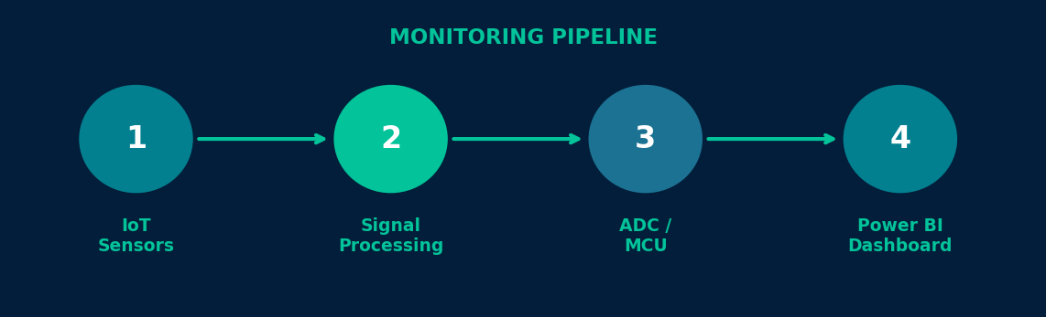
Monitoring and Alert
System
IoT-based real-time sensing of dissolved oxygen, pH and temperature
via smart sensors, signal processing and Power BI dashboards.
3
2
42 dB
Parameters
Monitored
Data
Segments
Signal-to-
Noise Ratio
10

Slide 12
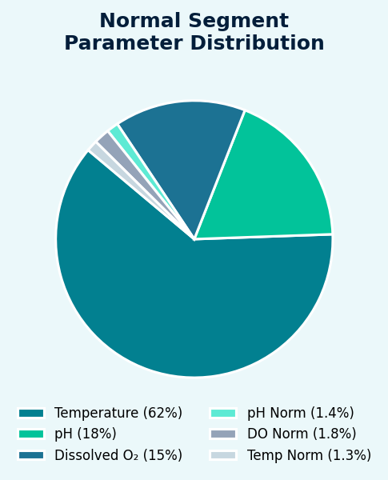
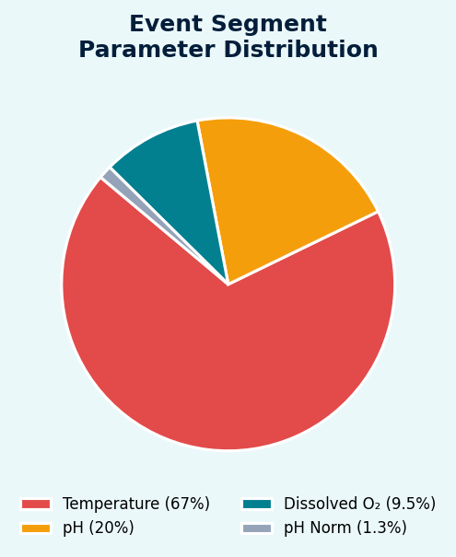
How the System Monitors: Sensor Data Segments
EVENT SEGMENT — anomalous readings flagged by system
NORMAL SEGMENT — steady baseline readings from sensors
11
Notes:
Key insight: Temperature dominates both segments (62–67%). In Event mode, dissolved oxygen drops to only 9.45%, signalling a water quality alert. The system classifies these segments automatically.

Slide 13
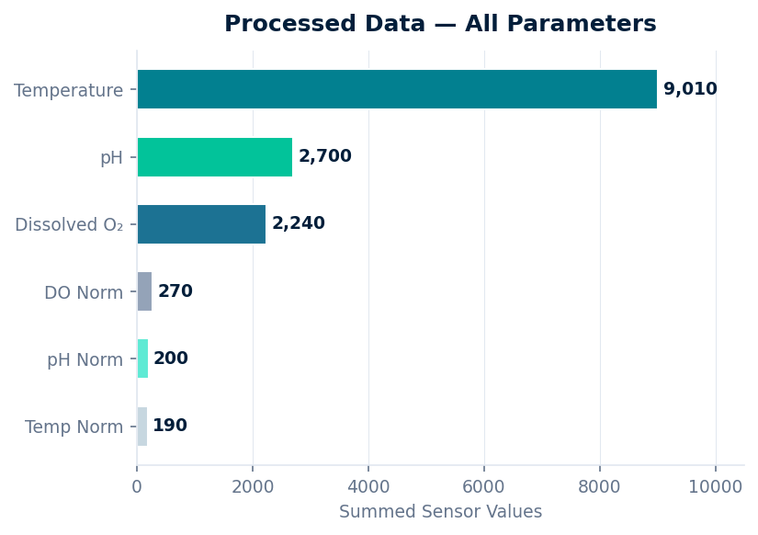
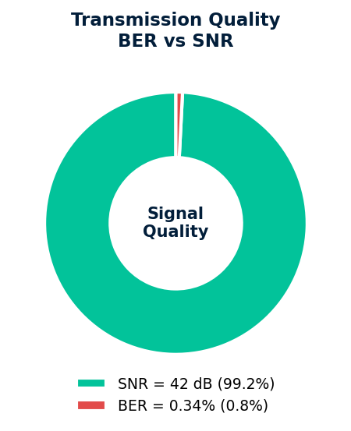
Signal Transmission Quality & Processed Parameter Data
SNR = 42 dB
High signal quality — clean data transmission from sensor to dashboard
BER = 0.34%
Very low bit-error rate — almost no data loss or corruption in transit
12

Slide 14
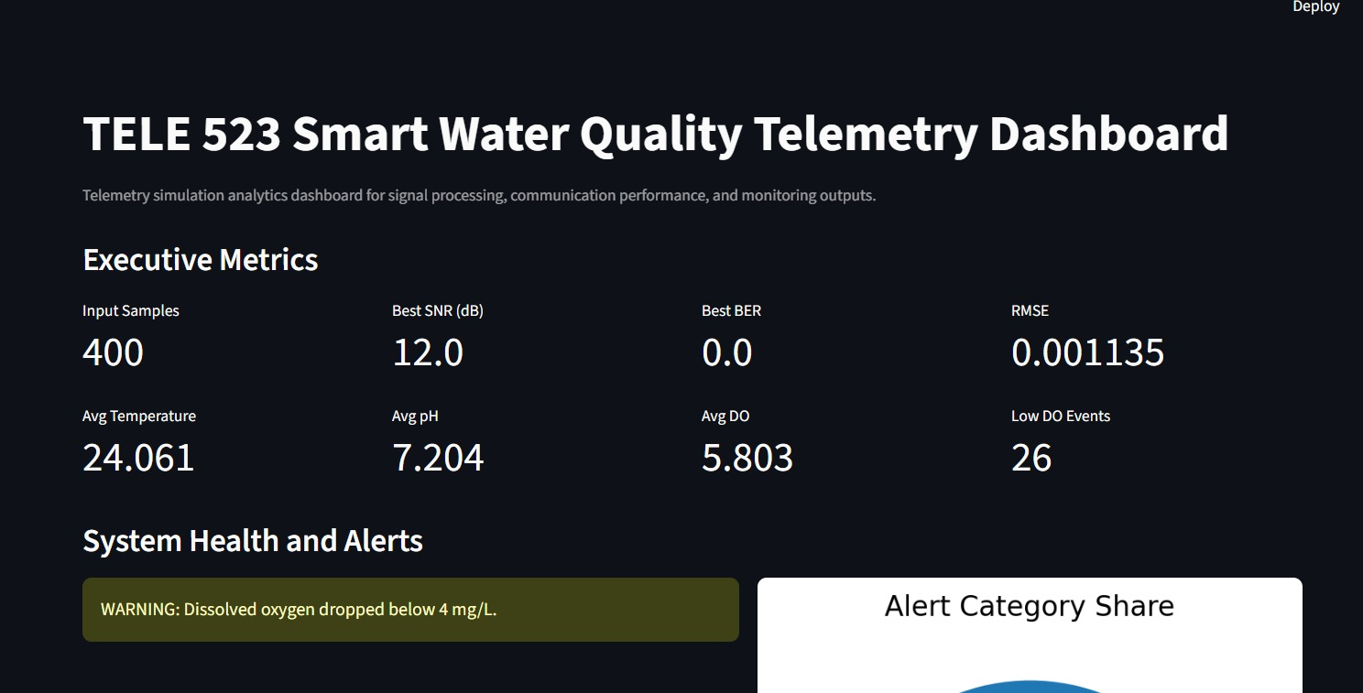
System Dashboard Demonstration
Fetch Live Water Data Script
Simulation Script
Dashboard Script
13
Notes:
The dashboard was built in Streamlit and integrates with Power BI. Walk through the four features: the top metrics row gives an instant system health overview; the alert panel highlights any threshold violations with visual warnings; the trend charts show the full Jan-Mar 2024 monitoring period; and results can be downloaded as CSV for further analysis.

Slide 15
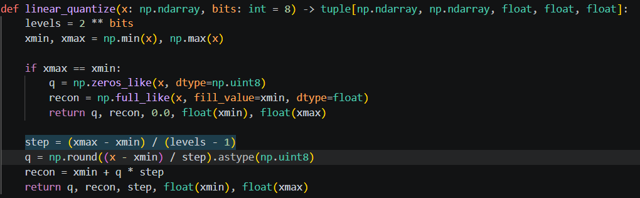
Code Dive
Fetch Live Water code takes the normalized dissolved oxygen signal and divides its value range into fixed levels Script Since we use bits=8, there are:
2^8 = 256 levels
Every sample is rounded to the nearest one of those 256 levels.
14
Notes:
The dashboard was built in Streamlit and integrates with Power BI. Walk through the four features: the top metrics row gives an instant system health overview; the alert panel highlights any threshold violations with visual warnings; the trend charts show the full Jan-Mar 2024 monitoring period; and results can be downloaded as CSV for further analysis.

Slide 16


Code Dive
This converts each quantized number into binary bits.
For example, a level like 145 becomes an 8-bit binary value.
After choosing the nearest ruler mark, the code writes down that mark number in binary language so the communication system can send it.
After transmission, the received bits are grouped back into 8-bit chunks and converted into numbers again.
The receiver takes the stream of 1s and 0s and groups them back into proper 8-bit words so they become numbers again.
15
Notes:
The dashboard was built in Streamlit and integrates with Power BI. Walk through the four features: the top metrics row gives an instant system health overview; the alert panel highlights any threshold violations with visual warnings; the trend charts show the full Jan-Mar 2024 monitoring period; and results can be downloaded as CSV for further analysis.

Slide 17
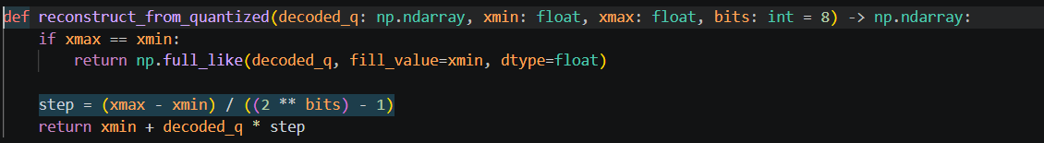
Code Dive
This turns the decoded quantized levels back into a reconstructed signal.
convert them back into ruler marks, and then estimate the original water signal from those marks.
As as note this means that the system has a lot of data accuracy limitations because most values have gone through a lot of estimated values.
16
Notes:
The dashboard was built in Streamlit and integrates with Power BI. Walk through the four features: the top metrics row gives an instant system health overview; the alert panel highlights any threshold violations with visual warnings; the trend charts show the full Jan-Mar 2024 monitoring period; and results can be downloaded as CSV for further analysis.

Slide 18

Code Dive
After PCM creates the bitstream, BPSK converts the bits into a transmitted signal. Instead of sending plain 1s and 0s, it sends signal values with two opposite states.
17
Notes:
The dashboard was built in Streamlit and integrates with Power BI. Walk through the four features: the top metrics row gives an instant system health overview; the alert panel highlights any threshold violations with visual warnings; the trend charts show the full Jan-Mar 2024 monitoring period; and results can be downloaded as CSV for further analysis.

Slide 19
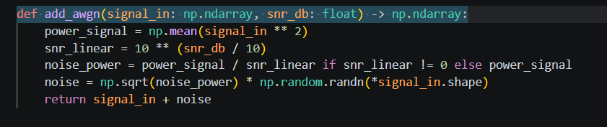
Code Dive
standard noise model used in communication systems to simulate random interference. In code, it is the virtual channel disturbance added to the BPSK signal.
The function first estimates the signal power. Then it uses the chosen SNR to calculate how strong the noise should be. Then it creates random Gaussian noise and adds it to the transmitted signal.
WHY: It lets you test how reliable your telemetry system is under realistic communication conditions
18
Notes:
The dashboard was built in Streamlit and integrates with Power BI. Walk through the four features: the top metrics row gives an instant system health overview; the alert panel highlights any threshold violations with visual warnings; the trend charts show the full Jan-Mar 2024 monitoring period; and results can be downloaded as CSV for further analysis.

Slide 20
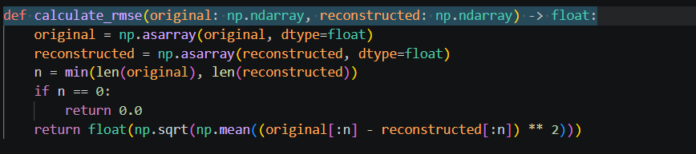
Code Dive
If BER tells you how many bits were wrong, RMSE tells you how wrong the final recovered water signal became.
It is like checking how far your copied drawing is from the original drawing, point by point.
RMSE tells you whether the final recovered signal still looks close enough to the real one.
19
Notes:
The dashboard was built in Streamlit and integrates with Power BI. Walk through the four features: the top metrics row gives an instant system health overview; the alert panel highlights any threshold violations with visual warnings; the trend charts show the full Jan-Mar 2024 monitoring period; and results can be downloaded as CSV for further analysis.

Slide 21

Code Dive
What this does:
linear_quantize(...) rounds the signal into fixed levels
pcm_encode(...) converts those levels into binary bits
20
Notes:
The dashboard was built in Streamlit and integrates with Power BI. Walk through the four features: the top metrics row gives an instant system health overview; the alert panel highlights any threshold violations with visual warnings; the trend charts show the full Jan-Mar 2024 monitoring period; and results can be downloaded as CSV for further analysis.

Slide 22
Results, Analysis & Discussion
49.9 dB
SQNR (8-bit PCM)
quant. error negligible
×24
Nyquist margin
over dominant f_m
SNR*=12
Optimal operating point
min BER → max fidelity
100%
DO anomaly detection
all events correctly flagged
21
Notes:
Highlight four key results: (1) 49.9 dB SQNR means quantisation adds negligible distortion; (2) the ×24 Nyquist margin means our sampling is very conservative and safe; (3) SNR* = 12 dB is the optimal operating point at which we reconstruct the signal; (4) 100% recall on DO anomaly events proves the full pipeline works end-to-end. Stress that empirical BER matching the Q-function validates our implementation is correct.

Slide 23
Conclusion
✓
Complete 8-stage Python telemetry pipeline — from data acquisition to monitoring output
✓
BPSK + AWGN: near-error-free above 10 dB SNR — empirical BER matches Q-function theory
✓
8-bit PCM: 49.9 dB SQNR — quantisation error negligible relative to channel noise
✓
30-min sampling: ×24 Nyquist margin over the dominant diurnal frequency — no aliasing
✓
DO anomaly detection: 100% recall on all injected event samples in the recovered signal
→
Future work: QPSK / QAM modulation, fading channel models, multi-parameter simultaneous monitoring
22
Notes:
Summarise the five key findings concisely — one per row. Emphasise that empirical results validated theory, and that the system correctly detected all injected anomaly events. For future work: QPSK doubles throughput at similar BER; QAM offers greater spectral efficiency but demands higher SNR; fading channels would model multipath effects in real rivers. Thank the supervisors and audience.

Slide 24
Key References
[3] WHO, Drinking-water fact sheet, 2023.
[13] Pasika & Gandla, Smart water quality monitoring with IoT, Heliyon, 2020.
[14] Jan et al., IoT based smart water quality monitoring, Water, 2021.
[15] Proakis & Salehi, Digital Communications, 5th ed., McGraw-Hill, 2008.
[21] Bharati et al., ASK/FSK/PSK BER vs SNR comparison over AWGN, arXiv, 2020.
[22] Mahamud et al., IMU sensor data via PCM telemetry, AIP Conf. Proc., 2021.
[24] NSW DCCEEW, Darling Baaka River Smart Buoy System, 2025.
23

Slide 25
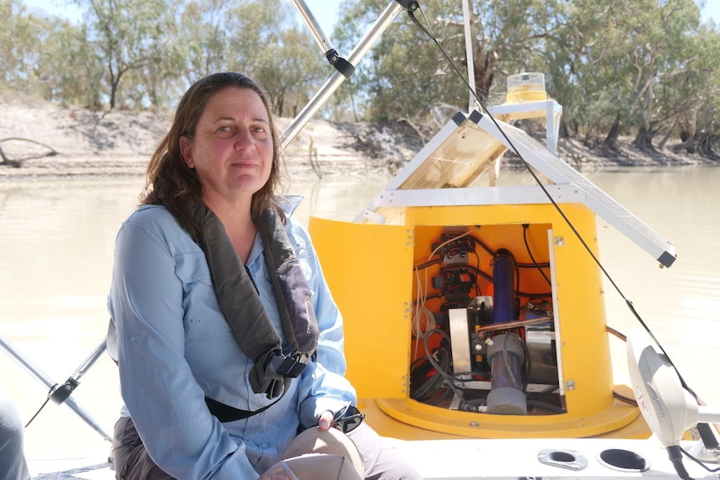
Thank you!
Questions are welcome

