Slide 1
5 beautiful cities in GuangDong

Slide 2
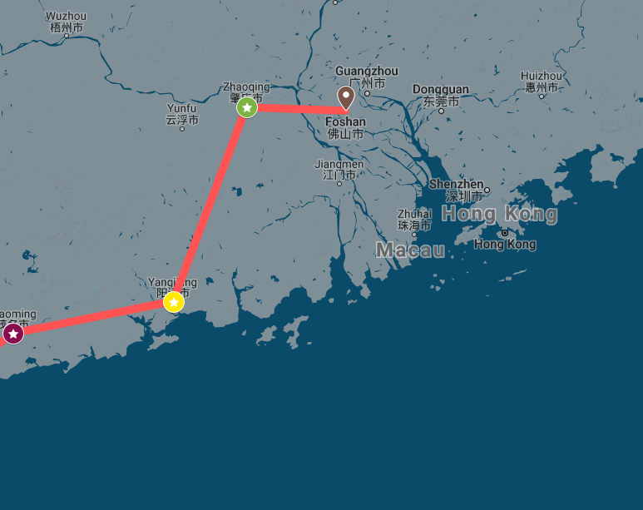
2-week Itinerary

Slide 3
2-week Intinerary
Day 1,2,3,4: Foshan (city)
Day 5,6,7,8 : Zhaoqing (city)
Day 9,10,11 : Yangjiang (city)
Day 12,13,14 : Maoming (city)

Slide 4
Transportation: Guangzhou Metro from Guangzhou to Foshan 2 hours.(￥10)
Accommodation: 7 days inns: ￥200/night (￥800 total)
Food/Drink: ￥150/day (￥600 total)
Sightseeing: The Ancestral Temple (￥20), Ancient Nanfeng kiln (￥25), Xiqiao Mountain (￥70), Changlu farm (￥130).
TOTAL budget: ￥1665
Day 1,2,3,4: Foshan

Slide 5
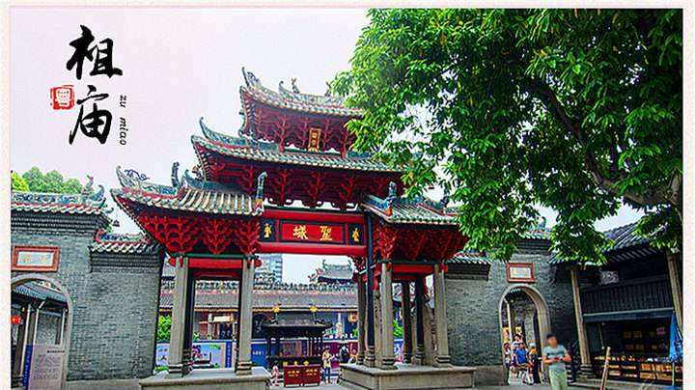
The Ancestral Temple

Slide 6
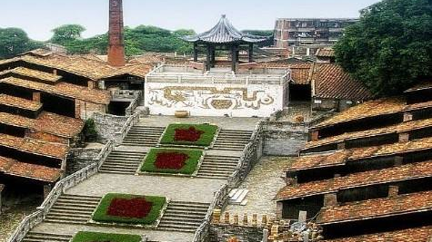
Ancient Nanfeng kiln

Slide 7

Xiqiao Mountain

Slide 8
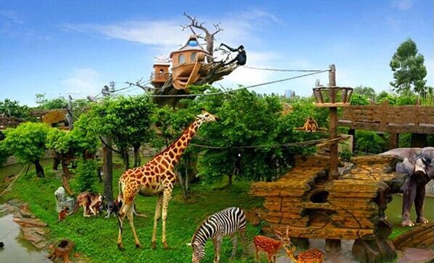
Changlu farm

Slide 9
Transportation: take a two-hour train from Foshan to Zhaoqing.(￥50)
Accommodation: 7 days inns: ￥168/night (￥672 total)
Food/Drink: ￥150/day (￥600 total)
Sightseeing: Seven Star Cave (￥78), Dinghu Mountain (￥78), Xiannvhu Lake (￥60), Panlong Gorge (￥120).
TOTAL budget: ￥1658
Day 5,6,7,8: Zhaoqing

Slide 10
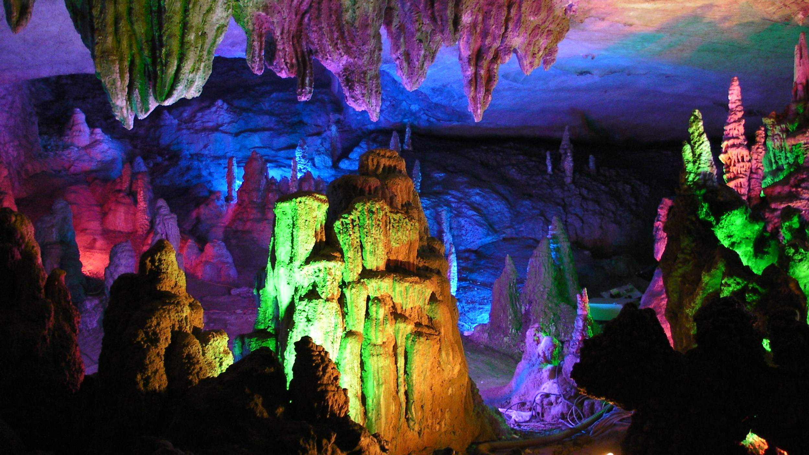
Seven Star Cave

Slide 11
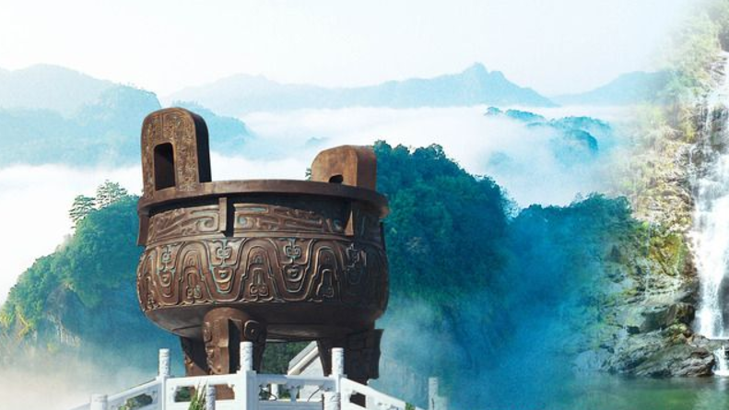
Dinghu Mountain

Slide 12
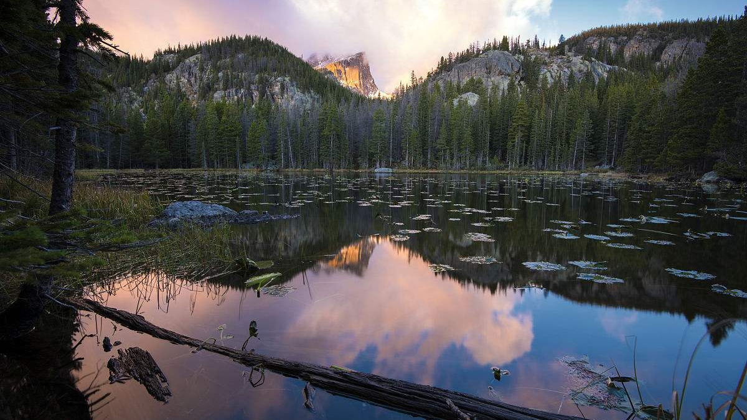
Xiannvhu Lake

Slide 13
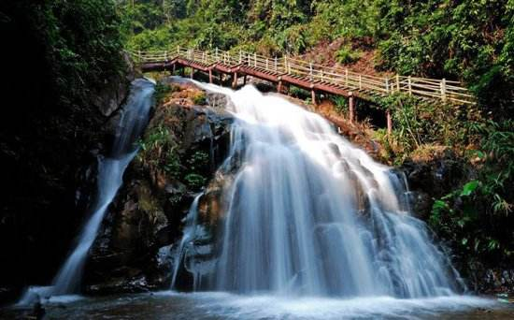
Panlong Gorge

Slide 14
Transportation: take a four-hour bus from Zhaoqing to Yangjiang.(￥80)
Accommodation: 7 days inns: ￥132/night (￥264 total)
Food/Drink: ￥200/day (￥400 total)
Sightseeing: Hailing Island (￥50), Horsetail Island (free), Lingxiaoyan (￥48).
TOTAL budget: ￥842
Day 9,10,11: Yangjiang

Slide 15
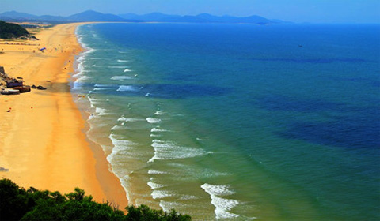
Hailing Island

Slide 16
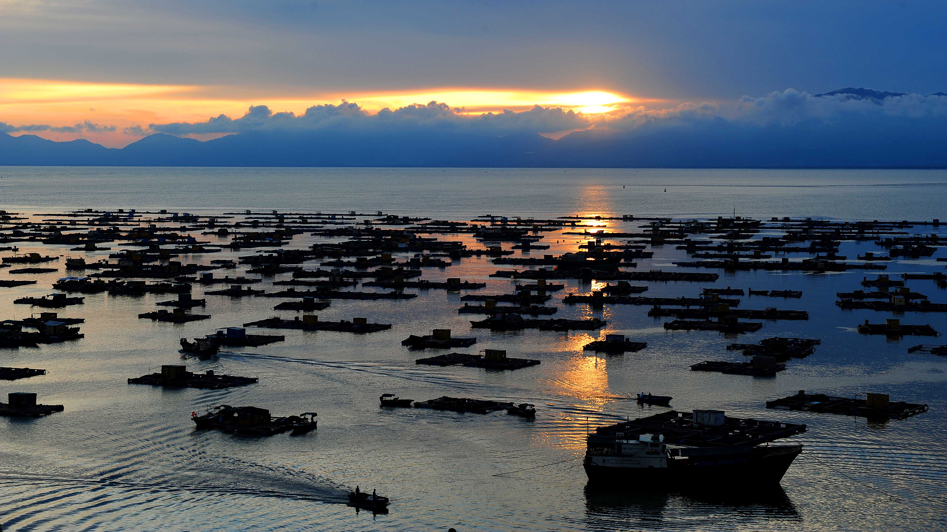
Horsetail Island

Slide 17
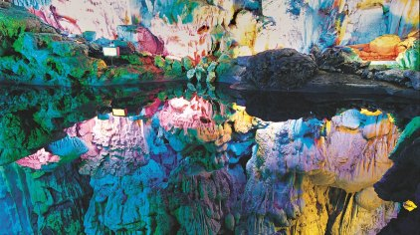
Lingxiaoyan

Slide 18
Transportation: take a two-hour bus from Yangjiang to Maoming (￥60)
Accommodation: 7 days inns: ￥140/night (￥420 total)
Food/Drink: ￥200/day (￥600 total)
Sightseeing: China's first Beach Resort (￥free), Fu Shanling Mountain (free), Fangji island (￥180).
TOTAL budget: ￥1260
Day 12,13,14: Maoming

Slide 19
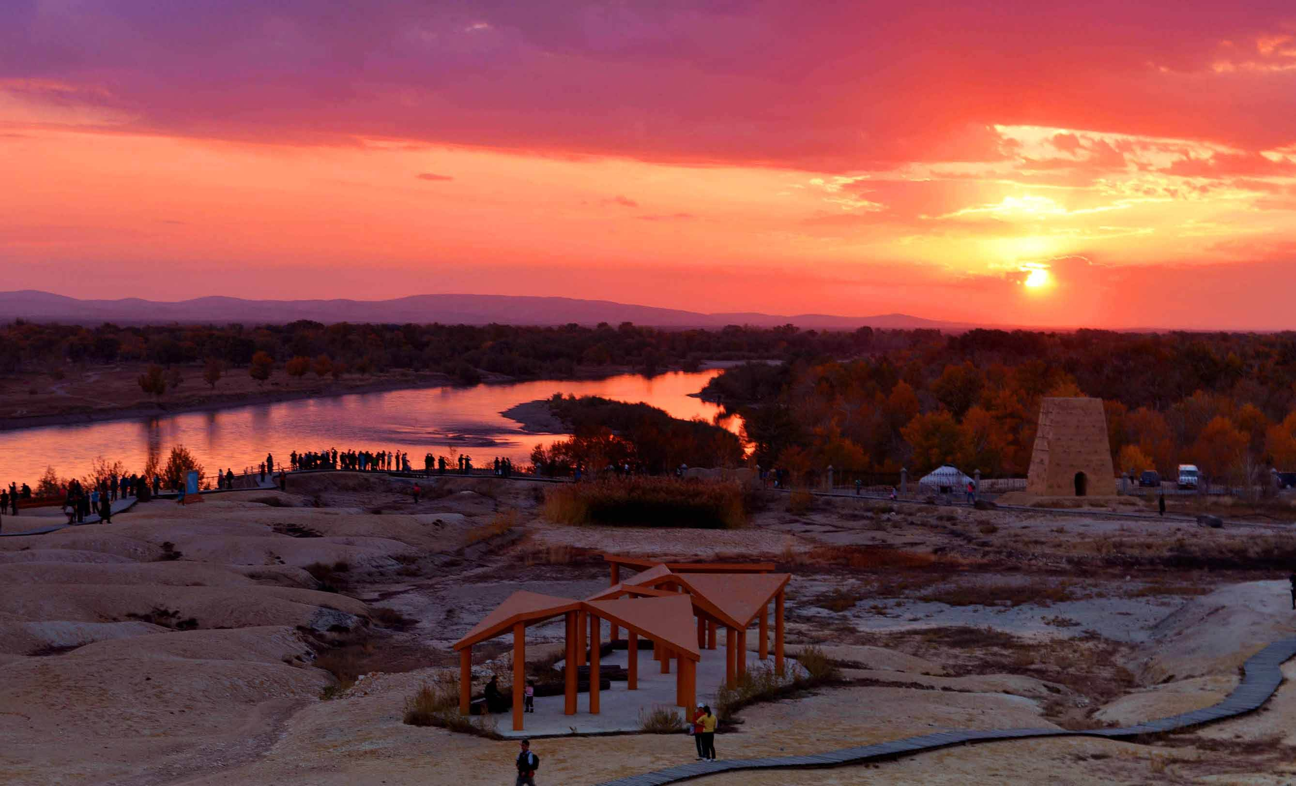
China's first Beach Resort

Slide 20
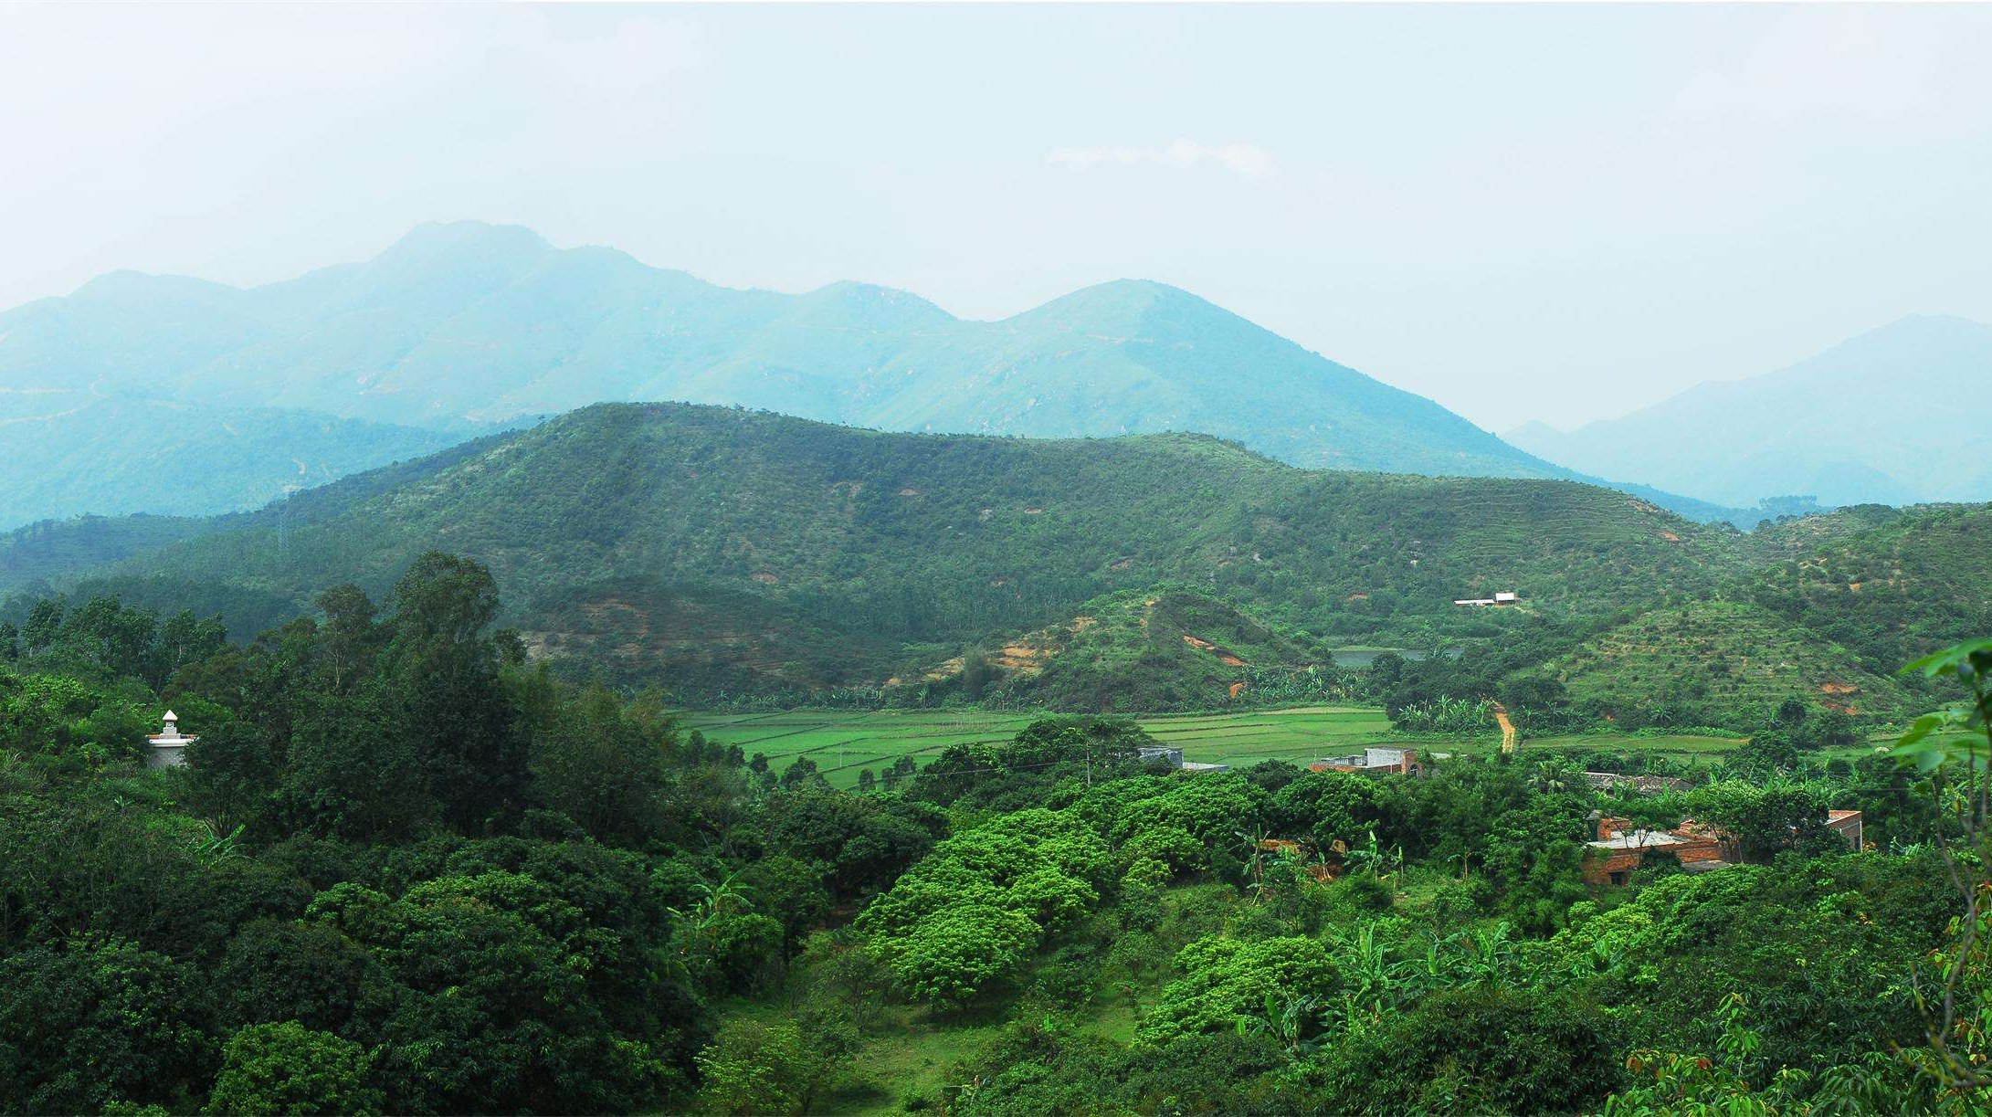
Fu Shanling Mountain

Slide 21
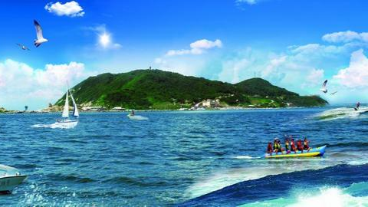
Fangji island

