Slide 1
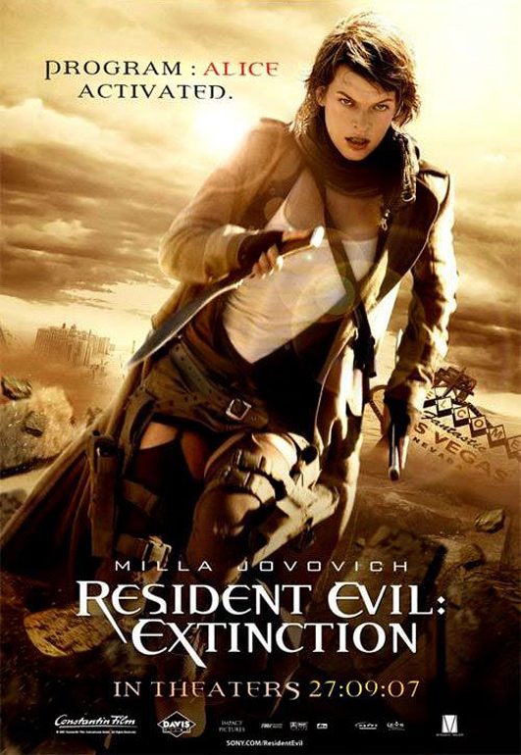
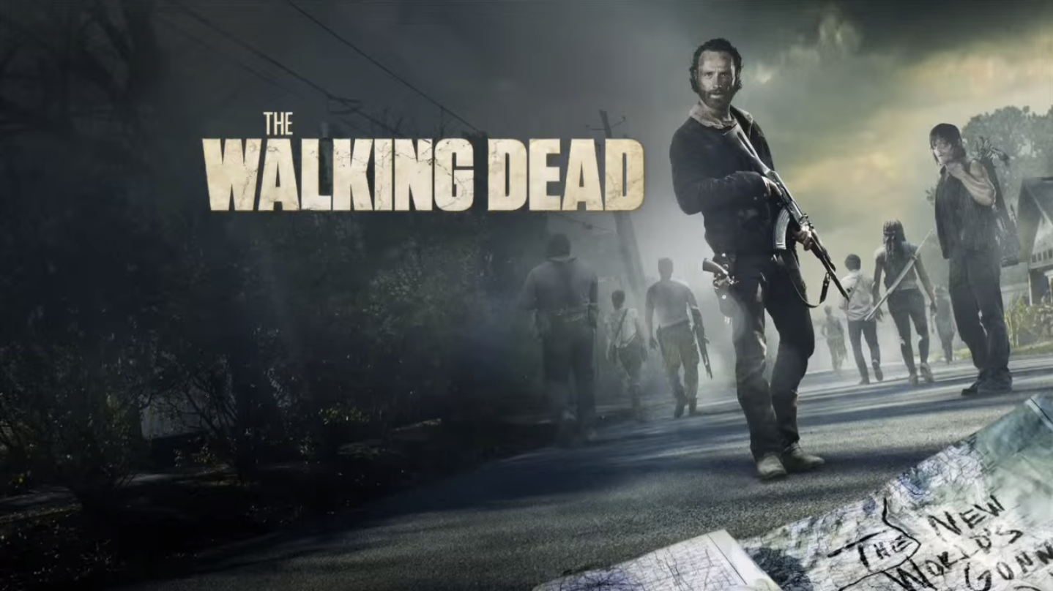

zombie
It's a dead body reanimated through various methods.
Dead Brian,Aniaml reaction.

Slide 2
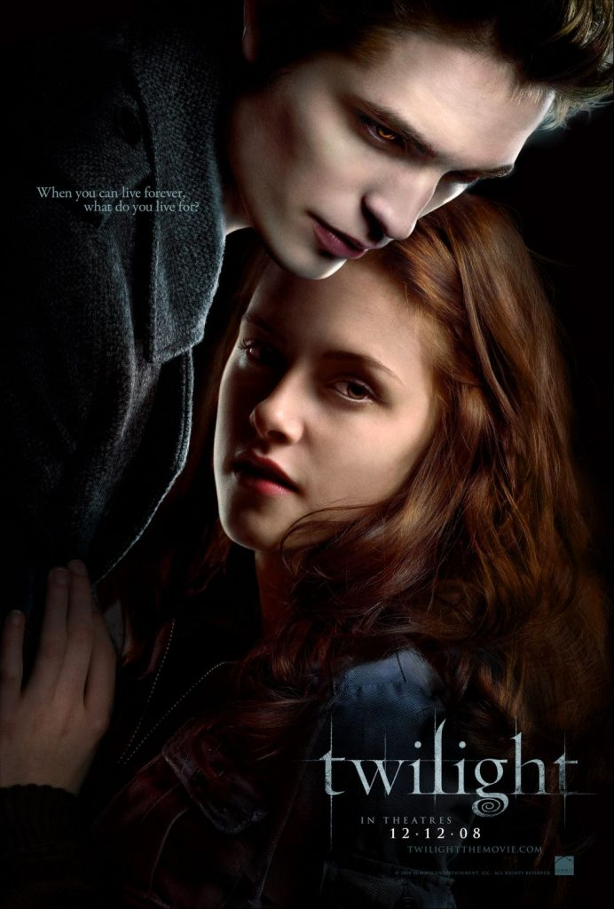
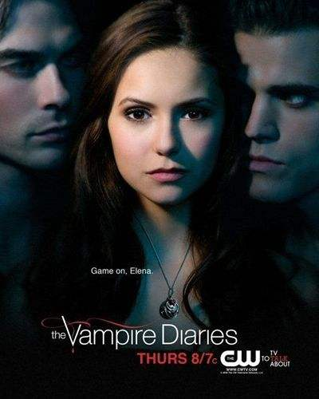
Vampire is a being from folklore who subsists by feeding on the life essence (generally in the form of blood) of the living.

Slide 3
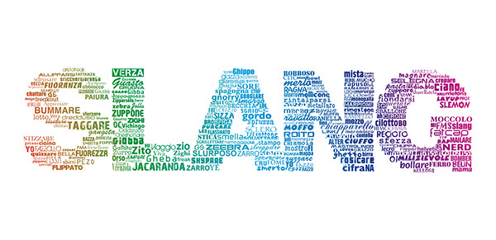
SLANG:ZOMBIE (Derogatory) a dull, brainless person; a person having no independent judgment, intelligence, etc.;

