Slide 1
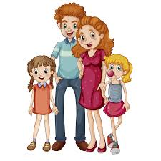
Evidence: Family likes and dislike
Learning Activity 3
Karen Andrea Culman

Slide 2

DESCRIPTIONS

