Slide 1
Automata From RNN
Summary of Weiss, Goldberg, and Yahav 2018b

Slide 2
Goal: Define an Automata that represents than RNN
The RNN is an acceptor, trained to 100% accuracy to match a regular language
The Automata will represent the regular language with minimal complexity
The L* exact learning algorithm will derive the Automata from the RNN

Slide 3
The RNN is an acceptor
trained to 100% accuracy to match a regular language

Slide 4
RNN Quick Review
(Weiss, Goldberg, Yahav, 2018a)
h_{t}= activation(Wx_{t} + Uh_{t-1} + b)
f(h_{t}) -> {0,1}

Slide 5
RNN Quick Review
(Weiss, Goldberg, Yahav)
Classification is a function of the internal state vector h,
Similarly, the acceptance or rejection in a DFA is determined by the DFA’s states
The n states of the extracted DFA will correspond to n partitions of the real valued vector space represented in the RNN’s h.

Slide 6
Don’t worry, we’ll come back to partitioning H.
For now, DFA states ~ h.

Slide 7
The Automata will represent the regular language
with minimal complexity

Slide 8
Automata Stuff
DFA accepting sequences starting with ‘b’ followed by one or more ‘a’s:
DFAs can exactly represent the concept underlying the string classification that these RNNs were trained on
Direct comparison of DFAs to RNNs can be done via classification of random strings. (inefficient!)
2 DFAs can be compared to each other by parallel traversal and state comparison.

Slide 9
The L* exact learning algorithm
will derive the Automata from the RNN

Slide 10
L*: Concept, Teacher, Queries, Hypothesis
The L* algorithm learns a
concept (a regular language) from a
teacher (~our trained RNN) that can answer
queries about
  membership (sequence classification) and
  equivalence between that concept and the
hypothesis (DFA) generated by the algorithm so far

Slide 11
But Remember…
Comparing an RNN to a DFA is hard. So instead, we’ll create DFA abstraction of our RNN, and compare the abstraction to both the hypothesized DFA and the RNN.
But isn’t abstracting a DFA from an RNN the goal? What is the difference between the abstraction DFA and the hypothesis DFA?
  The hypothesis DFA is minimal. It will include only enough states to correctly represent the concept, and no more.
  The abstraction DFA is a shortcut, through which we will discover necessary refinements to our hypothesis, but on its own it will not necessarily be interpretable and certainly won’t be minimal.

Slide 12
Let’s Get more formal
This is complicated. Here’s some notation.

Slide 13
5. Notation
Standard Automata Notation: A = < \Sigma, Q, q₀ F, and \delta > with the addition of
  \deltaHat representing transitions from recursive application of delta to each character in a word
  f(q) = Acc <-> q in F
RNN acceptor notation :
  h_{0,R} the initial state of the RNN
  gHat_{R} (h, w) the state resulting from the sequential processing of w in R

Slide 14
4. Learning Automata from RNNS using L*
To define an automata A that corresponds a given RNN R, we’ll represent R in an abstraction A^{R,p} and use A^{Rp} as our teacher in the L*, which requires the teacher to answer two query types:
Membership Queries:
  Is w in the concept/language?
  ‘Trivially’ answered by R
Equivalence Queries:
  Is the hypothesis, A, equivalent to the concept in R?
  Not Trivial

Slide 15
6. Equivalence Queries
Is the hypothesis A equivalent to the concept in R?
Compare A and A^{R,p} by parallel traversal, searching for a disagreeing example
When a classification divergence is found between the two automata, refer to R…
NA
 | R accepts w | R rejects w
A accepts w, A^{R,p} rejects w | Abstraction disagrees with original | Return counterexample
A rejects w, A^{R,p} accepts w | Return counterexample | Abstraction disagrees with original
Classification conflicts

Slide 16
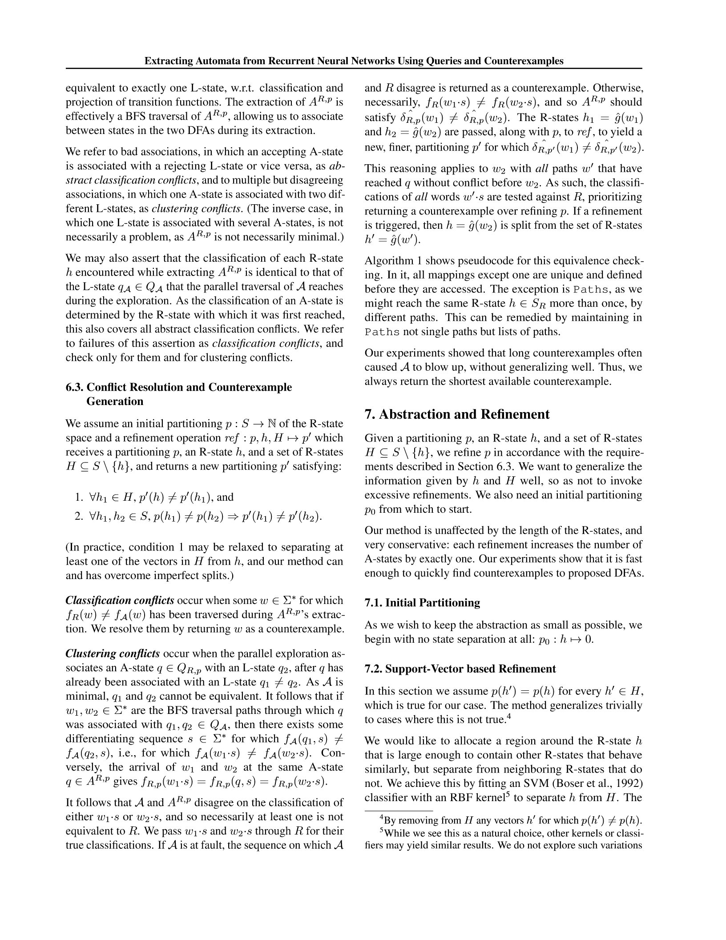
Why Is Abstraction Never at Fault in Classification conflicts?
From sections 6.2 and 6.3, page 4.

Slide 17
6. Classification Conflicts
Is the hypothesis A equivalent to the concept in R?
Compare A and A^{R,p} by parallel traversal, searching for a disagreeing example
When a classification divergence is found between the two automata, refer to R…
 | R and A^{R,p} classification:
A classification: |  | accept | reject
 | accept |  | Return counterexample
 | reject | Return counterexample
Classification conflicts
When a state divergence is found…

Slide 18
Clustering Conflicts
Occur when there is a misalignment of states between machines
States in the three machines are differentiated as:
  A- state = abstraction A^{R,p} state
  R- state = RNN state
  L- state = L* hypothesis generated state (from A)

Slide 19
Clustering Conflicts
How will we know them?
Parallel traversal, when a second L state (q₂) is associated with an A state (q) which has already been associated a previous L state (q₁). (q₁ != q₂)
  There is no issue if two A states map to one L state, because A is not necessarily minimal
  Misalignment with R states is discovered via classification conflicts
q₁
A
q₂
A^{R,p}
q

Slide 20
Clustering Conflicts
If
  w₁ -> q₁
  w₂ -> q₂
And A is minimal…
  There exists s s.t. f_{A}(w₁+s) != f_{A}(w₂+s)
However,
  f_{R,p}(w₁+s) == f_{R,p}(w₂+s)
Therefor…
A^{R,p}
q
q₁
A
q₂

Slide 21
Clustering Conflicts
 | f_{R}(w₁+s) == f_{R}(w₂+s) | f_{R}(w₁+s) != f_{R}(w₂+s)
f_{R,p}(w₁+s) == f_{R,p}(w₂+s) | Abstraction agrees with original | Refine partitioning for ghat(w₁) and ghat(w₂)
f_{A}(w₁+s) != f_{A}(w₂+s) | Return counterexample | Original supports hypothesis

Slide 22
Abstraction Refinement
“This reasoning applies to w₂ with all paths w’ that have reached q without conflict before w₂”
Revisit all prior w’, prioritizing short counterexamples.
If no counterexamples are found, new partitions should separate ghat(w₂) from all ghat(w’)
A^{R,p}
q₁
A
q₂
q

