Slide 1
T-sne
An introduction to the algorithm and examples of practical use
By Kendra Chalkley (kchalk)
Kd.Chalkley@gmail.com

Slide 2
TSNE is…
A method of visualizing
high dimensional numeric data
in low dimensional, plottable space
Original t-SNE paper, supplemental material, and follow up papers available at https://lvdmaaten.github.io/tsne/

Slide 3
TSNE Talk Outline
Motivations
Why Visualize?
What data?
How Does it work?
Algorithm Details
Example Results
Euclidean Distance
Neighborhood Probabilities
Perplexity
Student’s T
KL Divergence
Images MNIST, COIL-20
Word and Character Embeddings
Classification errors
Language Data Exploration

Slide 4
Motivations

Slide 5
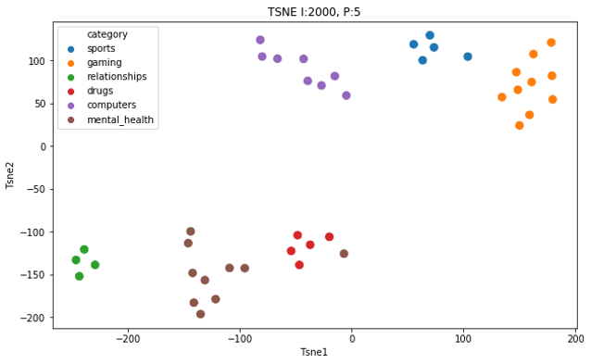
Why Visualize?
Data Exploration
Interpretation
Error Analysis
Notes:
What groups exist? Are they the ones I expected? (ProED and 2 v. 6 groups)

Slide 6
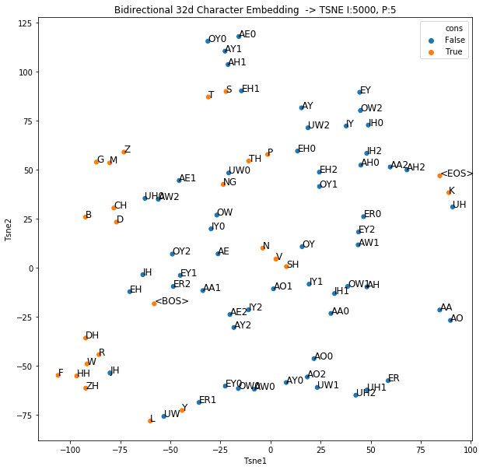
Why Visualize?
Data Exploration
Interpretation
Error Analysis
Notes:
What is this vis? Importance of understanding NN. (under addressed outside ‘should ethics’) (save the rest for later?)

Slide 7
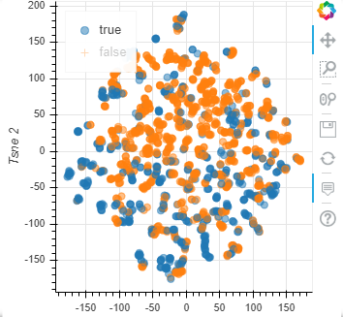
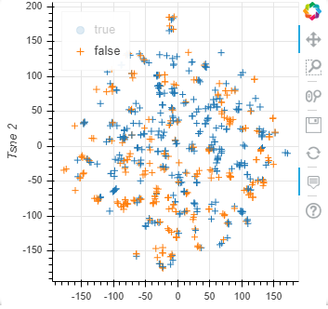
Why Visualize?
Data Exploration
Interpretation
Error Analysis
Notes:
I had hope for this one. Dots v. crosses and orange v. blue. Hypothesis? Improved version later in talk

Slide 8

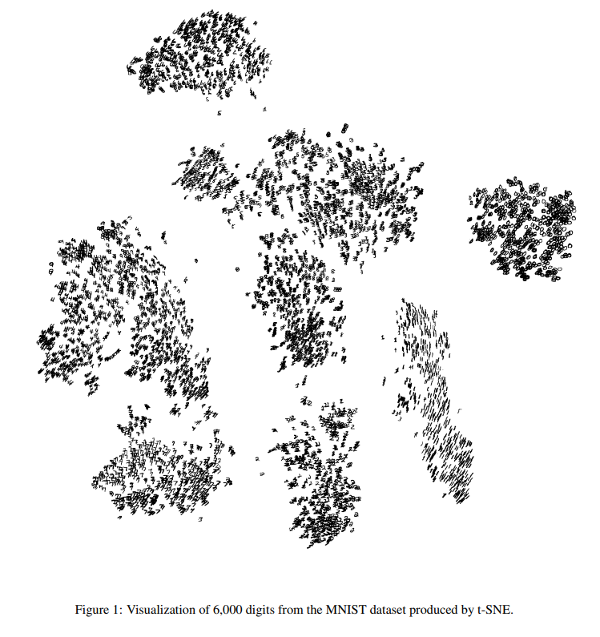
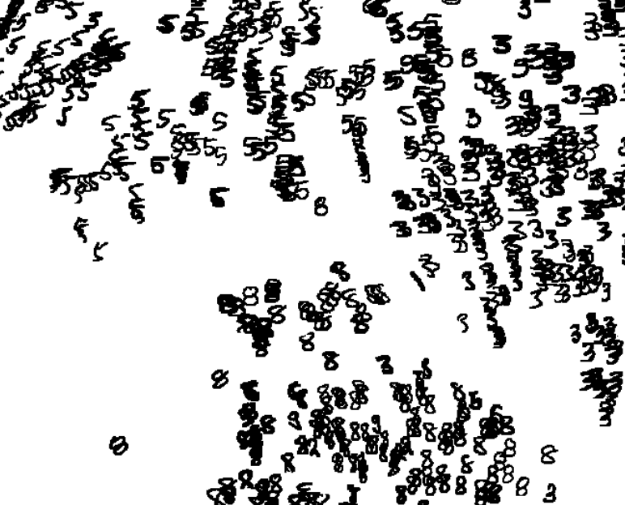
What Data?
Images
Embeddings
Other hidden states
Language data
Images from supplemental material available at https://lvdmaaten.github.io/publications/misc/Supplement_JMLR_2008.pdf

Slide 9
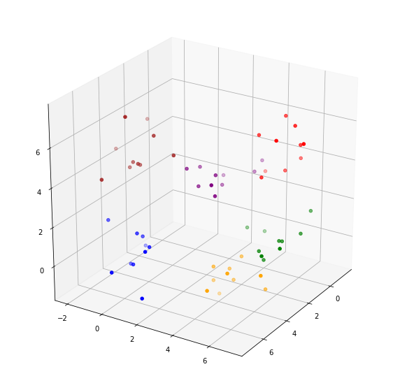
Example Data
6 clusters of random, 3d data
Notes:
In this talk I’ll use this dataset…

Slide 10
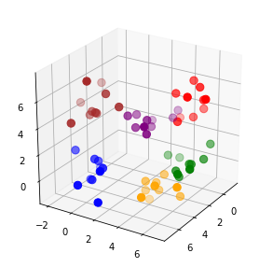
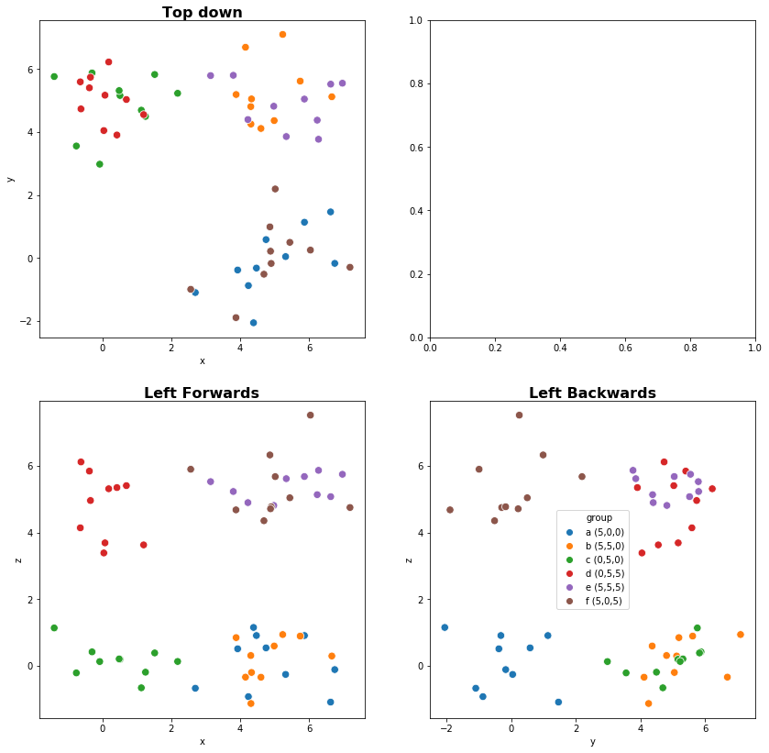
Example Data in 2d

Slide 11
How? Part 1
The Algorithm

Slide 12


T-distributed Stochastic Neighborhood Embedding
Calculate pairwise Euclidean distance between all points
For each point, transform distance measures to neighborhood probabilities.
“The similarity of datapoint j to datapoint i is the conditional probability i would pick j as its neighbor if neighbors were picked in proportion to their probability density under a gaussian centered at i.”

Slide 13
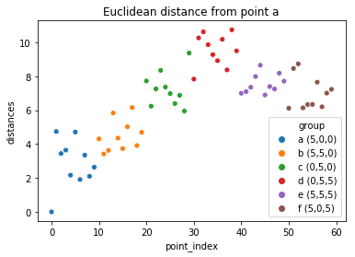
Euclidean Distance

Slide 14
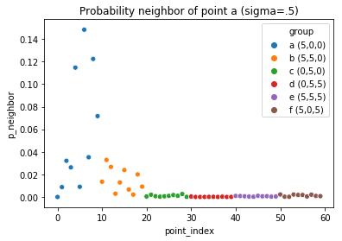
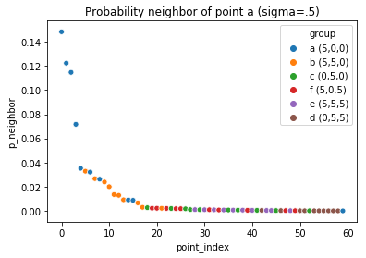
Neighborhood Probabilities
Notes:
Looks vaguely normal. Sigma is small. Sigma is arbitrarily chosen in this example. In the algorithm…

Slide 15


T-distributed Stochastic Neighborhood Embedding
Calculate pairwise Euclidean distance between all points
For each point, transform distance measures to neighborhood probabilities.
For each point, determine the variance which will produce a distribution with the correct perplexity

Slide 16
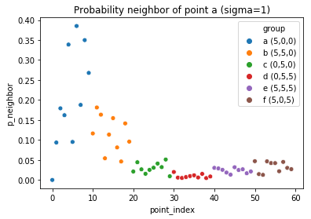
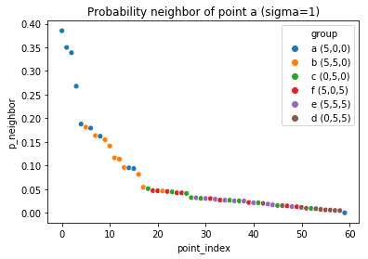
Perplexity and neighborhood size
Sigma varies by point, to maintain a constant perplexity.
Thus the perplexity hyper parameter defines neighborhood size.

Slide 17

T-distributed Stochastic Neighborhood Embedding
Calculate pairwise Euclidean distance between all points
For each point, transform distance measures to neighborhood probabilities.
For each point, determine the variance which will produce a distribution with the correct perplexity
Perform the same calculations on randomly initialized lower dimensional points, but replace the gaussian distribution with a student’s t distribution.

Slide 18
The Crowding problem
Imagine a sphere, each point equidistant from the origin.
Now represent those points in 2d…
Notice the crowding…

Slide 19
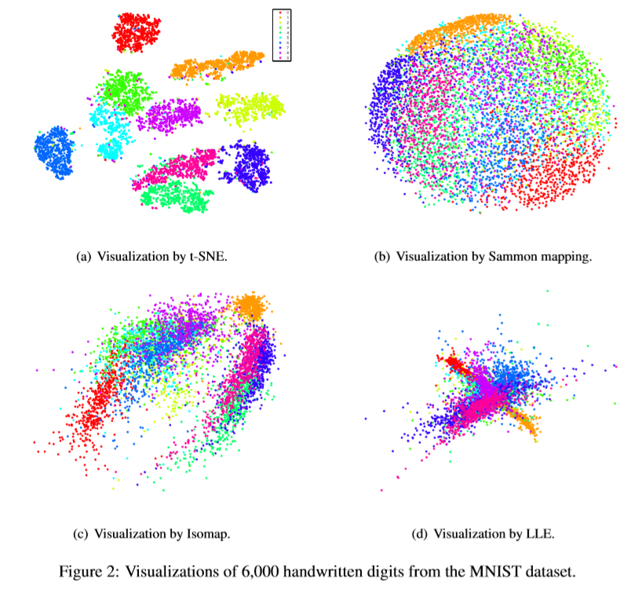
The Crowding problem

Slide 20
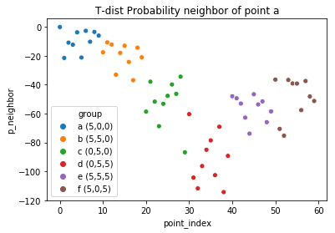
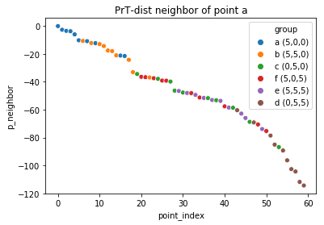
Low Dimensional Probabilities

Slide 21
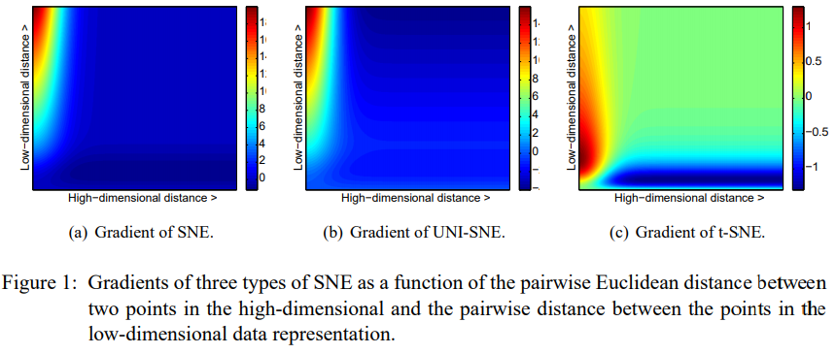

Slide 22

T-distributed Stochastic Neighborhood Embedding
Calculate pairwise Euclidean distance between all points
For each point, transform distance measures to neighborhood probabilities.
For each point, determine the variance which will produce a distribution with the correct perplexity
Perform the same calculations on randomly initialized lower dimensional points, but replace the gaussian distribution with a student’s t distribution.
Iteratively update low-d values to minimize the KL divergence between the two distributions

Slide 23
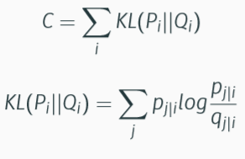



Cost Function: Kullback-Leibler Divergence
Reference:
https://towardsdatascience.com/demystifying-kl-divergence-7ebe4317ee68
Notes:
Difference in entropies, entropy is the expected value of log of distributions, when you subtract two logs division, discrete expectation represented as summation… copy of other slides in appendix. https://towardsdatascience.com/demystifying-kl-divergence-7ebe4317ee68

Slide 24
T-distributed Stochastic Neighborhood Embedding
In both high and low dimensions…
Calculate Euclidean distance between all points
Transform distance measures to neighborhood probabilities.
In high-d using the variance which will produce a gaussian distribution with the correct perplexity…
In low-d using a student’s T distribution
Iteratively update low-d values to minimize the KL divergence between the two distributions

Slide 25
Gif from a great t-sne explanation:
https://www.oreilly.com/learning/an-illustrated-introduction-to-the-t-sne-algorithm

Slide 26
How? Part 2
The Results

Slide 27
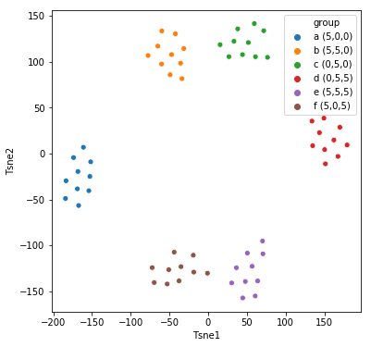
Random Example Data

Slide 28
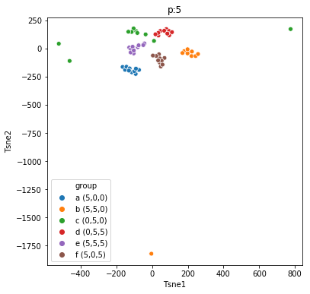
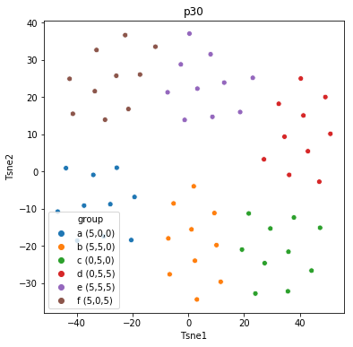
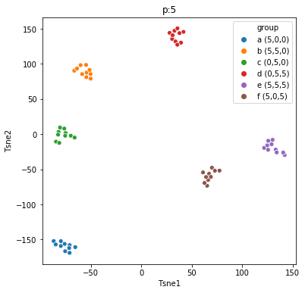
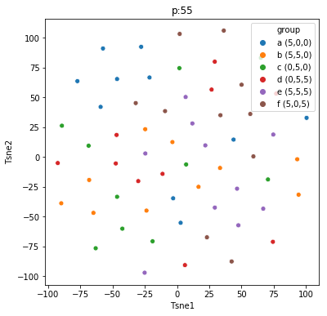
Random Example Data

Slide 29
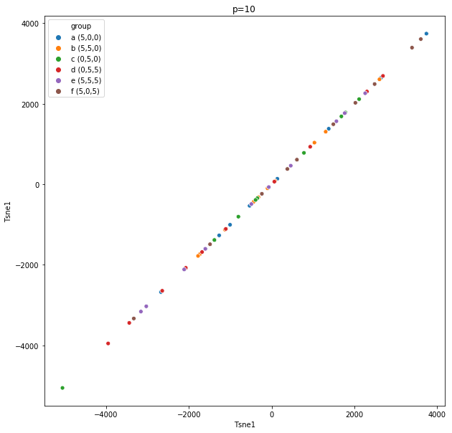
Random Example Data

Slide 30
Character Embeddings

Slide 31
Reddit Project

Slide 32
Reddit is a Website
Forums are called subreddits or /r/’s
Posts are called ‘submissions’ and replies are called ‘comments’
Many submissions are external links, some are ‘self_text’
This project analyzed text from self posts which contained at least 100 words and were posted 1/2012 – 11/2017

Slide 33
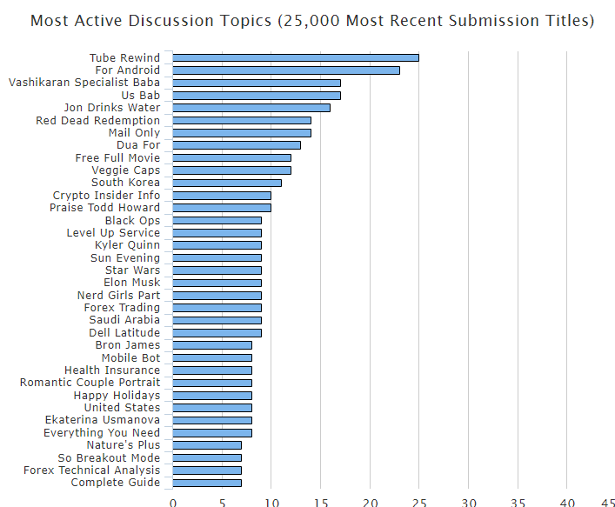
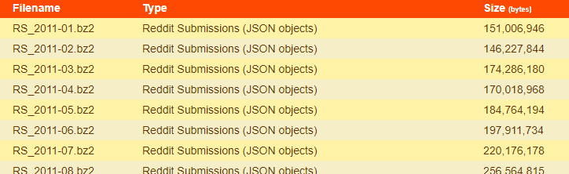


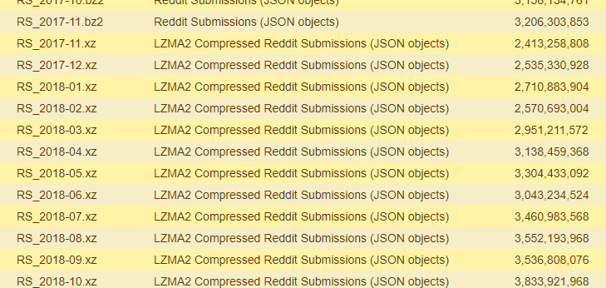
Pushshift.io
A complete history of reddit posts is available at
files.pushshift.io/reddit
It’s a neat site

Slide 34
Social Science of Web Postings
Subreddit composition and language is of interest to social scientists
In an Absolutist State DOI: 10.1177/2167702617747074
CL Psych: http://clpsych.org/
Expert, Crowdsourced, and Machine Assessment of Suicide Risk via Online Postings DOI: 10.18653/v1/W18-0603

Slide 35
Subreddit Categories
gaming: leagueoflegends, gaming, DestinyTheGame, DotA2, ContestofChampions, StarWarsBattlefront, Overwatch, WWII, hearthstone, wow, heroesofthestorm, destiny2, darksouls3, fallout
mental_health: SuicideWatch, depression, OCD, dpdr, proED, Anxiety, BPD, socialanxiety, mentalhealth, ADHD, bipolar
computers: buildapc, techsupport, buildapcforme, hacker, SuggestALaptop, hardwareswap, laptops, computers, pcmasterrace
relationships: relationships, relationship_advice, breakups, dating_advice, LongDistance, polyamory, wemetonline
drugs: MDMA, Drugs, trees, opiates, LSD
general: tifu, r4r, AskReddit, reddit.com, tipofmytongue, Life, Advice, jobs, teenagers, HomeImprovement, redditinreddit
sports: FIFA, nba, hockey, nfl, mls, baseball
media: BokuNoHeroAcademia, anime, movies, StrangerThings

Slide 36
Dictionaries
absolutist
functional
pronoun
verb
past
present
future
negate
number
swear
social
family
positive emotion
negative emotion
anger
sad
tentative
certain
body
ingest
motion
space
time
work
achieve
leisure
home
money
death
filler

Slide 37
~ a brief Pause ~

Slide 38

Thank you!

Slide 39
Appendix
Other things you might care about…

Slide 40
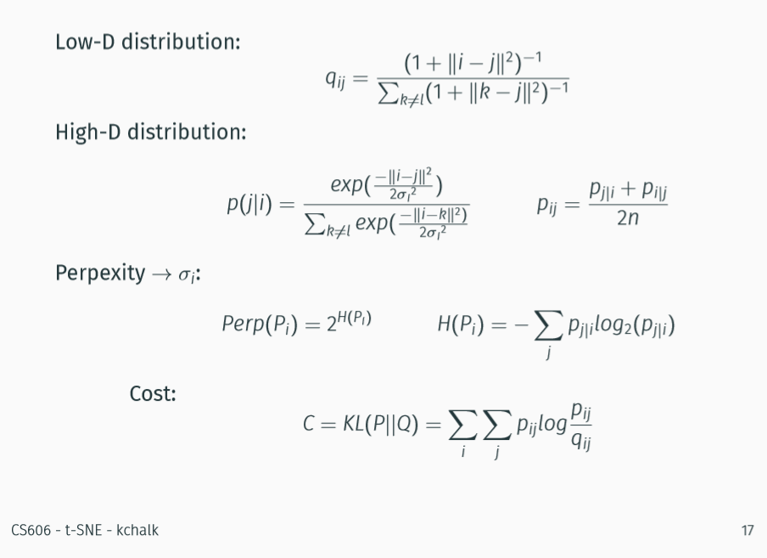

Slide 41
Other Dimensionality reduction techniques
https://lvdmaaten.github.io/publications/papers/JMLR_2008.pdf

Slide 42
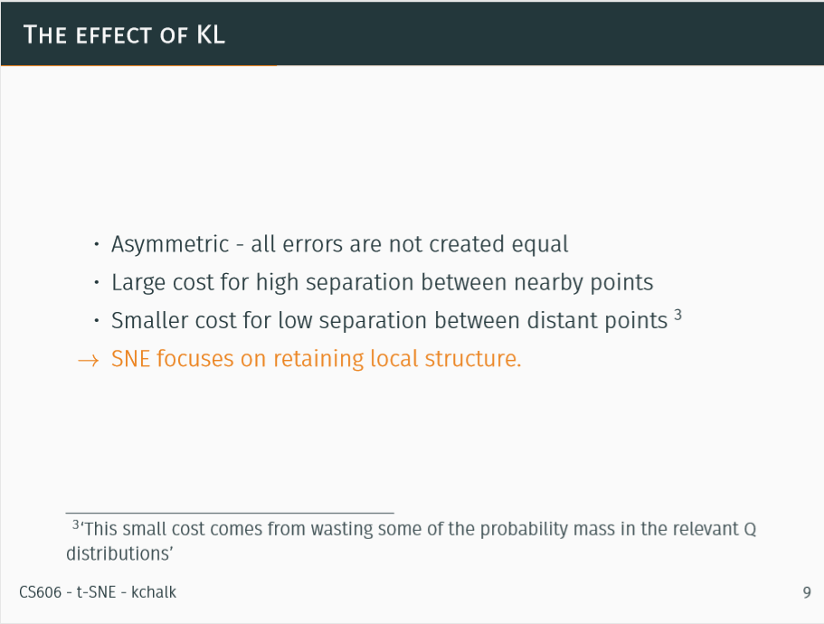

Slide 43
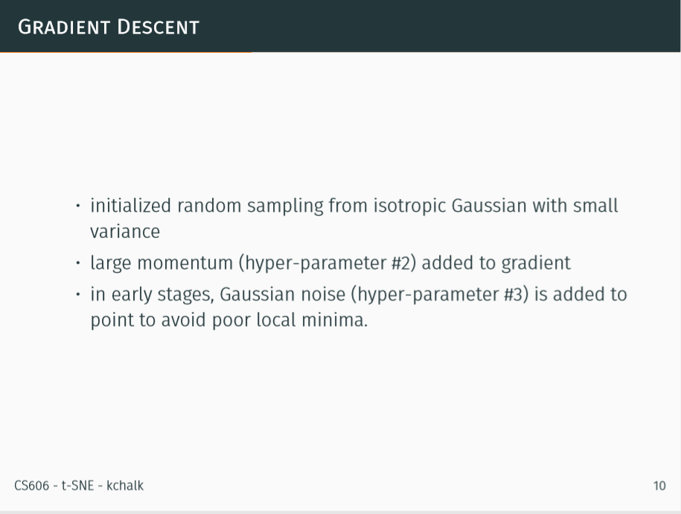

Slide 44
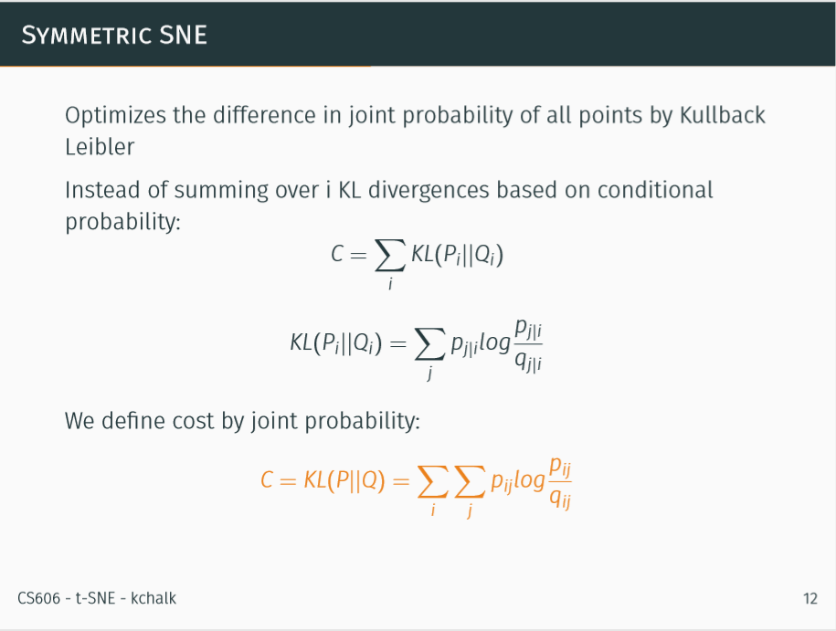

Slide 45
