Slide 1
Introduction
The importance of Software Quality is increasing with the increase in reliance on software systems, ensuring software quality
is crucial to prevent significant financial losses resulting from software defects or failures.
Static analysis tools play a key role in ensuring software quality by allowing developers to analyze code without running it. These tools identify defects early in the development process, making it easier and cheaper to fix issues.
Developers can use static analysis tools in various ways, including integrating them into IDEs, running them from the command line, or as standalone tools. These tools help developers find bugs while typing code and offer solutions for detected defects.
Despite the benefits, consistent usage of static analysis tools is not widespread among developers. One of the reasons for this is the complexity of tool interfaces and difficulties in interpreting feedback.
Existing research has focused on the improvement of static analysis tools, but there is a lack of understanding regarding why developers avoid using these tools and what specific features could enhance their usability and effectiveness.
This research aims to investigate the reasons behind developers' reluctance to use static analysis tools and explore how these tools can be improved based on developers' feedback.
The study will concentrate on tools like FindBugs, Lint, IntelliJ, and PMD, with a focus on understanding developer perspectives on FindBugs, the tool selected for the research interviews.

Slide 2
Study
The researchers conducted conducted semi-structured interviews with software developers, lasting 40-60 minutes each, and recorded with participant consent.
They manually transcribed each interview session and performed qualitative analysis by coding the transcriptions.
They engaged with a group of 20 participants, among which sixteen participants were professional developers in a large company, while four were graduate students at North Carolina State University with prior industry experience. Participants' development experience ranged from 3 to 25 years.
The researchers then collected demographic information through short questionnaires, including participants' pseudonyms for confidentiality. Also gathered data on open-source and closed-source tools used by participants to find bugs. Participants' responses were recorded and analyzed, forming the basis of the study's findings.

Slide 3
Survey
The survey consisted of 40 questions (Q1-Q40) grouped into six categories, covering participant information, general use of static analysis tools, reporting warnings, working context, features of analysis tools, and fixing analysis warnings.
Most questions were multiple-choice, with an option for free-text responses under an "Others" category.
A pilot survey involving five developers was conducted to refine the questionnaire. After adjustments, the survey was designed to be completed within approximately 20 minutes, removing questions redundant with similar content to ensure efficiency.
Participant Profile: The survey included participants with varied experience levels: 46.8% had 2-5 years of experience, 25.3% had 5-10 years, 13.9% had 1-2 years, 10.1% had more than 10 years, and 3.8% had less than a year of experience as software developers. The majority (91.1%) worked with Java, with other languages such as JavaScript, C/C++, PHP, and Python also being used to varying extents.
Most questions were multiple-choice, facilitating straightforward analysis of the responses. The high response rate was attributed to the survey's multiple-choice format and the company's internal promotion of the survey. Free-text responses were collected but were not numerically significant enough to report on. The survey design incorporated suggestions from an experienced Software AG developer, ensuring comprehensive coverage of developers' responses.

Slide 4
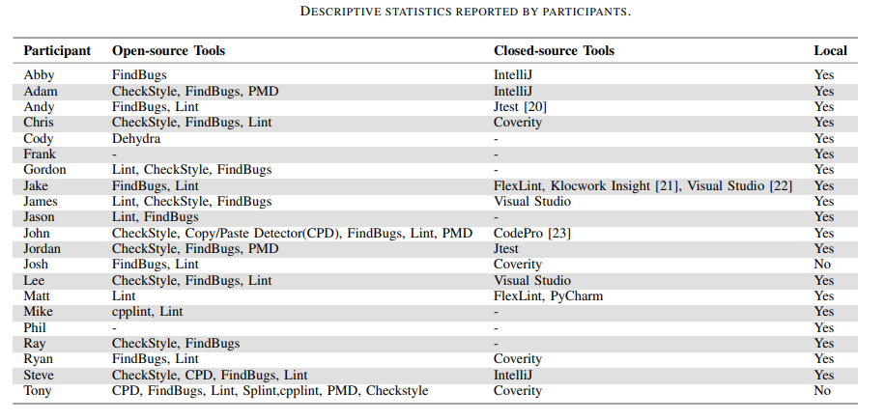
Results

Slide 5
Research Questions
RQ1: What reasons do developers have for using or not
using static analysis tools to find bugs?
RQ2: How well do current static analysis tools fit into
the workflows of developers?
RQ3: What improvements do developers want to see
being made to static analysis tools?
Notes:
. Expertise:
Developers with a deeper understanding of program analysis tend to use analyzers more frequently, especially those focused on security.
This suggests a strong relationship between familiarity with program analysis and its usage.
It's possible that using program analysis frequently helps developers develop a better understanding of it.
2. Trust and Bug-finding Capabilities:
Developers' trust in program analyzers is related to their expertise.
Experts are more likely to believe that program analyzers can catch reliability errors and maintainability issues.
Better expertise can help in setting realistic expectations with users regarding analyzer capabilities.
3. Speed vs. Quality:
Two developer camps exist: those prioritizing faster analysis and those valuing higher result quality.
The preference for analysis type correlates with where it fits in the development process.
Developers wanting analysis after every compile lean slightly towards deeper analyses, while those before code review prefer slower analyses detecting intricate issues.
4. Annotations:
Developers are willing to provide additional information (annotations) to program analyzers in exchange for better results.
Some developers are not willing to write annotations, while others are more likely to provide specifications.
Program analysis should be tunable through annotations but not require them.
5. Trust and Default Rules:
To build trust in program analyzers, designers should focus on minimizing false positives, as developers are more concerned about them.
One of the major pain points is that default rules or checks in analyzers often do not align with developers' preferences

Slide 6
RQ1: What reasons do developers have for using or not
using static analysis tools to find bugs?
Tool Output Complexity: Problems included false positives, large volumes of warnings, and lack of context, making it challenging for developers to assess the importance of identified issues.
Lack of Collaboration Features: Nine participants cited inadequate support for teamwork and collaboration within existing static analysis tools. Difficulties in sharing settings among team members and the absence of easy communication channels hindered collaborative efforts.
Configuration Challenges: Difficulties in finding and customizing options within tools discouraged developers, with some struggling to locate preferences, hindering their ability to tailor the tool to their needs.
Result Understandability: Nineteen participants found that many static analysis tools failed to present results in an understandable manner. Inadequate information about problems, lack of context, and vague error messages made it difficult for developers to comprehend the detected issues fully.
Limited Quick Fixes: Most participants desired effective quick fixes or code suggestions to assist them in addressing bugs. However, skepticism arose regarding the automatic application of fixes due to concerns about preserving code semantics, potential conflicts with other tools, and the need for developers to understand the changes made.
Overall, developers value automation, integrated environments, team support, customizability, and effective quick fixes. Challenges include complex tool output, collaboration limitations, configuration difficulties, poor result understandability, and skepticism toward quick fixes.

Slide 7
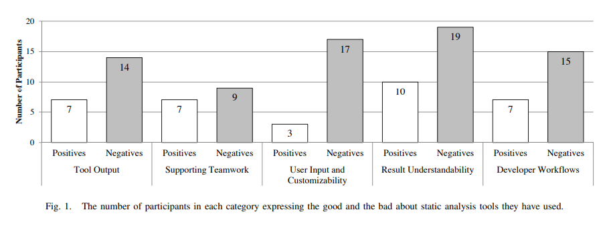
Results

Slide 8
RQ2: How well do current static analysis tools fit into
the workflows of developers?
Disjoint Processes and Context Switching: Developers expressed frustration when static analysis tools required leaving their coding environment to view results. Tools like FindBugs, Coverity, and Lint were criticized for disrupting workflow and necessitating extra effort due to context switching.
Tool Performance Impact: Slow tool performance was a significant concern. Tools that interrupted developers' workflow or took too long to analyze code were perceived as hindrances. Large codebases posed challenges as existing tools struggled to run efficiently.
Integration Compatibility: Integration, even within IDEs, did not guarantee seamless fit into developers' processes. Some developers, like Mike, preferred tools like Clang, integrated directly into their compiler, bypassing the need for a traditional IDE.
Timing of Bug Resolution: Developers acknowledged the value of addressing potential bugs immediately when contextual information was fresh. Fixing bugs later in the development process, requiring recall of specific contexts, was seen as more challenging and less efficient.
In summary, developers had diverse integration preferences, but common challenges included disruptions caused by disjoint processes, slow tool performance, and the need for tools to fit seamlessly into their workflow. Timing of bug resolution was a crucial consideration in integration strategies.

Slide 9
RQ3: What improvements do developers want to see
being made to static analysis tools?
Quick Fix Design:
Preview and Manual Application: Participants preferred a preview of quick fixes, allowing them to see the changes before applying them. The ability to manually apply fixes after previewing was suggested, ensuring developers had control over changes.
Three Option Dialog Box: Ryan proposed a "three option dialog box" offering choices: applying the entire fix (default), not applying the fix, or step-by-step application. This detailed control was seen as valuable for developers.
Warning Notification and Manipulation Design:
Fast and Non-Disruptive Feedback: Developers emphasized the need for fast feedback without disrupting their workflow. Tools should run in the background, provide results during stopping points, and ensure quick notifications without interrupting the thought process.
Judgements and Temporary Suppression: Participants desired the ability to make judgements about defects, setting some aside for later review. They suggested a system for temporarily suppressing specific defects, allowing developers to prioritize issues.
In summary, participants highlighted the importance of previewing quick fixes, receiving fast and non-disruptive feedback, and having options for judgments and temporary defect suppression. Creative design ideas included dynamic editor interactions, visual representations, and innovative severity indicators.

Slide 10
Conclusion
Key Takeaways
They have explored the reasons behind the limited adoption of static analysis tools among developers and examined ways to enhance their usage involving a user study with 20 software developers, each having an average of approximately 10 years of experience in utilizing static analysis tools for bug detection
Their findings validated that developers' dissatisfaction with existing static analysis tools is influenced by the occurrence of false positives and developer overload.
In the future, static analysis tools could enhance their acceptance among software developers by providing better support for team collaboration, integrating seamlessly into developers' workflows, presenting defects in an intuitive manner, offering detailed explanations of issues along with automatic solutions when applicable, and offering straightforward and practical configuration choices for users.

Slide 11
Research Paper 2
Why Do Software Developers Use Static
Analysis Tools? A User-Centered Study
of Developer Needs and Motivations

Slide 12
Introduction
Static analysis tools, from simple to complex, have improved in bug detection, but usability has lagged, leading to misinterpretation and tool abandonment.
Previous studies highlighted usability problems, focusing on correctness and user-reported issues. This study takes a user-centered design approach.
A survey of 87 developers at Software AG explored their goals, motivations, and strategies when using 17 analysis tools. It delved into how tools integrate into their work processes.
Findings confirmed past results (e.g., soundness issues), revealed contrasts (e.g., focus on performance over style warnings), and uncovered new areas (e.g., collaborative interfaces).
Developers' strategies included warning prioritization, distinguishing false positives, understanding warnings, and handling unclear warnings.
Recommendations include considering developers' work time in tool workflows, integrating developer heuristics, and building collaborative platforms for team knowledge sharing.

Slide 13
Study
Two-Part Study: The study was conducted in two parts. First, a survey was sent to Software AG's main development teams, gathering insights on developers' experiences with static analysis tools. In the second part, access was granted to reports generated by Checkmarx, a major analysis tool used at Software AG.
Checkmarx Overview: Checkmarx, the focal static analysis tool, supports 20 programming languages and can be used as a standalone tool with a web interface or as a plugin in various Integrated Development Environments.
Research Questions: The study aimed to answer specific research questions:
RQ1: How are analysis tools integrated into the development environment at Software AG?
RQ2: In what contexts do developers use analysis tools, and what are their goals in doing so?
RQ3: What strategies do developers employ when working with analysis tools?
RQ4: What features should analysis tools provide to support developers effectively?

Slide 14
RQ1: How are analysis tools integrated in the development environment?
Variety of Analysis Tools: Software AG developers utilize 17 different analysis tools, categorized as IDE notifications, IDE tools, dedicated tools, and CLI tools. Dedicated tools are most commonly used, aligning with the company's policy.
Integration Across Development Stages: Analysis tools are integrated throughout the software development lifecycle: 55.9% used during coding, 52.9% in nightly builds, 29.4% at commit time, and 17.6% at major milestones.
Reporting and Verification: Analysis warnings are reported in code editors, build outputs, and dedicated tools. Developers prefer aggregated reporting platforms like separate PDFs or email reports, indicating a need for a centralized overview of analysis results. Developers themselves often fix warnings, with reviews conducted by colleagues. Notably, 9.1% of fixes go unverified.
Configuration and Motivations: Analysis tools at Software AG are configured mainly by a dedicated team (47.1%), but 36.8% of developers configure some tools themselves. Developers are motivated to use analysis tools primarily to improve coding (78.3%) rather than solely due to company policy (30.4%).
Warning Types: Most commonly reported warnings are related to coding style (82.1%), followed by security vulnerabilities (59.7%) and functional bugs (38.8%). However, developers express higher interest in performance, memory, and concurrency bugs, signaling a shift in focus from coding style issues.
Summary (RQ1):
The most frequently used analysis tools are dedicated tools, as well as IDE tools and notifications. Tools report warnings in various locations, but developers prefer to have them aggregated in a central interface. Unlike prior studies, Software AG developers rank coding style warnings low on their list, and have a higher interest in performance, memory, and concurrency bugs.

Slide 15
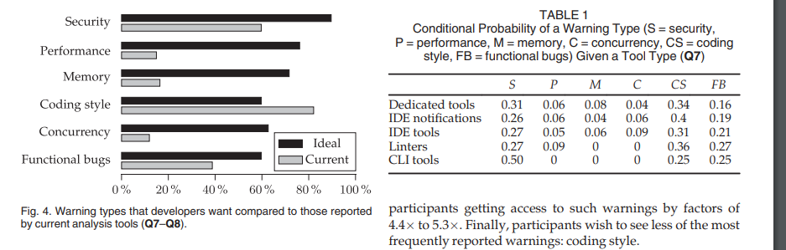

Slide 16
RQ2:In which usage contexts do developers use analysis
tools, and with which goals?
Developer Workflow: Analysis tools are used throughout the day, with 22.7% of developers utilizing them during spare time between tasks. Usage is frequent but brief, with 75.6% using them multiple times a week and 24.5% using them more than once a day. Working sessions with analysis tools typically last 10-30 minutes, with developers spreading their treatment of warnings across multiple sessions.
Tool Usage Patterns: IDE notifications, IDE tools, and dedicated tools are commonly used. IDE tools' warnings are typically fixed within a shorter timeframe (between an hour and a day) compared to dedicated tools (around a day), suggesting varying complexities of warnings.
Developer Motivation: Developers use analysis tools primarily to fix warnings (Q17). 78.3% report that these tools help them code better, indicating intrinsic value beyond company obligations. When developers open analysis tools, fixing all warnings is a common goal, although with dedicated tools, the focus is often on fixing as many warnings as possible within a given time.
Tool Closing Reasons: Most developers close the tool when all warnings are fixed, indicating task completion. Time constraints and waiting for tool updates are other common closing reasons. When developers aim to fix all warnings but have time constraints, they only achieve this goal 45% of the time, highlighting the challenge of resolving all issues in a single session.
Usage Context and Challenges: Analysis tool usage involves short, flexible sessions spread across the day. Developers prioritize resolving warnings, indicating their focus on improving code quality. However, challenges arise when dealing with complex warnings, potentially requiring multiple sessions and waiting for tool updates.
Developers primarily utilize analysis tools during their free moments and address warnings in brief work sessions. The main factor leading to tool closure is time constraints, shaping distinct interaction patterns, especially concerning the selection of warnings to address.

Slide 17
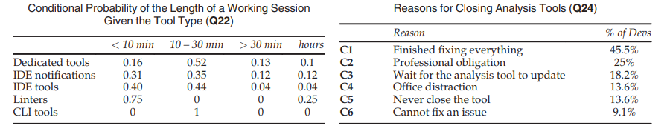
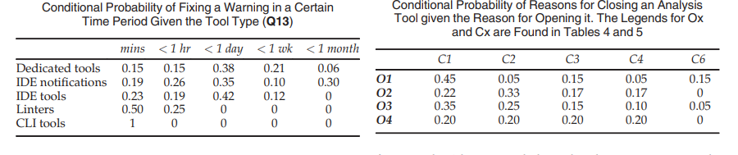
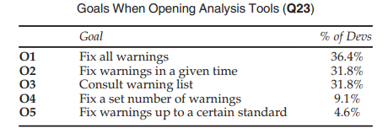

Slide 18
RQ3:What are the strategies that developers apply when
working with analysis tools?
Developer Warning Selection: Developers prioritize warnings based on impact, their ability to fix them, and their knowledge of the codebase. Severity plays a significant role, aligning with the company policy of addressing severe warnings before major releases.
Understanding Developer Strategies: Developers predominantly focus on warnings they comprehend well or that directly impact their code. They use heuristics, including examining warning types and code constructs, to triage through warnings quickly. However, relying solely on categories can lead to overlooking critical issues.
Handling Unfamiliar Warnings: When faced with unfamiliar warnings, developers often postpone addressing them, potentially due to time constraints. Some resort to ignoring or suppressing warnings, which should be discouraged. Collaborative efforts, like seeking help from colleagues, are common but can be hindered by unclear tool explanations.
Tool Improvements: To improve developer experiences, analysis tools should provide clearer explanations, especially concerning how the tool interprets code. Integrating effective heuristics and encouraging collaborative behavior could enhance overall tool usage.
Developers tend to choose warnings they are familiar with, often relying on their knowledge of the codebase and their experience with specific tool types. Effective heuristics based on code constructs can aid developers, while weaker heuristics like warning categories may lead to suboptimal outcomes, such as ignoring critical warnings. Clear and informative tool interfaces, along with promoting collaboration between developers, can enhance the effectiveness of static analysis tools.

Slide 19
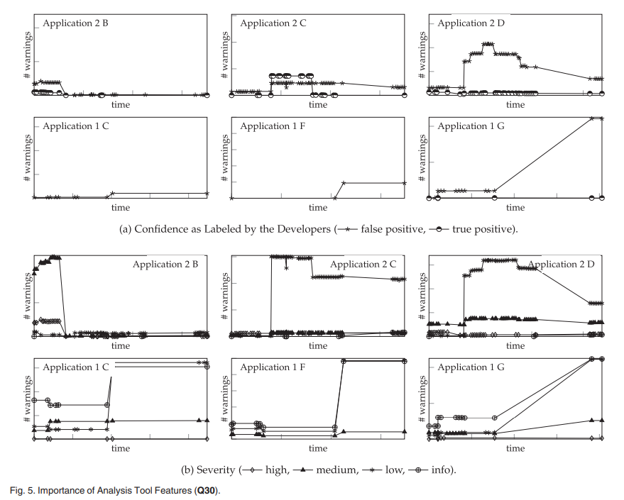

Slide 20
RQ4: What are the features that analysis tools should provide to developers to support them?
Developer Interface Preferences: Most developers at Software AG prefer default layouts of analysis tools, indicating a tendency toward standardized interfaces. While company-specific layouts are available, developers favor the default configurations provided by the tools.
Key UI Features: When opening an analysis tool, developers focus on the dashboard for a high-level project summary (47.7%). Throughout tool usage, the warning list takes central importance (68.2%), underlining its significance in tracking issues, their locations, and progress towards meeting company standards. When closing the tool, 59.1% of developers concentrate on the warning list.
Importance of UI Features: Developers find certain UI features crucial. Notably, explaining bugs (F3) and indicating bug severity (F4) are marked as very important by 28 and 26 developers, respectively. Providing explanations on how bugs can be fixed (F7) is highly valued. However, features suggesting specific fixes (F8) receive lower support, potentially due to concerns about introducing new errors during manual verification.
Less Popular Features: Features related to collaboration (F19), customization of analysis rules (F18), and visualization (F10-F11) have lower ratings. The reasons behind these lower scores remain unclear – it could be dissatisfaction with current implementations, skepticism about these features, or a lack of prior experience. Despite these ratings, all features were considered important or more by at least 75% of the participants, indicating their potential usefulness in analysis tools.
Developers most often look at the dashboard when they first open an analysis tool. When using and closing the tool, they most often look at the warning list.

Slide 21
Outcome of the Sutdy
Consider Time Constraints: Design analysis tool workflows based on developers' working session lengths. Propose suitable warnings depending on developers' past performance to align with their available time.
Optimize Responsiveness: Minimize waiting times in analysis tools to enhance user experience. Ensure both analysis responsiveness and tool interfaces are designed for efficiency.
Customize Analysis Rules: Allow developers to customize rules based on project-specific or company-specific heuristics. Enable intelligent learning of valuable rules and contributions from developers.
Improve Explainability: Enhance warning explanations by integrating knowledge from past experiences, codebase familiarity, and understanding of the analysis tool. Prevent harmful heuristics.
Personalize Warning Suggestions: Integrate developer knowledge into recommender systems for personalized warning suggestions, considering individual abilities and work hours.
Promote Collaboration: Facilitate collaboration options within analysis tools to formalize communication channels. Encourage sharing developer knowledge among users.
Encourage Good Behavior:Design tool features to promote positive behavior, especially when users face challenges or blockages in their work.
Use Multiple Tools: Utilize multiple static analysis tools simultaneously, covering various aspects such as performance and memory. Combine results for comprehensive analysis.
Centralize Reporting: Implement a unified reporting platform to consolidate warnings from different tools. Utilize platforms like Khasiana to standardize tool usage, assist new projects, and enhance collaboration.
Company Support and Policies: Maintain and develop company policies promoting analysis tool usage. Conduct initiatives and training programs to raise awareness and encourage proper tool usage among developers.

Slide 22
Conclusion
Usage Patterns: Developers at Software AG use static analysis tools throughout the software development process, primarily during their spare time to address warnings.
Time Constraints Influence Usage: Time limitations heavily impact developers' goals, workflow, and interactions with analysis tools, necessitating consideration in tool design.
Internal Knowledge and Strategies: Developers create internal knowledge and strategies to prioritize, verify, and handle warnings, emphasizing the need for user-specific approaches.
Ten Recommendations:
Integrate User Knowledge, Allow User Heuristics, Discourage Negative Behavior, Promote Positive Behavior, Customization, Central Analysis Platform, User-Centered Design, Encourage Tool Use, Collaborative Fixing, Real-Time Feedback,
Nineteen Desirable Features,features include responsiveness, explainability, visualization, customization, and collaboration options.
Advocacy for User-Centered Design: Advocate for a user-centered approach in designing static analysis tools, focusing on understanding user motivations and usage contexts to drive new requirements and perspectives in tool design.

Slide 23
Research Paper 3
What Developers Want and Need from Program Analysis: An Empirical Study³
3 Source: What Developers Want and Need from Program Analysis: An Empirical Study by Christakis , Bird ; Microsoft Research, Redmond, USA

Slide 24
Introduction
Program Analysis
It is a process of automatically analyzing the behavior of a program without running it, that is, we are only considering static program analysis. Feedback in terms of warnings: True Positive and False negative.
True Positive : flag real issues in the code. False Negative: warn about code issues that do not occur in practice.

Slide 25
Survey
The survey aimed at asking high level research questions:
What barriers hinder the adoption of program analyzers by practitioners?
What functionality do practitioners want from program analyzers?
What non-functional characteristics should a program analyzer have to be widely used?
What code issues occur most in practice that program analyzers should try to detect?

Slide 26
Survey
A comprehensive survey at Microsoft to understand developers' perspectives on program analyzers.
Surveys were chosen because they can gather responses from a large sample of industrial software developers, aiming for representative data.
A beta survey was deployed to 100 developers for feedback, resulting in improvements to question clarity and format.
The final survey was sent to 2,000 developers at random within Microsoft, with 375 responses received
(a 19% response rate).
The survey aimed to take about 15 minutes to complete and covered various aspects related to program analyzers.

Slide 27
Result Breakdown
3 categories
Barriers to using program analyzers and reasons why developers stop using them.
Functionalities that developers’ answers indicate they want in analyzers. Such as types of issues that program analyzers catch, types of programming languages they can analyze, if program analyzers can be directed towards code.
Non-functional characteristic that a program analyzer should have. Such as false positives, when it should run, where output should be and where analysis fit in development process.

Slide 28
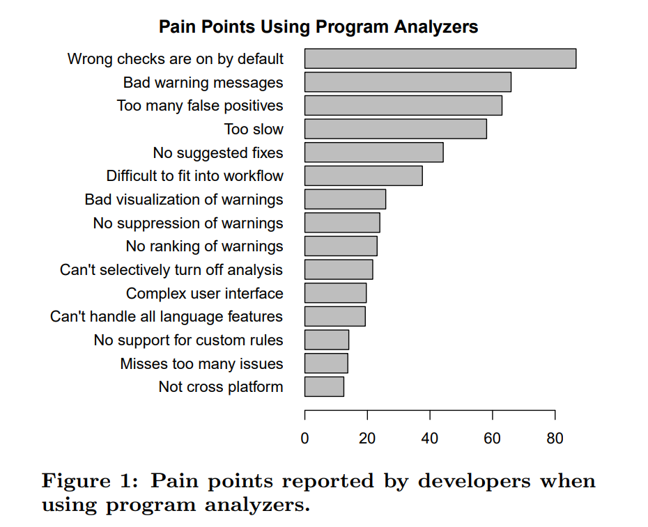
Results
What makes program analyzers difficult to use?
The largest pain point is that default rules or checks that are enabled in a program analyzer do not match what the developer wants. E.g. some default rules , Hungarian notations to name variables or detect spelling mistakes are not useful and seem quite annoying.

Slide 29
Key factors
Program analysis should not have all rules on by default.
High false positive rates lead to disuse.
Team policy is often the driving factor behind use of program analyzers.

Slide 30
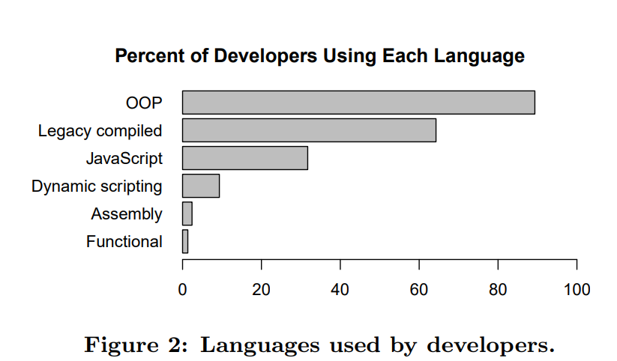
Categorization are based on perceptions and experiences as well as observations of Microsoft development. OOP- C# and java . Legacy compiled- C,C++ and objective-C. Dynamic scripting –Python, Ruby ,Pearl.
What functionality should Analyzers have?

Slide 31
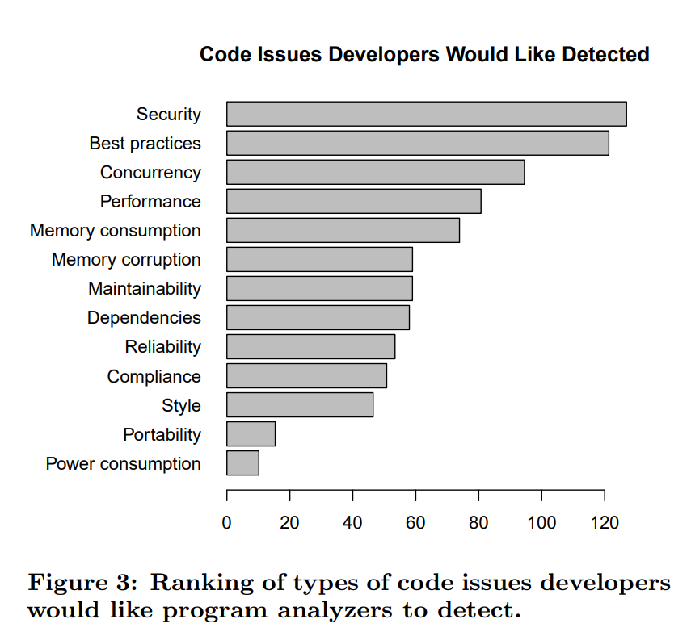
Results
They found that security issues are most important followed by Violation of best practices. Surprising is developers not finding power consumption issues important.

Slide 32
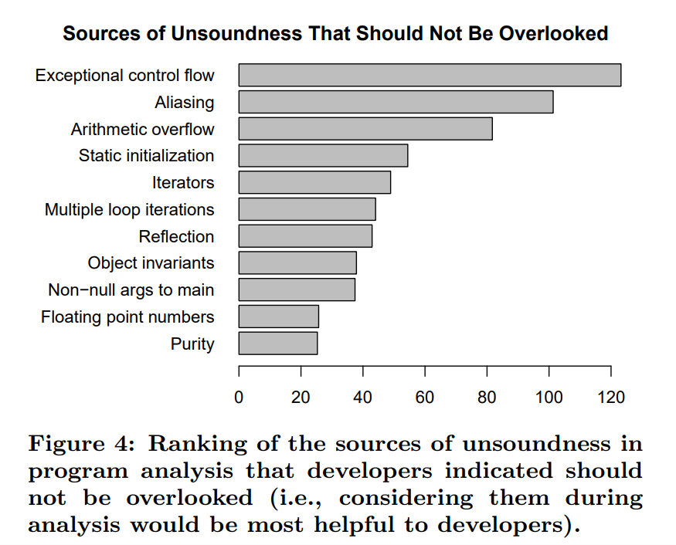
Result
Potential sources of unsoundness in program analysis that can affect detection of code issues. Many analyzers choose to ignore exceptional control flow in order to avoid losing efficiency and transitions which complicating analysis and is time consuming. But there are set of developer who wish to add

Slide 33
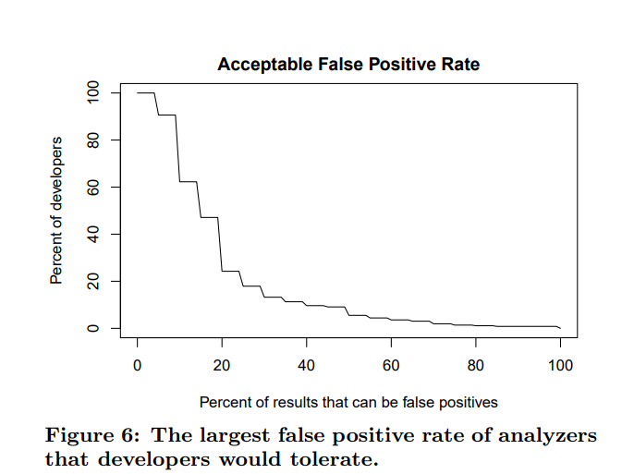
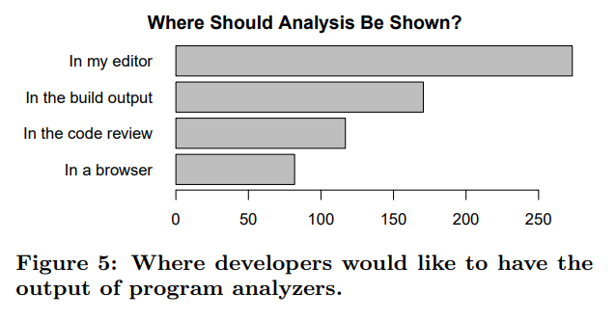
NON-FUNCTIONAL CHARACTERISTICS OF PROGRAM ANALYZERS BE
90% developers willing to accept 5% FP rate, 47% developers willing to accept up to 15%,
24% developers can accept as high as 20%.

Slide 34
Key Take Aways
Program analysis should take a two-stage approach, with one analysis stage running in real time providing fast, easy feedback in the editor and another overnight finding more intricate issues.
Program analysis designers should aim for a false positive rate no higher than 15–20%.
Developers are willing to trade analysis time for higher quality results (fewer false positives, fewer false negatives, more intricate issues).

Slide 35
Implications
1. Expertise
2. Trust and Bug-finding Capabilities
3. Speed vs. Quality
4. Annotations
5. Trust and Default Rules
Notes:
. Expertise:
Developers with a deeper understanding of program analysis tend to use analyzers more frequently, especially those focused on security.
This suggests a strong relationship between familiarity with program analysis and its usage.
It's possible that using program analysis frequently helps developers develop a better understanding of it.
2. Trust and Bug-finding Capabilities:
Developers' trust in program analyzers is related to their expertise.
Experts are more likely to believe that program analyzers can catch reliability errors and maintainability issues.
Better expertise can help in setting realistic expectations with users regarding analyzer capabilities.
3. Speed vs. Quality:
Two developer camps exist: those prioritizing faster analysis and those valuing higher result quality.
The preference for analysis type correlates with where it fits in the development process.
Developers wanting analysis after every compile lean slightly towards deeper analyses, while those before code review prefer slower analyses detecting intricate issues.
4. Annotations:
Developers are willing to provide additional information (annotations) to program analyzers in exchange for better results.
Some developers are not willing to write annotations, while others are more likely to provide specifications.
Program analysis should be tunable through annotations but not require them.
5. Trust and Default Rules:
To build trust in program analyzers, designers should focus on minimizing false positives, as developers are more concerned about them.
One of the major pain points is that default rules or checks in analyzers often do not align with developers' preferences

Slide 36
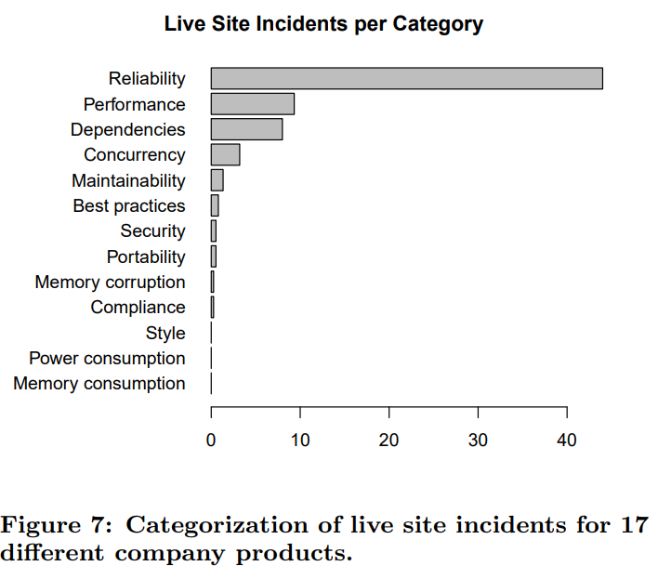
LIVE SITE INCIDENTS
A high-severity bug that demands immediate attention by a software engineer so that the health of the affected company service is not compromised further.

Slide 37
First Part Program Analyzer at Microsoft
BinSkim: validates compiler and linker settings.
FxCop:analyze managed assemblies using predefined rules. Include mostly issues that violate
PoliCheck:scans text for anything that might be politically or geopolitically incorrect. E.g. persons name in red letters should be avoided as its signifies dead person in some context or culture.
PREfast: Identify defects on C and C++ source code. Plug –in include Badvalue, CppCoreCheck, DriversDLL.
PreFix: Detects security, reliability and performance but without user providing extensive annotations its is impossible to give memory and performance leaks.
StyleCop: selected by 50% respondents , analyzes C# code to enforce style and consistency rules.

Slide 38
Third Party Program Analyzers at Microsoft
ReSharper: A productivity tool with code analysis capabilities.
CodeRush: Offers code investigation, automation, and code analysis.
Fortify: Identifies security vulnerabilities in source code.
Checkmarx: Analyzes source code for security rules, easier to configure than Fortify.
Coverity: Detects security and reliability errors in multiple languages.
Cppcheck: A rule-based analyzer for C and C++.

Slide 39
Program Analyzers at Google
Find Bugs: Detects defects in Java code, including performance and correctness issues.
Tricorder: An ecosystem for detecting various code issues across multiple languages.
Error Prone and Clang Tidy: Analysis frameworks for Java and C++.
Linter: Detects style issues and contains individual linters.
Domain-specific analyzers like Android Lint.

Slide 40
Program Analyzers at Facebook
Infer: Used to find resource leaks and null-pointer exceptions in Android and iOS applications.
Incremental analysis for efficiency.
Discussion
Emphasize the variety of program analyzers used in the industry.
Highlight the importance of efficiency, accuracy, and integration into the development workflow.
Mention challenges such as false positives, scalability, and workflow integration.
Stress the significance of tools like Tricorder and Infer for large-scale deployment.

Slide 41
Conclusion
Empirical Investigation: We conducted a comprehensive empirical investigation within Microsoft.
Practitioner Needs: Our findings provide insights into what practitioners expect from program analyzers.
Research Adoption: We offer guidance on how program analysis researchers can achieve broader tool adoption.
Defect Prioritization: We identify the types of defects that are most critical to minimize through program analysis.
Industry Insights: We reveal the program analyzers currently in use at three major software companies.

Slide 42
ARTICLE 4
A few Billion Lines of code Later
using static Analysis to find Bugs
in the Real World⁴
4 Source: A few Billion Lines of code Later using static Analysis to find Bugs in the Real World by AL Bessey et. al.

Slide 43
Commercializing Bug-Finding Tools
In 2002, Coverity commercialized a research static bug-finding tool.
They have documented most important examples of what they learned while developing and commercializing this tool.
Tool Objectives
Developed tool to find generic errors (e.g., memory corruption, data races) and system-specific or interface-specific violations.
Leveraged static inspection to detect violations by mapping programming rules to source code.

Slide 44
Research Process
Checker Approach
Checkers in the research system traversed program paths in a forward direction (flow-sensitive).
Analysed code across function calls (inter-procedural).
Maintained call-site-specific information (context-sensitive).
Could detect infeasible paths (path-sensitive).
Varied Approaches in Bug finding
Mentioned the diverse approaches to static bug finding in the literature.
Highlighted the focus on results and efficiency in the tool's development.
Emphasized the preference for avoiding manual labour and annotations

Slide 45
Unsoundness and Scalability
Discussed the unsound nature of the tool, which aimed to find as many errors as possible.
Unsoundness allowed the tool to handle easier cases first and scale up effectively.
Mentioned that unsoundness was initially controversial but became common in commercial and research projects.
Early Tool Development and Publishing
Explained that initially, publishing research findings drove tool development.
Ran the tool over large, previously unchecked systems to find bugs empirically.
Highlighted the common experience of finding bugs when using a reasonable tool on a large codebase.
Commercial Context
Transitioned to the commercial context of tool development.
Acknowledged the initial perception that technical challenges were limited.
Mentioned that commercialization brought unforeseen obstacles.

Slide 46
Scaling Challenges
Addressed the challenges that arise when many programmers use the tool on numerous code bases.
Discussed the shift from a few people checking a few code bases in a research lab to many checking many in reality.
Explained how this scale revealed unforeseen problems and distribution dynamics.
Unusual Occurrences
Described the implications of a Gaussian distribution and its tails.
Pointed out that as the number of samples (users) grows, unusual occurrences become more frequent.
Emphasized the need to adapt to unexpected issues in a real-world, commercial setting.

Slide 47
Laws of Bug Finding
Fundamental Law of Bug Finding:
Introduced the fundamental law of bug finding, which states that "No Check = No Bug“
Law: You can't check code you don't see: This law highlights the challenge of checking code that is not visible or easily accessible. In many cases, extracting code from complex build systems or proprietary environments can be difficult, and if you can't see the code, you can't check it for bugs.
Law: You can't check code you can't parse: This law emphasizes the importance of parsing code for deep analysis. To understand code and identify potential bugs, you first need to parse it. However, parsing code, especially code with compiler extensions or non-standard constructs, can be a complex task.
Notes:
Fundamental law in other words states that if a tool cannot check a system, code, or property, it cannot find bugs in it. The effectiveness of bug finding tools is directly related to the amount of code they can process.

Slide 48
Challenges and Issues to Bug Finding
Build System Challenges: Homegrown build systems can make it hard to extract information about the code being built, leading to difficulties in checking the code.
Isolation and Test Machines: Companies often isolate development environments and provide test machines for checking code. This can create challenges when the provided build does not work correctly, and modifying it is not allowed.
Early Approach: The paper discusses an initial approach of recording build commands and rewriting them to include the checking tool. This approach worked in some cases but had limitations, especially in environments with diverse build processes.
Social vs. Technical Challenges: The paper emphasizes the social challenges associated with modifying build processes and code, even when it's broken. Build engineers may resist changes and prioritize successful tool execution over code quality.
Notes:
Challenges in Finding Code: The paper highlights the challenge of finding and checking code. In many cases, especially in large code bases with complex build systems, it can be difficult to identify and extract the code for analysis.

Slide 49
Compiler and Language Divergence: The paper discusses the issue of compilers diverging from language standards, which can result in code that is accepted by compilers but rejected by static analysis tools.
Parsing Challenges: Parsing code is a fundamental requirement for analyzing it deeply. However, the paper argues that parsing is a more complex problem than commonly believed, as it depends on the specific compiler's interpretation of the code.
Use of Compiler Extensions: Programmers often use compiler extensions and non-standard constructs, making it challenging for static analysis tools to handle the code correctly.
EDG Front-End and Transformers: The paper mentions the use of the Edison Design Group (EDG) front-end for parsing code and the need to write transformers to adapt code from various compilers to a format that can be parsed.
Incompatibilities and Versions: Even when using EDG-based compilers, there can be incompatibilities due to different versions and configurations of the EDG front-end.

Slide 50
How Compilers Should Detect And Report Such Issues To Maintain Code Quality And Adherence To Language Standards.
Redefinition of Parameter ‘a’
void foo(int a, int a);
Useless Type Name in Empty Declaration:
typedef char int;
Invalid Suffix '_beef' on Integer Constant:
unsigned x = 0xdead _ beef;
Storage Size of 'x' is Not Known:
void x;
Stray '@' in Program:
unsigned x @ "text"; Using Hexadecimal Values as Program Source:
Int16 ErrSetJump(ErrJumpBuf buf) = { 0x4E40 + 15, 0xA085; }

Slide 51
Significance of Bugs
Not everyone agrees that bug matters.
They went through numerous trails for which they got replies which either gave lack of accountability issue or replies such as “No, your tool is broken ; that is not a bug.”
Weird code examples:
foo(i = 1; i < 0; i++) ... deadcode ... “No, that’s a false positive; a loop executes at least once.”
For this memory corruption error (32-bit machine)
int a[2], b; memset(a, 0, 12);
Notes:
1) Significance: This code snippet represents a loop with an unreachable condition (i < 0). It is an example of a bug that a bug-finding tool might detect as dead code. The significance here is that such dead code can indicate an issue in the program's logic. The loop will never execute, suggesting that the condition or loop itself might be incorrect or unnecessary. 2) Significance: In this snippet, memory is initialized using memset, but the size specified (12) exceeds the actual size of the array a. This could lead to memory corruption and undefined behavior. The significance is that bug-finding tools can identify potential memory-related issues, which are crucial for preventing security vulnerabilities and program crashes.

Slide 52
3. A potential use-after-free bug
free(foo);
foo->bar = ...;
“No, that’s ok, there is no malloc call between the free and use.”
4. A buffer overflow checker flag
unsigned p[4];
….
p[4]=1; “No, ANSI lets you write 1 past the end of the array.”
A not understood bug report is commonly labelled as false positive
The researchers here argue about how to handle cluelessness? Try organizing large meetings: people can discuss collectively, and more people will get idea about tool. So later when they are laid off it will help boost business level. CHURN: try to cap churn at least 5% per release.
Notes:
3) Significance: This code represents a potential use-after-free bug. After freeing memory pointed to by foo, it is accessed again through foo->bar. This can lead to undefined behavior, crashes, or security vulnerabilities. Bug-finding tools can detect such issues, which are essential for maintaining the integrity and security of the software.
4)Significance: writing to p[4] is an attempt to access memory beyond the allocated space for the array p. CHURN: "churn" typically refers to the frequent or continuous changes made to the codebase. It often implies that developers are making numerous modifications, additions, or deletions to the code.

Slide 53
Conclusion
The paper summarized all the unpleasant experiences in commercialization of static analysis tool. Mains 2 key factors are:
Selling of this tool has become drastically easier in recent times.
Bug finding is worthwhile for anyone with this effective tool.

Slide 54
ARTICLE 5 SCALING STATIC ANALYSES AT FACEBOOK⁵
5 Source: Scaling static Analyses at Facebook by Distefano et. al.

Slide 55
Introduction
Facebook's investment in advanced static analysis tools, specifically focusing on Infer and Zoncolan.
Infer targets both mobile apps and backend C++ code.
Zoncolan is designed for Hack code. These tools are integrated into the code review process, and they have helped fix thousands of issues, including security and privacy vulnerabilities.
These tools analyze code without executing it and are used to address issues related to crashes and security in their services.
The paper discusses the human and technical challenges faced during the development and deployment of these static analysis tools.
Notes:
This research paper discusses Facebook's investment in advanced static analysis tools, specifically focusing on Infer and Zoncolan.

Slide 56
Software Development at Facebook
Main code base (master) is altered by thousands of programmers by submitting code modifications(diffs).
A continuous integration system (CI system) is used to ensure code continues to build and passes certain tests.
Websites and mobile products are deployed differently.
Websites: deploys new code to its own datacenters.
Mobile Apps: people to download new versions from the Android or in the Apple store.
Common runtime errors for example, null pointer exceptions, division by zero—are more difficult to get fixed on mobile than on the server.
Server-side security and privacy bugs can severely impact both the users of the web version of Facebook as well as our mobile users, since the privacy checks are performed on the server-side.
Notes:
For the website, the bug fixes can be shipped directly to our datacenters frequently, several times daily and immediately when necessary.
For the mobile apps, new versions are shipped weekly, but mobile bugs are less under our control because even if a fix is shipped it might not be downloaded to some people’s phones.
Facebook invests in tool to make mobile apps more reliable and server side code more secure.

Slide 57
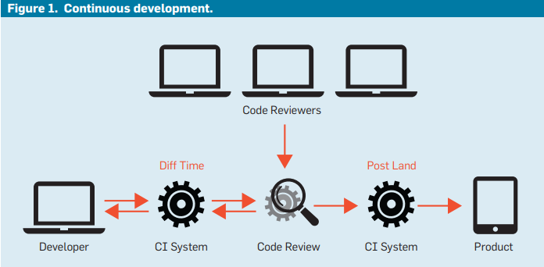
Infer: Continuous Development
Fast incremental analysis of code changes.
When diff is submitted to code review an instance of Infer is run in Facebook’s internal CI system.
After reviewing , Infer writes comments to code review system.
Though aim to run infer was 15-20 min on average ,if run in whole program mode it can take more than hour.

Slide 58
Infer
Human Factors
First deployment was batch rather than continuous.
Mental effort of context switch.
Issue of relevance.
Inter procedural Analysis:
Infer is capable of identifying inter procedural bugs that span multiple procedures or files.
It uses compositional reasoning to cover such bugs while still scaling to large codebases.
Concurrency: The development of RacerD, a concurrency analysis tool within Infer.
This tool was developed in response to Facebook's need to convert part of its Android app to a multithreaded architecture.
RacerD helps detect data races in Java programs and has been successful in improving performance and reducing data race bugs.
Notes:
Infer is a powerful static analysis tool used at Facebook to identify and fix various types of bugs and issues in their codebase. It has had a significant impact on code quality, security, and performance, especially when deployed at diff time during the code review process.

Slide 59
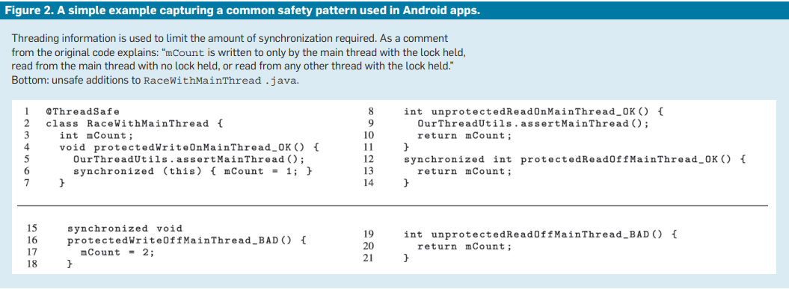
An example of an OpenSSL bug that Infer helped identify and fix.
Notes:
The example in Figure 2 (top) illustrates: If we run the Infer on this code it doesn’t find a problem.
The unprotected read and the protected write do not race because they are on the same thread.
But, if we include additional methods that do conflict, then Infer will report races, as in Figure 2, bottom.

Slide 60
Impact of Infer
Since 2014, Infer has helped Facebook developers resolve over 100,000 issues.
It has been particularly effective in diff-time deployment, but it is also used batch-wise and for tracking issues in master code.
The RacerD data race detector played a crucial role in Facebook's transition to multithreading in its Android app.
Infer reports on over 30 types of issues, including deep inter procedural checks, simple procedure-local checks, and lint rules.
It also includes checks for deadlocks, starvation, and security vulnerabilities.

