Slide 1

PREDICTING THE DIRECTION OF STOCK PRICES
BY:
KARLEN CHOW
PHUONG DANG
SARIM TARIQ

Slide 2
INTRODUCTION
PREDICTIONS MADE USING AAPL STOCK
RANDOM FOREST CLASSIFICATION USED FOR ML MODEL
STEPS:
COLLECT & PREPROCESS DATA
EXTRACT FEATURES
TRAIN THE MODEL
PREDICT RESULTS

Slide 3
PREPROCESSING & FEATURE EXTRACTION
AAPL DATA TAKEN FROM YAHOO FINANCE
HISTORICAL DATA EXPONENTIALLY SMOOTHED
TECHNICAL INDICATORS CALCULATED:
RELATIVE STRENGTH INDEX
STOCHASTIC OSCILLATOR
WILLIAMS %R
MOVING AVERAGE CONVERGENCE DIVERGENCE
PRICE RATE OF CHANGE
ON BALANCE VOLUME

Slide 4

MODEL TRAINING
TRAINING DATA PASSED TO RANDOM FOREST CLASSIFIER
EACH NODE DIVIDES THE DATA BASED ON IF A THRESHOLD IS MET
PREDICTS RISE OR DROP IN PRICE AT LEAF NODES
ACCURACY OF EACH NODE EVALUATED WITH GINI IMPURITY

Slide 5
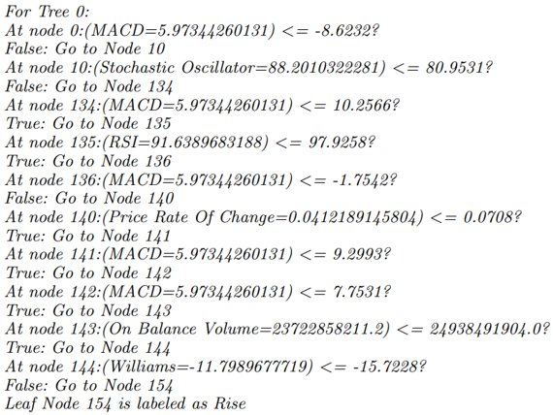
SAMPLE TREE

Slide 6
EXPECTED RESULTS
MODEL PREDICTS +1 IF PRICE IS EXPECTED TO RISE AFTER n DAYS, SUGGESTING TO BUY STOCK
MODEL PREDICTS –1 IF PRICE IS EXPECTED TO FALL AFTER n DAYS, SUGGESTING TO SELL STOCK

