Slide 1

Notes:
This chart really didn’t give evidence of the total death total per state. Did more sorting out the data for more information that will support the vast difference of death total from state to state. In the next couple slides will validate the drastic death total that we seen on the news.

Slide 2
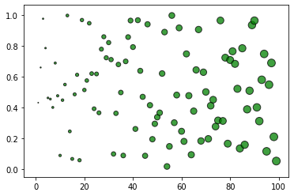
Notes:
The first scatter chart that showed all the inaccurate numbers of deaths and how they are displaced on the chart. It doesn’t give enough information that could determine number people in each state comparisons.

Slide 3
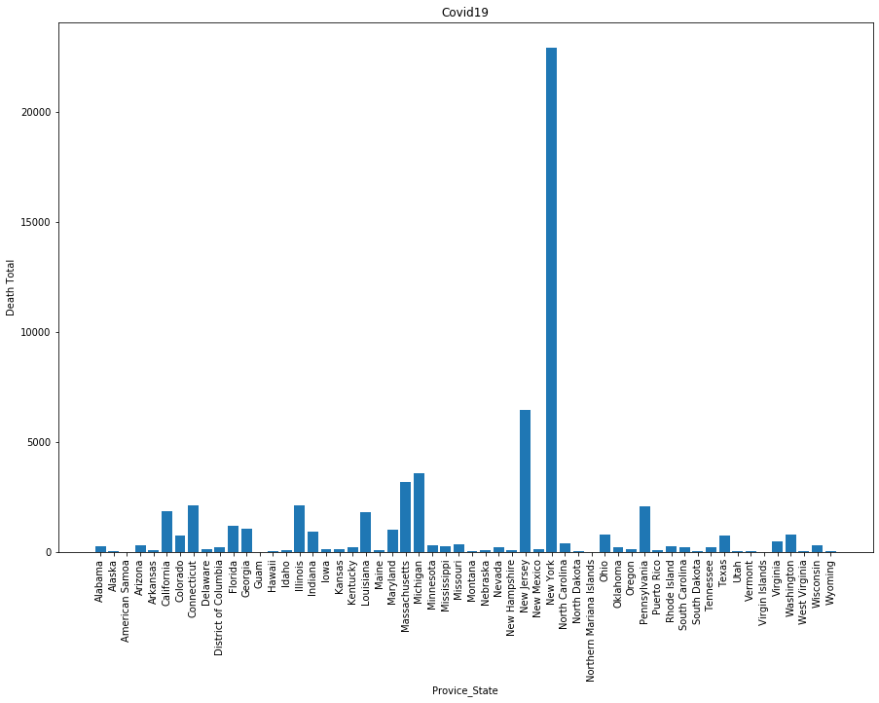
Notes:
This bar chart display accurate numbers per state and the all Death Total.

Slide 4
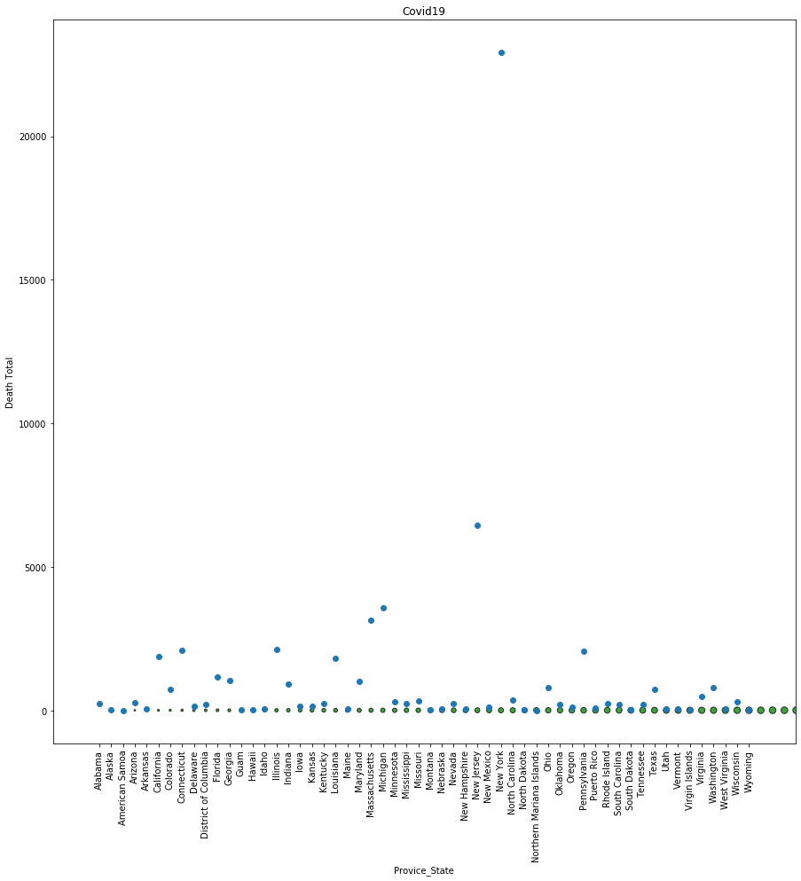
Notes:
The scatter chart of all the United States showing how large that number deaths in New Yok versus all the other states death total. The scatter map have drastic patterning throughout the chart. In some states they have very little deaths over the course of 4 months.

Slide 5
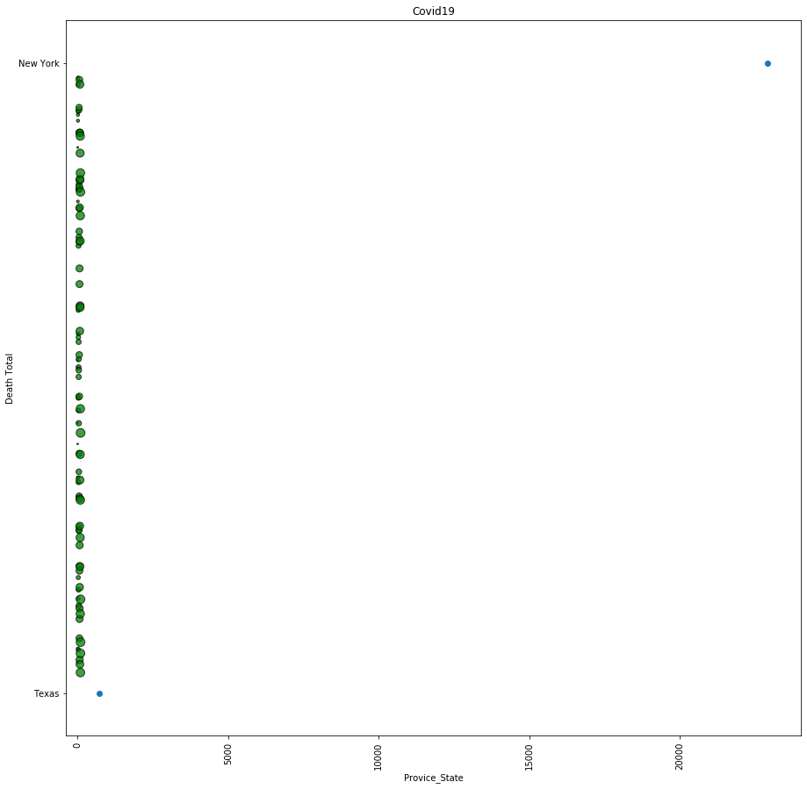
Notes:
Compared on the scatter chart between New York & Texas. New York has 22,912 death from Covid19 while Texas has 719 during the outbreak. The Death Total is a huge difference from New York to Texas based off the number of people that continue to stay home.

