Slide 1
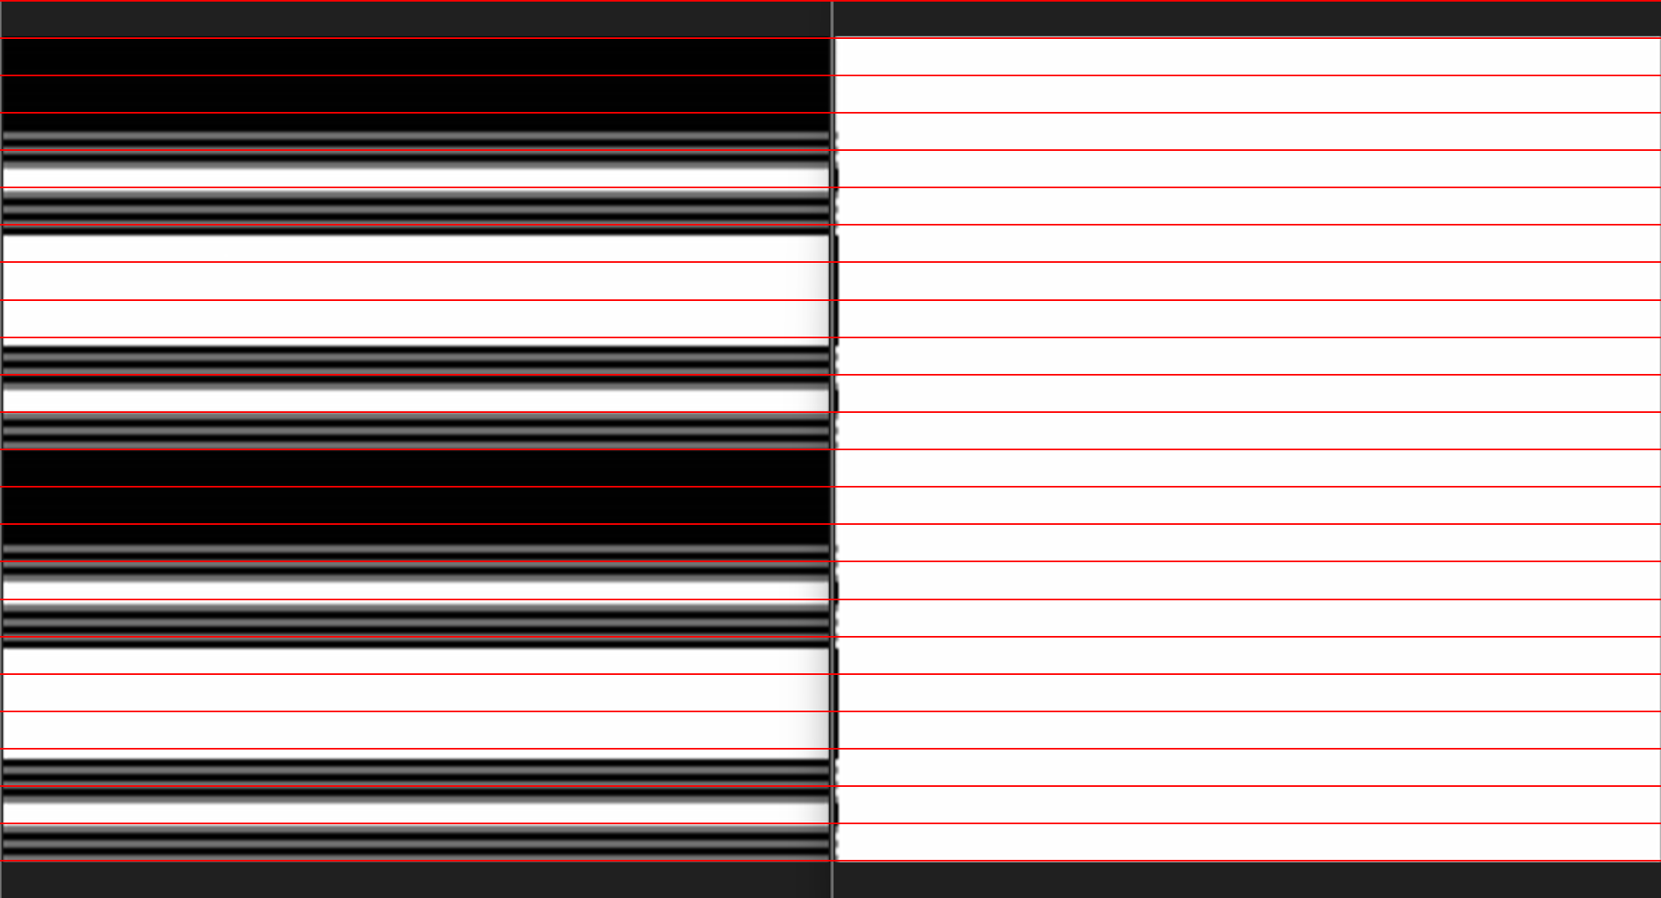

Original Image
$U \text{Σ}$ image

Slide 2
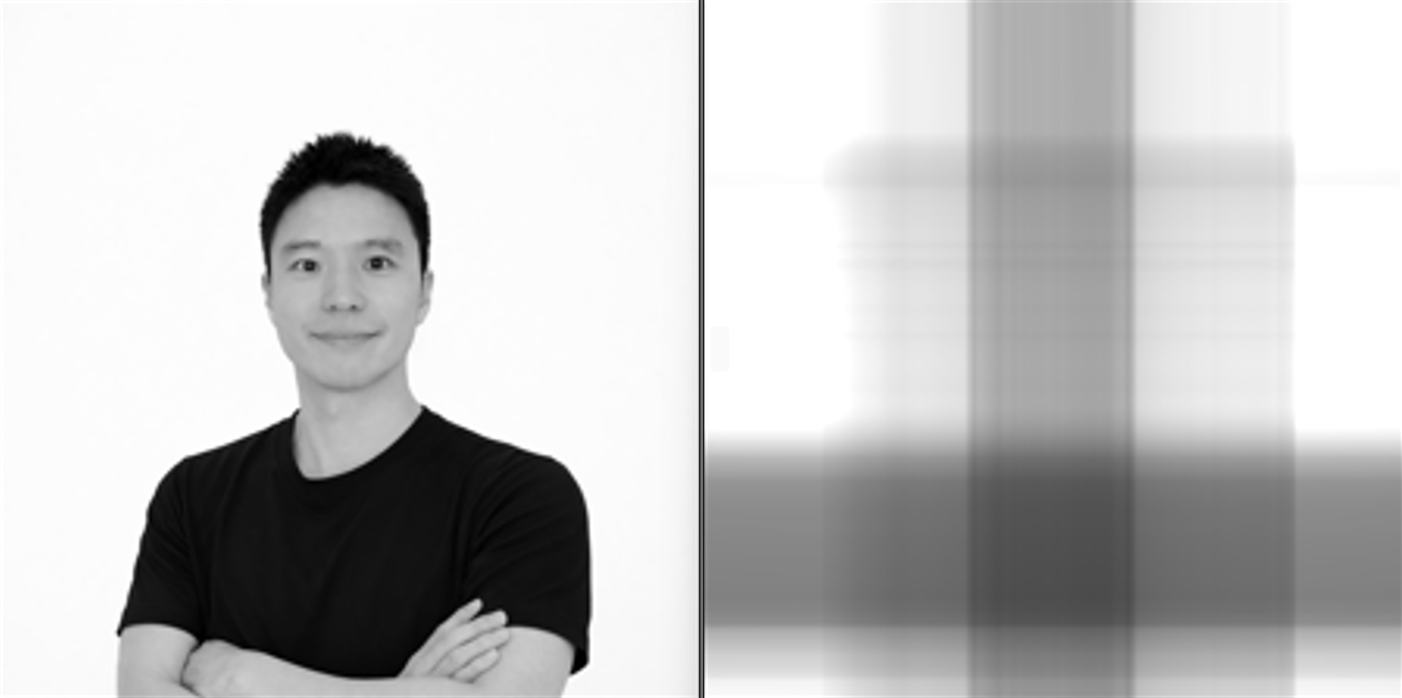

Original Image
$$U \text{Σ} V^{T}: \text{rank}\text{ 1}$$

