Slide 1

Telco Customer Churn Prediction
Prepared by
Kyle Converse

Slide 2

Why is this project beneficial?
Customer retention is more cost-effective than acquisition
Managing customer churn can have an impact on a company’s revenue and profitability
“A firm’s acquisition cost per customer is more sensitive to market position and competition than retention cost per customer.”
- Journal of Marketing Research 2016
“A five percent churn reduction can improve a company’s profitability by up to twenty-five percent.”
- Uday Bhale, Doctor of Marketing from Lovely Professional University
- Harpreet Bedi, Professor at the Mittal School of Business
“Across a wide range of businesses, customers generate increasing profits each year they stay with a company. Return customers tend to buy more from a company over time. As they do, your operating costs to serve them decline. And they’ll often pay a premium to continue to do business with you rather than switch to a competitor with whom they’re neither familiar nor comfortable”
- Fred Reichheld, New York Times Best-selling author, Harvard Business School Graduate, and creator of the Net Promotor System of management

Slide 3
Data Description
Found on Kaggle, but originates from IBM
Made up of 7,043 California customers during Q3 (July – September)
Includes customer demographics, locations, services provided, and their status with the company

Slide 4
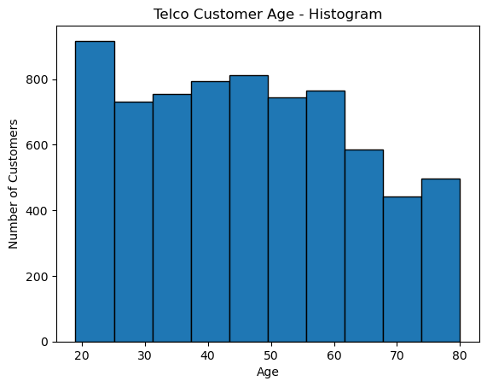
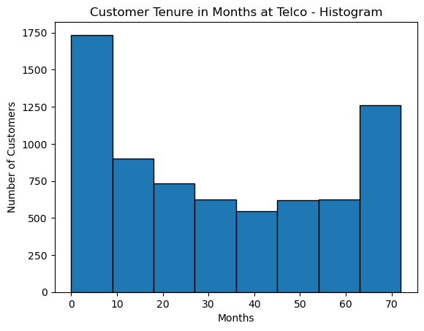
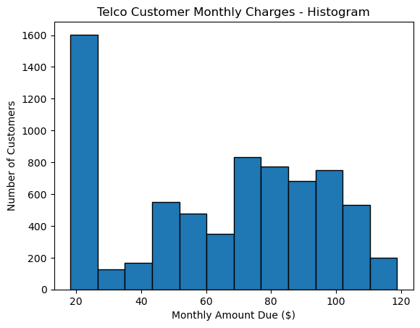
Age Descriptives
mean 47.0
min 19.0
25% 32.0
50% 46.0
75% 60.0
max 80.0
Tenure Months Descriptives
mean 32.37
min 0.00
25% 9.00
50% 29.00
75% 55.00
max 72.00
Monthly Charges Descriptives
mean 64.76
min 18.25
25% 35.50
50% 70.35
75% 89.85
max 118.75

Slide 5
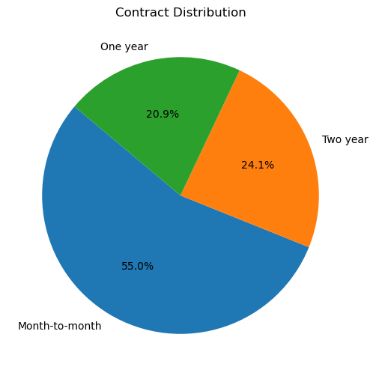
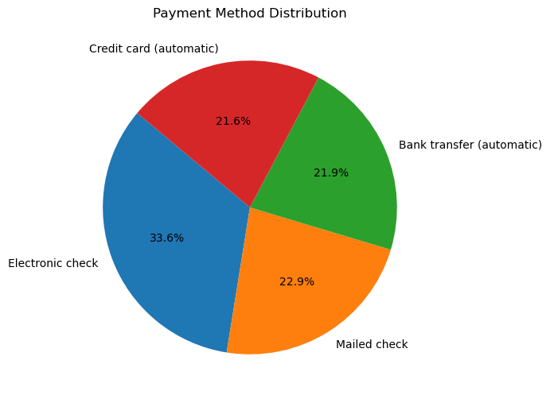

Slide 6
Additional EDA Conducted
Numerical
Correlation with churn
Explored transforms such as taking the natural log, using a MinMax Scaler, and a Standard Scaler to compare predictive power on low/moderate correlating variables
Categorical
Correlation with churn using Chi-Square test
Strength of Association testing using Cramer’s V test
Feature Engineering
Interaction terms between categorical variables
Interaction terms between categorical and numerical variables

Slide 7
Algorithms Utilized
Logistic Regression
Easy to interpret results from
Fast to run and predict on datasets of all sizes
Sensitive to multicollinearity
Struggles with class imbalance
Extreme Gradient Boost
Powerful algorithm
Handles complex data patterns well
Provides feature importances
Needs tuned carefully to avoid overfitting
Results can be hard to interpret
Evaluation Metrics
Recall
f1-score
AUC-ROC
Random Forest
Robust against overfitting
Easy to determine feature importance
Can perform slower than other algorithms on large datasets
Can be difficult to interpret due to its tricky to follow decision making process
Scaled Vector Classifier
Very effective with highly dimensional data
Very slow to train and predict on large datasets
Difficult to interpret results from

Slide 8
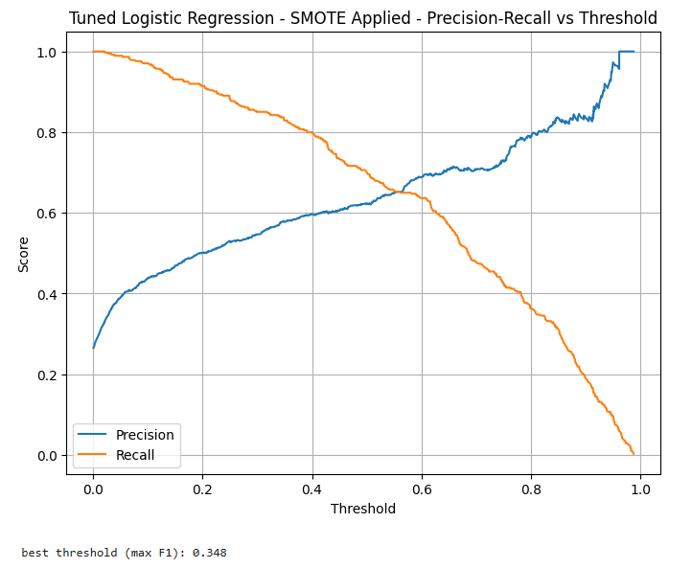
Model Building Process
Split data with an 80/20 train-test split with stratified y. Resample later with SMOTENC.
Encoded categorical variables using OneHotEncoding
Standardized numerical values using standard scaler
Column transformer + pipeline for repeatability
5-fold cross-validated grid searches for hyperparameters
Precision-recall graphs for optimal thresholds
Evaluate Results

Slide 9
Model | Non-Churner Precision | Non-Churner Recall | Non-Churner f1-score | Churner Precision | Churner Recall | Churner f1-score | AUC-ROC
Logistic Regression Baseline | 0.91 | 0.81 | 0.86 | 0.60 | 0.78 | 0.68 | 0.8786
Random Forest Baseline | 0.91 | 0.80 | 0.85 | 0.58 | 0.78 | 0.67 | 0.8681
eXtreme Gradient Boosting Baseline | 0.90 | 0.84 | 0.87 | 0.62 | 0.74 | 0.68 | 0.8691
Scaled Vector Classifier Baseline | 0.91 | 0.83 | 0.87 | 0.62 | 0.76 | 0.69 | 0.8811
Tuned LR w/o SMOTENC | 0.91 | 0.83 | 0.87 | 0.62 | 0.77 | 0.69 | 0.8848
Tuned RF w/o SMOTENC | 0.90 | 0.81 | 0.85 | 0.59 | 0.75 | 0.66 | 0.8661
Tuned XGB w/o SMOTENC | 0.92 | 0.83 | 0.87 | 0.62 | 0.79 | 0.70 | 0.8828
Tuned SVC w/o SMOTENC | 0.90 | 0.85 | 0.87 | 0.64 | 0.74 | 0.69 | 0.8808
Tuned LR with SMOTENC | 0.93 | 0.78 | 0.85 | 0.58 | 0.84 | 0.68 | 0.8815
Tuned RF with SMOTENC | 0.89 | 0.83 | 0.86 | 0.61 | 0.73 | 0.66 | 0.8600
Tuned XGB with SMOTENC | 0.91 | 0.79 | 0.85 | 0.58 | 0.79 | 0.67 | 0.8690
Tuned SVC with SMOTENC | 0.90 | 0.85 | 0.87 | 0.63 | 0.73 | 0.68 | 0.8802
Averages | .9075 | .8210 | .8617 | .6075 | .7670 | .6792 | .8752
Performance Metrics for All Models Tested

Slide 11
Top 20 Most Important Model Features in Relation to Churn Odds
Feature Name | Correlation | Churn Odds
Number of Referrals | -0.38 | -31.6%
Log_Total_Charges | -0.15 | -13.9%
Tenure Months | -0.14 | -13.1%
Log_Total_Revenue | -0.13 | -12.2%
Senior Citizen_No_Streaming Music_No | -0.11 | -10.4%
Total Charges | -0.08 | -7.7%
Feature Name | Correlation | Churn Odds
Dependents_No_Number of Referrals_1 | 0.14 | +15%
Partner_Yes_Number of Referrals_1 | 0.13 | +13.9%
Total Extra Data Charges | 0.12 | +12.7%
Referred a Friend_Yes_Number of Referrals_1 | 0.11 | +11.6%
Paperless_Billing_Yes_Number of Referrals_1 | .10 | +10.5%
Phone_Service_Yes_Number of Referrals_1 | .10 | +10.5%
Senior Citizen_No_Number of Referrals_1 | .10 | +10.5%
Online Security_No_Number of Referrals_1 | .09 | +9.4%
Unlimited Data_Yes_Number of Referrals_1 | .09 | +9.4%
Payment Method_Electronic Check_Number of Referrals_1 | .08 | +8.3%
Premium Tech Support_No_Number of Referrals_1 | .08 | +8.3%
Payment Method_Mailed Check_Tenure Months_1 | .08 | +8.3%
Age | .08 | +8.3%
Contract_Month-to_month_Tenure Months_1 | .08 | +8.3%

Slide 12
High-Risk Customers
Recommendations
Customers that are on month-to-month contracts and/or new customers
Manual paying customers (mailed check and electronic check)
Single referral customers that do not have deep product/service adoption
Customers without premium support or online security services
Customers that accrue extra data charges
Offer 3–6-month discounted bundles upon sign-up
Incentivize autopay services
30 day free-trials for new customers on premium tech support and online security
Offer referral bonuses such as a month of a free service upon a customer achieving 2+ referrals

Slide 13
Moderate-Risk Customers
Recommendations
Single service customers (only on phone plans or cable plans)
Customers that are enrolled in paperless billing and have low engagement
Senior Citizen customers without support services (premium tech support, device protection, online security, etc.)
Create bundles at a discount to promote service adoption and future engagement
“Digital loyalty” program that rewards customers that continue to be enrolled in autopay
Launch a “Senior Care” program to offer senior citizen customers easier and discounted access to tech support and security services.

Slide 14
Low-Risk Customers
Recommendations
Customers that are high total spenders
Customers that have made multiple referrals (2+)
Customers with longer tenure
Create a VIP program to recognize and incentivize these customers:
Exclusive offers
Loyalty credits on bills
Early access on deals for new devices
“Thank you” gifts for tenure milestones

Slide 15

Moving Forward
Monitor
Monitor customer segments for movement
Note and Respond
Note where retention efforts were effective and take stronger/reduced action when needed.
Refresh and validate
Refresh and validate the model

Slide 16
References
Bhale, U.A., Bedi, H.S. (2024). Customer Churn Construct: Literature Review and Bibliometric Study. Management Dynamics: Vol. 24: No. 1, Article 1. https://managementdynamics.researchcommons.org/cgi/viewcontent.cgi?article=1327&context=journal
Min, S., Zhang, X., Kim, N., & Srivastava, R.K. (2016). Customer Acquisition and Retention Spending: An Analytical Model and Empirical Investigation in Wireless Telecommunications Markets. Journal of Marketing Research, 53(5), 728-744. https://doi.org/10.1509/jmr.14.0170
Reichheld, F. (2001). Prescription for cutting costs. Bain & Company. https://media.bain.com/Images/BB_Prescription_cutting_costs.pdf

