Slide 1

First Introduction into Relational Database Systems
Konstantin Kuzmin
RCOS Special!

Slide 2
Database Systems
CSCI-4380 Database Systems
DBMS (Database Management System) is a software tool for storing and managing large amounts of data
Database is a collection of data organized for a specific application, often stored in a DBMS
Database application is a software product that uses DBMSs to store one or more databases to accomplish a specific purpose

Slide 3
What Is a Relational Database Management System?
Database Management System = DBMS
Relational DBMS = RDBMS
A collection of files that store the data
A big C program written by someone else that accesses and updates those files for you

Slide 4
Where are RDBMS used?
Backend for traditional “database” applications
Backend for large Websites
Backend for Web services

Slide 5
Example of a Traditional Database Application
Suppose we are building a system
to store the information about:
students
courses
professors
who takes what, who teaches what

Slide 6
Can we do it without a DBMS ?
Sure we can! Start by storing the data in files:
students.txt courses.txt professors.txt
Now write C or Java programs to implement specific tasks

Slide 7
Doing it without a DBMS...
Enroll “Mary Johnson” in “CSE444”:
Write a C program to do the following:
Read ‘students.txt’
Read ‘courses.txt’
Find&update the record “Mary Johnson”
Find&update the record “CSE444”
Write “students.txt”
Write “courses.txt”

Slide 8
Problems without an DBMS...
System crashes:
What is the problem ?
Large data sets (say, 50GB)
What is the problem ?
Simultaneous access by many users
Need locks: we know them from OS, but now data on disk; and is there any fun to re-implement them ?
Read ‘students.txt’
Read ‘courses.txt’
Find&update the record “Mary Johnson”
Find&update the record “CSE444”
Write “students.txt”
Write “courses.txt”
CRASH !

Slide 9
Enters a DMBS
“Two tier database system”
connection
(ODBC, JDBC)
Database server (someone else’s C program)
Data files
Applications

Slide 10
Functionality of a DBMS
The programmer sees SQL, which has two components:
Data Definition Language - DDL
Data Manipulation Language - DML
query language
Behind the scenes the DBMS has:
Query optimizer
Query engine
Storage management
Transaction Management (concurrency, recovery)

Slide 11
Functionality of a DBMS
Two things to remember:
Client-server architecture
Slow, cumbersome connection
But good for the data
It is just someone else’s C program
In the beginning we may be impressed by its speed
But later we discover that it can be frustratingly slow
We can do any particular task faster outside the DBMS
But the DBMS is general and convenient

Slide 12
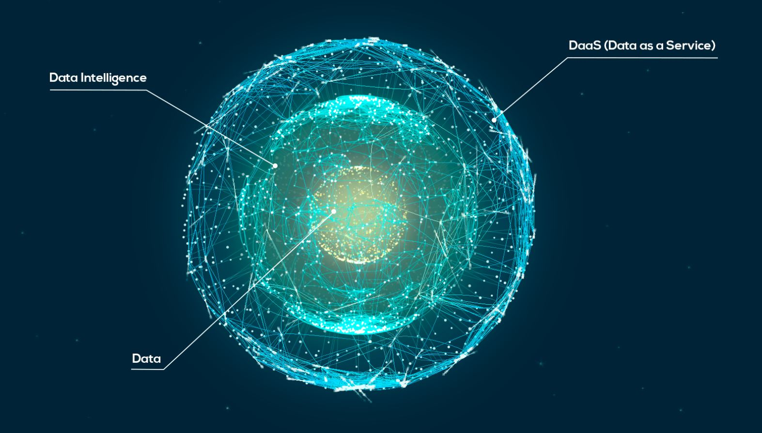
Data-centric Applications
Data is the primary and permanent asset
Applications come and go
Data model precedes the implementation of any given application and will be around and valid long after it is gone

Slide 13
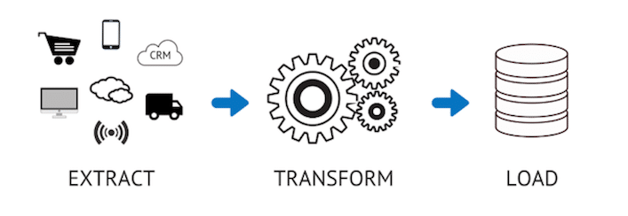
Extract, Transform, and Load (ETL)
CSCI-4350 Data Science
Data integration
Allows different data to work together
Allows consolidation of data from multiple sources into a single centralized location

Slide 14

Extract
Extract raw data from different sources
Possible sources
Existing databases and legacy systems
Cloud, hybrid, and on-premises environments
Sales and marketing applications
Mobile devices and apps
CRM systems
Data storage platforms
Data warehouses
Analytics tools
Web sites

Slide 15

Transform
Apply rules and regulations to ensure data quality and accessibility
Processes
Cleansing — inconsistencies and missing values in the data are resolved
Standardization — formatting rule are applied to the data set
Deduplication — redundant data is excluded or discarded
Verification — unusable data is removed and anomalies are flagged
Sorting — data is organized according to type
Other tasks — any additional/optional rules can be applied to improve data quality

Slide 16
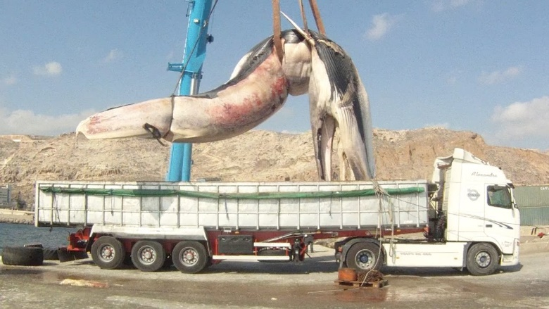
Load
Load the newly transformed data into a new destination
Loading methods
Full loading — data loaded at once
Incremental loading — data loaded at scheduled intervals

Slide 17
How the Programmer Sees the DBMS
Start with DDL to create tables:
Continue with DML to populate tables:
CREATE TABLE Students (
Name CHAR(30)
SSN CHAR(9) PRIMARY KEY NOT NULL,
Category CHAR(20)
) . . .
INSERT INTO Students
VALUES(‘Charles’, ‘123456789’, ‘undergraduate’)
. . . .

Slide 18
How the Programmer Sees the DBMS
Tables:
Still implemented as files, but behind the scenes can be quite complex
Students:
Takes:
Courses:
“data independence” = separate logical view from physical implementation

Slide 19
Queries
Find all courses that “Mary” takes
What happens behind the scene ?
Query processor figures out how to answer the query efficiently.
SELECT C.name FROM Students S, Takes T, Courses C WHERE S.name=“Mary” and S.ssn = T.ssn and T.cid = C.cid

Slide 20
Database Systems
The big commercial database vendors:
Oracle
IBM (with DB2) bought Informix recently
Microsoft (SQL Server)
Sybase
Some free database systems (Unix) :
PostgreSQL
MySQL
Predator

Slide 21
SQL Introduction
Standard language for querying and manipulating data
Structured Query Language
Many standards out there:
ANSI SQL
SQL92 (a.k.a. SQL2)
SQL99 (a.k.a. SQL3)
Vendors support various subsets of these
What we discuss is common to all of them

Slide 22
SQL
Data Definition Language (DDL)
Create/alter/delete tables and their attributes
Data Manipulation Language (DML)
Query one or more tables
Insert/delete/modify tuples in tables

Slide 23
Data Types in SQL
Characters:
CHAR(20) -- fixed length
VARCHAR(40) -- variable length
Numbers:
BIGINT, INT, SMALLINT, TINYINT
REAL, FLOAT -- differ in precision
MONEY
Times and dates:
DATE
DATETIME -- SQL Server
Others... All are simple

Slide 24
Tables in SQL
Attribute names
Product
Table name
PName | Price | Category | Manufacturer
Gizmo | $19.99 | Gadgets | GizmoWorks
Powergizmo | $29.99 | Gadgets | GizmoWorks
SingleTouch | $149.99 | Photography | Canon
MultiTouch | $203.99 | Household | Hitachi
Tuples or rows

Slide 25
Tables Explained
A tuple = a record
Restriction: all attributes are of atomic type
A table = a set of tuples
Like a list…
…but it is unordered: no first(), no next(), no last().

Slide 26
Tables Explained
The schema of a table is the table name and its attributes:
Product(PName, Price, Category, Manfacturer)
A key is an attribute whose values are unique; we underline a key
Product(PName, Price, Category, Manfacturer)

Slide 27
SQL Query
Basic form: (plus many many more bells and whistles)
SELECT attributes
FROM relations (possibly multiple)
WHERE conditions (selections)

Slide 28
Simple SQL Query
Product
PName | Price | Category | Manufacturer
Gizmo | $19.99 | Gadgets | GizmoWorks
Powergizmo | $29.99 | Gadgets | GizmoWorks
SingleTouch | $149.99 | Photography | Canon
MultiTouch | $203.99 | Household | Hitachi
SELECT * FROM Product WHERE Category=‘Gadgets’
PName | Price | Category | Manufacturer
Gizmo | $19.99 | Gadgets | GizmoWorks
Powergizmo | $29.99 | Gadgets | GizmoWorks
“selection”

Slide 29
Simple SQL Query
Product
PName | Price | Category | Manufacturer
Gizmo | $19.99 | Gadgets | GizmoWorks
Powergizmo | $29.99 | Gadgets | GizmoWorks
SingleTouch | $149.99 | Photography | Canon
MultiTouch | $203.99 | Household | Hitachi
SELECT PName, Price, Manufacturer FROM Product WHERE Price > 100
“selection” and
“projection”
PName | Price | Manufacturer
SingleTouch | $149.99 | Canon
MultiTouch | $203.99 | Hitachi

Slide 30
Joins in SQL
Connect two or more tables:
Product
PName | Price | Category | Manufacturer
Gizmo | $19.99 | Gadgets | GizmoWorks
Powergizmo | $29.99 | Gadgets | GizmoWorks
SingleTouch | $149.99 | Photography | Canon
MultiTouch | $203.99 | Household | Hitachi
Company
CName | StockPrice | Country
GizmoWorks | 25 | USA
Canon | 65 | Japan
Hitachi | 15 | Japan
What is
the connection
between
them ?

Slide 31
Joins
Product (PName, Price, Category, Manufacturer)
Company (CName, StockPrice, Country)
Find all products under $200 manufactured in Japan; return their names and prices.
Join between Product and Company
SELECT PName, Price FROM Product, Company WHERE Manufacturer=CName AND Country=‘Japan’ AND price <= 200

Slide 32
Modifying the Database
Three kinds of modifications
Insertions
Deletions
Updates
Sometimes they are all called “updates”

Slide 33
Insertions
General form:
INSERT INTO R(A1,…., An) VALUES (v1,…., vn)
Example: Insert a new purchase to the database:
INSERT INTO Purchase(buyer, seller, product, store)
VALUES (‘Joe’, ‘Fred’, ‘wakeup-clock-espresso-machine’, ‘The Sharper Image’)
Missing attribute → NULL.
May drop attribute names if give them in order.

Slide 34
Deletions
Example:
DELETE FROM PURCHASE
WHERE seller = ‘Joe’ AND
product = ‘Brooklyn Bridge’
Factoid about SQL: there is no way to delete only a single occurrence of a tuple that appears twice in a relation.

Slide 35
Updates
Example:
UPDATE PRODUCT
SET price = price/2
WHERE Product.name IN
(SELECT product
FROM Purchase
WHERE Date =‘Oct, 25, 1999’);

Slide 36
Creating Tables
Example:
CREATE TABLE Person(
name VARCHAR(30),
social-security-number INT,
age SHORTINT,
city VARCHAR(30),
gender BIT(1),
Birthdate DATE
);

Slide 37
Deleting or Modifying a Table
Deleting:
Example:
DROP Person;
Exercise with care !!
Altering: (adding or removing an attribute).
ALTER TABLE Person
ADD phone CHAR(16);
ALTER TABLE Person
DROP age;
Example:
What happens when you make changes to the schema?

Slide 38
Constraints in SQL
A constraint = a property that we’d like our database to hold
The system will enforce the constraint by taking some actions:
forbid an update
or perform compensating updates

Slide 39
Constraints in SQL
Constraints in SQL:
Keys, foreign keys
Attribute-level constraints
Tuple-level constraints
Global constraints: assertions
The more complex the constraint, the harder it is to check and to enforce
simplest
Most complex

Slide 40
Keys
CREATE TABLE Product (
name CHAR(30) PRIMARY KEY,
category VARCHAR(20))
OR:
CREATE TABLE Product (
name CHAR(30),
category VARCHAR(20)
PRIMARY KEY (name))

Slide 41
Keys with Multiple Attributes
CREATE TABLE Product (
name CHAR(30),
category VARCHAR(20),
price INT,
PRIMARY KEY (name, category))

Slide 42
Other Keys
CREATE TABLE Product (
productID CHAR(10),
name CHAR(30),
category VARCHAR(20),
price INT, PRIMARY KEY (productID),
UNIQUE (name, category))
There is at most one PRIMARY KEY; there can be many UNIQUE

Slide 43
Foreign Key Constraints
Referential integrity constraints
CREATE TABLE Purchase (
prodName CHAR(30)
REFERENCES Product(name),
date DATETIME)
prodName is a foreign key to Product(name) name must be a key in Product

Slide 44
Product
Purchase
Name | Category
Gizmo | gadget
Camera | Photo
OneClick | Photo
ProdName | Store
Gizmo | Wiz
Camera | Ritz
Camera | Wiz

Slide 45
Foreign Key Constraints
OR
(name, category) must be a PRIMARY KEY
CREATE TABLE Purchase (
prodName CHAR(30),
category VARCHAR(20),
date DATETIME,
FOREIGN KEY (prodName, category)
REFERENCES Product(name, category)

Slide 46
What happens during updates ?
Types of updates:
In Purchase: insert/update
In Product: delete/update
Product
Purchase
Name | Category
Gizmo | gadget
Camera | Photo
OneClick | Photo
ProdName | Store
Gizmo | Wiz
Camera | Ritz
Camera | Wiz

Slide 47
NoSQL Databases
MongoDB
Neo4j
DynamoDB

