Slide 1
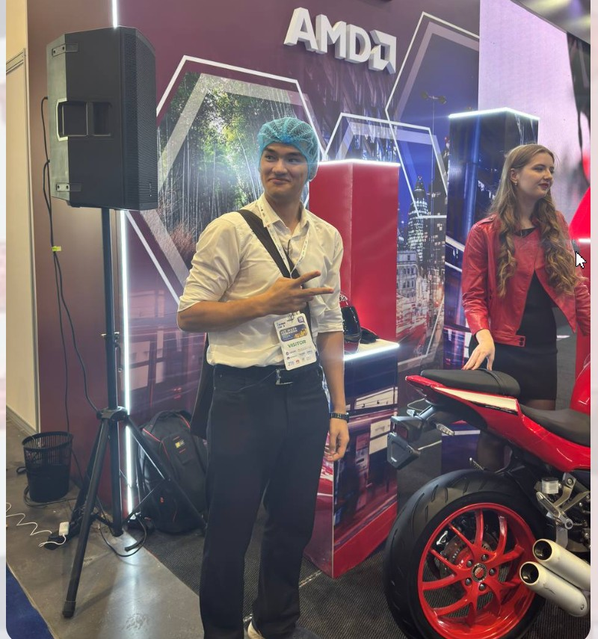
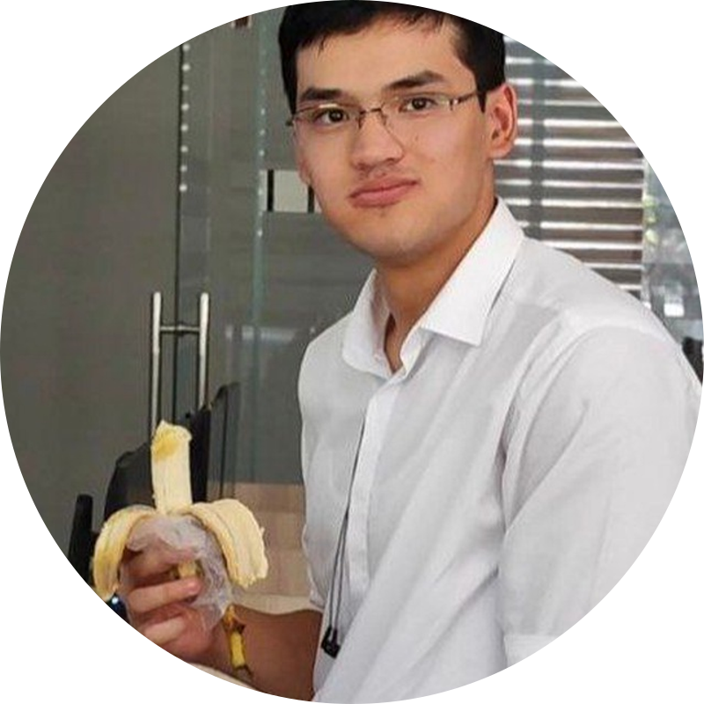
A PRACTICAL GUIDE · 2026
Learn Korean
무엇이 필요하고, 어디서 배울까
What you need, which test proves your level, and where to study

Slide 2
What's required depends on your goal
Starting has no requirements. They appear when you want something official.
나
대
장
일
집
Personal interest
University in Korea
GKS scholarship
Working in Korea
Long-term residency
No requirements
TOPIK 3+
Not required to apply
EPS-TOPIK
KIIP or TOPIK
Learn Hangul, then a textbook or course. TOPIK is optional.
Typical for Korean-taught degrees; some ask for 4. Each school sets its own rule.
1-year language course included. Must reach TOPIK 3 by its end.
A separate test for Employment Permit System jobs.
The integration program teaches language and society.

Slide 3
TOPIK is the official proof of your level
2
Paper | Levels | Skills tested | Fee in Korea
TOPIK I | 1–2 | Listening, reading | ₩40,000
TOPIK II | 3–6 | Listening, reading, writing | ₩55,000
TOPIK Speaking | 1–6 | Speaking, scored out of 200 | Varies
papers
6
levels
You choose the paper; your score decides the level. Fees outside Korea are set by local test centers.
2 yrs
score validity

Slide 4
Remaining 2026 test dates
Oct 17–18
Oct 24
Nov 15
Nov 28
108th TOPIK
15th IBT + 12th Speaking
109th TOPIK
16th TOPIK IBT
Paper test
Computer tests
Paper test
Computer test
Korea schedule. Not every session runs in every country; local centers set their own registration windows. Register on topik.go.kr from a computer, not a phone.

Slide 5
GKS: a fully funded path that teaches you Korean
1 yr
TOPIK 3
Korean language course, fully paid, before the degree
Minimum level every scholar must reach by the end of that year
TOPIK 5–6
₩100,000
Already have it? You skip the language year
Extra monthly grant for scholars holding TOPIK 5 or 6
TOPIK isn't required to apply, but any score strengthens your application. Apply via the Korean embassy or a designated university.

Slide 6
Where to learn
세
King Sejong Institute
온
Nuri-Sejong online
학
University language institutes
Korea's official overseas schools. Low fees, standard textbooks, TOPIK prep.
The institute's free online platform, for anyone without a branch nearby.
Full-time in Korea: Yonsei, Korea, Sogang and more. 10-week terms.
관
Korean Education Centers
강
Online courses & podcasts
책
Textbooks & past papers
Linked to Korean embassies. Courses, TOPIK and GKS information.
Yonsei's First Step Korean on Coursera, Talk To Me In Korean.
Sejong, Yonsei and Sogang series. Free past TOPIK papers on topik.go.kr.

Slide 7
King Sejong Institutes are close to most learners
273
89
239,020
institutes worldwide
countries
students enrolled
as of June 2026
29 new institutes added in 2026
in 2025, a record
Find the nearest branch at ksif.or.kr. Source: Ministry of Culture, Sports and Tourism, via The Korea Times.

Slide 8
A realistic roadmap at an hour a day
Full-time intensive courses move roughly three times faster.
5
4
Level 5–6
3
TOPIK II, Level 3–4
2
3+ years
Take TOPIK I
1
1.5–2.5 years
Basic grammar
≈ 6–12 months
Learn Hangul
3–6 months
1–2 weeks

Slide 9
Check the rules where they're made
topik.go.kr
TOPIK dates, registration, past papers
studyinkorea.go.kr
GKS scholarship and university study
ksif.or.kr
King Sejong Institutes
eps.go.kr
EPS-TOPIK and work permits
hikorea.go.kr
Visas and the KIIP program
감사합니다 · Thank you

