Slide 1
FARMER WELFARE - Ashish prasad - Yashwant Dope - Nikhil Shinde

Slide 2
CONTENTS
Use case
UI Design:
Registration
Login
Farmers
Shopkeepers
Buyers
Admin
Feedback
Contact us

Slide 3
Introduction :
This project aims to explore and analyze methods to streamline APMC operations, reduce market fees, and promote digitalization through initiatives like eNAM (Electronic National Agriculture Market). Such measures can provide greater market access, real-time price transparency, and more direct buyer-seller interactions, helping farmers get fair compensation for their produce. Additionally, exploring infrastructure improvements—such as storage and transport facilities—could further reduce post-harvest losses and empower farmers. Through this project, we aim to propose actionable strategies that could enhance the welfare of farmers by addressing the limitations of APMC markets and advocating for a more inclusive and efficient agricultural trading system.

Slide 4
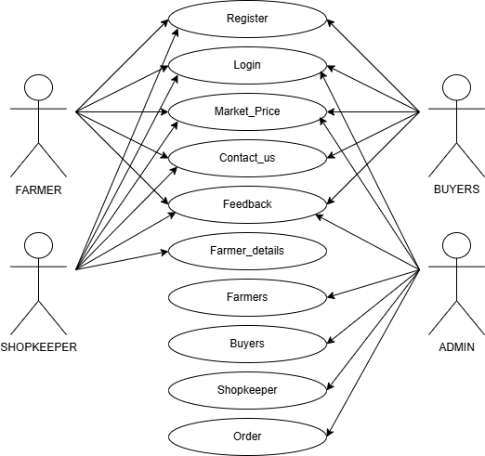
USE CASE

Slide 5
UI DESIGN

Slide 6
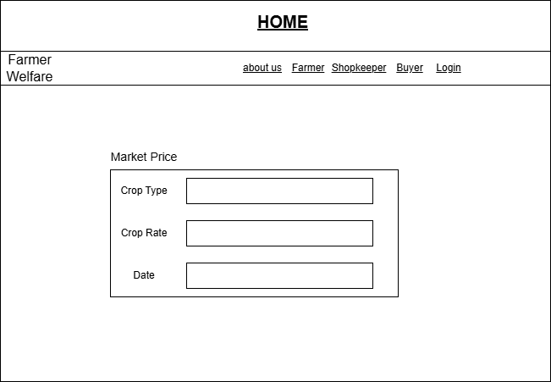
Home Screen:

Slide 7
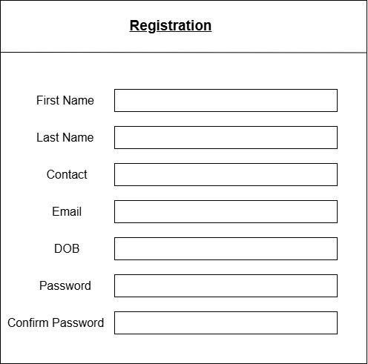
Registration Page :

Slide 8
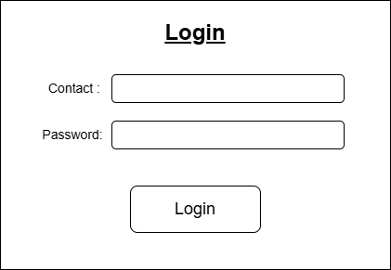
Login Page :

Slide 9
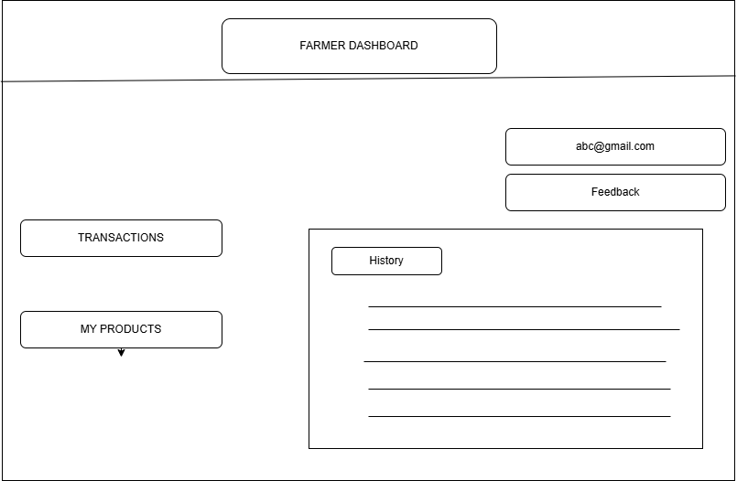
Farmer Page :

Slide 10
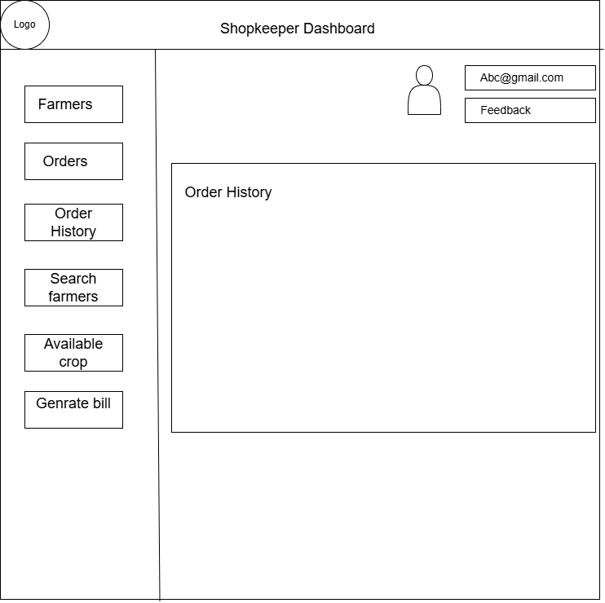
Shopkeeper :

Slide 11
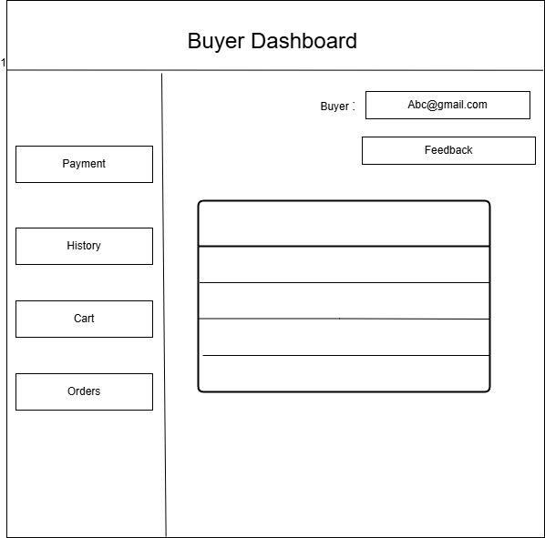
Buyer :

Slide 12
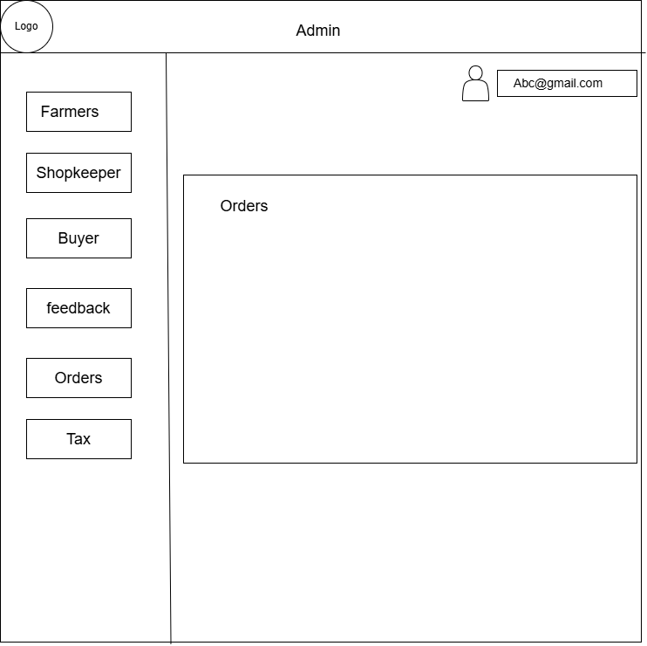
Admin Page :

Slide 13
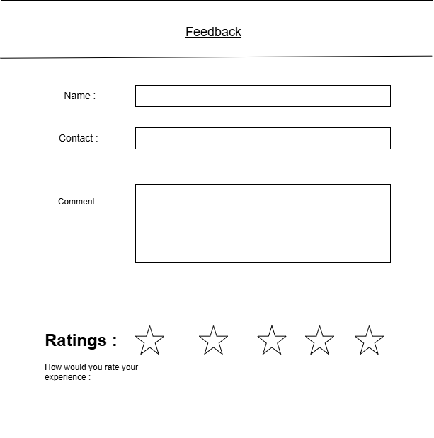
Feedback :

Slide 14
Thank you………

