Slide 1
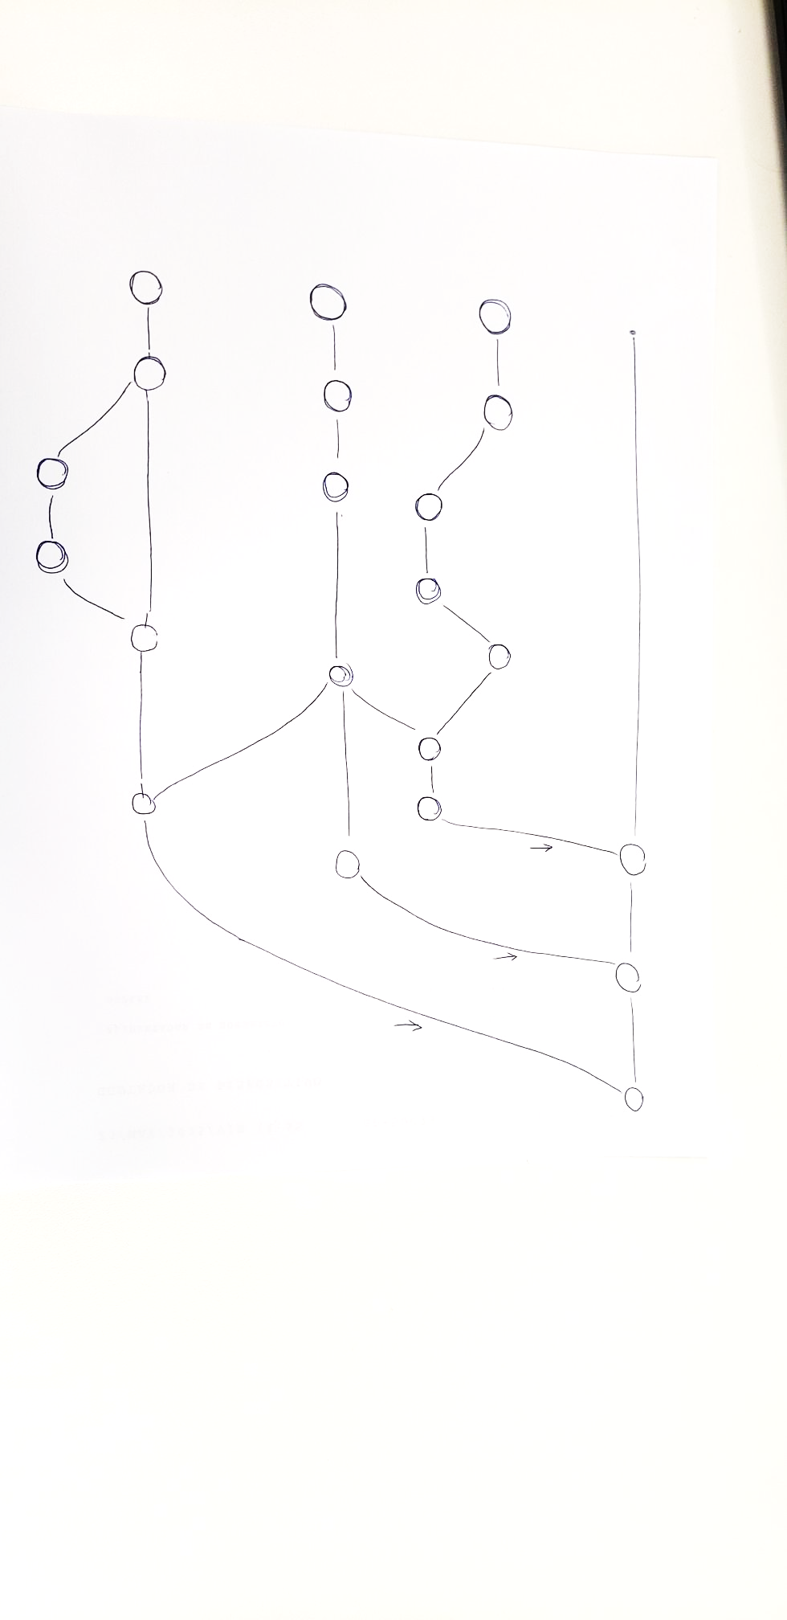
GitHub for SolidWorks Training
28-May-2025

Slide 2
Agenda
Why GitHub for PDM?
How it works
New daily workflow in GitHub
Protocol for naming files, branches, and commits
Demonstration
Next steps

Slide 3
Why GitHub?
Transition Goals
Current Issues
Manual version control
Unclear which is latest or published version
Lack of documentation and design reviews
Goals
Superior version control
Controlled changes – reversible, auditable
Simplify documentation, especially to signal “published” version
Add review process
Better collaboration across roles and teams
Notes:
In current model, there is only working directory and remote directory, but they are copies of each other. All users see the same view.

Slide 4
How GitHub Works
1

Slide 5
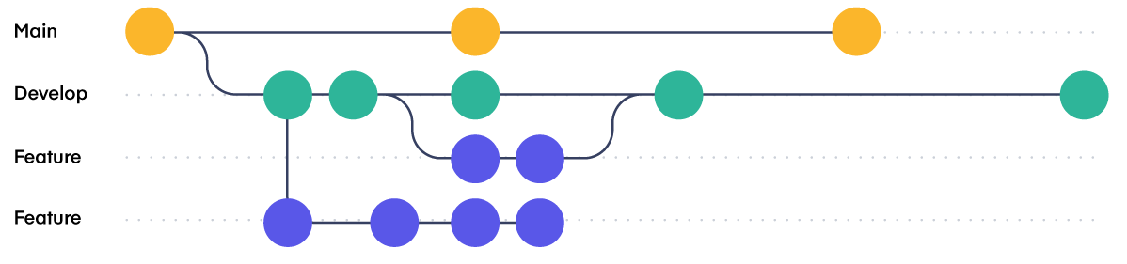
How it Works
Branches
V1
V1 - FINAL
V1 – FINAL - modified
V1 – FINAL – modified.v2
V1 – FINAL – modified.v2-smaller
Current
GitHub

Slide 6
How it Works
Repository Model
Remote Repository
Local Repository
Working Directory
git clone
git commit
git push
git fetch/pull
GitHub Web
GitHub Desktop
SolidWorks
Notes:
In current model, there is only working directory and remote directory, but they are copies of each other. All users see the same view.

Slide 7
Workflow
2

Slide 8
Workflow
for Viewers
Remote Repository
Local Repository
Working Directory
Outside Directory
1
git clone
git fetch/pull
2
3
release after PR
GitHub Web
GitHub Desktop
SolidWorks
R&I Folders

Slide 9
Workflow
for Designers and Engineers
Remote Repository
Local Repository
Working Directory
1
git clone/fetch/pull
2
add / edit
3
git commit
4
git push
GitHub Web
GitHub Desktop
SolidWorks
Notes:
In current model, there is only working directory and remote directory, but they are copies of each other. All users see the same view.

Slide 10
Protocol
3

Slide 11
Naming Conventions
SolidWorks Files
Type | Rule | Example
Part | ProjectName_PartName | Haven_InnerShell
Sub assembly | ProjectName_PartName_SubAssembly | Haven_Housing_SubAssembly
Assembly | ProjectName_Assembly | Haven_Assembly
Off-the-shelf part | PartType_Code | M3x6_Screw_RS280981
Version number
Description
Long file names
Name of designer

Slide 12
Protocol
Branches
main
Branch = parallel workspace
Core branches
main
mechanical, design, packaging, electrical, firmware, etc
Sub-branches
mech+, des+, pack+
mechanical
mech+SLA-optimize
design
packaging
pack+2mm-PET

Slide 13
Naming Conventions
Branch Names
Good names
mech+WL-design
des+add-sliding-door
pack+minimize-material
fix+lid-interference
Poor names
newFolder
Marta-changes
temp
Clear
Descriptive
Categorizes work

Slide 14
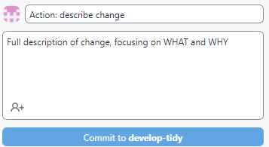
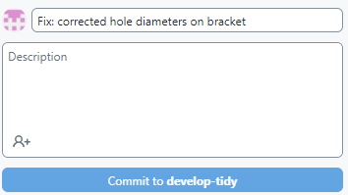
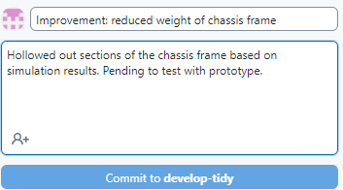
Naming Conventions
Commits
Template
Commit = snapshot of project, step-by-step
Clear
Descriptive
Frequent (~1 to 2 hours editing)
Minimum
Better

Slide 15
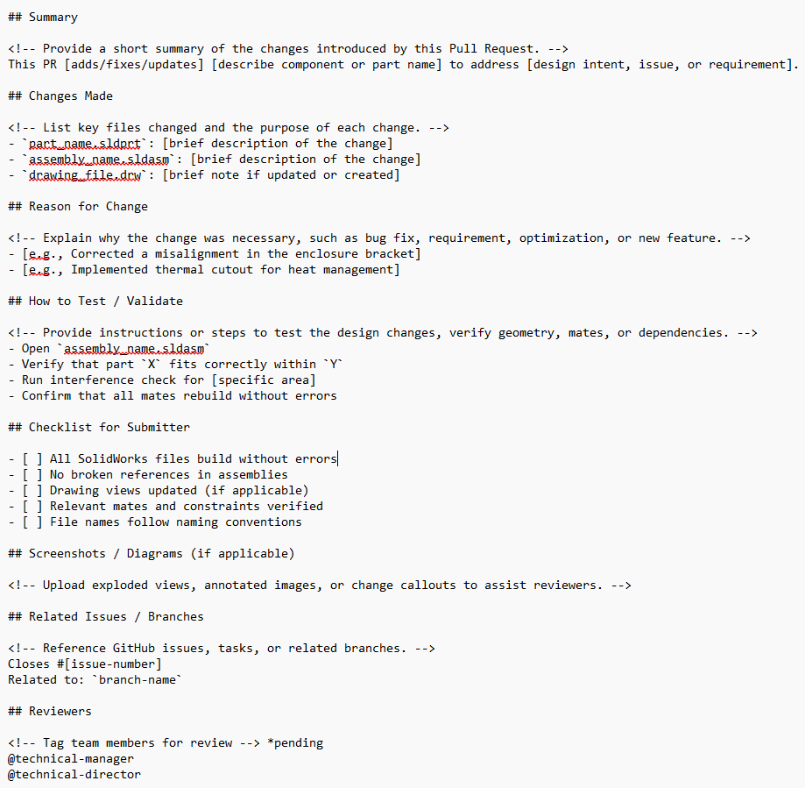
Protocol
Pull requests
Template
Thorough description
References specific issues
Assign reviewer(s)
PullRequestTemplate.md

Slide 16
Protocol
Release files out of GitHub
R1
R2
R3
main
main branch = published versions
Published version is any file that leaves GitHub (3D printing, send to client, etc)
Published versions are named R1, R2, …
Optionally R2.2, R2.3, etc
Example: Haven_Assembly_R3

Slide 17
Protocol
Documenting Technical Releases
R1
R2
R3
main
Published versions of mechanical files are documented in the PDD in the main branch
Notes:
How do releases

Slide 18
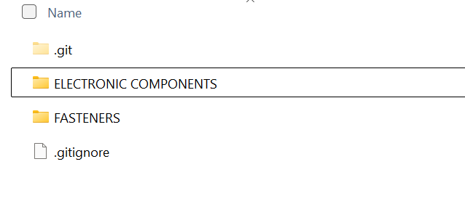
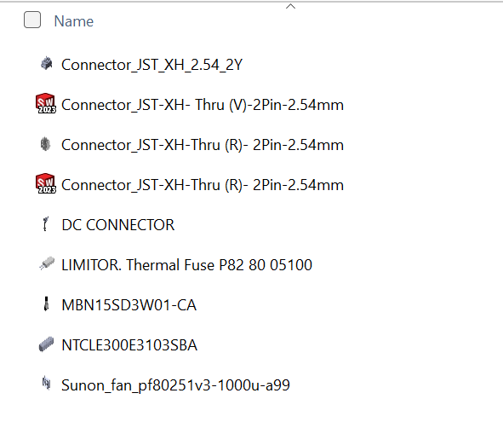
Protocol
Part Library
All users should clone 00-Library
Contains parts we have in house or plan to buy for an ongoing project
Files should be high fidelity (ideally downloaded, but reproduced is okay)
Link directly to part for your project, don’t copy!

Slide 19
Demo
4

Slide 20
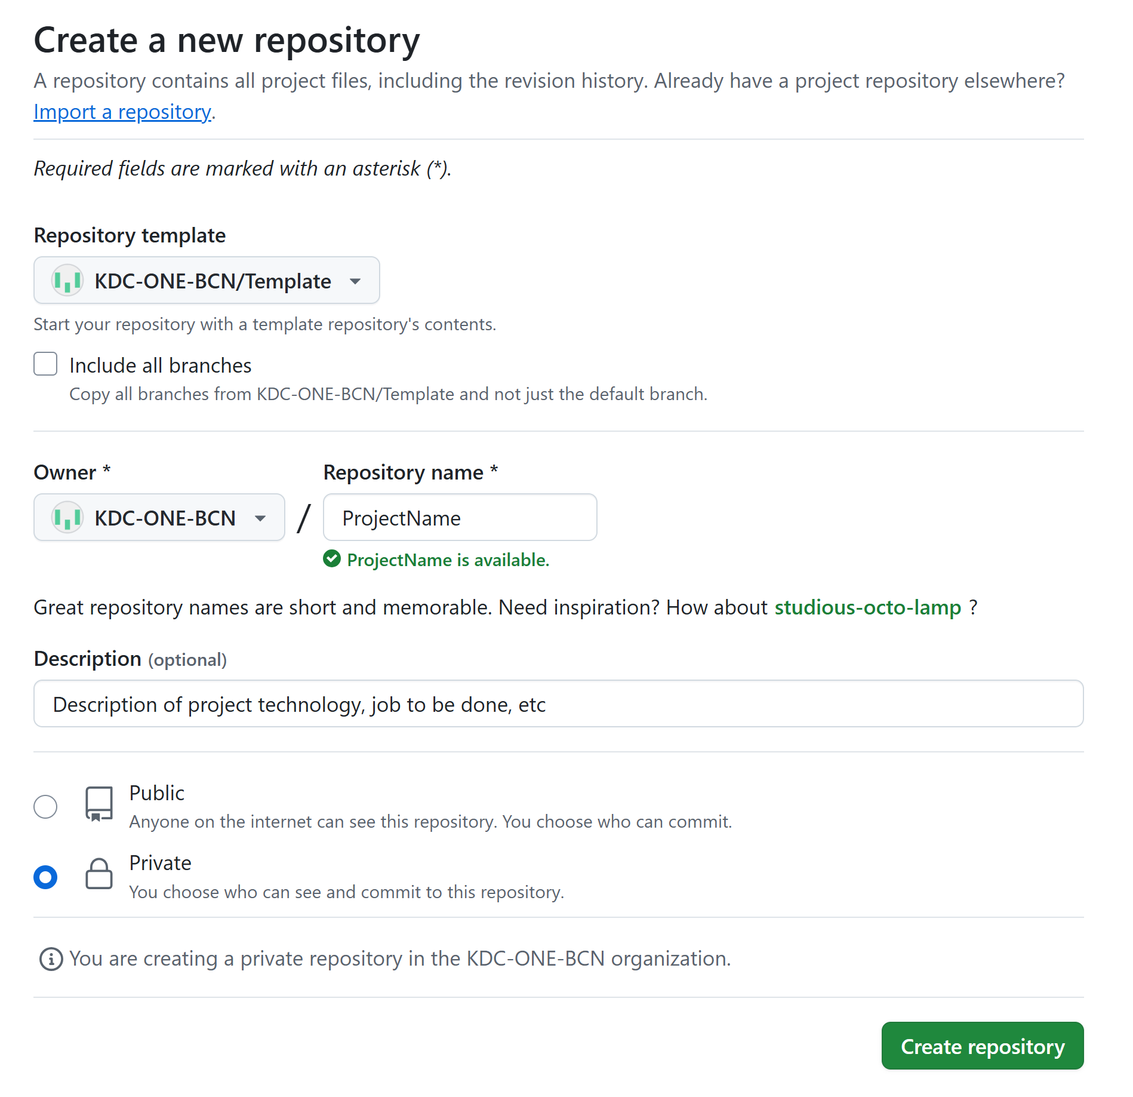
Workflow
Setting up a new project
Open repository template (link) in website
Click “Use this template”
Fill in the name and description of your project
Set reviewers (pending)
Add external(s)
Clone and start using local repo
All KDC team members automatically have access to all repos

Slide 21
Watch out for …
5

Slide 22
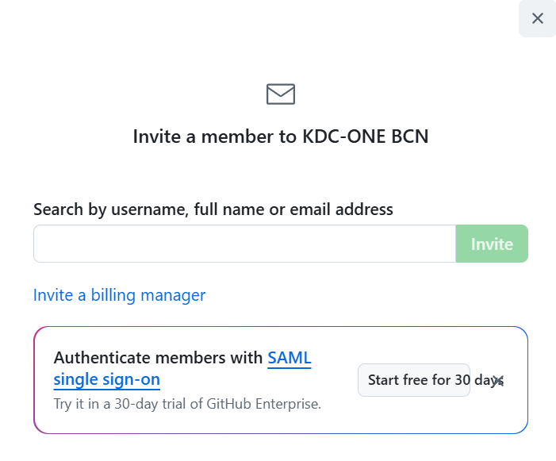
Watch out for …
Collaborating with externals
Consultants should be added as member
Add member to project repository and part library (repo: 00-LIBRARY)
Technical manager (or contact person in other cases) is responsible for ensuring access is revoked after the contract is over

Slide 23
Watch out for …
Pull to start, push when done
Which branch you are working in
Large files (< 1 GB)
File types (some are not tracked by default)
Moving files into GitHub that don’t follow conventions

Slide 24
Watch out for …
Next Steps
Now
Migrate your current and new SolidWorks projects to GitHub
Fill in part library (Concept Lab)
Explore and learn GitHub
QUESTIONS?

Slide 26
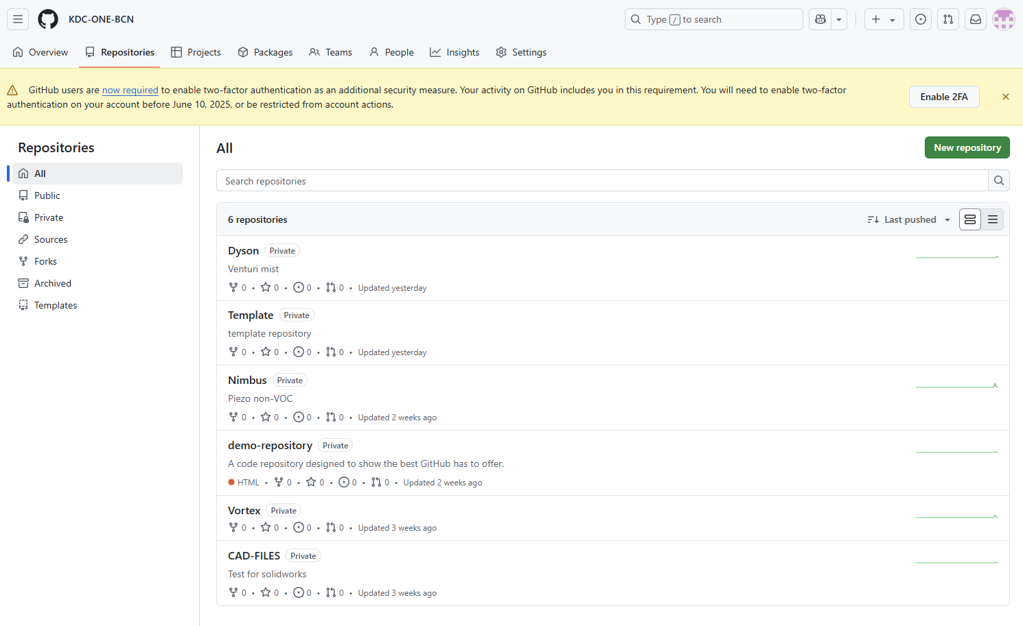
Getting Started
GitHub Setup
Make an account on GitHub (link)
Use either your kdc/one email or your personal email
Tell GitHub owner which email you’ve chosen
Download GitHub desktop (link)
This download should not require admin approval
Sign in to your account
You will not be able to edit or view files without a desktop application!
Confirm that you can see the team files
Once you’ve accepted the invitation, you should be able to see all team files on the web version of GitHub
When you login on GitHub desktop, you will not be able to see the team files initially. Do not worry!

Slide 27
Getting Started
Glossary
Repository - A digital storage space on GitHub where all the SolidWorks files related to a project are kept. It also tracks all changes made to those files. Think of it like a shared project folder that keeps a history of every version.
Branch - A branch is like a parallel workspace within the same project. It lets you work on changes or experiments (like redesigning a part) without affecting the main project. Once the work is ready, it can be merged back into the main branch.
Add – Move files from your computer into the local version of the repository.
Clone – To make a full copy of the repository at one point in the tree from the remote repository onto your own computer. This is usually the first step when starting to work on an existing SolidWorks project—so you have all the files and history locally.
Main - The default branch in a repository. For our purposes, it will contain only validated versions. All major updates are typically merged into main after they’ve been reviewed and tested.
Commit – To take a snapshot of your changes and save it in the version history. It includes the updated files and a short message describing what you changed (e.g., “Fix: Updated bracket thickness from 1 mm to 1,5 mm"). Commits are used to track the history of the project, step by step.
Push - To upload your local changes (files or updates you've made on your computer) to the shared remote repository. This means pushing updated CAD files or assemblies so others can see and use your changes.
Pull - To download the latest changes from the remote repository to your local computer. If a teammate has made updates to the SolidWorks project, you would pull to get those changes before continuing your work.
Merge - The process of combining changes from one branch into another—usually from a working branch into the main branch. For example, if you made improvements to one part of an assembly on a feature branch, merging would bring those updates into the main shared version.

Slide 28
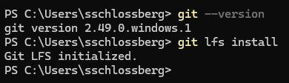
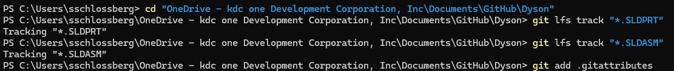
Next Steps
Working with Large Files (over 1GB)
Install Git (link)
During Installation – Important Options:
When you see “Adjusting your PATH environment”, select: “Git from the command line and also from 3rd-party software”
Restart your computer (or log out and back in)
Install Git LFS (link)
Run installation on command line (as in top image)
Activate large file tracking (as in bottom image)
LFS only tells activates tracking on new files, does not migrate files already in GitHub

Slide 29
Next Steps
More information and upcoming
New and in progress SolidWorks projects should be transfered to GitHub
Where to get more infor?
Protocol doc. Info on intermediate techniques like rebasing, large files
Pending to resolve:
Bot to remind to push
Reviewers to repos (new team of TM/TD), add codeowner file to template that includes all (Branch protection rules require Enterprise, BLOCKED)
How to handle main -
How to name published files - *A.sld. Could put in assem name only so it doesnt mess with references

Slide 30
How it works
Subtitle
 | Current Model | GitHub
File Location | One central live copy | Each user has a local copy
Collaboration Model | Synchronous editing | Asynchronous, versioned collaboration
Version History | Manual saving | Explicit via commits and branches
Update View | Instant for all | Manual push/pull
Notes:
In current model, there is only working directory and remote directory, but they are copies of each other. All users see the same view.

Slide 31
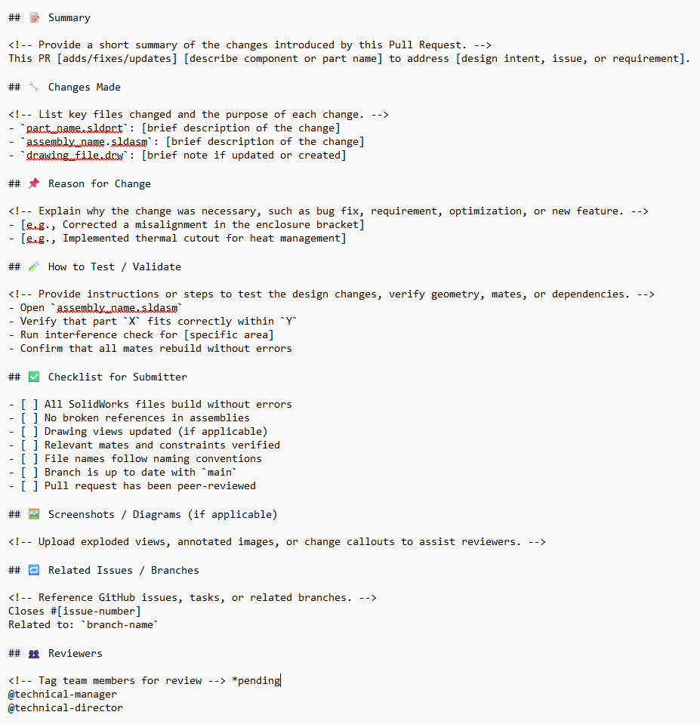
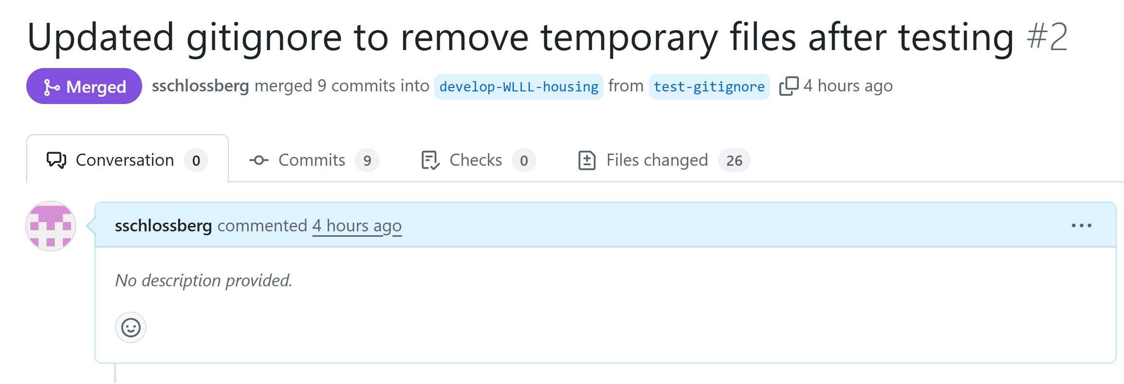
Protocol
Pull requests
Better
Thorough description
References specific issues
Assigns reviewer(s)
Minimum
PullRequestTemplate.md

