Slide 1


Department of Computer Science and Engineering
FIRST & FOLLOW SET CALCULATOR
Review-1
Team Number : 3
Name: Roll Number:
T Lasya Priya 2420030258
K Dharani Harika 2420030304
Donica panem 2420030655
Akhila Mulukutla 2420030433
Under the guidance of:
P.Krishna Kishore
Associate Professor
Koneru Lakshmaiah Education Foundation

Slide 2
OUTLINE:
Problem Statement
Objectives
Existing System
Proposed System
Technology Used
Workflow
Modules
Conclusion & Future Scope

Slide 3
Problem Statement:
Manual calculation of FIRST and FOLLOW sets is time-consuming and error-prone.
Complex grammars with multiple productions make calculation difficult.
Handling epsilon (ε) productions and nullable symbols requires repeated calculations.
FOLLOW sets require propagation of information between different productions.
Manual calculation becomes difficult as grammar complexity increases.
There is a need for an automated system to calculate and display FIRST and FOLLOW sets efficiently.

Slide 4
Objectives:
To develop a system for automatically calculating FIRST sets of non-terminals.
• To automatically calculate FOLLOW sets for a given Context-Free Grammar.
• To handle epsilon (ε) productions and nullable symbols correctly.
• To support multiple production alternatives.
• To validate the grammar and identify invalid or undefined non-terminals.
• To display the calculated FIRST and FOLLOW sets in a clear tabular format.

Slide 5
Existing System:
FIRST and FOLLOW sets are generally calculated manually using compiler design rules.
• Users need to identify terminals and non-terminals manually.
• FIRST sets must be repeatedly calculated for different productions.
• FOLLOW information has to be propagated manually between productions.
• Handling epsilon and nullable symbols increases complexity.
• Manual calculation can result in errors, especially for larger grammars.

Slide 6
Proposed System:
A web-based FIRST & FOLLOW Set Calculator is developed.
• Users can enter a Context-Free Grammar through the interface.
• The system parses and validates the entered grammar.
• FIRST sets are calculated using an iterative approach.
• FOLLOW sets are calculated by analyzing symbols following each non-terminal.
• Epsilon and nullable productions are handled automatically.
• The final FIRST and FOLLOW sets are displayed in separate tables.

Slide 7
Technology Used:
Frontend: HTML5, CSS3
• Programming Language: JavaScript
• UI: Responsive Web Interface
• Algorithm: FIRST & FOLLOW Set Computation
• Concepts: Context-Free Grammar, Epsilon Productions, Nullable Symbols, LL(1) Parsing
• Output: Dynamic tabular representation of FIRST and FOLLOW sets

Slide 8
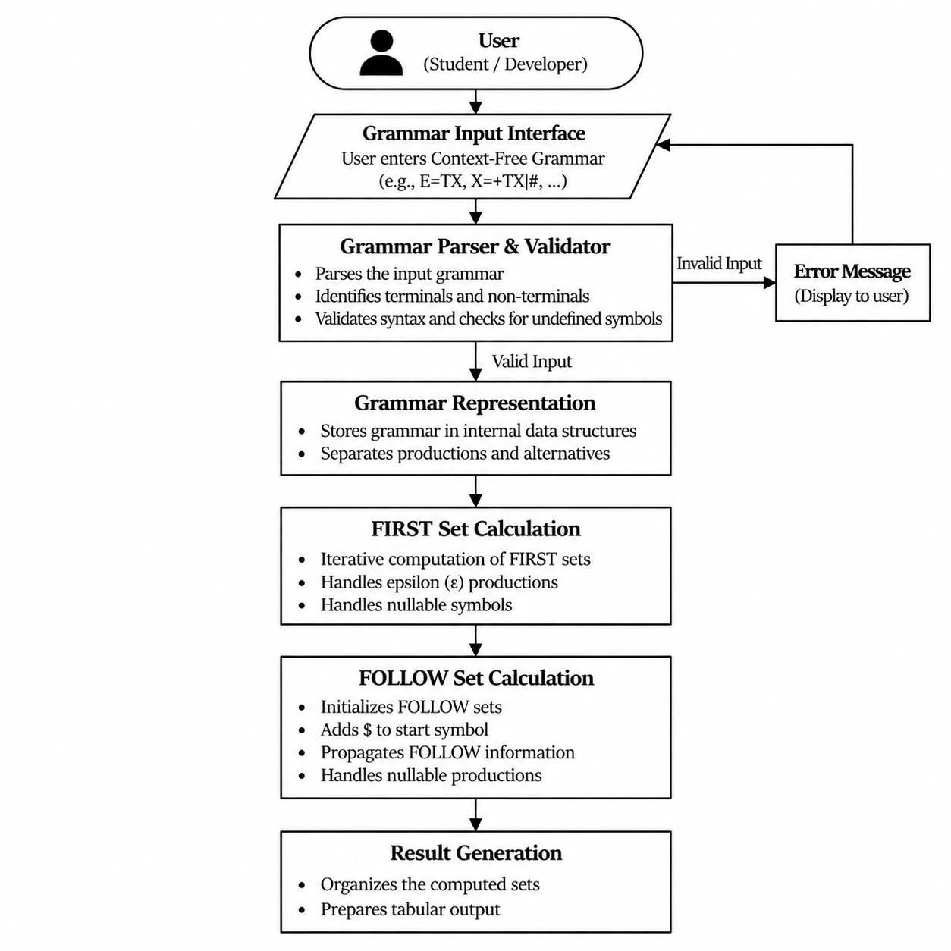
System architecture:

Slide 9
Modules:
• Grammar Input Module: Accepts the Context-Free Grammar from the user.
• Grammar Parsing & Validation: Parses productions and checks for invalid or undefined symbols.
• FIRST Set Calculation: Calculates FIRST sets while handling terminals, non-terminals and epsilon.
• FOLLOW Set Calculation: Calculates FOLLOW sets and propagates $ and other symbols according to grammar rules.
• Result Display Module: Displays FIRST and FOLLOW sets in separate tables.
• Error Handling Module: Displays meaningful errors for invalid grammar input.
The code has explicit parsing, FIRST/FOLLOW computation, validation and rendering functions.

Slide 10
Conclusion & Future Scope:
Conclusion:
• The system automates the calculation of FIRST and FOLLOW sets for Context-Free Grammars.
• It reduces the effort and errors involved in manual calculation.
• The system handles multiple alternatives, epsilon productions and nullable symbols.
• It provides a simple interface for entering grammars and viewing results.
Future Scope:
• Generate LL(1) Parsing Tables automatically and parse trees for input strings.
• Detect FIRST/FIRST and FIRST/FOLLOW conflicts.
• Add support for multi-character grammar symbols.
• Add grammar transformations such as left recursion removal and left factoring.

