Slide 1
Ideathon Visit Manipur
A Perfect Guide for Manipur Tourism

Slide 2

Our Agenda
Manipur being an unrecognized jewel for rest of India, people find difficulty to trip their plan due to cunning myths in their mind, giving them a whole beauty of Manipur.

Slide 3
01
VisitManipur.com
World to Manipur

Slide 4
What we are working on
Tourism
Travel Plan
Total Solution
Encouraging people to explore Manipur
Giving Tourist a Itinery for their Manipur Tour
A Travelers every need

Slide 5
About the project
A web app to give tourist coming to Manipur a well guided travel plan from their stay, food to travel.
Telling Tourist what to do, what to visit to make their stay more pleasant and enjoyable

Slide 6
—Valleys of Manipur
“Manipur the jewel of beauty and culture known as
“Slice of Switzerland”
World to Manipur”

Slide 7

Why To Use VisitManipur.com
Our U.S.P and Reasons to Choose us:
Everything at one place
Not a booking or reservation site
Fits on Every Budget
Make travelers to know more about Manipur
Advertisement for Manipur Tourism Industry

Slide 8
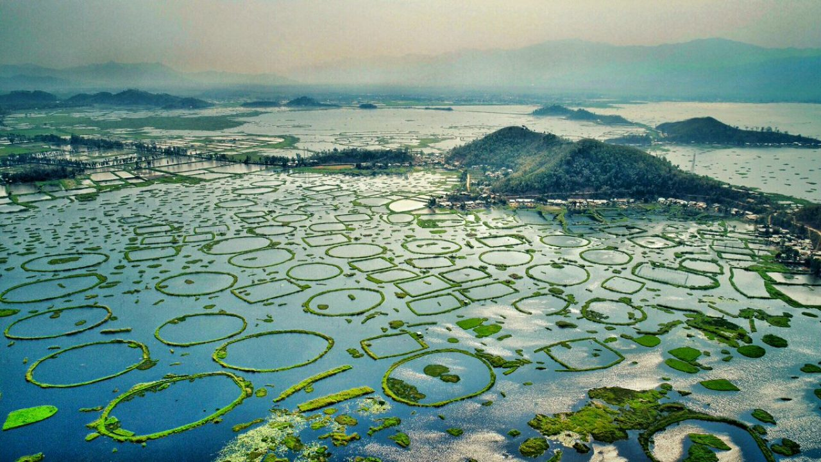
Now
As, Manipur recently went through difficult situation. People outside Manipur are avoiding Manipur and the Manipur Tourism is in it’s downphase.
Encouraging tourist to visit Manipur by helping them to plan their trip is our aim.

Slide 9
Major requirements
Advertisement
Collaboration
As to make our website reach to audience we should focus on marketing
Collaboration with Manipur Government and local Hotel, restraunts etc.

Slide 10
Our Travel Plan
For All
Hotels
Food
Travel
Hotels for Every Budget
From Dine to Luxury to Daily Street food
Every Destination as per your group

Slide 11
Project goals
Goal 1
Goal 2
Website about Manipur
Travel Plan for Tourist
Goal 3
Goal 4
Suggest Stay and Eatery to tourist
Promote World to Manipur

Slide 12
100,000…
Big numbers catch your audience’s attention

Slide 13
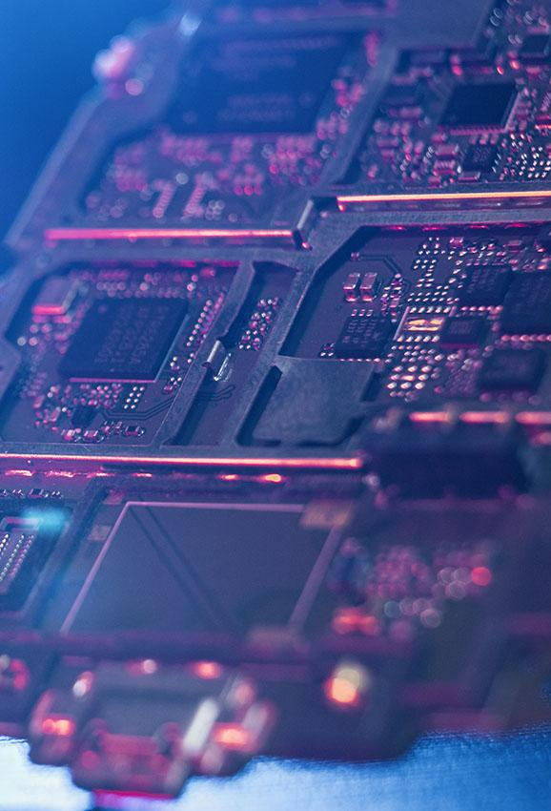
Our End
From our side we can offer hotels and restraunts to put their advertising banners and give their recommendation push

Slide 14
Hackathon Strategy
Designing
Database
Fetching
UI/UX
Algorith needs
Raw Database
tEAMs
All the Frontend job
How to manage data of tourism essentials

Slide 15
Our Work Plan
02
04
Itinery
Plan
Provide them a flexible travel plan as their need
Redirect to book,
Download Itinery
01
03
User
Partners
User enters data:
Budget, People, Duration of stay
We Push them hotels, restraunts which can be our partners

Slide 16
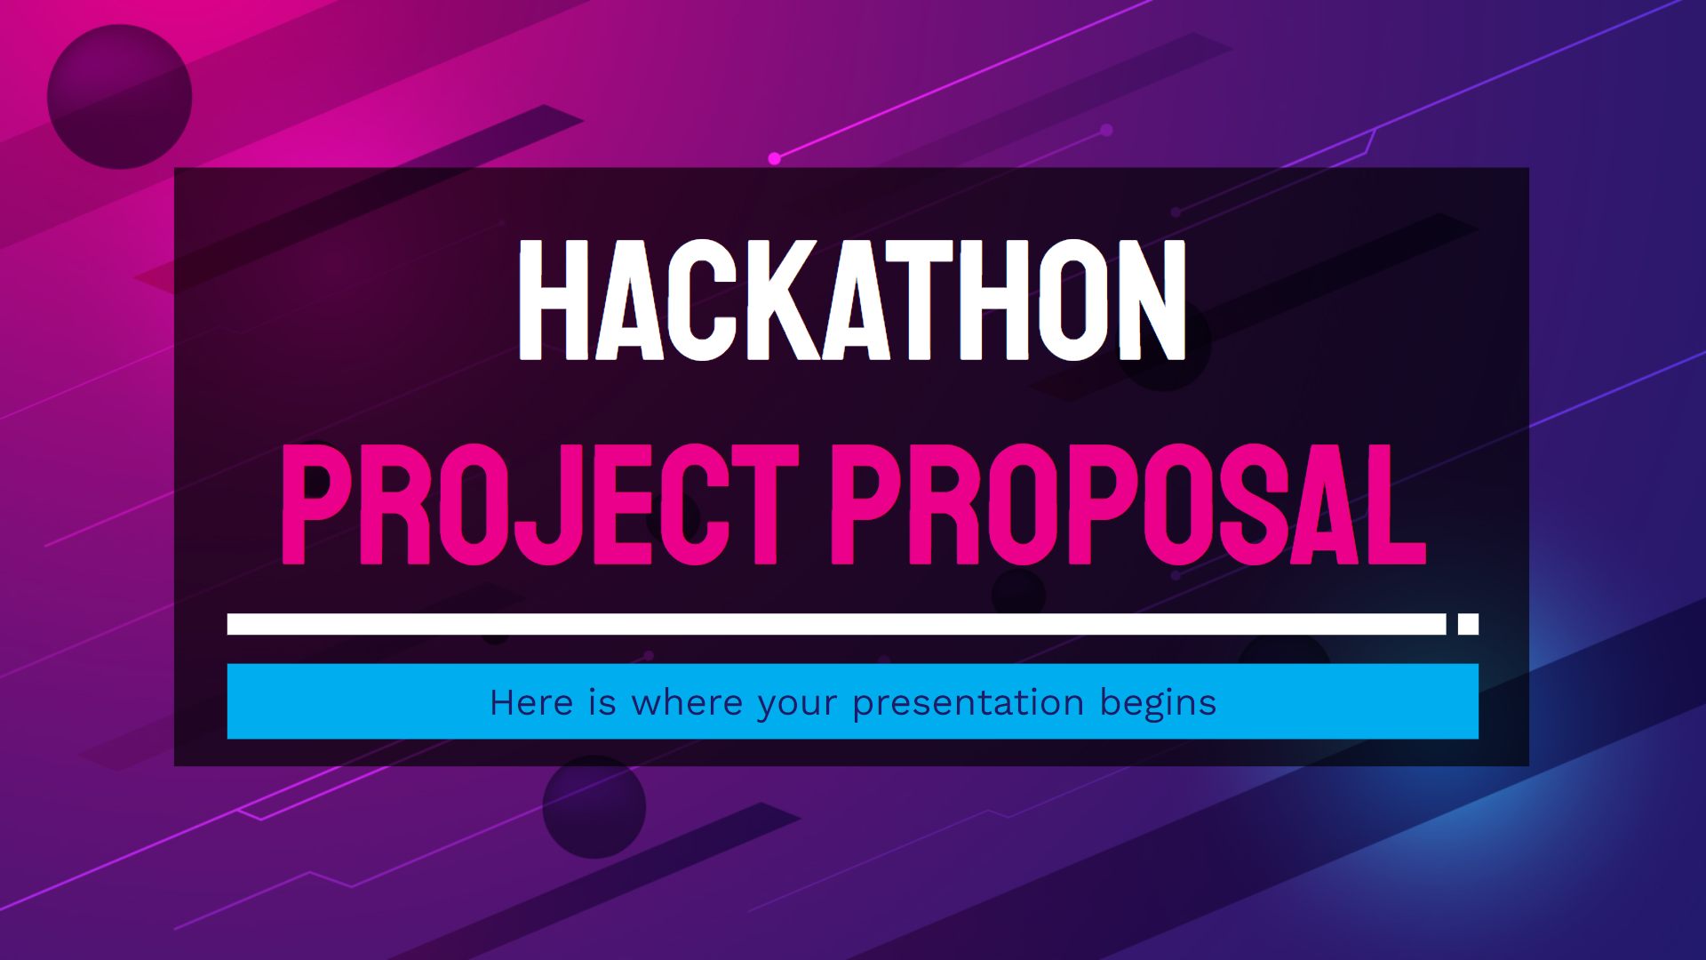
A LITTLE DEMO
You can replace the image on the screen with your own work. Just right-click on it and select “Replace image”

Slide 17
World to Manipur

Slide 18
Our team
Balkishan Bajpay
Harsh Kumar Das
Chirag Goyal
Vikram

Slide 19
MAJOR FEATURES :
Itinerary generator .
Emg. SOS call .
Manipur BNB ( to promote home-stay ) .
News feed .

Slide 20
FUTURE IMPLEMENTATION
Making it to whole India to every place possible for Tourism Considering all type of audience.
VisitPlaces.com
Databased
Web Scrap
Exapansation of SOS system
AI Chatbot
Dynamic News Feed

Slide 21
Project stages
STAGE 1
STAGE 2
STAGE 3
Ideathon Project
For Manipur Tourism
Improve it’s scale and include every indian tourism
Take it World Wide

Slide 22
Table of contents
01
02
03
04
05
the project
requirements
project goals
VisitManipur.com
Reach to large Scale Audience
Provide Tourist with a Travel Plan
06
sneak peek
our team
Future
You can describe the topic of the section here
Everyone is our contributor
Global Tourism Market

Slide 23
THANK YOU!

