Slide 1

Code Sprint Project

Slide 2
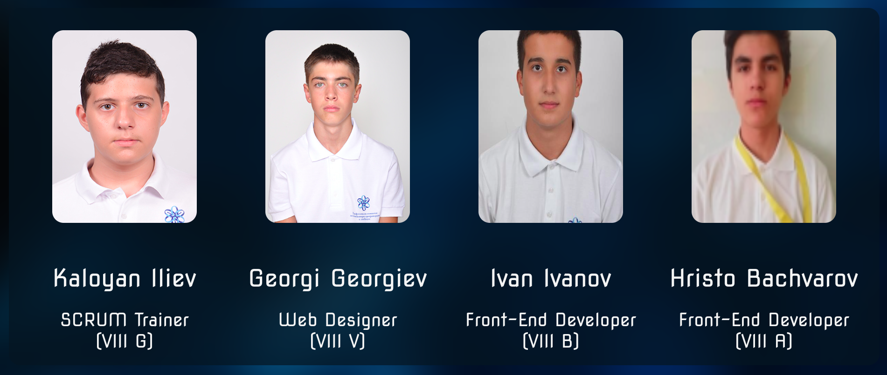
The Team

Slide 3
The Task
For the Code Sprint project, we were tasked to build a website from scratch with the theme ‘Robotics’. We decided to dedicate it to some of the leading contributors of Robotics and Artificial Intelligence.

Slide 4

Technologies Used

