Slide 1
Evaluation
Ref: Lucas Theis, Aäron van den Oord, Matthias Bethge, “A note on the evaluation of generative models”, arXiv preprint, 2015

Slide 2

Likelihood
: real data (not observed during training)
: generated data
Prior
Distribution
Generator
P_{G}
$$x^{i}$$
$$L=\frac{1}{N}\sum_{i}{logP_{G}\left(x^{i}\right)}$$
Log Likelihood:
We cannot compute $P_{G}\left(x^{i}\right)$. We can only sample from $P_{G}$.

Slide 3

Likelihood - Kernel Density Estimation
Estimate the distribution of P_{G}(x) from sampling
Generator
P_{G}
Each sample is the mean of a Gaussian with the same covariance.
Now we have an approximation of $P_{G}$, so we can compute $P_{G}\left(x^{i}\right)$ for each real data $x^{i}$
Then we can compute the likelihood.
Notes:
A common way is the use the bandwidth that minimises the optimality criterion
https://stats.stackexchange.com/questions/244012/can-you-explain-parzen-window-kernel-density-estimation-in-laymans-terms/244023

Slide 4







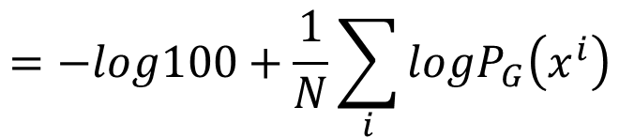
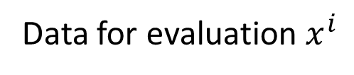
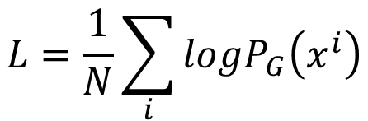

Likelihood v.s. Quality
Low likelihood, high quality?
High likelihood, low quality?
Considering a model generating good images (small variance)
Generator
P_{G}
$$P_{G}\left(x^{i}\right)=0$$
Generated data
Data for evaluation $x^{i}$
X 0.99
X 0.01
G1
G2
$$L=\frac{1}{N}\sum_{i}{logP_{G}\left(x^{i}\right)}$$
$$=−log100+\frac{1}{N}\sum_{i}{logP_{G}\left(x^{i}\right)}$$
100
4.6

Slide 5


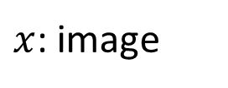

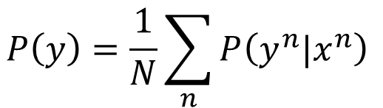






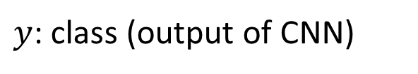
Objective Evaluation
[Tim Salimans, et al., NIPS, 2016]
$x$: image
$y$: class (output of CNN)
class 2
Off-the-shelf Image Classifier
$$x$$
$$P\left(y|x\right)$$
class 1
class 3
e.g. Inception net, VGG, etc.
Concentrated distribution means higher visual quality
CNN
$$P\left(y\right)=\frac{1}{N}\sum_{n}{P\left(y^{n}|x^{n}\right) }$$
$$x^{1}$$
$$P\left(y^{1}|x^{1}\right)$$
$$x^{2}$$
CNN
$$P\left(y^{2}|x^{2}\right)$$
$$x^{3}$$
CNN
Uniform distribution means higher variety
$$P\left(y^{3}|x^{3}\right)$$
…
Notes:
Objective evaluation / quantitatively

Slide 6
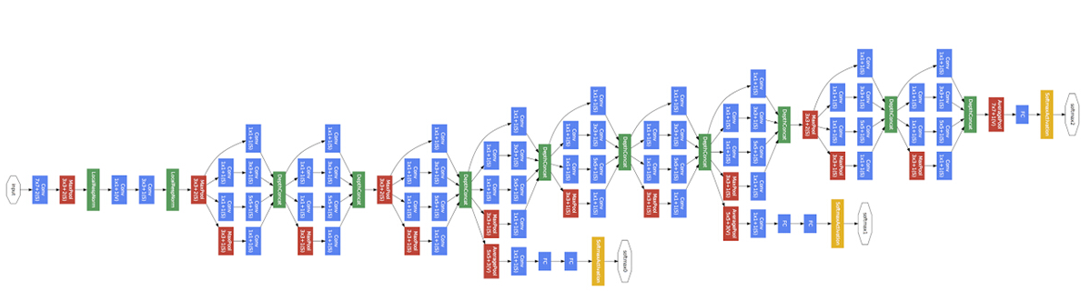


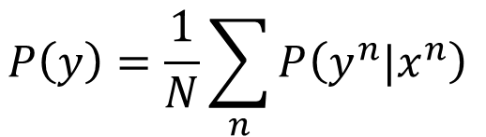
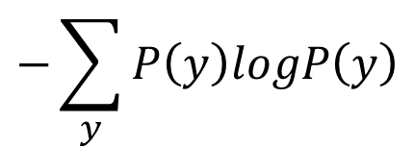
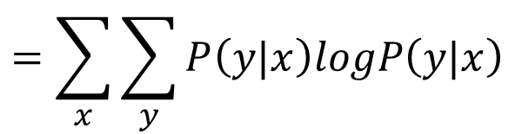
Objective Evaluation
$$P\left(y\right)=\frac{1}{N}\sum_{n}{P\left(y^{n}|x^{n}\right) }$$
$$P\left(y|x\right)$$
class 2
class 1
class 3
Inception Score
$$=\sum_{x}{\sum_{y}{P\left(y|x\right)logP\left(y|x\right)}}$$
Negative entropy of P(y|x)
$$−\sum_{y}{P\left(y\right)logP\left(y\right)}$$
Entropy of P(y)
Notes:
Tim Salimans, Ian Goodfellow, Wojciech Zaremba, Vicki Cheung, Alec Radford, Xi Chen, “Improved Techniques for Training GANs”, arXiv prepring, 2016

Slide 7
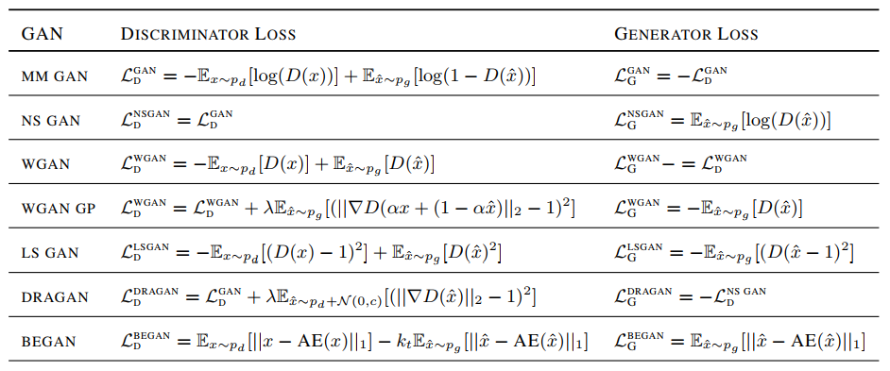
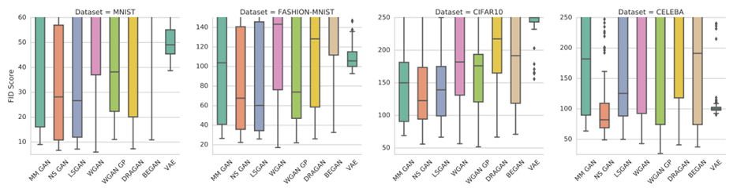
Smaller is better
Mario Lucic, Karol Kurach, Marcin Michalski, Sylvain Gelly, Olivier Bousquet, “Are GANs Created Equal? A Large-Scale Study”, arXiv, 2017
FIT:
https://arxiv.org/pdf/1706.08500.pdf

Slide 8
We don’t want memory GAN.
https://arxiv.org/pdf/1511.01844.pdf
Using k-nearest neighbor to check whether the generator generates new objects
Notes:
reverse

Slide 9
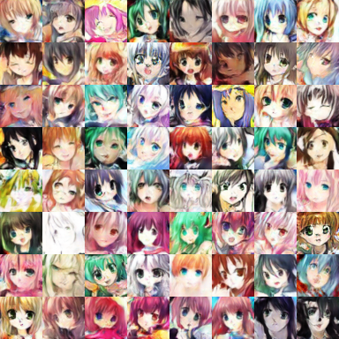
Missing Mode ?
Mode collapse is easy to detect.
?
Notes:
Lucas Theis, Aäron van den Oord, Matthias Bethge, “A note on the evaluation of generative models”, arXiv preprint, 2015

